Slide 1


Safety Meetings and Committees
Presented by Oregon OSHA Public Education

Slide 2


Oregon OSHA
Public Education Mission:
Oregon OSHA Services
Consultation Services
Enforcement
Appeals
Public Education and Conferences
Standards and Technical Resources
We provide knowledge and tools to advance self-sufficiency in workplace safety and health.

Slide 3
Contact us
Consultation Field Offices:
Portland 503-229-6193
Salem 503-373-7819
Eugene 541-686-7913
Medford 541-776-6016
Bend 541-388-6068
Pendleton 541-276-2353
Salem Central
Toll Free:
  English 800-922-2689
  Spanish 800-843-8086
Website: osha.oregon.gov

Slide 4
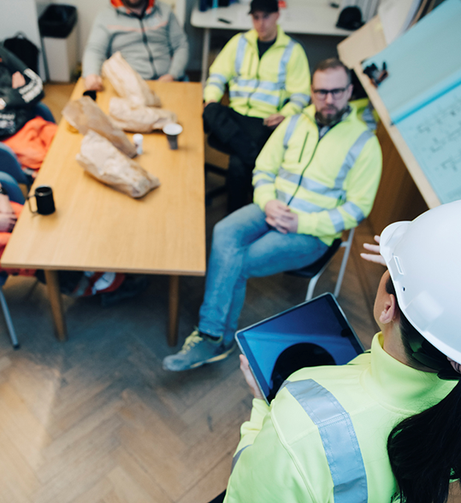
Goals
You will learn about:
Rules, regulations, and best practices for safety committees and safety meetings.
Differences between safety committees and safety meetings.
How the “culture” in your organization can affect your safety and health outcomes.

Slide 5

Purpose
The purpose of safety committees and safety meetings is to bring workers and management together in a non-adversarial, cooperative effort to promote safety and health.
Safety committees and safety meetings will assist you in making continuous improvement to your safety and health programs.

Slide 6
Who does this rule apply to?
Oregon Administrative Rule 437-001-0765, Safety Committees and Safety Meetings, applies to public or private employers in Oregon subject to Oregon OSHA jurisdiction, except if you are:
The sole owner and only employee of a corporation.
A member of a board or commission and do not participate in the day-to-day activities of the company. You are not considered an employee for purposes of this rule.
Engaged in agricultural activities covered by Division 4, Subdivision C.
Engaged in forest activities covered by Division 7, Subdivisions B and C.

Slide 7
Meeting vs committee
A safety meeting is a company-wide meeting with all available employees and management in attendance, where current safety and health topics and the current state of issues are presented.
A safety committee is a group made up of employees and management who meet regularly and are responsible for identifying safety and health concerns in their workplace, as well as developing solutions or recommendations to address those concerns.
You are only required to implement one of these, depending on how your company is structured.

Slide 8
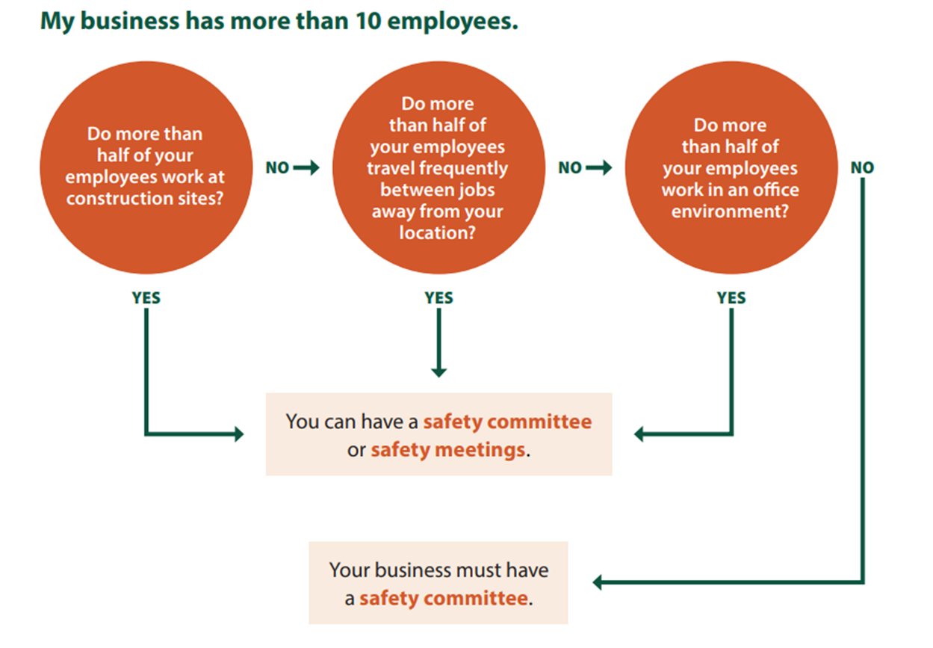
Safety committee or safety meetings?

Slide 9
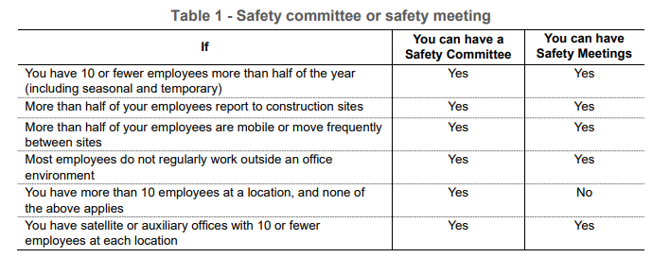
Safety committee or safety meetings? (continued)
If your business has 10 or fewer employees, your business can have a safety committee or safety meetings. For small businesses, safety meetings save time and keep paperwork to a minimum.

Slide 10
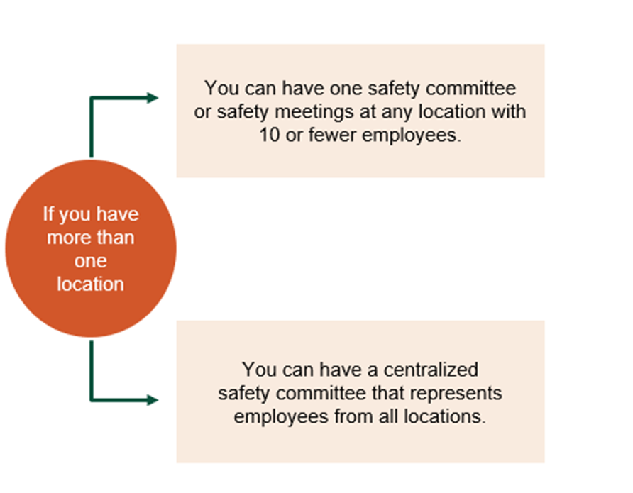
Multi-location employers
Centralized safety committees follow the same requirements for safety committees and represent the safety and health concerns of employees at all locations.

Slide 11
Multi-location employers (continued)
If you rely on a centralized committee, you must also have a written safety and health policy that:
Represents management commitment to the committee.
Requires and describes effective employee involvement.
Describes how the company will hold employees and managers accountable for safety and health.
Explains specific methods for identifying and correcting safety and health hazards at each location.
Includes an annual written comprehensive review of the committees’ activities to determine effectiveness.

Slide 12
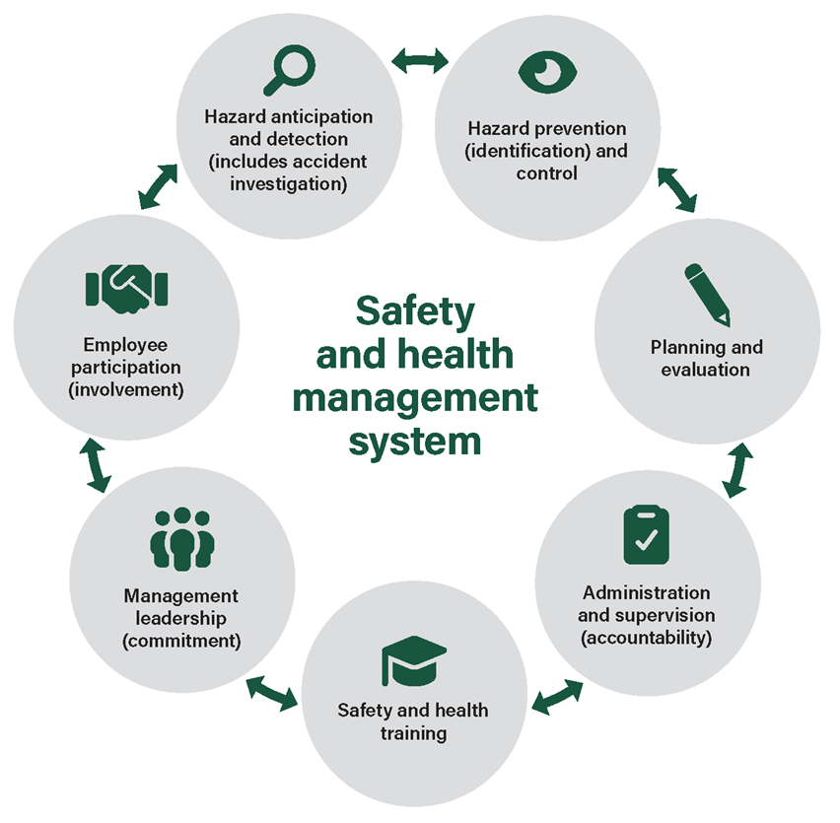
Evaluation for safety meetings and committees
Purpose Exercise (page 8)
Answer the questions in your workbook to see if management and workers at your place of employment are meeting the intent of the rule at 100 percent.
Then, review and discuss the safety and health management system.

Slide 13
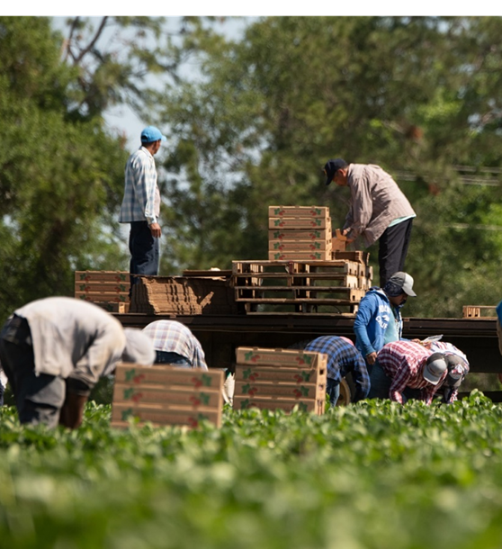
Agricultural employers
Main differences:
Certain seasonal workers aren’t included in employee count.
Those that have centralized committees aren’t required to have a written safety and health policy.
All agricultural employers must keep records of safety committees or safety meetings; minimal records are still allowed if all employees attend a safety meeting.

Slide 14

Seasonal workers
Need to be informed about:
Safety and health rules of their work
How to contact a supervisor in case of an accident, illness, or safety or health problems
What to do if workers are injured or sick and how to get emergency assistance
Location of posted safety and health information

Slide 15
Safety Committees

Slide 16
Committee members
You must have an equal number of employer-selected members and employee-elected or volunteer members. If both parties agree, the committee may have more employee-elected or volunteer members.
Note: Management can select a supervisor to represent them. Employees can elect a supervisor to represent them.

Slide 17
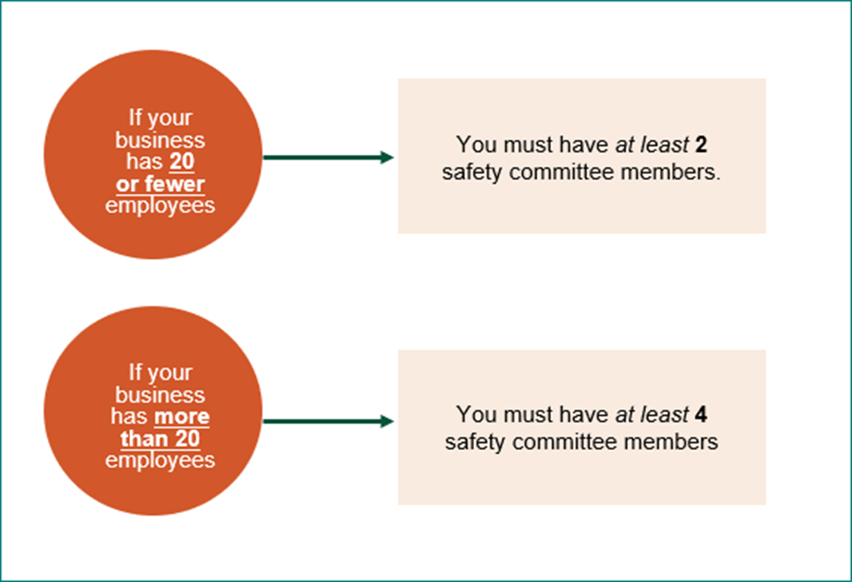
Determining how many safety committee members

Slide 18
Safety committee meeting frequency
Monthly or quarterly depending on the work employees do. You can meet by conference call, if needed.
Mostly office workers
Meet quarterly
All other employers (except the months when quarterly worksite inspections are performed)
Meet monthly

Slide 19
Basic requirements for safety committee members
Your safety committee members must:
Have a majority agree on a chairperson
Serve a minimum of one year, when possible
Be compensated at their regular rate of pay
Be trained in accident investigation principles and know how to apply them
Be trained in hazard identification in the workplace
Be provided with safety committee meeting minutes
Represent the major activities of your business

Slide 20
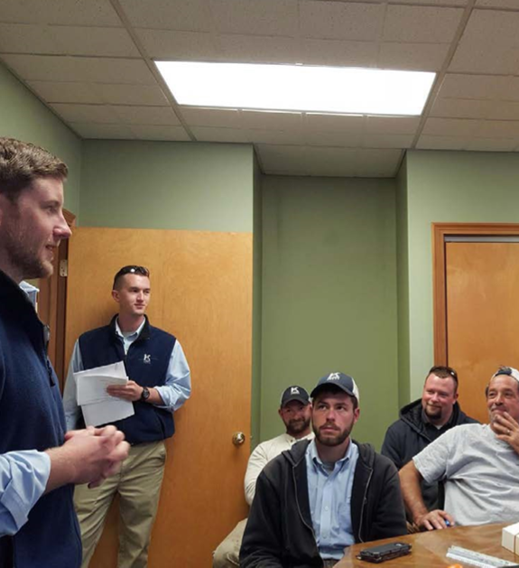
Four safety committee requirements
Meet monthly or quarterly, depending on the work that your employees do
Keep a record of each meeting for three years
Have procedures for workplace safety and health inspections
Accomplish a set of specific tasks

Slide 21
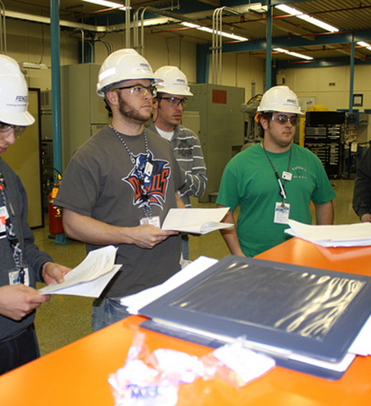
Safety committee member training
Your safety committee members must have training in:
Hazard identification
Principles of incident and accident investigation
Watch this video: Hazard Identification Example Safety Inspection

Slide 22
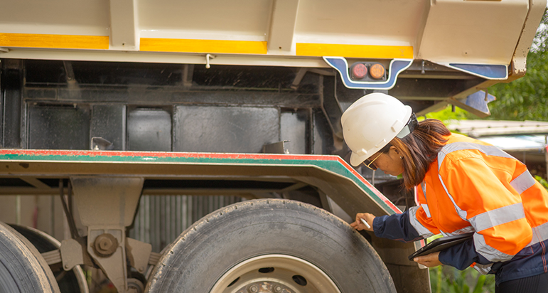
Hazard identification Exercise (page 12)
Review the photo and answer these questions:
What is the hazard?
What should be done immediately to fix the problem shown in this picture?
What should be done so this problem doesn’t happen again?

Slide 23
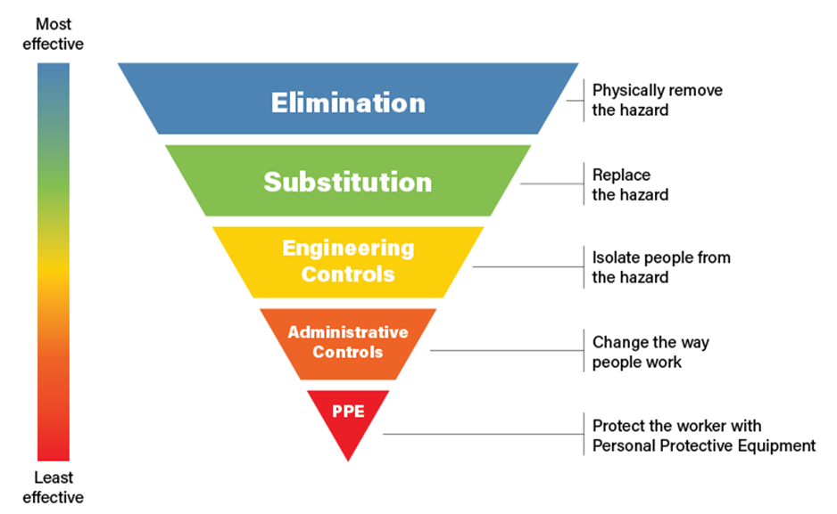
Hazard controls
The hierarchy of controls is a method of identifying and ranking safeguards to protect workers from hazards. The hierarchy of controls consists of five elements, ranging from most effective to least effective:
Elimination
Substitution
Engineering controls
Administrative controls
Personal protective equipment (PPE)
The Hierarchy of Controls

Slide 24
Exercise (page 13)
Answer the following questions and discuss as a group.
What are examples of engineering controls?
What are examples of administrative controls?
Why is PPE the last choice for protection?

Slide 25
Incident / accident investigation
It is the safety committee’s responsibility to evaluate all accident and incident investigations and make recommendations to prevent similar events from occurring.
Why take the time to investigate incidents?
What’s the difference between an incident and an accident?
How do you get people to report near misses?

Slide 26
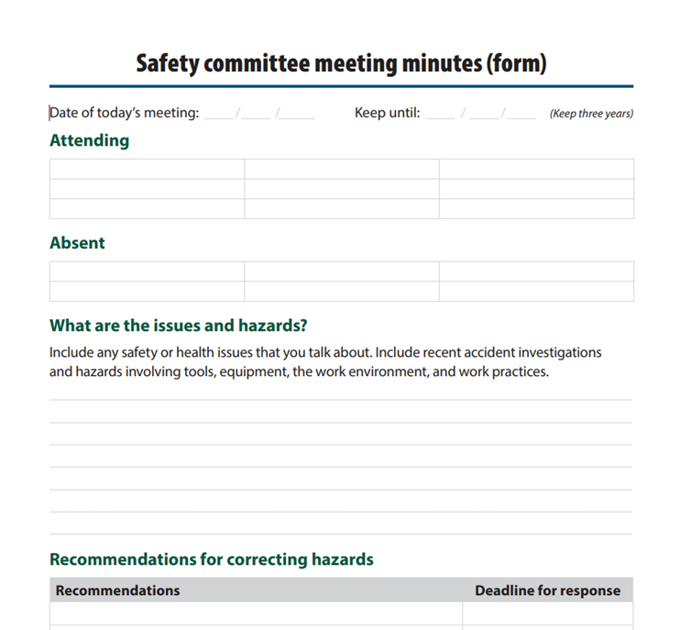
Safety committee meeting records
You must keep written records of each safety committee meeting for three years that include:
Name of attendees
Meeting date
All safety and health issues discussed, including tools, equipment, work environment, and work practice hazards
Recommendations for corrective action and a reasonable date by which management agrees to respond
Person responsible for follow up on any recommended corrective actions
All reports, evaluations, and recommendations made by the committee

Slide 27
Safety committee evaluation and inspections exercise (page 21)
Answer the Inspections and Inspection procedures questions to see how much you know about your safety committee and inspection procedures.

Slide 28
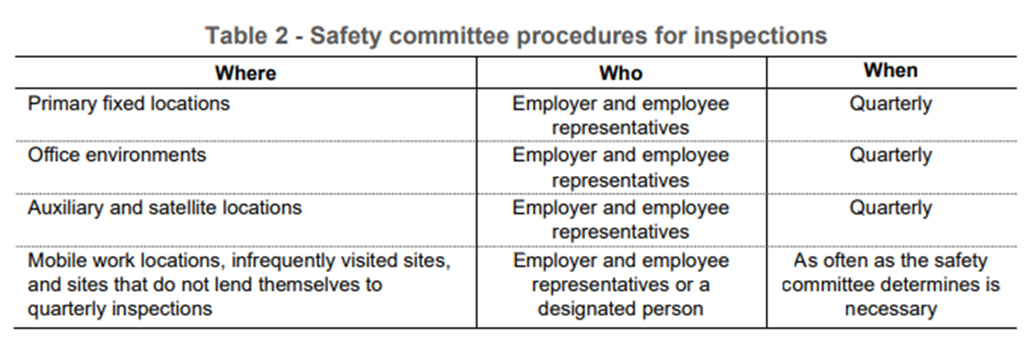
Safety committee inspections
Your safety committee must establish procedures for conducting workplace safety and health inspections. Persons trained in hazard identification must conduct inspections as follows:

Slide 29
Additional safety committee requirements
Your safety committee must:
Work with management to establish, amend, or adopt accident investigation procedures that will identify and correct hazards.
Have a system that allows employees an opportunity to report hazards and safety and health-related suggestions.
Establish procedures for reviewing inspection reports and for making recommendations to management.
Continued on next slide.

Slide 30
Additional safety committee requirements (continued)
Your safety committee must:
Evaluate all accident and incident investigations and make recommendations for ways to prevent similar events from occurring.
Make safety committee meeting minutes available for all employees to review.
Evaluate management’s accountability system for safety and health and recommend improvements. Examples include use of incentives, discipline, and evaluating success in controlling safety and health hazards.

Slide 31
Safety Meetings

Slide 32
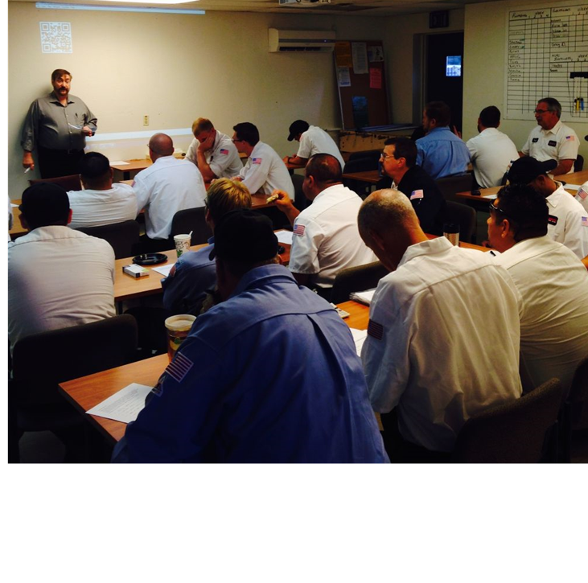
Safety meetings
Safety meetings must:
Include all available employees
Include at least one employer representative authorized to ensure correction of safety and health issues
Be held on company time and employees are paid at their regular rate of pay

Slide 33
Safety meeting frequency
Monthly or quarterly depending on what your business does.
Do you have construction workers?
Yes
Meet at least monthly and meet before the start of each job that lasts more than one week
Do you have mostly office workers?
Yes
Meet at least quarterly
Do neither of the above apply to you (all other employers)?
Yes
Meet at least monthly

Slide 34
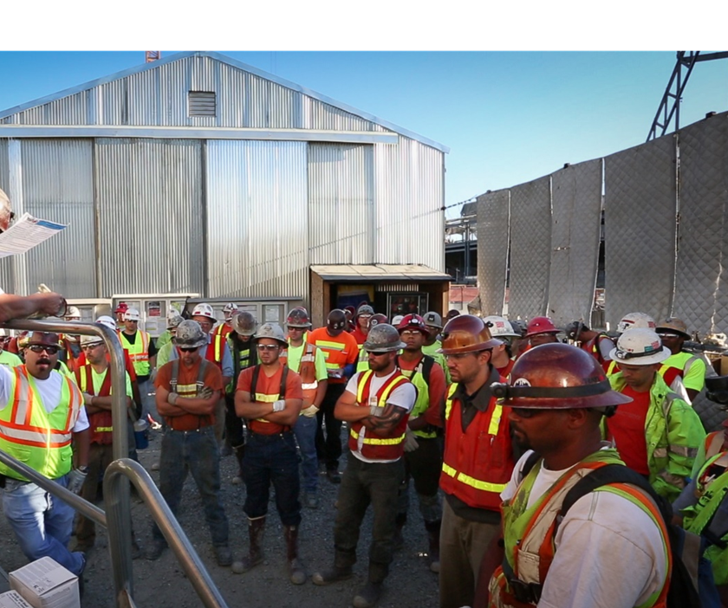
Safety meeting discussions
Must include:
Safety and health issues
Accident investigations, causes, and the suggested corrective measures

Slide 35

Documenting safety meetings
If your employees do construction, utility work, manufacturing:
Keep minutes of all safety meetings for three years and make available to all employees
All other employers don’t have to keep minutes, unless someone is absent.

Slide 36
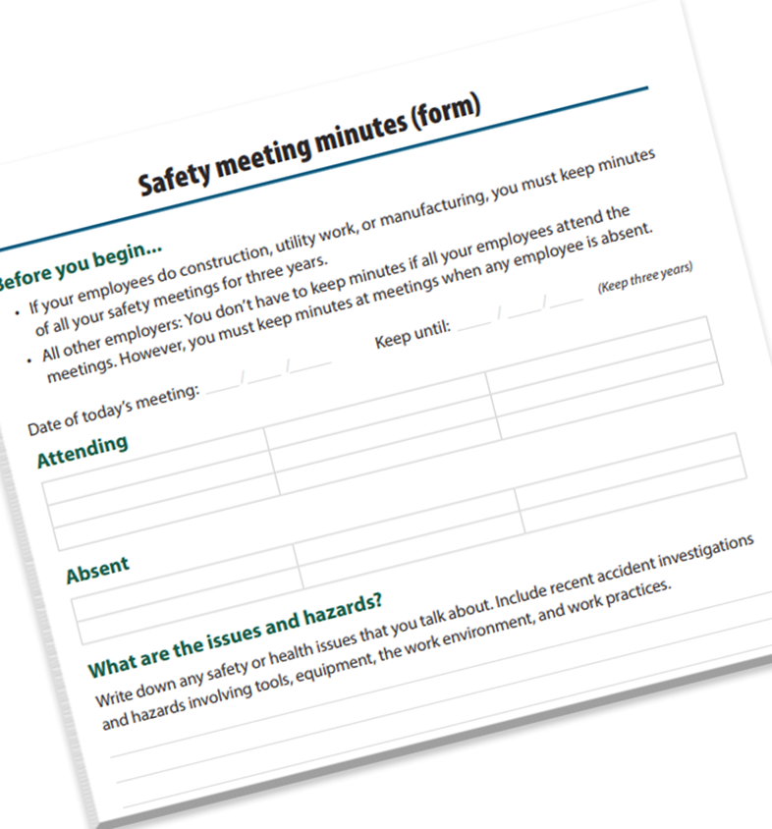
Safety meeting information to keep
Date of the meeting
Name of all attendees
All safety and health issues discussed during the meeting

Slide 37
Safety meetings for multi-employer worksites
If your employees attend the primary contractor’s safety meetings, you do not have to conduct separate safety meetings for your employees.
Keep the minutes from the prime contractor’s safety meetings for three years as part of your records.
You must still meet with your employees to discuss any accidents involving them.

Slide 38

Innovation exception
If you are unable to meet all the requirements of safety committees and safety meetings rules, you may apply for an exception from Oregon OSHA. After you apply, Oregon OSHA may grant approval for safety committees or safety meetings that differ from the rule requirements yet meet the intent of these rules.

Slide 39
Additional educational resources
Oregon OSHA
YouTube Channel
Website A-Z Topic Index
Online Training Courses
PESO – English to Español
Other Safety and Health Training Resources

Slide 40
Need more information? Call your nearest Oregon OSHA Office
Bend
541-388-6066
Consultation: 541-388-6068
Eugene
541-686-7562
Consultation: 541-686-7913
Medford
541-776-6030
Consultation: 541-776-6016
Pendleton
541-276-9175
Consultation: 541-276-2353
Portland
503-229-5910
Consultation: 503-229-6193
Salem
503-378-3274
Consultation: 503-373-7819
Salem Central Office
350 Winter St NE
Salem, OR 97301-3882
503-378-3272
Toll-Free: 800-922-2689
Fax: 503-947-7461
en Español: 800-843-8086
Website: osha.oregon.gov

Slide 41
Thank you!

