Slide 1


Lockout/Tagout and
Machine Safeguarding
Presented by Oregon OSHA Public Education

Slide 2


Oregon OSHA
Public Education Mission:
Oregon OSHA Services
Consultation Services
Enforcement
Appeals
Public Education and Conferences
Standards and Technical Resources
We provide knowledge and tools to advance self-sufficiency
in workplace safety and health.

Slide 3
Contact us
Consultation Field Offices:
Portland 503-229-6193
Salem 503-373-7819
Eugene 541-686-7913
Medford 541-776-6016
Bend 541-388-6068
Pendleton 541-276-2353
Salem Central
Toll Free English:
800-922-2689
Toll Free Spanish:
800-843-8086
Website: osha.oregon.gov

Slide 4
Lockout/Tagout

Slide 5

Workshop Goals
You will learn about the requirements in the Hazardous Energy Control Standard, the importance of a hazardous energy control program, and energy control procedures, training, and periodic inspection criteria, divided into these five parts:
Part 1: Scope and application
Part 2: The hazardous energy control program
Part 3: Lockout/tagout procedures
Part 4: Lockout/tagout training
Part 5: Lockout/tagout periodic inspections

Slide 6
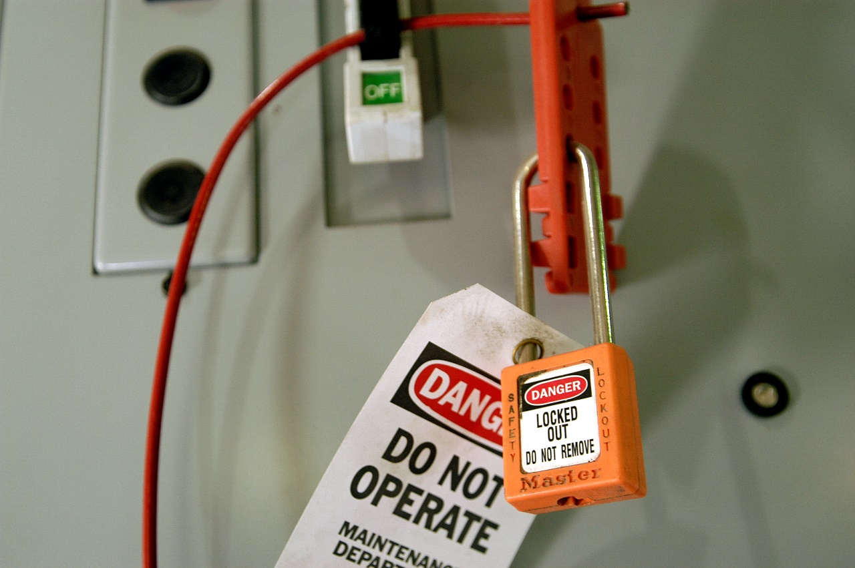
Part 1: Scope and application
Three key elements of an energy control program:
Energy control procedures
Employee training
Periodic inspection

Slide 7
The hazardous energy control standard covers the following employees:
Authorized Employee
The person who services or performs maintenance on machines and equipment.
Affected Employee
An employee whose job requires him/her to operate or use a machine or equipment on which servicing or maintenance is being performed under lockout or tagout, or whose job requires him/her to work in an area in which such servicing or maintenance is being performed.
Other Employee
The person who may be in an area where lockout procedures are being used.

Slide 8
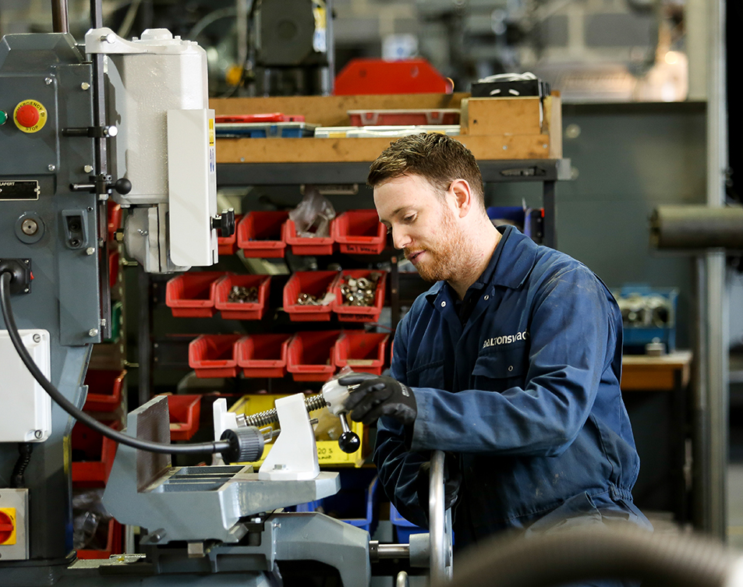
Servicing and maintenance
Adjusting
Inspection
Modifying
Constructing
Retooling
Lubricating
Installing
Setting up
Removing jams
Cleaning

Slide 9

Sources of energy capable of causing serious injury
Examples include:
Electrical
Pneumatic
Gravity
Hydraulic
Radiation
Kinetic

Slide 10
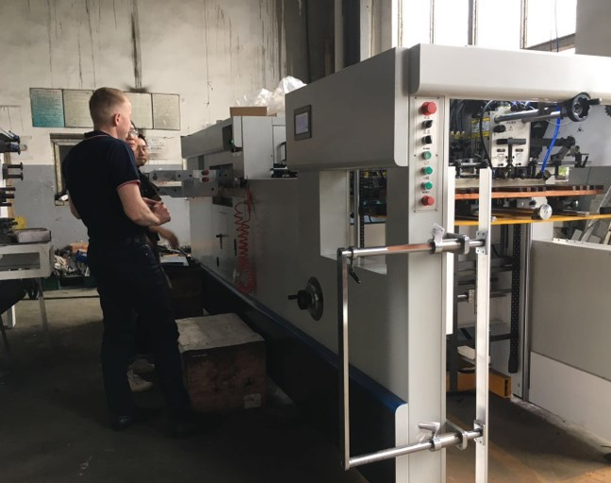
Part 2: The hazardous energy control program
Your hazardous energy control program must:
Specifically outline the scope, purpose, authorization, rules, and techniques for the control of hazardous energy, and
Include your methods to enforce compliance.
See workbook page 8 for the steps that must be taken at a minimum.

Slide 11

Develop a program
List all equipment or machines that need servicing or maintenance.
Identify the machines that could unexpectedly start up or release stored energy while being serviced or maintained.
Determine the steps in the maintenance or servicing task.
Review each step for the potential of a hazard from all energy sources.

Slide 12
Exercise (page 8)
Create groups, assign a team leader, and answer the following questions:
Why is a comprehensive written program critical to a successful lockout/tagout program?
What are some reasons a lockout/tagout program may not work effectively?
Who is responsible, who is accountable, and for what?

Slide 13
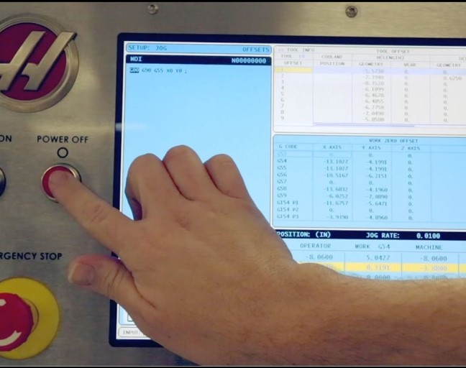
Part 3: Lockout/tagout procedures
Step 1 - Prepare for lockout
Step 2 - Shutdown
Step 3 - Energy isolation
Step 4 - Apply lockout or tagout devices
Step 5 - Controlling stored energy
Step 6 - Verify

Slide 14

Step 1 - Prepare for lockout
Authorized employee must know:
The types and magnitudes of energy
The hazards posed by that energy
The methods to effectively control the energy

Slide 15

Step 2 - Shutdown
Machinery and equipment must be turned off or shut down using the procedures you’ve established for the machine or equipment.

Slide 16
Step 3 - Energy isolation
All energy isolating devices must be located and deactivated to completely de-energize and isolate the equipment from the energy source(s).
Question:
What are some examples of energy-isolating devices?

Slide 17
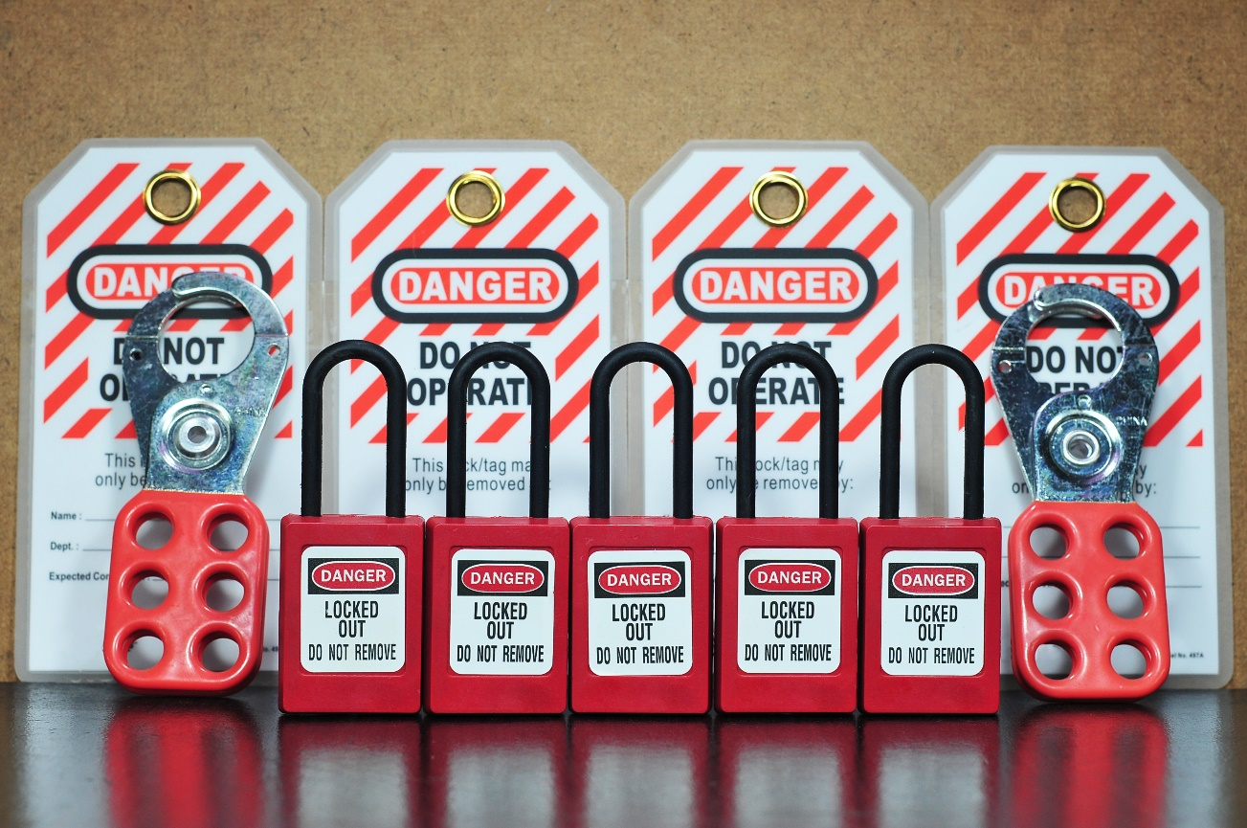
Step 4 - Lockout or tagout application
Lockout vs tagout
Lockout devices
Tagout devices

Slide 18
When can an employer use a tagout system?
When an energy isolating device is not capable of being locked out, or
When the employer can demonstrate (prove) that using a tagout system will provide full employee protection.

Slide 19
Exercise (page 11)
Answer the following questions about protective hardware.
Protective hardware must be provided by the _____.
Each lockout and tagout device must be singularly identified as being used _____ for lockout or tagout.
Lockout and tagout devices must be _____ within the facility.
Lockout and tagout devices must _____ the user.

Slide 20

Step 5 - Controlling stored energy
Immediately after applying lockout or tagout devices, the authorized employee must ensure all potentially hazardous stored or residual energy is:
Relieved
Disconnected
Restrained
Question: What are some examples of stored or residual energy?

Slide 21

Step 6 - Verify
Before starting work on a machine or piece of equipment that has been locked or tagged out, the authorized employee must verify that the machine or piece of equipment has been isolated and de-energized.
Serious injury and death have occurred when workers did not ensure that the machine or equipment was isolated from hazardous energy before starting work.
Question: How do you verify that a machine or piece of equipment is actually isolated and de-energized?

Slide 22
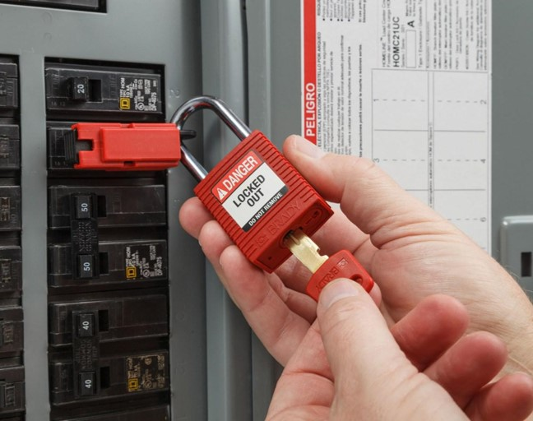
Release from lockout or tagout
Equipment
Employees
Removing lockout/tagout devices
Question:
If the authorized employee is not available, who is authorized to remove the lockout or tagout device?

Slide 23

Testing and positioning machines or equipment
Sequence must include:
Clear the machine or equipment of tools and materials.
Remove employees from the machine or equipment area.
Remove the lockout or tagout devices.
Energize and proceed with testing or positioning.
De-energize all systems and reapply energy control measures.

Slide 24
Group lockout and group tagout
Group lockout or tagout devices must be used according to specific procedures and must include the following requirements, at a minimum:
Primary responsibility
Monitor the exposure status
Coordinate all affected groups
Personal lockout or tagout

Slide 25
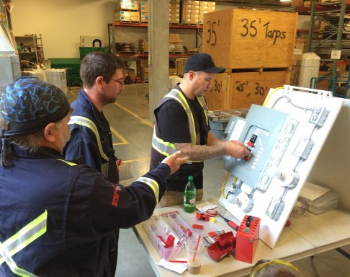
Part 4: Lockout/tagout training
Training must ensure that the purpose and function of your energy control program are understood and that employees gain the knowledge and skills to safely apply, use, and remove hazardous energy controls. There is minimum training required for each:
Authorized employee
Affected employee
Other employee
Question: What are effective training types for each level of training listed above?

Slide 26

Training on tagout devices
If tagout devices are used, further training needs to emphasize that:
Tags are warning devices only; they do not provide a physical restraint that lockout devices provide.
Tags must not be removed without the authorized employee’s approval and should never be bypassed or ignored.
Tags must be legible and comprehendible by all employees.
Tags must be able to withstand environmental conditions in the workplace.
Tags may give employees a false sense of security.
Tags must be securely attached to prevent accidental detachment.

Slide 27
Retraining exercise (page 15)
When should employees be retrained?
Whenever there is a change in their jobs or _____ .
Whenever there is a change in _____, equipment, or processes that present a new hazard.
Whenever there is a change in your energy _____.
Whenever there are deviations from or inadequacies in the _____ knowledge or use of the energy control procedures.
The retraining must reestablish employee proficiency and introduce new or revised control methods and procedures, as necessary.

Slide 28

Training documentation
At a minimum training certification must contain:
Employee’s name
Date of training

Slide 29

Part 5: Lockout/tagout periodic inspections
An inspection of each energy control procedure must be conducted at least annually.
The inspection must include a demonstration of the procedures and may be implemented through random audits or planned visual observations.

Slide 30

Periodic inspection documentation
The employer must certify that the periodic inspections are being performed.
The certification must identify:
The equipment or machine being serviced
The inspection dates
The employees included in the inspection
The authorized employee performing the inspection

Slide 31
Exercise (page 15)
Answer the following questions about periodic inspections.
What questions would you consider when conducting your inspection?
How often must lockout/tagout inspections occur?
Who must conduct the inspection?

Slide 32
Principles of Machine Safeguarding

Slide 33
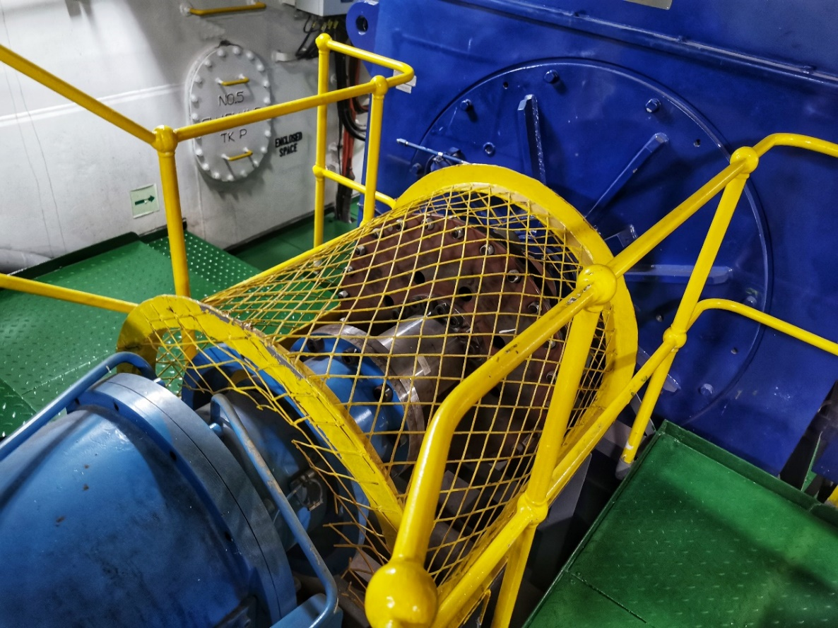
Goals
Describe machine-related hazards, including point-of-operation and power transmission devices.
Introduce effective machine guarding principles and methods.

Slide 34
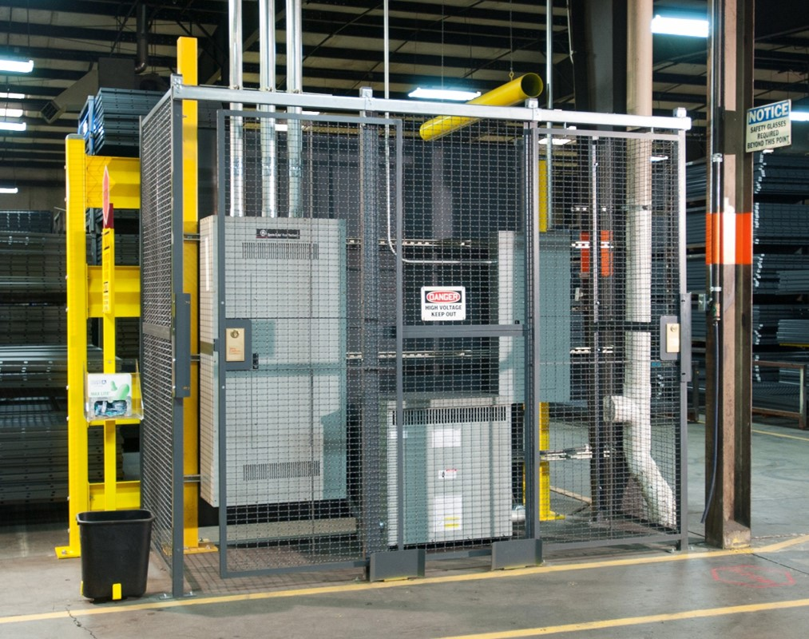
Purpose
The purpose of machine guarding is to protect against, and prevent injury from the point of operation from, in-running nip points, rotating
parts, flying chips, and sparks.

Slide 35

Three areas where mechanical hazards occur
The point of operation
The power transmission apparatus
Other moving parts

Slide 36






Hazardous mechanical motions
Rotating motion
Reciprocating motion
Transverse motion

Slide 37



Nip points
Nip points are areas in machinery where two rotating or moving parts come close together, creating a small opening or point of contact.

Slide 38

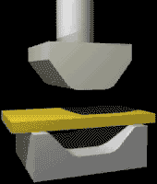
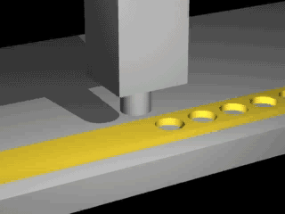

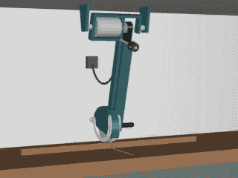
Hazardous mechanical actions
Cutting
Shearing
Bending
Punching

Slide 39
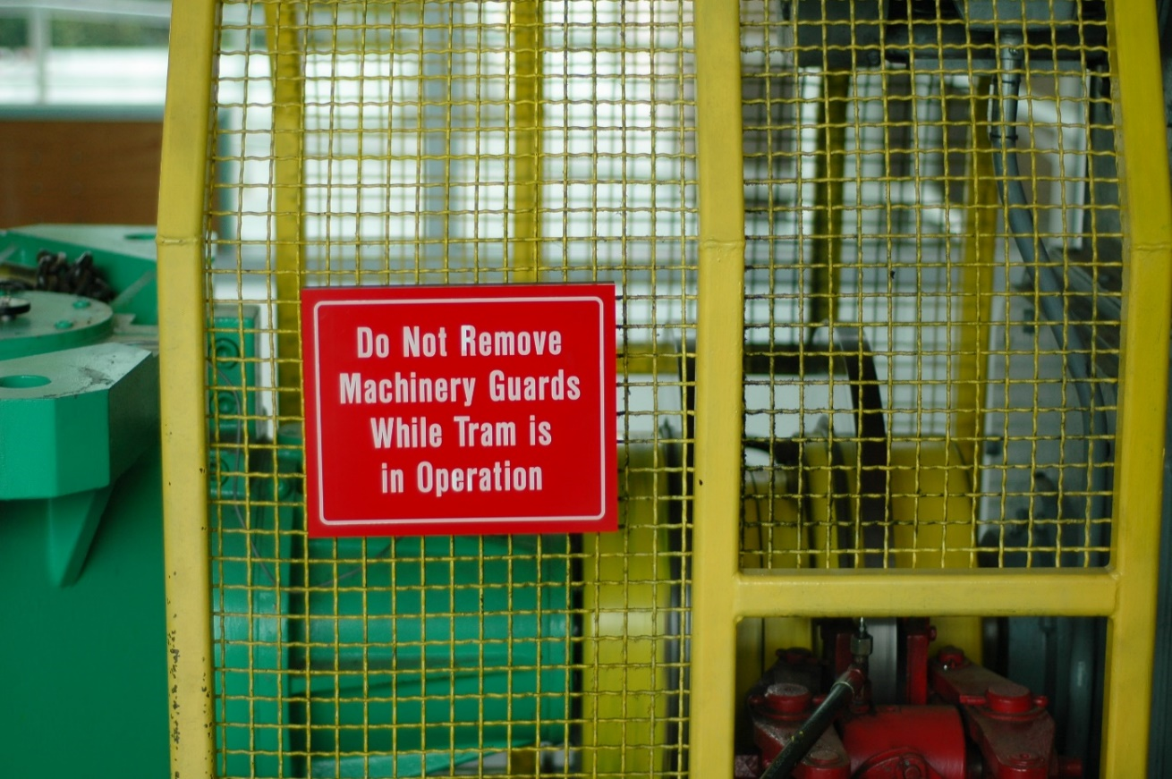
Machine safeguarding
There are many ways to safeguard machines, including:
Type of operation
Size or shape of stock
Handling method
Physical layout of the work area

Slide 40
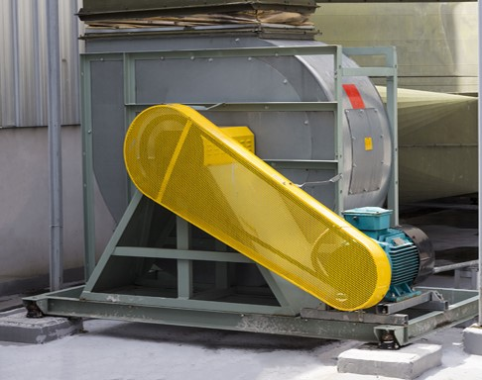
Safeguarding strategies
Primary safeguarding strategies include:
Guard strategies
Devices strategies
Other safeguarding strategies include:
Location and distance
Feeding and ejection
Awareness barriers
Protective shields
Hand-feeding and holding tools
Anti-restart devices

Slide 41
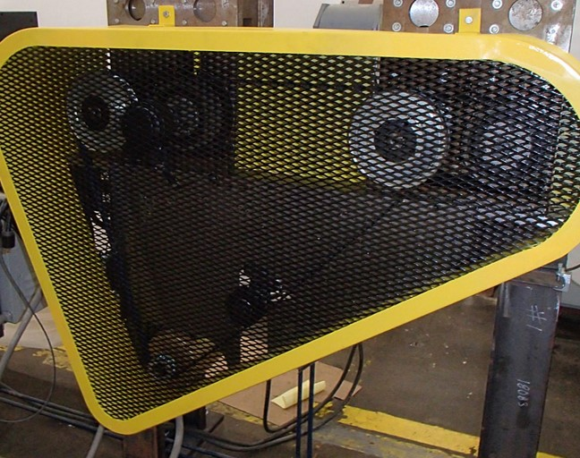
What makes a guard effective?
Must eliminate any contact around, over, through, or under the guard
Must not present a hazard in itself or create interference
Must not allow objects to fall into moving parts
Allows safe maintenance and lubrication
Affixed to the machine where possible and remains secure
Conforms with other appropriate standards

Slide 42
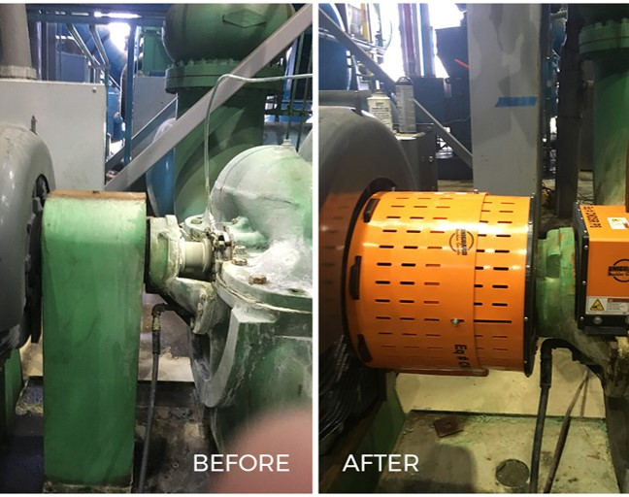
Guard strategies
Fixed
Interlocked
Adjustable
Self-adjusting

Slide 43
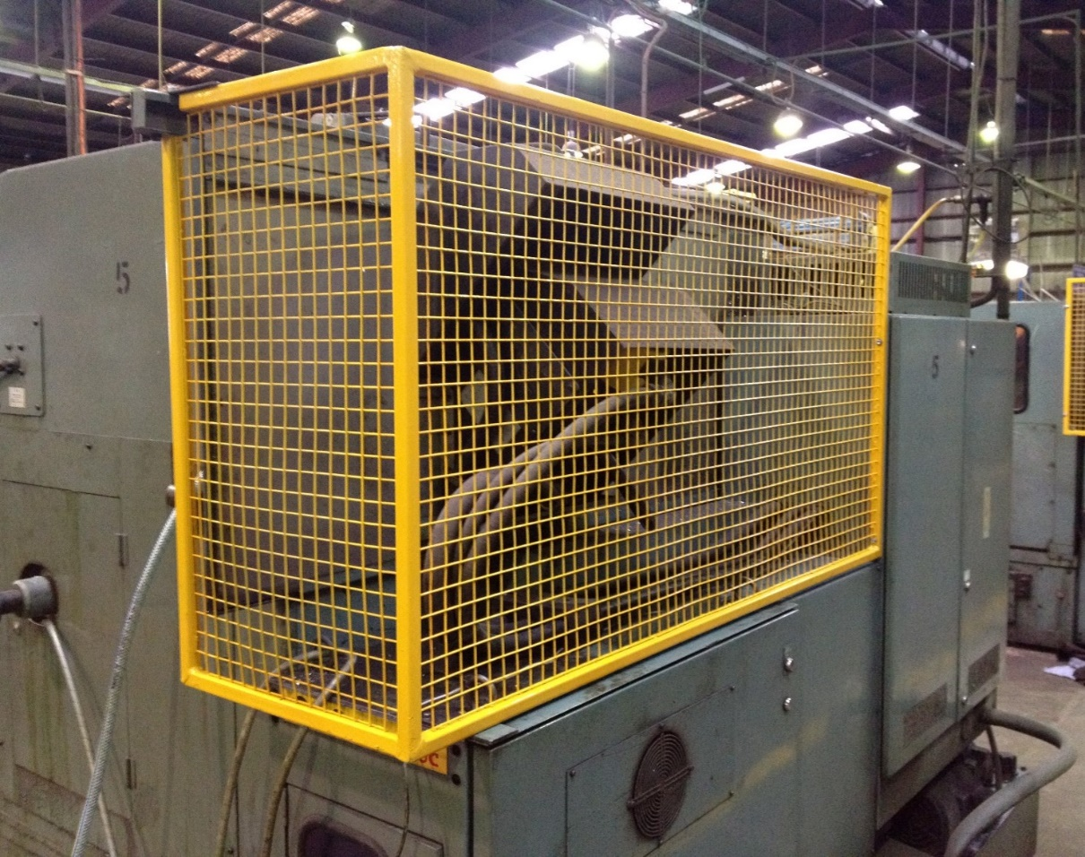
Fixed guards
Permanent part of the machine
Not dependent on moving parts to perform its intended function
Constructed of sheet metal, screen, substantial material
Usually preferable to all other types of safeguarding strategies because of its relative simplicity and permanence

Slide 44
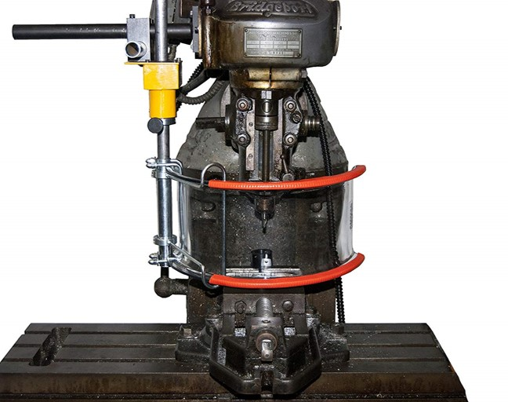
Interlocked guards
The tripping mechanism or power automatically shuts off or disengages when opened or removed
The machine cannot cycle or be started until the guard is back in place
The guard uses electrical, mechanical, hydraulic, or pneumatic power
Replacing the guard should not automatically restart the machine

Slide 45
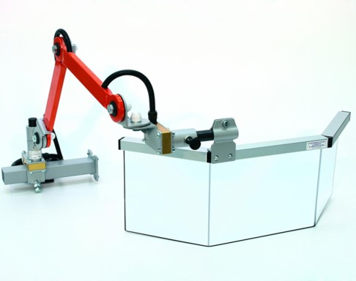
Adjustable guards
Allow flexibility in accommodating various sizes of stock

Slide 46

Self-adjusting guards
Opening is only large enough to admit the stock
Openings are determined by the movement of stock
Guard is pushed away as stock is introduced
Guard returns to rest position after stock passes through

Slide 47
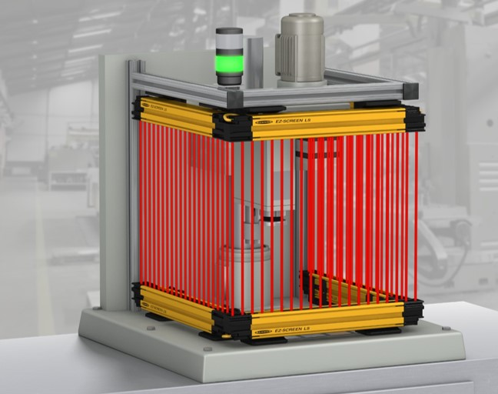
Device strategies
Presence-sensing
Pullback
Restraints
Controls and trips
Gates

Slide 48

Presence-sensing devices
Photoelectric
Radiofrequency
Electromechanical

Slide 49
Pullback and restraint devices
Pullback
Uses cables attached to the
operator’s hands, wrists, or arms; primarily used on machines with stroking action.
Restraint
Uses cables or straps attached
to the operator’s hands at a fixed point. The cables or straps must be adjusted to let the operator’s hands travel within a predetermined safe area.

Slide 50
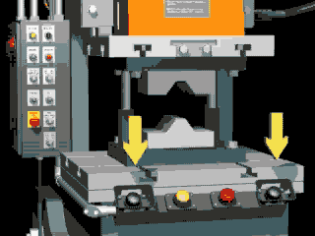
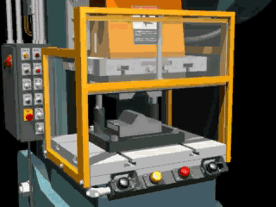
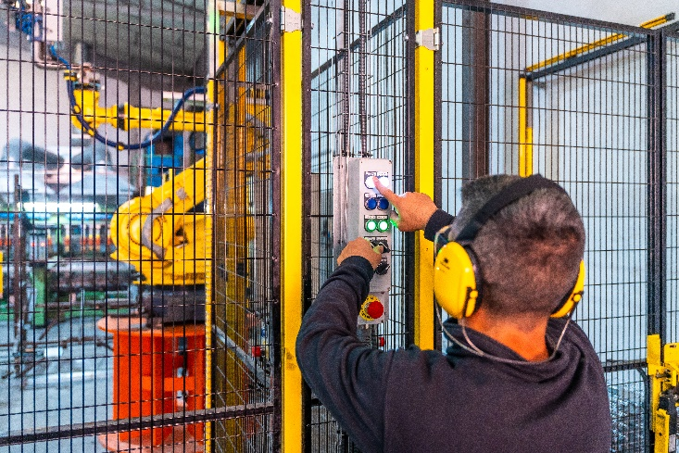
Trip, control, and gate devices
Two-hand Controls
Safety trip
Two-hand controls
Two-hand trip
Gate
  Type A
  Type B
Type A Gate
Two-hand Trip

Slide 51
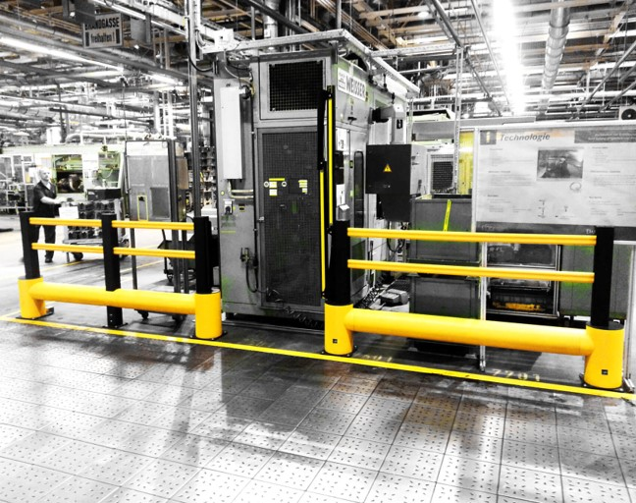
Location and distance
Walls
Barriers and fences
Height above worker
Size of stock
Controls positioned at a safe distance

Slide 52
Exercise (page 10)
Answer the following questions about factors to consider when guarding by location and distance.
Can dangerous parts still be accessed, even with great effort?
Can pieces break off?
Are sparks or other flying debris being produced?

Slide 53

Feeding and ejection
Automatic
Semi-automatic
Robots

Slide 54
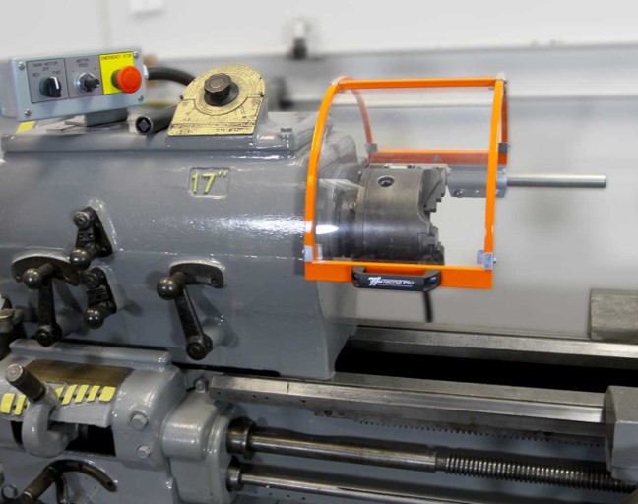
Miscellaneous aids
Miscellaneous aids do not give
complete protection from machine hazards, but can help in moving stock, deflecting minor chips, or providing awareness.
Examples include:
Awareness barriers
Protective shields
Hand-feeding/holding tools
Anti-restart devices

Slide 55
Additional Educational Resources
Oregon OSHA
YouTube Channel
Website A-Z Topic Index
Online Training Courses
PESO – English to Español
Other Safety and Health Training Resources

Slide 56
Need more information? Call your nearest Oregon OSHA Office
Salem Central Office
350 Winter St. NE
Salem, OR 97301-3882
Phone: 503-378-3272
Toll-Free: 800-922-2689
Fax: 503-947-7461
en Español: 800-843-8086
Website: osha.oregon.gov
Eugene
1500 Valley River Drive, Suite 150
Eugene, OR 97401-4643
541-686-7562
Consultation: 541-686-7913
Medford
1840 Barnett Road, Suite D
Medford, OR 97504-8293
541-776-6030
Consultation: 541-776-6016
Pendleton
750 SE Emigrant Ave., Ste. 131
Pendleton, OR 97801
541-276-9175
Consultation: 541-276-2353
Portland
Durham Plaza
16760 SW Upper Boones
Ferry Road, Suite 200
Tigard, OR 97224-7696
503-229-5910
Consultation: 503-229-6193
Salem
1340 Tandem Ave. NE, Suite 160
Salem, OR 97301-8080
503-378-3274
Consultation: 503-373-7819
Bend
Red Oaks Square
1230 NE Third St., Suite A-115
Bend, OR 97701-4374
541-388-6066
Consultation: 541-388-6068

Slide 57
Thank you!

