Slide 1
Hazard Communication Aligned with GHS
Presented by Oregon OSHA Public Education

Slide 2
Oregon OSHA Public
Education Mission
Oregon OSHA Services
Consultation Services
Enforcement
Appeals
Public Education and Conferences
Standards and Technical Resources
We provide knowledge and tools to advance self-sufficiency in workplace safety and health.

Slide 3
Contact us
Consultation Field Offices
Salem Central
Portland 503-229-6193
Salem 503-373-7819
Eugene 541-686-7913
Medford 541-776-6016
Bend 541-388-6068
Pendleton 541-276-2353
Website: osha.oregon.gov
Toll Free English:
800-922-2689
Toll Free Spanish:
800-843-8086

Slide 4

HazCom’s four parts

Slide 5
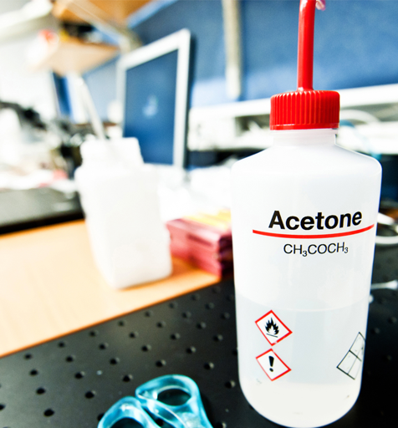
What is a chemical?
What is a hazardous chemical?
Workbook Page 2

Slide 6

Practice
Think of a hazardous chemical that you use.

Slide 7

Emergency exposures
HazCom also applies to any chemical known to be present in the workplace in such a manner that employees may be exposed under a foreseeable EMERGENCY.

Slide 8
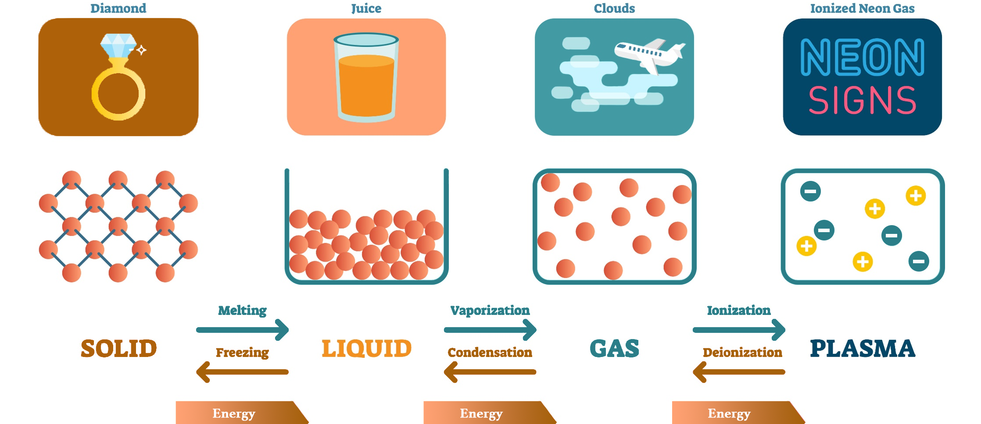
States of matter

Slide 9
Uses and hazards
Chemicals are necessary:
However, chemicals can also be dangerous:
GLUES help build
SOLVENTS help clean
OILS help protect
GLUES can cause skin allergies (epoxy)
SOLVENTS can cause cancer (benzene)
OILS can cause skin ulcers and eye damage (creosote)

Slide 10

Routes of entry

Slide 11

How HazCom works
Manufacturers and importers
Employer

Slide 12
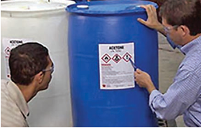
The big picture
Are all hazardous chemicals in the workplace covered by the Hazard Communication Rule?

Slide 13

Discussion (page 9)
What HazCom does and
does not apply to

Slide 14
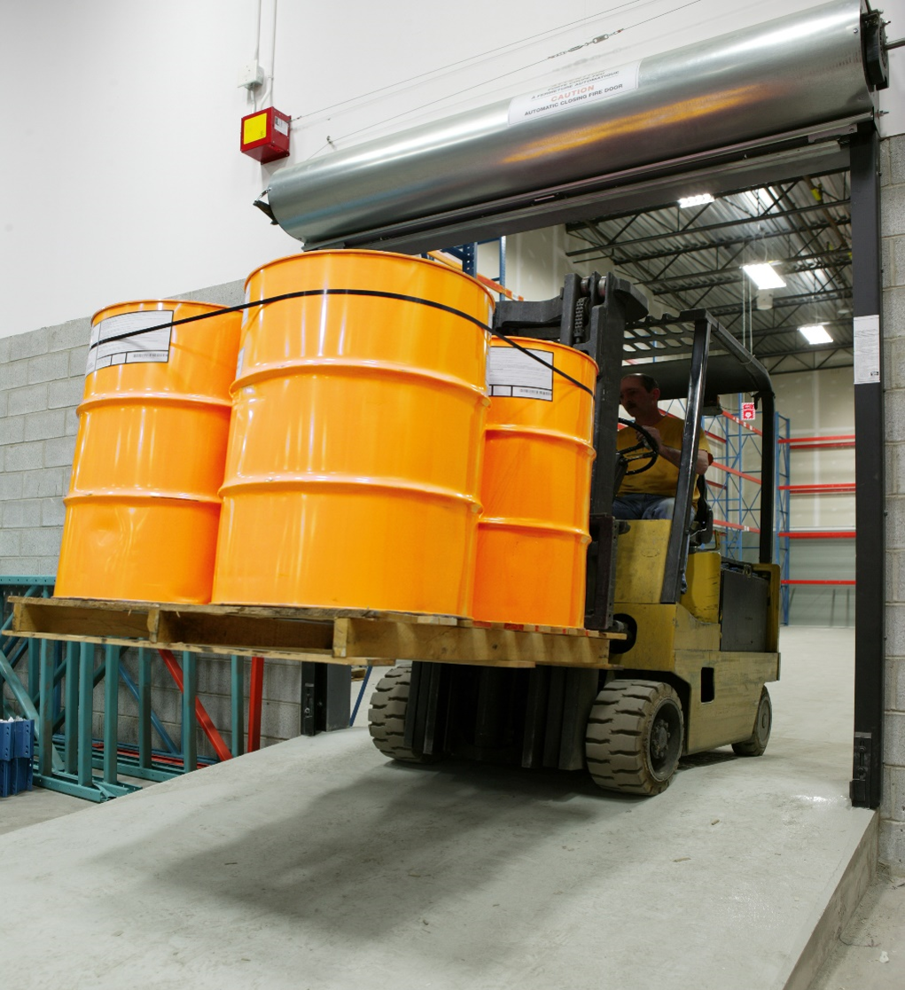
Workplaces such as warehouses or retail stores
Handling unopened, sealed containers

Slide 15

Handling chemicals in labs

Slide 16

GHS
Globally harmonized system (GHS) of classification and labeling of chemicals.

Slide 17
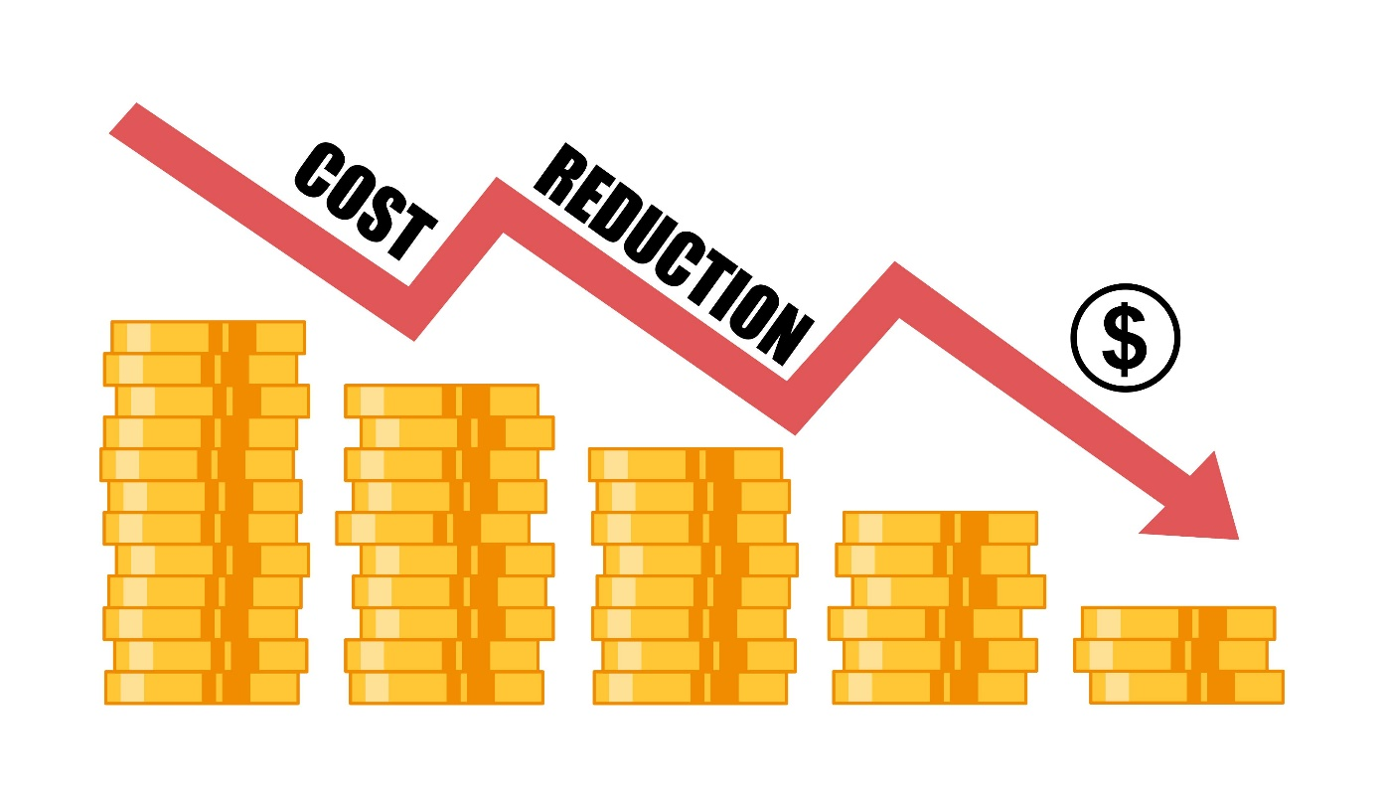
Advantages to aligning with Federal OSHA’s HazCom rule
Understanding of hazards
Reduce death and injuries
Reduce cost

Slide 18

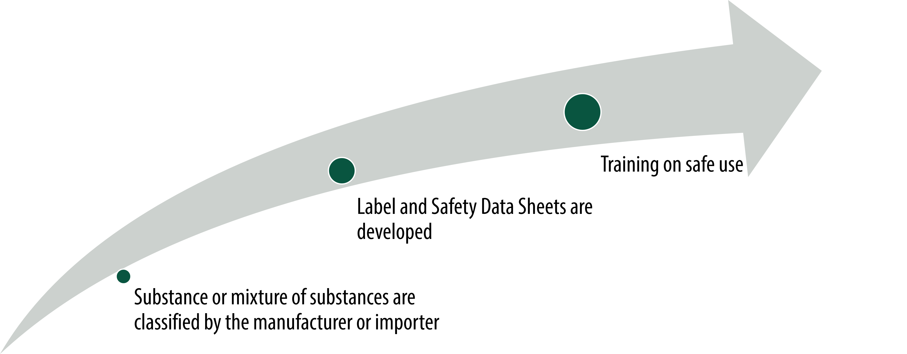
Classify and categorize chemicals

Slide 19

Who is responsible for classifying and categorizing chemicals?

Slide 20

How it works
Classify and categorize.

Slide 21


Appendix A & B
Health Hazards
Physical Hazards

Slide 22

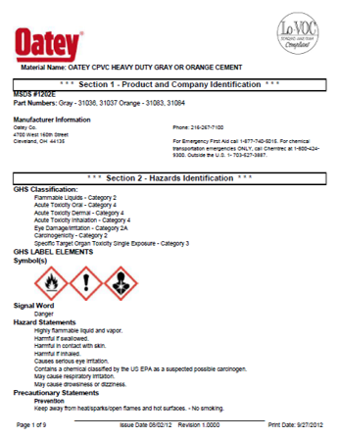
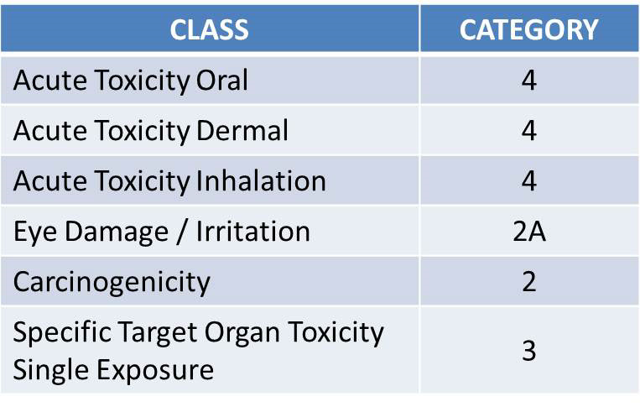
Classify & Categorize Oatey PVC Glue

Slide 23

Appendix A: categorize a health effect
Serious eye damage or eye irritation

Slide 24

Appendix B: categorize a physical effect
Flammable (includes gases, liquids, and solids)

Slide 25

Pictograms parts
Red border
White background
Black symbol

Slide 26

Pictograms

Slide 27
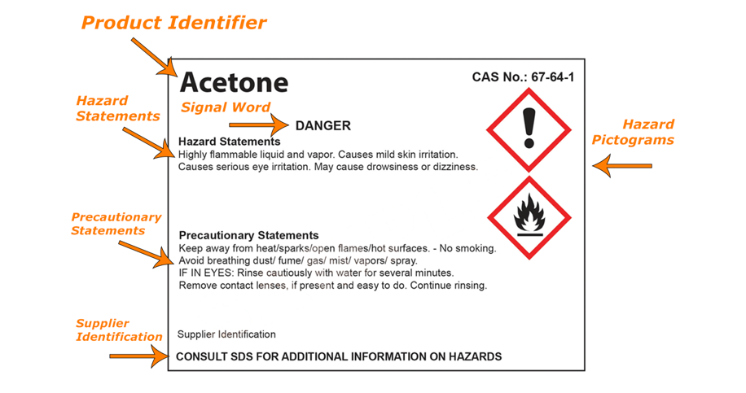
Labels

Slide 28

Labels (Continued)
Primary
Secondary
Stationary
Portable
Small
Pipes

Slide 29
Labeling containers - small
For containers less than or equal to 100ml capacity, the label must include, at a minimum:
Product identifier
Pictogram(s)
Signal word
Chemical manufacturer’s name and phone number
A statement that the full label information for the hazardous chemical is provided on the immediate outer package
For containers less than 3ml capacity, where a label would interfere with the normal use of the container, a label is not required, but the container must have a product identifier at the very minimum.

Slide 30
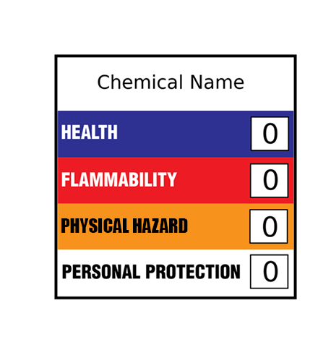
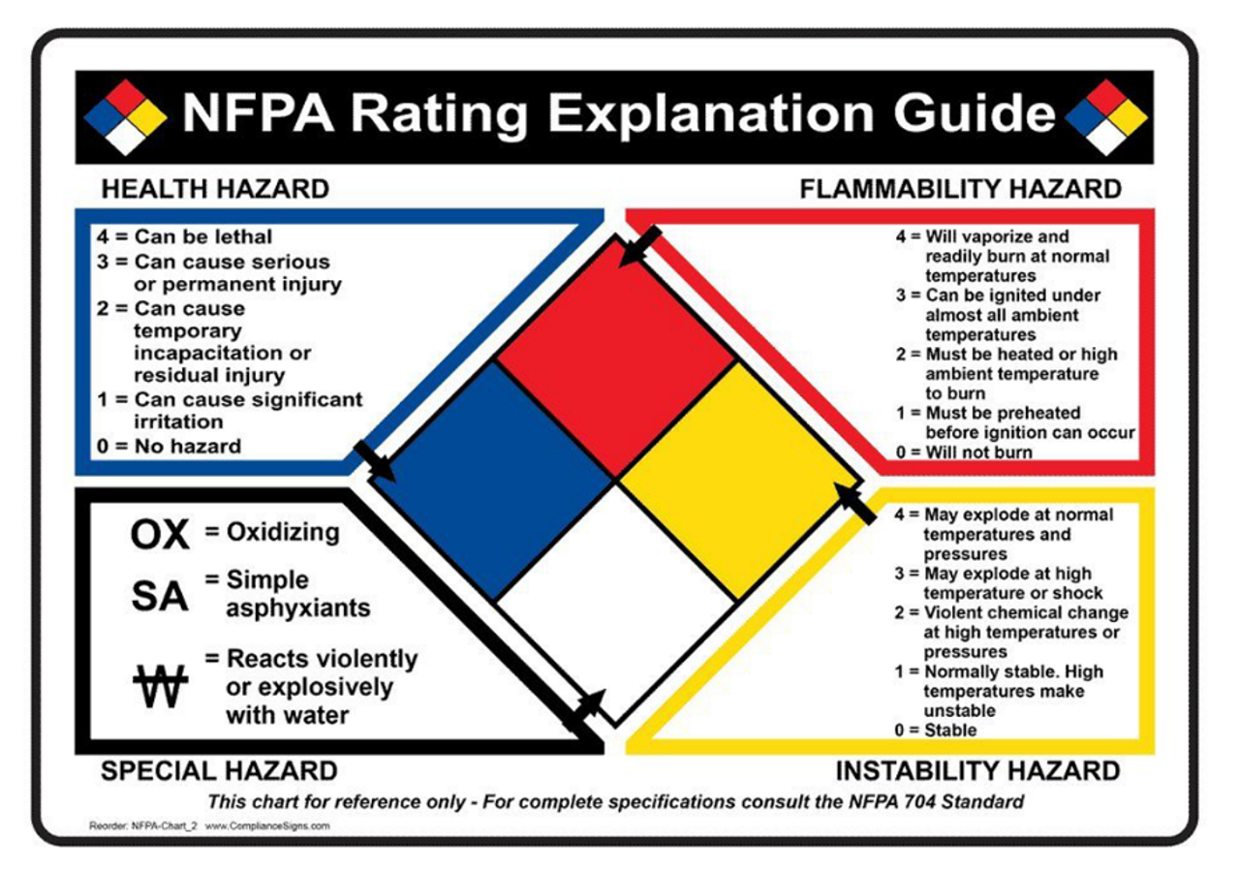
NFPA 704 HMIS

Slide 31

Safety data sheets (key parts)
Emergency tool
Routes of entry
Physical and health effects
Personal protective equipment
Pictogram(s) and signal word

Slide 32
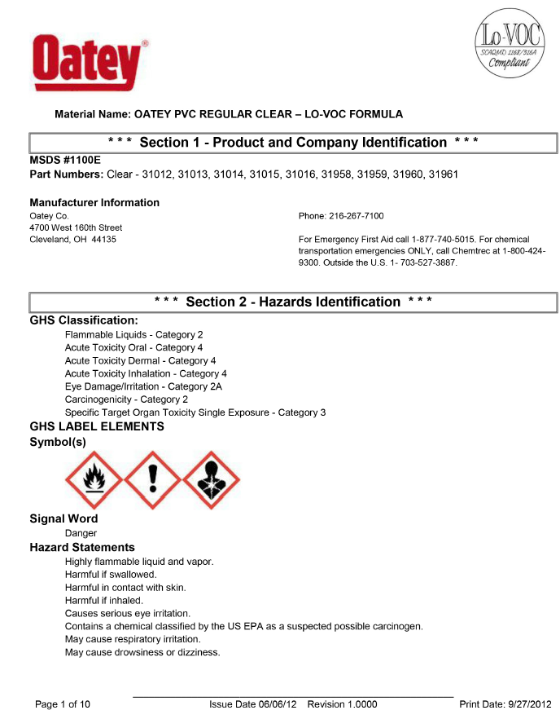
SDS review

Slide 33


Pesticides section 15
GHS
EPA

Slide 34

Written program
Chemical list
Labeling
Safety data sheets
Training
Hazardous non-routine tasks
Chemicals in pipes
Contractors

Slide 35
Chemical list
Chemical | Signal Word | Location of Use
Dymax Adhesive | Danger | Shop
HiQ Acetylene | Danger | Shop
Oatey’s PVC Glue | Danger | Shop

Slide 36
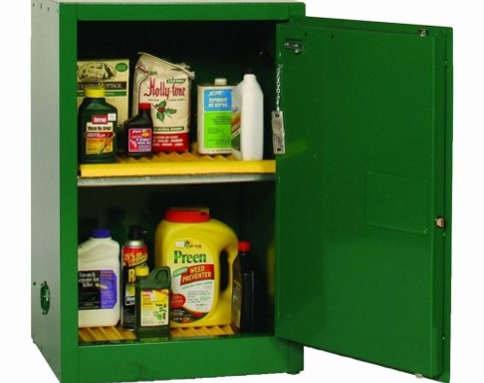
Discussion (page 36)

Slide 37
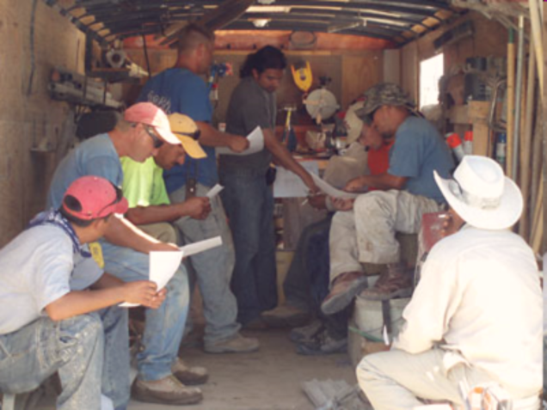
Training
Group
Individual
When should we train
What needs to be explained

Slide 38

Training practice
Health and physical hazards
Controls and PPE
Emergency procedures

Slide 39
Additional educational resources
Oregon OSHA
YouTube Channel
Website A-Z Topic Index
Online Training Courses
PESO – English to Español
Other Safety and Health Training Resources

Slide 40
Need more information? Call your nearest Oregon OSHA Office
Bend
541-388-6066
Consultation: 541-388-6068
Eugene
541-686-7562
Consultation: 541-686-7913
Medford
541-776-6030
Consultation: 541-776-6016
Pendleton
541-276-9175
Consultation: 541-276-2353
Portland
503-229-5910
Consultation: 503-229-6193
Salem
503-378-3274
Consultation: 503-373-7819
Salem Central Office
350 Winter St NE
Salem, OR 97301-3882
503-378-3272
Toll-Free: 800-922-2689
Fax: 503-947-7461
en Español: 800-843-8086
Website: osha.oregon.gov

Slide 41
Thank you!

