Slide 1


Powered Industrial Truck (Forklift) Safety
Presented by Oregon OSHA Public Education

Slide 2


Oregon OSHA Public Education Mission:
Oregon OSHA Services
Consultation Services
Enforcement
Appeals
Public Education and Conferences
Standards and Technical Resources
We provide knowledge and tools to advance self-sufficiency
in workplace safety and health.

Slide 3
Contact us
Consultation Field Offices:
Portland 503-229-6193
Salem 503-373-7819
Eugene 541-686-7913
Medford 541-776-6016
Bend 541-388-6068
Pendleton 541-276-2353
Salem Central
Toll Free English:
800-922-2689
Toll Free Spanish:
800-843-8086
Website: osha.oregon.gov

Slide 4
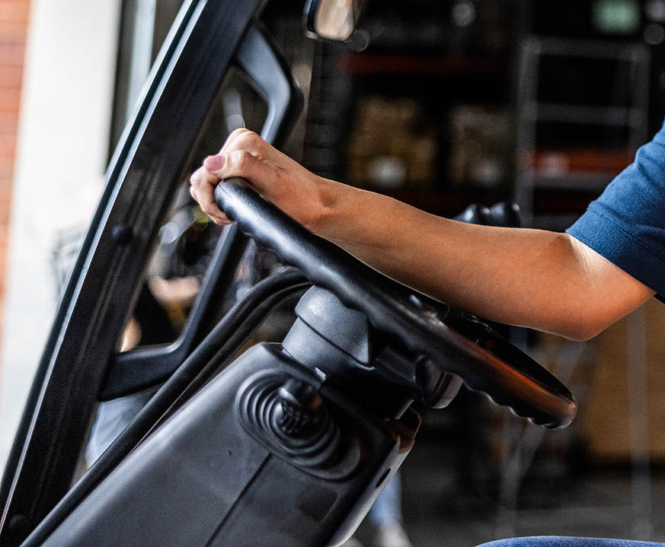
Workshop objectives
Discuss the safe work practices for operating forklifts.
Review Oregon OSHA’s general industry rules for forklifts: 29 CFR 1910.178, Powered Industrial Trucks; and OAR 437-002-0227, Additional Oregon Rules for Powered Industrial Trucks.

Slide 5
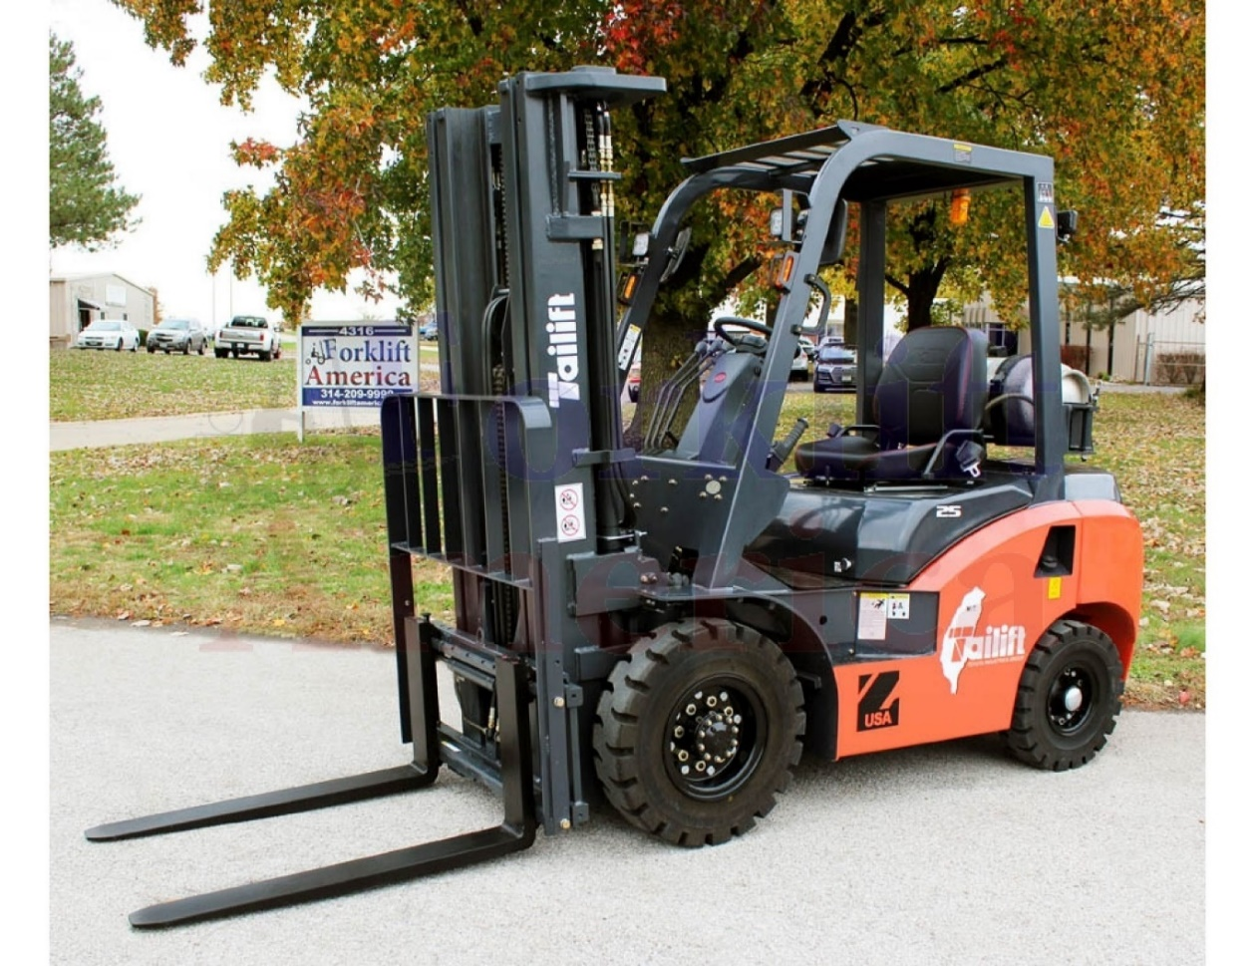
What is a forklift?
Mobile, power-driven vehicle used to carry, push, pull, lift, stack, or tier material.

Slide 6
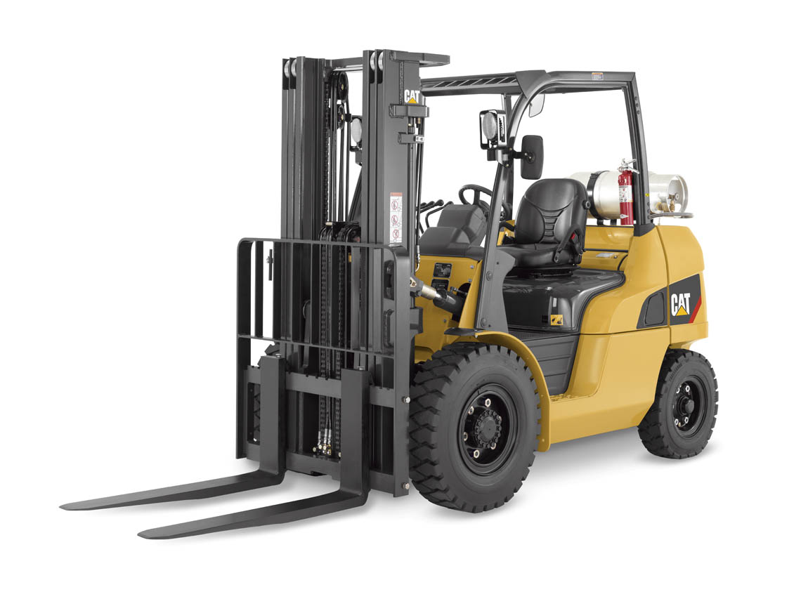
General requirements
Design and construction of forklifts must comply with ANSI/ITSDF B56.1: Safety
standard for low, high lift trucks (current standard).
Download at no cost from the Industrial Truck Standards Development Foundation.

Slide 7
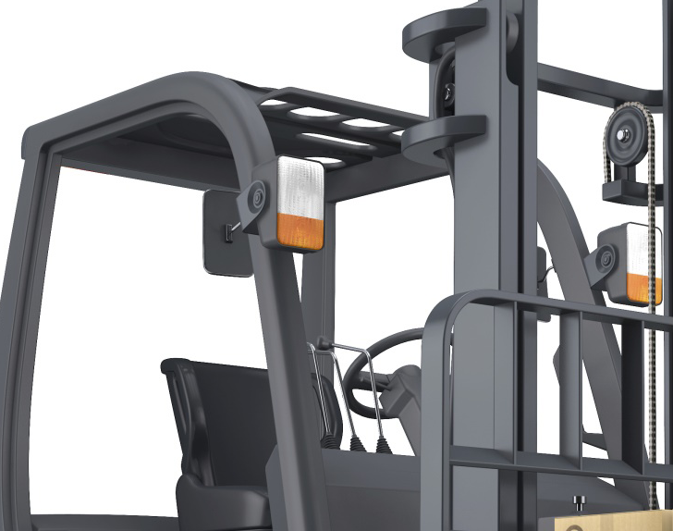
Additional Oregon rules for forklifts
Overhead guards
Load backrests
Shear-point guards

Slide 8
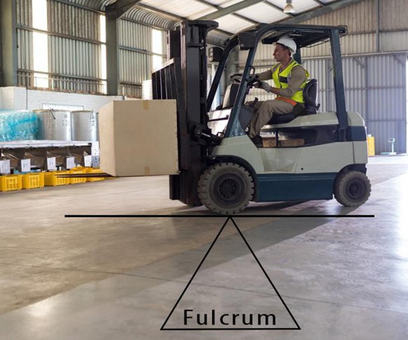
Fulcrum point
Forklift stability is based on the principle of two weights balanced on opposite sides of a pivot (fulcrum point).
The forward wheels are the fulcrum.
This is the same principle used for a teeter-totter.

Slide 9
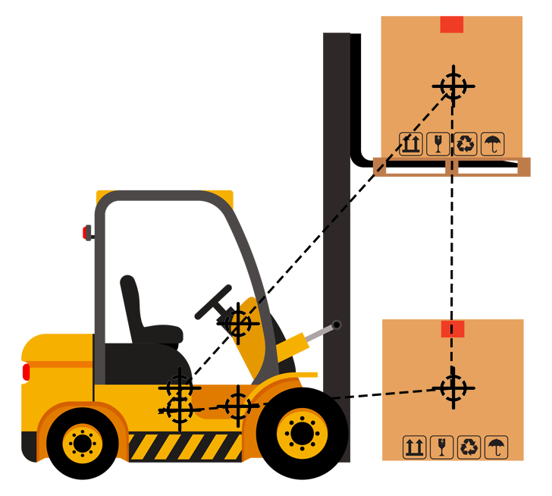
Center of gravity (CG)
When a forklift picks up a load, the forklift and load have a new combined CG.
The stability of the forklift is determined by the location of its CG, or if the forklift is loaded, the combined CG.

Slide 10
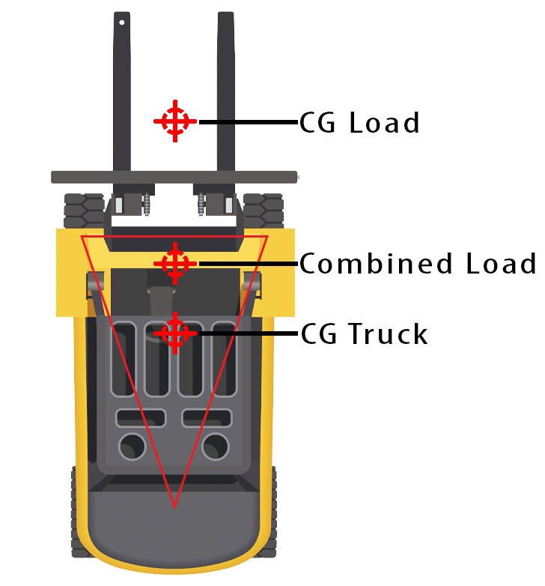
Stability triangle
For the forklift to remain stable, the center of gravity must stay within an area represented by a triangle drawn between the drive wheels and the pivot of the steering axle.
The operator must keep the combined center of gravity within the stability triangle.

Slide 11
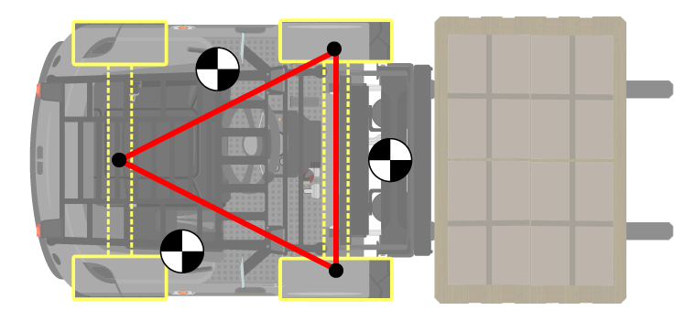
Exercise (page 8)
What can cause a forklift to tip forward?
What can cause a forklift to tip sideways?

Slide 12
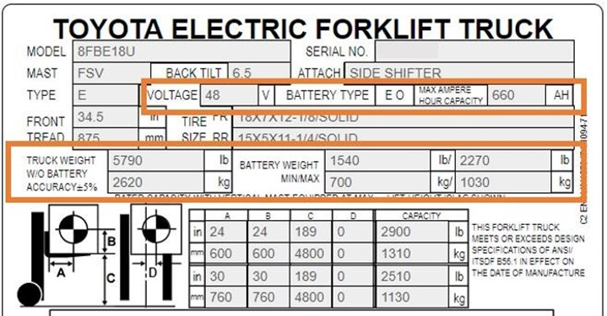
Load center
The load center is determined by the location of the center of gravity of the load.
The maximum capacity of the forklift at load center is shown on the forklift’s data plate at a specified load height.

Slide 13
Loaded forklift
The CG of a loaded forklift is affected by a number of factors, including:
Size, weight, shape, and position of the load
The height to which the load is raised
The amount of forward or backward tilt of the load
Tire pressure
Dynamic forces created when the forklift is moving, such as acceleration, braking, operating on uneven surfaces or inclines, and turning

Slide 14
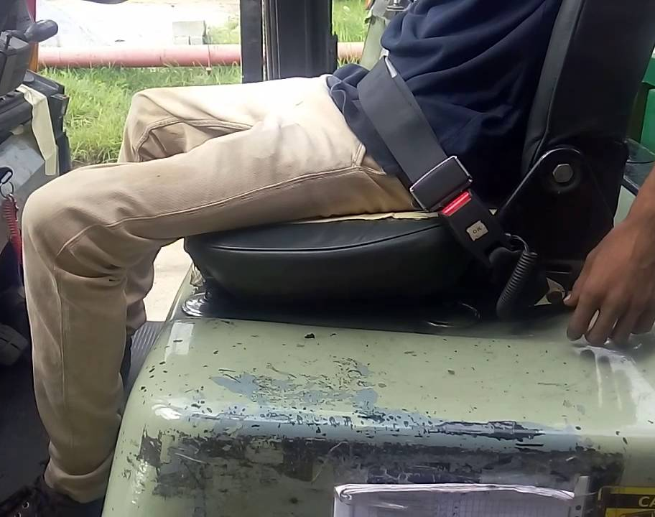
Seat belt safety
Seat belts or other operator restraint systems should be used when provided.
Seat belts prevent the operator from being thrown from the seat during a tip over.
Manufacturers’ operating manuals also require operators to use seat belts.
Operators must also be trained in the manual’s instructions, warnings, and precautions.
Continued on next slide.

Slide 15
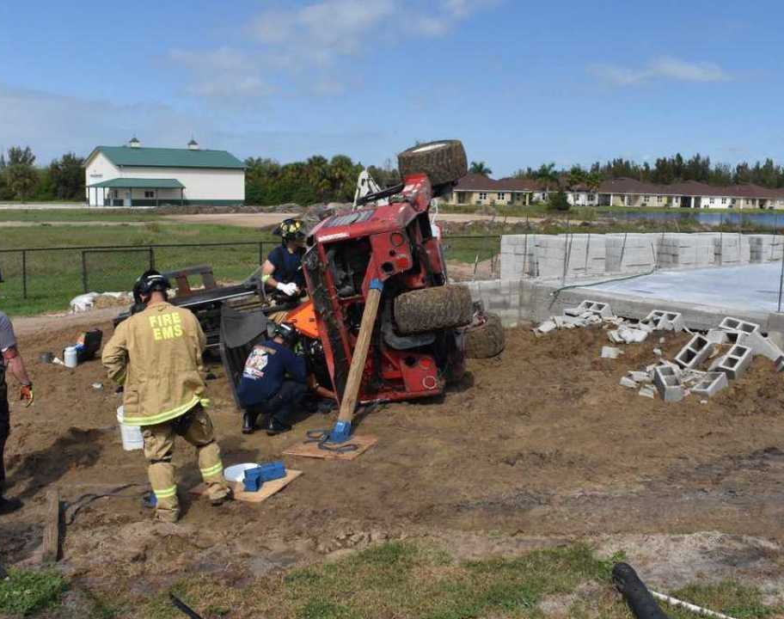
Seat belt safety (continued)
If a forklift has a seat restraint installed, operators must use them when exposed to an overturn hazard or traveling in areas where an operator can be thrown from the operator’s compartment.

Slide 16
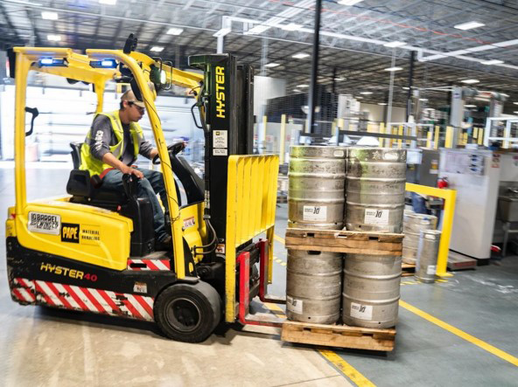
Picking up a load
Load does not exceed the forklift’s rated capacity
Forks are positioned properly
Load is balanced and secure
Bottom of the load is raised to the proper traveling height
Drive as far under the load as possible
Slightly tilt back and lift the load
Back, stop, and lower load 2 to 6 inches from the floor
Before backing up, check behind and on both sides for pedestrians or other traffic

Slide 17
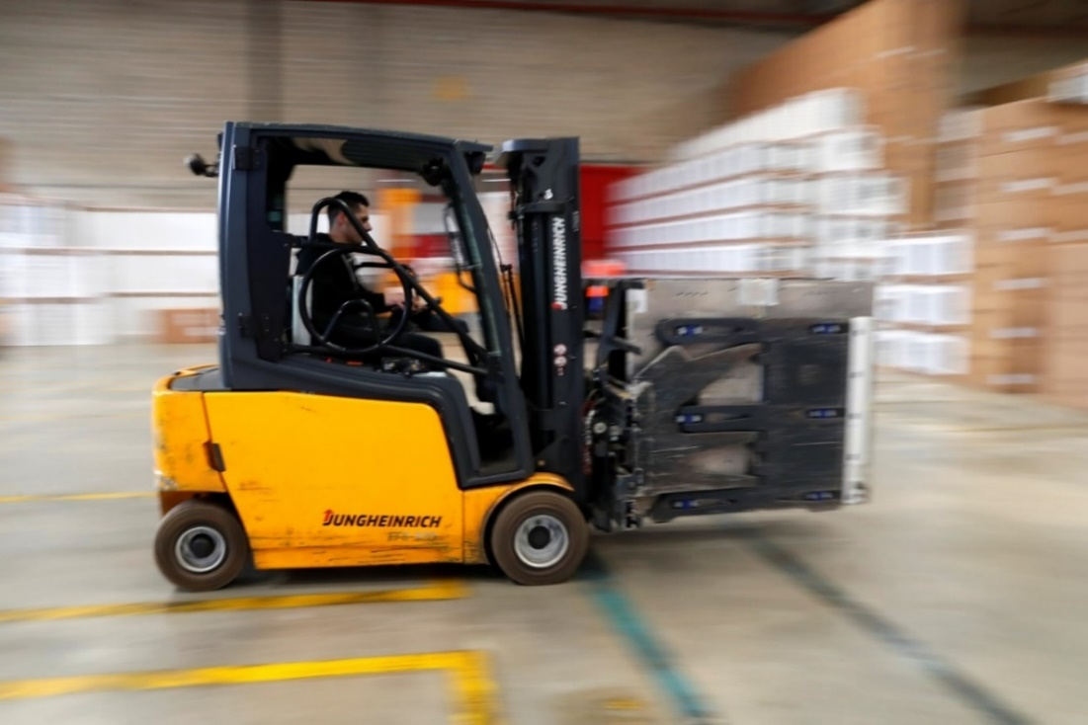
Traveling with a load
The operator and pedestrians must communicate
No riders/passengers are allowed
Travel at a safe operating speed
Follow all traffic regulations, including plant speed limits
Maintain at least 3 forklift lengths
Be aware of the traveling surface’s condition
Continued on next slide.

Slide 18
Traveling with a load (continued)
Keep the load slightly above grade, and travel in reverse if it obstructs the operator’s forward view
Avoid sudden braking
Turn in a sweeping motion
Keep the load slightly tilted back
When approaching corners and blind areas, sound the horn
Lift and lower the load only when stopped
Keep a safe distance from the edge of ramps or platforms while on any elevated dock

Slide 19
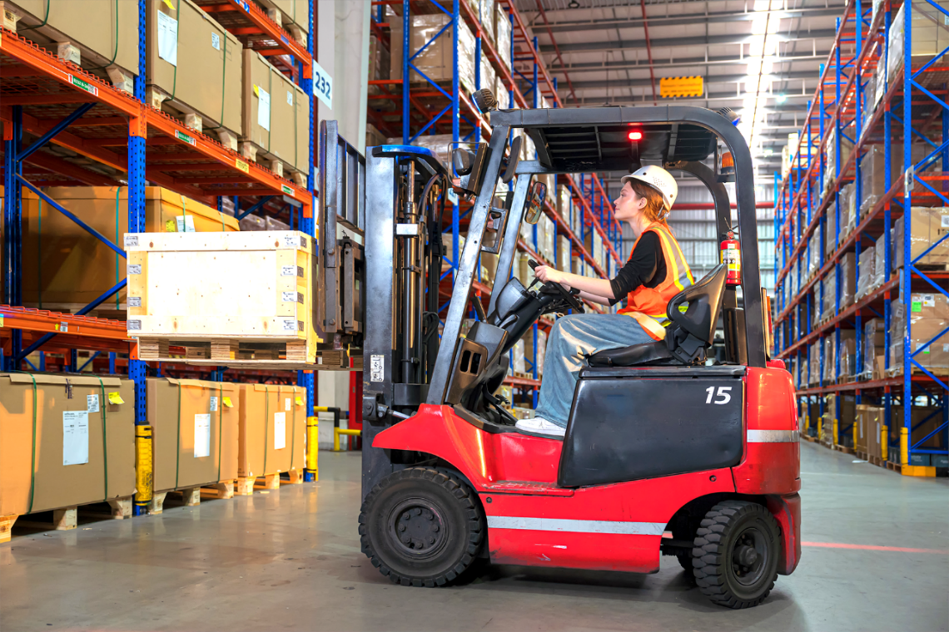
Placing and stacking a load
Safe Operations
Completely stop before raising a load
Never walk, stand, or allow anyone to pass under the elevated portion of any truck, whether loaded or empty
Move slowly after raising the load
Tilt forward, level only when over a stack or rack
Make sure forks have cleared the pallet when backing out & before turning or changing height
Before backing up, check behind and on both sides for pedestrians or other traffic
Continued on next slide.

Slide 20
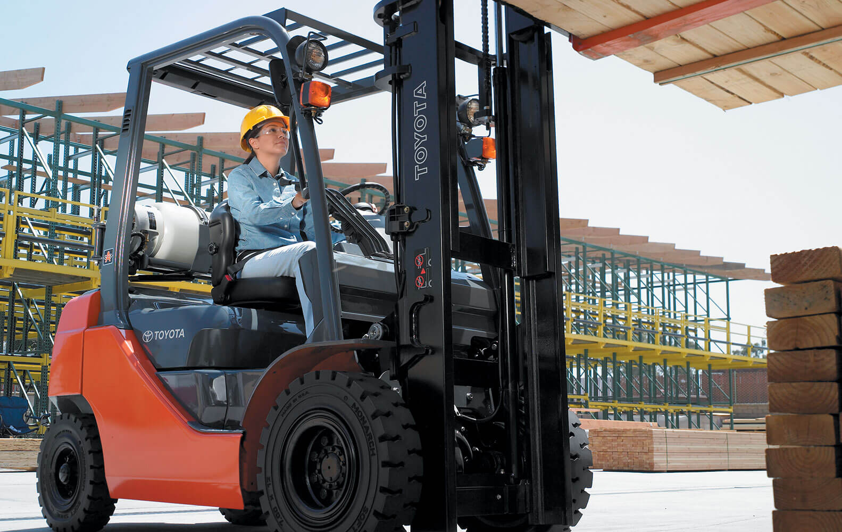
Placing and stacking a load (continued)
Safe Operations
Use additional caution when handling unusually shaped and/or off-center loads
Stack the load square and straight
Only handle loads within the forklift’s rated capacity
Forklifts equipped with attachments must be operated as partially loaded trucks even when unloaded
Avoid running over loose objects
Operate loaded and unloaded forklifts at a speed that will permit it to stop safely
Continued on next slide.

Slide 21
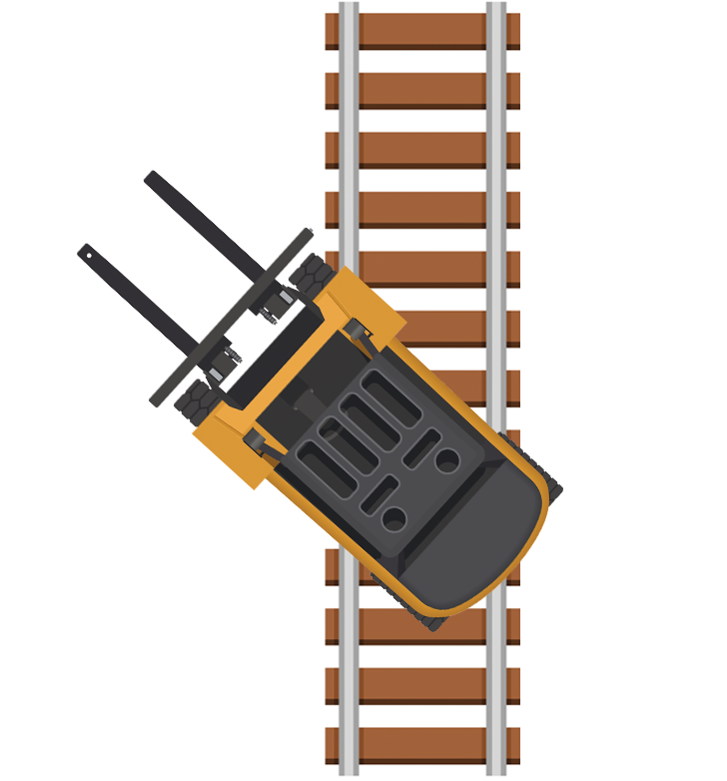
Placing and stacking a load (continued)
Safe Operations
Never engage in horseplay or stunts
Cross railroad tracks diagonally
Never park closer than eight feet from tracks
Give the right of way to emergency vehicles
Keep your arms and legs from the mast and within the running lines of the forklift
Continued on next slide.

Slide 22

Placing and stacking a load (continued)
Safe Operations
Never drive up to someone standing next to a fixed object
Enter enclosed areas with the forklift’s load-end forward
Never pass another forklift traveling in the same direction at blind corners, intersections, or other dangerous areas
Lower forks, neutralize controls, shut off, and set brakes (block if on an incline) if truck will be unattended

Slide 23

Operating forklifts around pedestrians
Best Practices
Establish clear and separate pathways
Wear high-visibility apparel
Minimize blind spots
Highlight intersections and restricted areas
Restrict use of forklifts near time clocks, break rooms, cafeterias and main exits
Install physical barriers
Use proximity detection lights on forklifts

Slide 24
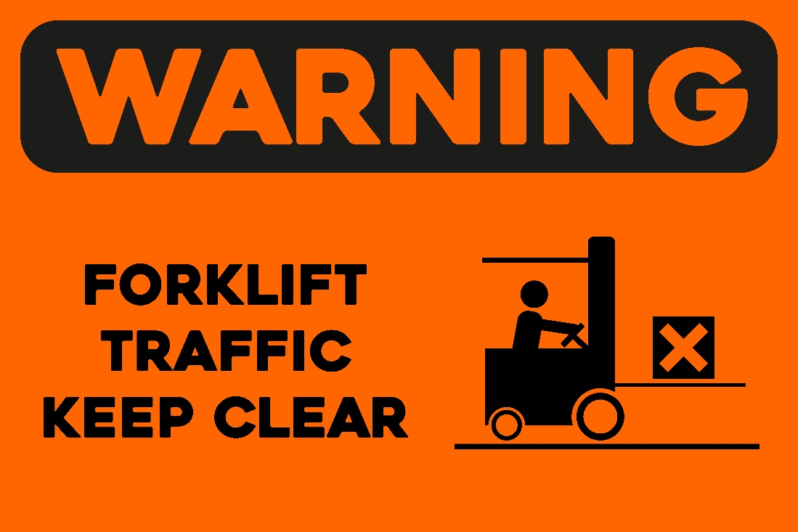
Exercise (page 13)
What safety instruction would you provide to the employees exposed to forklift traffic?

Slide 25
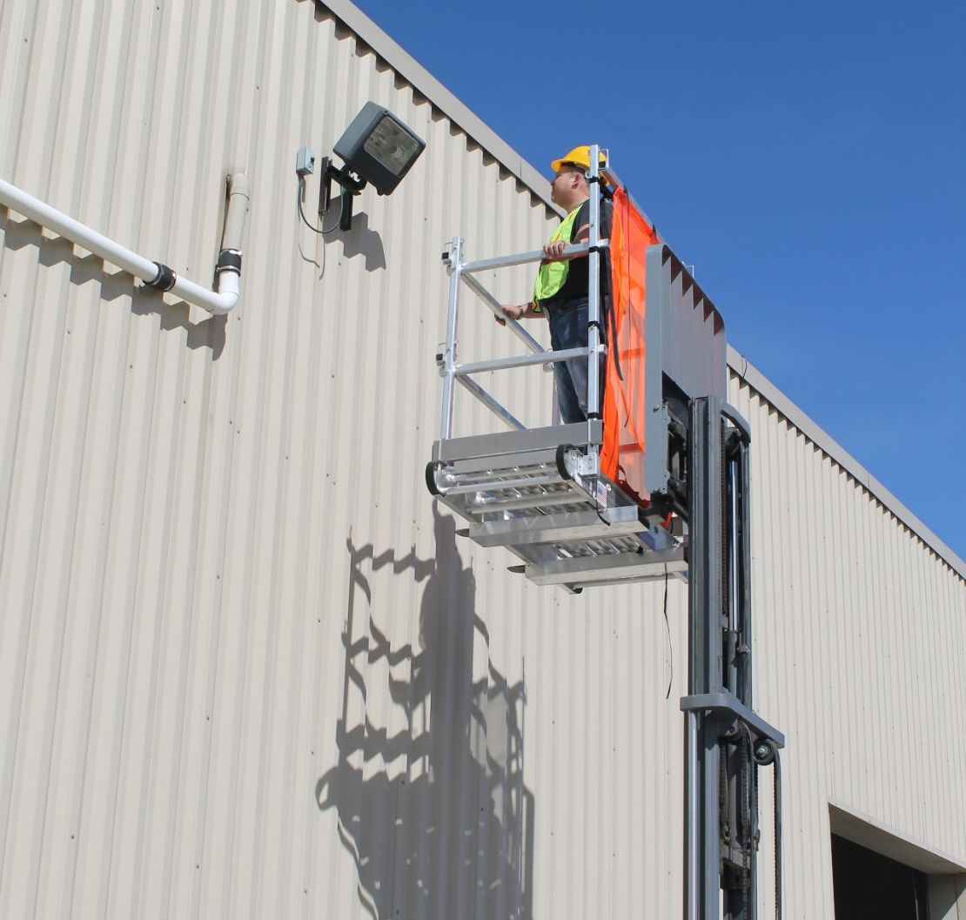
Lifting people
Work platform
Falling objects
Operator musts
Guards

Slide 26
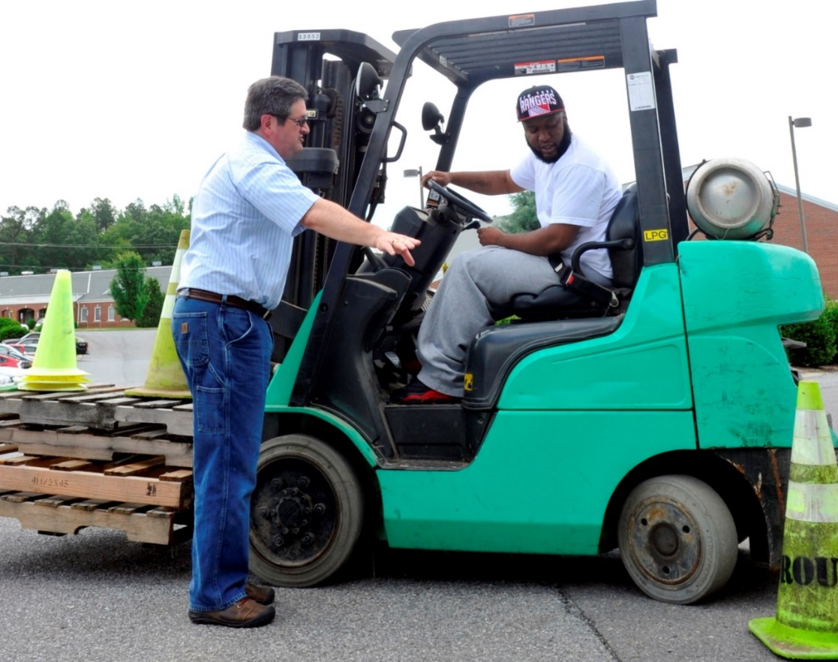
Training forklift operators
Training must include a combination of:
Lectures and discussion
Hands-on and site-specific training
Evaluation to determine the operator’s competency

Slide 27
Evaluating the operator’s competency
Evaluation must be conducted at least once every three years by the operator’s employer, and include:
Loading
Ramps and inclines
Stacking
Traveling
Fueling or charging
Using attachments
Inspecting
Tiering
Pedestrians
Visibility
Parking
Shutting down
Lifting and lowering
Maneuvering
Docks
Horn
Floor surfaces
Driving in reverse
Getting in and out of the forklift

Slide 28

Certifying operators
The certification document must include:
Operator’s name
Trainer’s name
Dates of training and evaluation
What does “certify” mean?

Slide 29
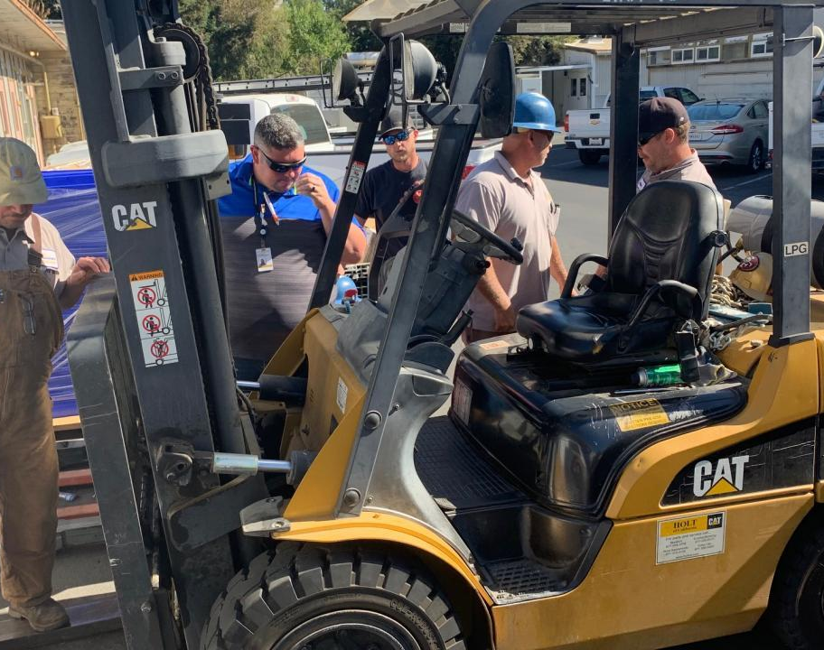
Refresher training for operators
Operators must receive refresher training when:
Observed operating the vehicle unsafely
Involved in an accident or near – miss
Received a poor evaluation
Assigned to different type of truck
Workplace condition changes that could affect safe operation

Slide 30
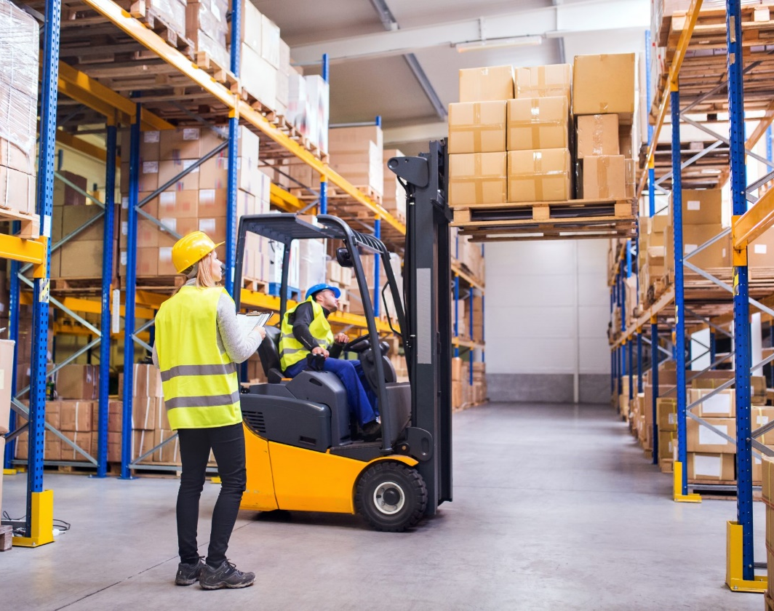
Qualifications of forklift trainers
Trainers must have the knowledge, training, and experience necessary to train and evaluate forklift operators. Their experience should include the practical skills and the judgment necessary to operate forklifts safely.

Slide 31
Training topics for operators
Operators must receive initial training in the following topics – unless they do not apply to the operator’s workplace.
Forklift-related topics
Operating instructions, warnings, and precautions for the types of truck the operator will be authorized to operate
Differences between a forklift and an automobile
Forklift controls and instrumentation, including where they are located, what they do, and how they work
Engine or motor operation
Steering and maneuvering
Visibility, including restrictions due to loading
Continued on next slide.

Slide 32
Training topics for operators (continued)
Operators must receive initial training in the following topics – unless they do not apply to the operator’s workplace.
Forklift-related topics
Fork and attachment adaptation, operation, and use limitations
Vehicle capacity
Vehicle stability
Any vehicle inspection and maintenance that the operator will be required to perform
Refueling or charging and recharging of batteries
Operating limitations
Any other operating instructions, warnings, or precautions listed in the operator’s manual for the type of vehicle that the employee is being trained to operate
Continued on next slide.

Slide 33
Training topics for operators (continued)
Workplace-related topics
Surface conditions where the vehicle will be operated
Composition of loads to be carried and load stability
Load manipulation, stacking, and unstacking
Pedestrian traffic in areas where the vehicle will be operated
Narrow aisles and other restricted places where the vehicle will be operated
Hazardous (classified) locations where the vehicle will be operated
Ramps and other sloped surfaces that could affect the vehicle’s stability
Closed environments and other areas where insufficient ventilation or poor vehicle maintenance could cause a buildup of carbon monoxide or diesel exhaust
Other unique or potentially hazardous environmental conditions in the workplace that could affect safe operation

Slide 34
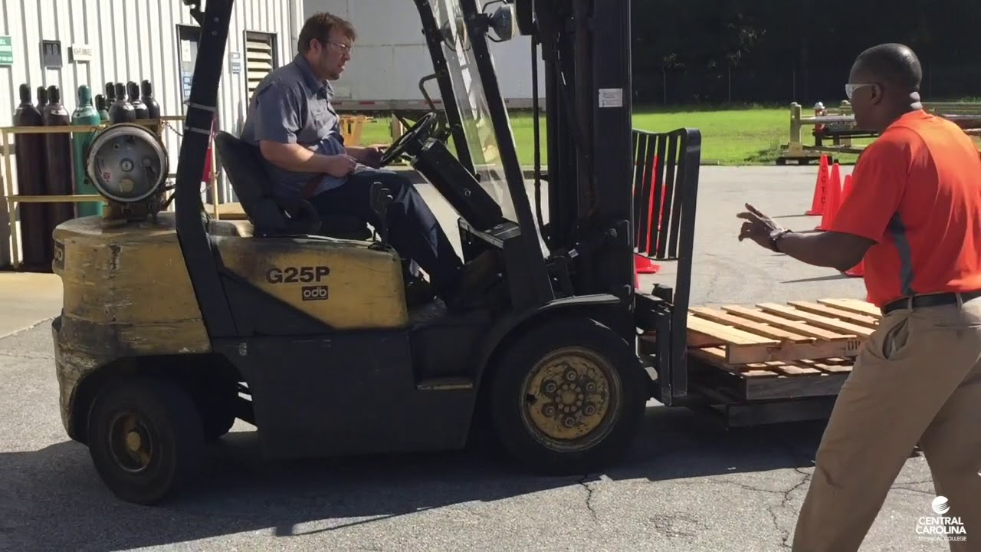
Previously received training
If an operator has previously received training in a topic specified under the training program content criteria, and the training is appropriate for the forklift and work environment, then additional training in that topic is not necessary. However, all operators must still be evaluated and found competent to operate the forklift safely.

Slide 35
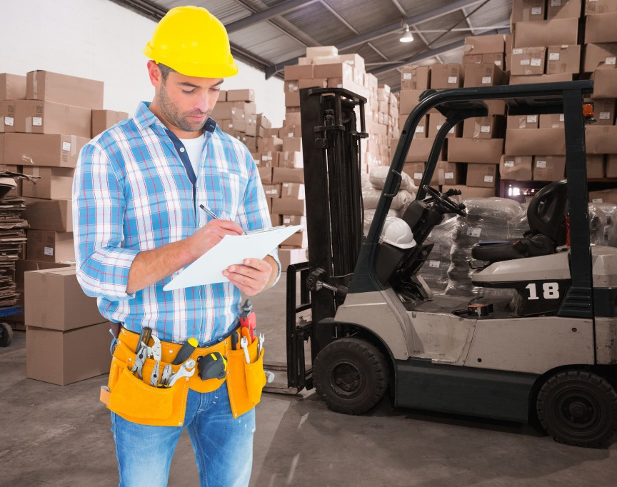
Let’s review!
Answer the 10 quiz questions to test what you have learned.

Slide 36
Additional educational resources
Oregon OSHA
YouTube Channel
Website A-Z Topic Index
Online Training Courses
PESO – English to Español
Other Safety and Health Training Resources

Slide 37
Need more information? Call your nearest Oregon OSHA Office
Salem Central Office
350 Winter St. NE
Salem, OR 97301-3882
Phone: 503-378-3272
Toll-Free: 800-922-2689
Fax: 503-947-7461
en Español: 800-843-8086
Website: osha.oregon.gov
Eugene
1500 Valley River Drive, Suite 150
Eugene, OR 97401-4643
541-686-7562
Consultation: 541-686-7913
Medford
1840 Barnett Road, Suite D
Medford, OR 97504-8293
541-776-6030
Consultation: 541-776-6016
Pendleton
750 SE Emigrant Ave., Ste. 131
Pendleton, OR 97801
541-276-9175
Consultation: 541-276-2353
Portland
Durham Plaza
16760 SW Upper Boones
Ferry Road, Suite 200
Tigard, OR 97224-7696
503-229-5910
Consultation: 503-229-6193
Salem
1340 Tandem Ave. NE, Suite 160
Salem, OR 97301-8080
503-378-3274
Consultation: 503-373-7819
Bend
Red Oaks Square
1230 NE Third St., Suite A-115
Bend, OR 97701-4374
541-388-6066
Consultation: 541-388-6068

Slide 38
Thank you!

