Slide 1
Fall Protection
An introduction to basic fall protection principles and codes related to fall protection used in construction and general industries.

Slide 2
Oregon OSHA Public Education Mission
Consultative Services
Enforcement
Public Education and Conferences
Standards and Technical Resources
We provide knowledge and tools to advance self-sufficiency in workplace safety and health.

Slide 3

Contact Us
Field Offices:
Portland 503-229-5910
Salem 503-378-3274
Eugene 541-686-7562
Medford 541-776-6030
Bend 541-388-6066
Pendleton 541-276-2353
Salem Central:
Toll Free English: 800-922-2689
Toll Free Spanish: 800-843-8086
Website: osha.oregon.gov

Slide 4
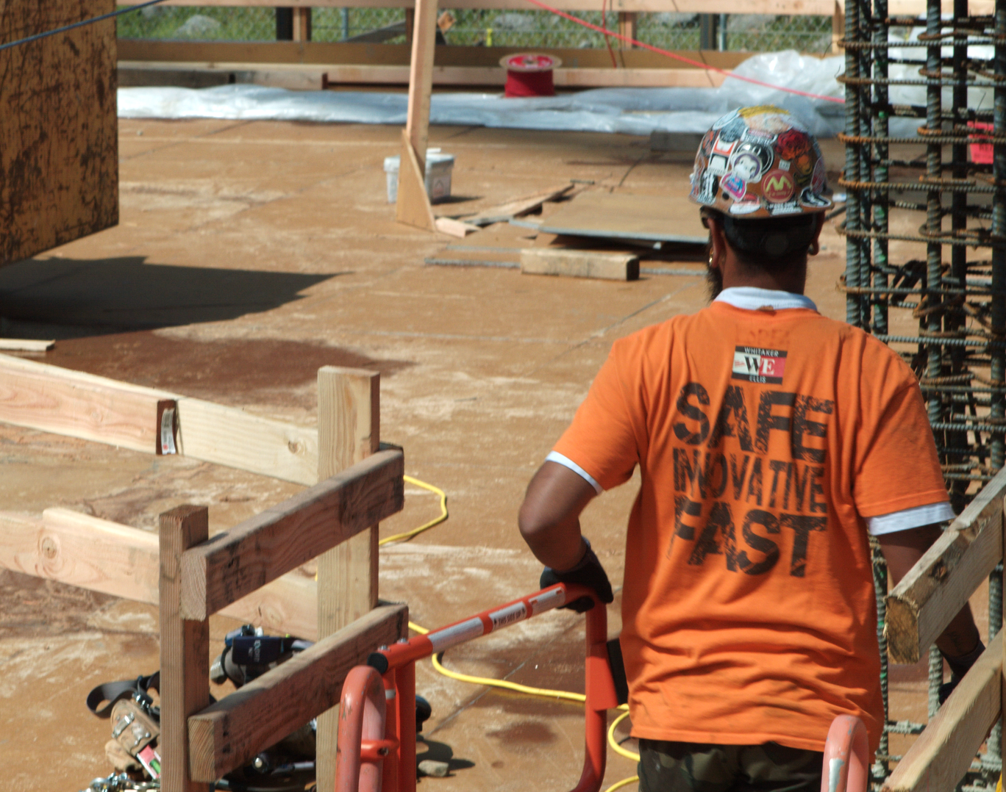
Workshop Objective
Introduce a proactive approach to identify fall hazards
Protection methods through a planning process
Oregon OSHA’s fall protection requirements for both general industry and construction

Slide 5

(2) Primary Standards
Division 2/Subdivision D [Walking-Working Surfaces]
Division 2/Subdivision I [Personal Protective Equipment]

Slide 6
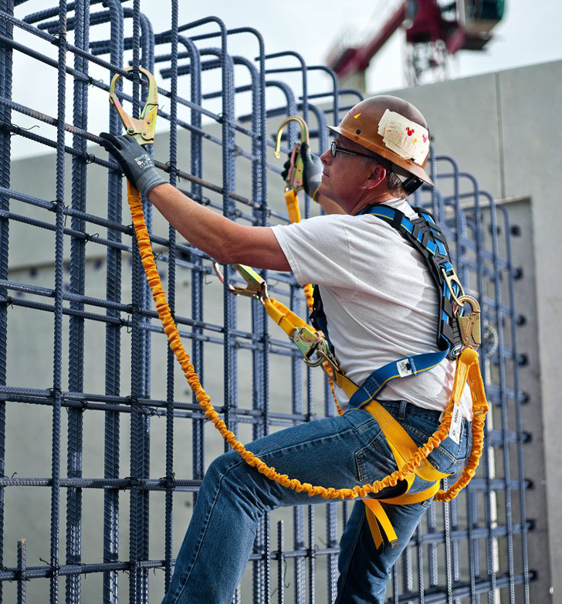
Introduction to Fall Protection Videos
The Russ Youngstrom Story
Why are Falls Dangerous
What is Fall Protection
History of Fall Protection
Aftermath of a Fall
Who Needs Fall Protection
Does it Work?
Oregon OSHA Standards

Slide 7
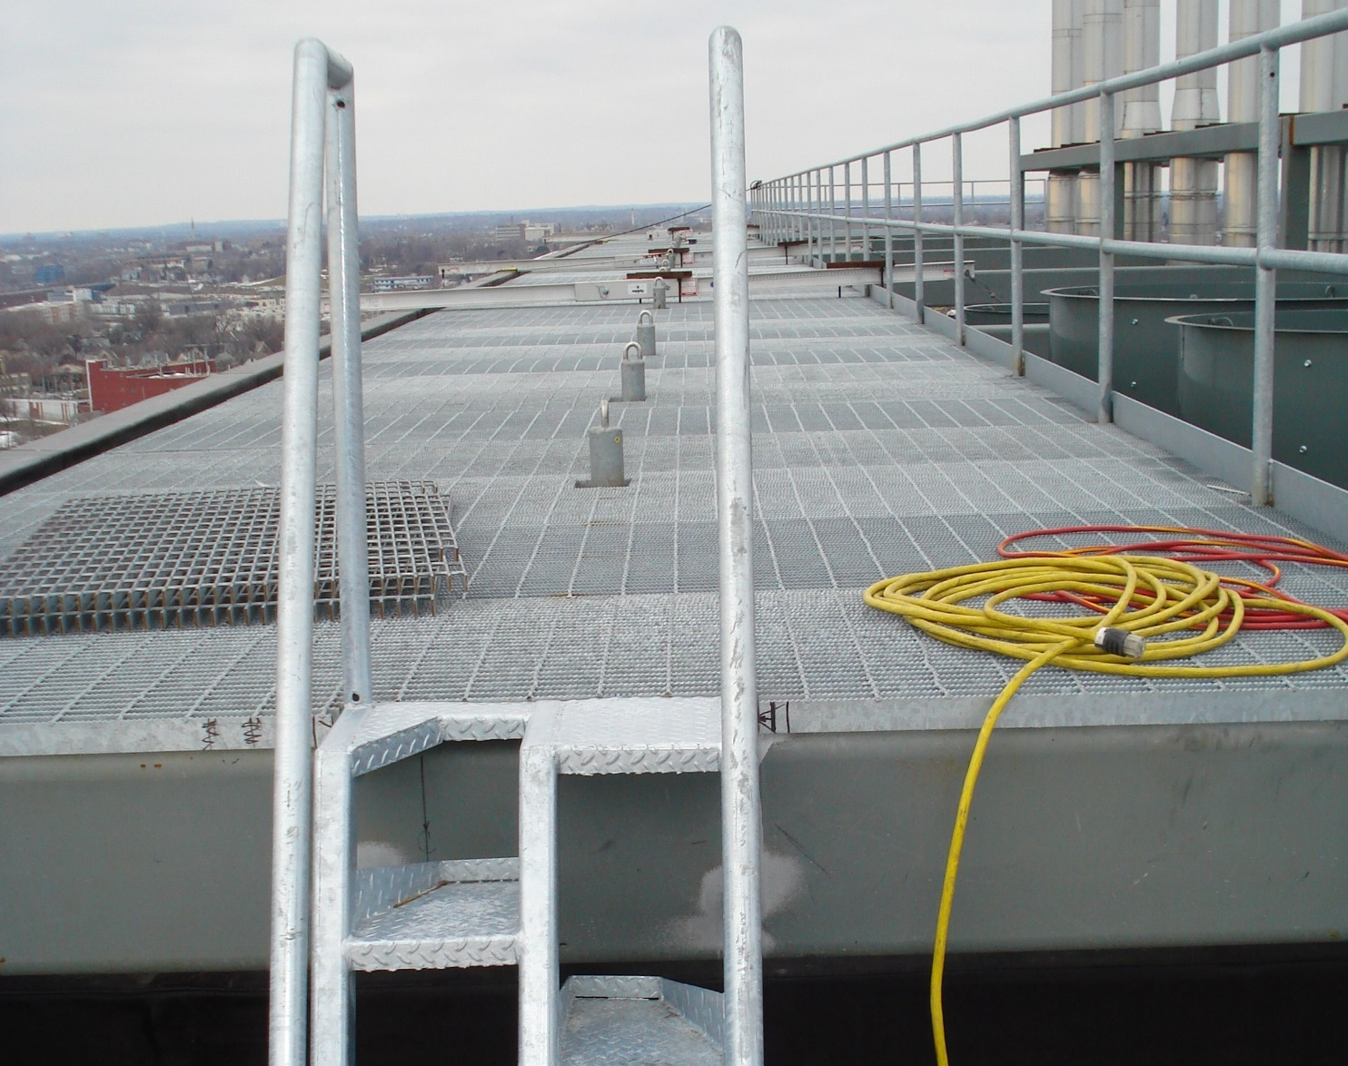
Fall Hazards
Fall hazards exist when an employee can fall over the side of an unprotected walking-working surface, through a hole in a horizontal surface such as a floor, or through an opening in a vertical surface such as a wall.

Slide 8

Definitions
Walking-working surface
Lower level
Unprotected sides and edges
Hole
Opening

Slide 9

Holes
All holes must be guarded or covered, regardless of fall distance.
Skylights (Roofing) Video
Holes and Openings (Construction) ‘coming soon’

Slide 10

Openings
All openings must be protected to prevent an employee from falling through.

Slide 11
WWS Video HERE Stairways Coming Soon

Slide 12

Stairways (stairs)
Means risers and treads that connect one level with another, and includes any landings and platforms in between those levels.
Stairways include standard, spiral, alternating tread-type, and ship stairs.

Slide 13
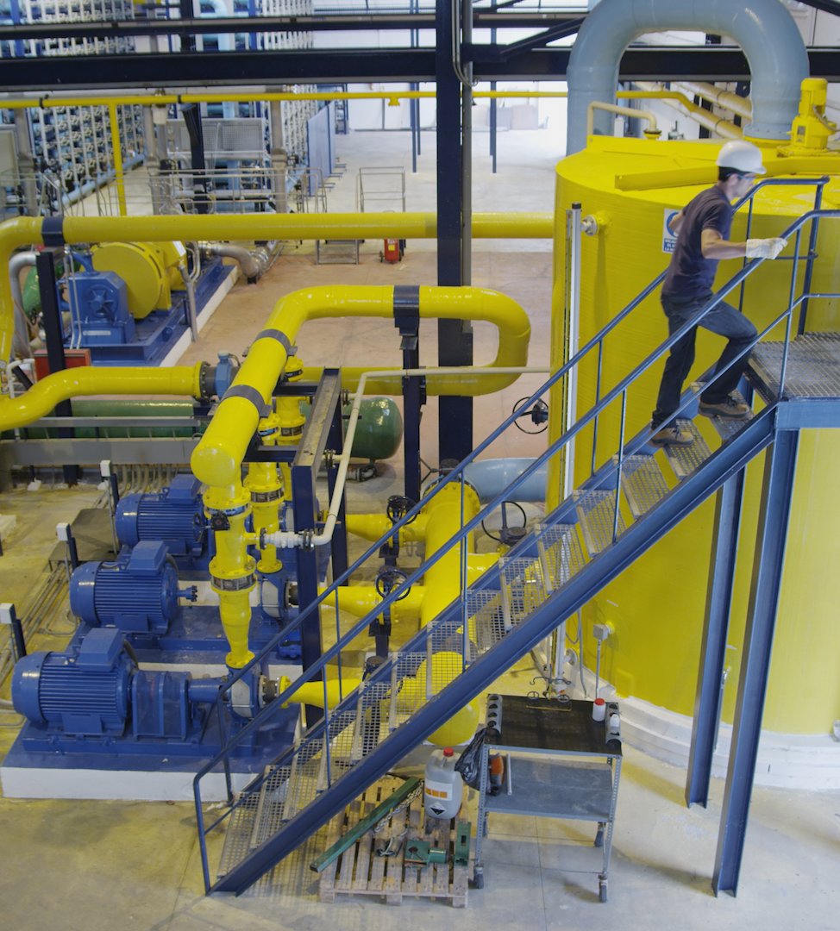
4 feet or more above a lower level
Stairway landings that are 4 feet or more above a lower level must be protected by a guardrail or stair rail system. 1910.28(b)(11)(i).

Slide 14
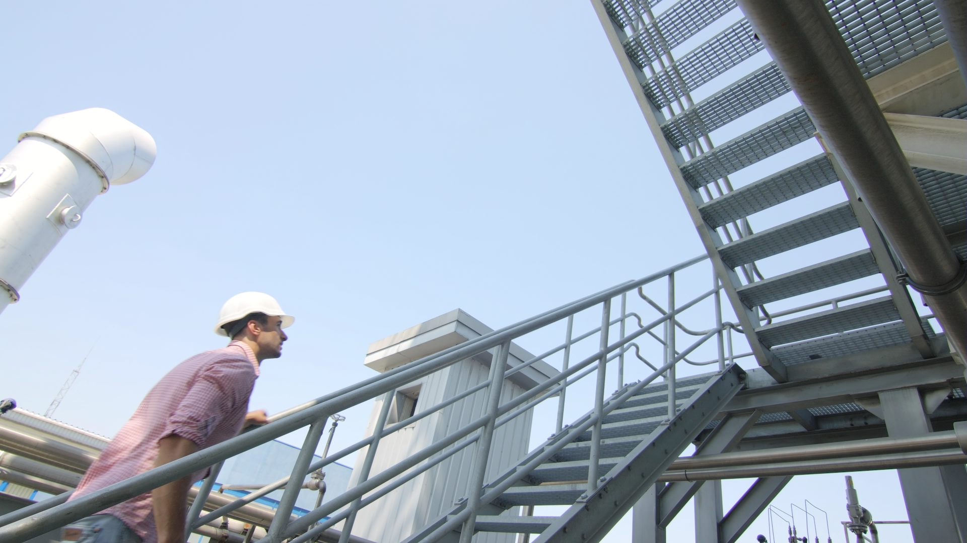
Stair railings or Handrails

Slide 15
Other Fall Protection/Falling Object Protection general industry standards:
Oregon OSHA Div 2/Sub F
Oregon OSHA Div 2/Sub N
Oregon OSHA Div 2/Sub R
Oregon OSHA Div 2/Sub RR

Slide 16
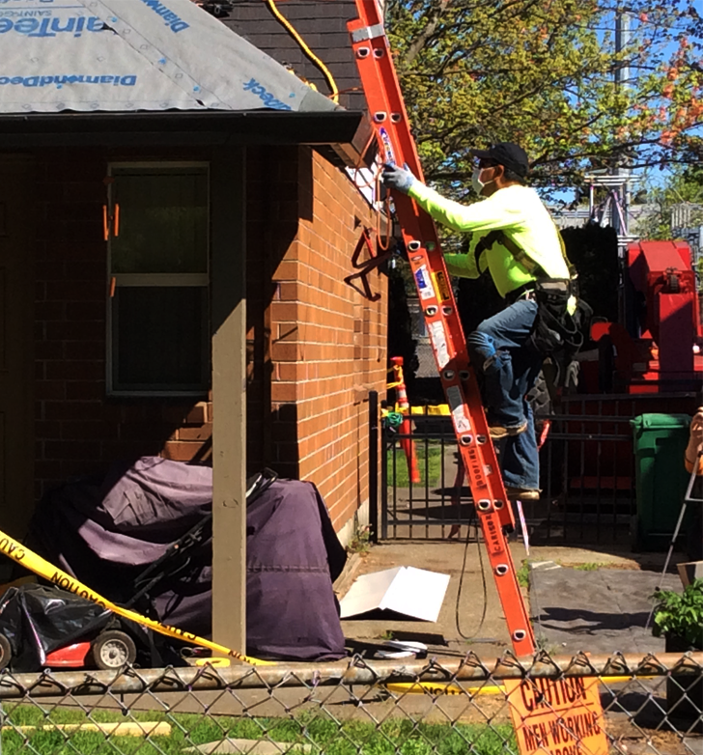
Division 3/Subdivision M
Oregon’s primary standard for fall protection in the construction industry.

Slide 17



When to provide Fall Protection
When employees are exposed to a hazard of falling 6 feet or more:
to a lower level
through holes (including skylights)
through wall openings
into excavations

Slide 18
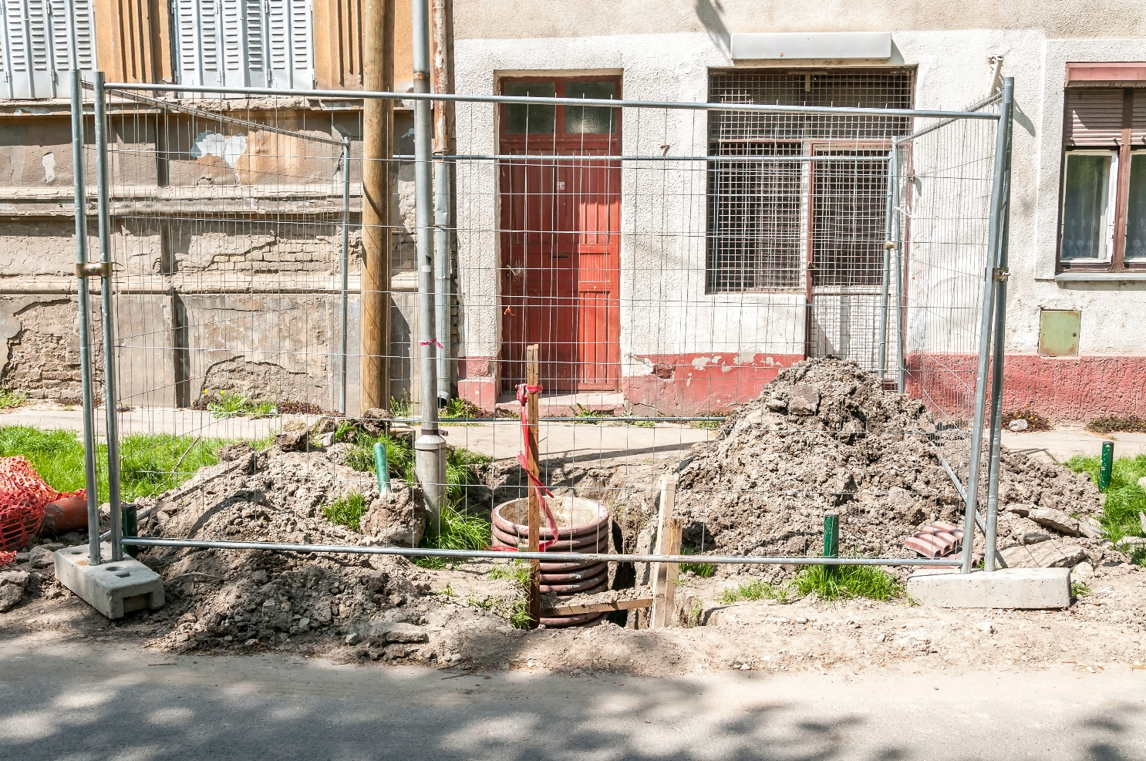
Excavations
Each employee at the edge of a well, pit, shaft, or excavation 6 feet or more in depth, must be protected from falling.

Slide 19

Dangerous Equipment
Every employee must be protected from falls into or onto dangerous equipment, regardless of height.
Uncapped rebar
Debris
Machinery
Tanks

Slide 20

Covered somewhere else
Scaffolds
(Div 3/Sub L)
Cranes and derricks
(Div 3/Sub CC)
Steel erection
(Div 3/Sub R)
Tunneling operations
(Div 3/Sub S)
Construction of electrical transmission and distribution lines and equipment
(Div 2/RR)
Stairways and ladders
(Div 3/ Sub X)

Slide 21
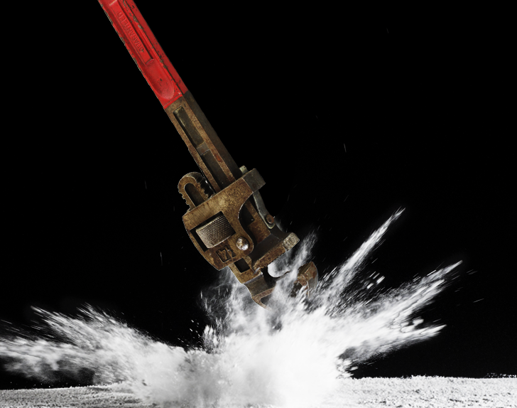
Falling Objects
Hard hat
Toeboards
Canopies
Barricades
Falling Objects Video

Slide 22
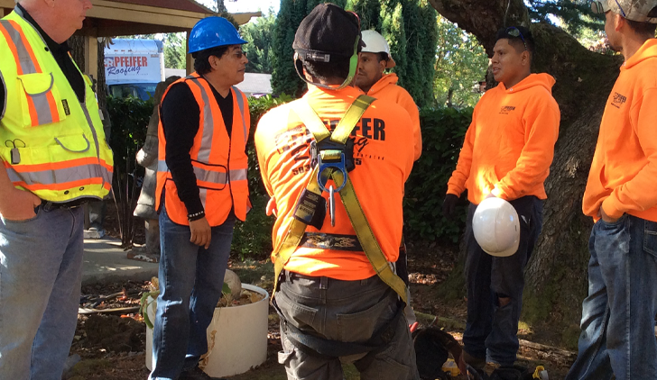
Planning Elements
A simple planning process can include the following elements:
Evaluate the work site
Identify fall hazards
Identify who is exposed to fall hazards
Evaluate the process to be done and the needs to complete the task
Identify what method of fall protection will be used for each hazard identified
Educate and train the workers
Planning (Roofing) Video

Slide 23

An 8 step approach to fall protection
Determine walking/working surfaces are structurally safe
Conduct a fall hazard assessment
Eliminate the need for fall protection, if possible
Select the appropriate type of fall protection system
Develop rescue/retrieval procedures
Develop an equipment inspection, maintenance and storage program
Provide fall protection training
Monitor the fall protection program

Slide 24

Step 1
Determine walking/working surfaces are structurally safe

Slide 25



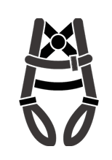







Step 2
Conduct a fall hazard assessment
Risk Assessment Video

Slide 26
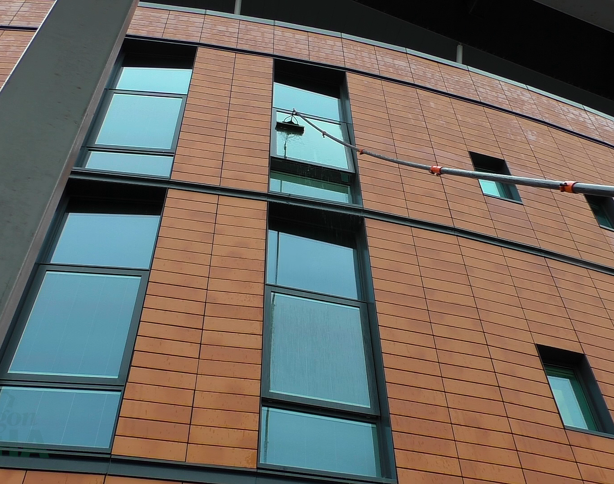
Step 3
Eliminate the need for fall protection, if possible
Elimination Video

Slide 27
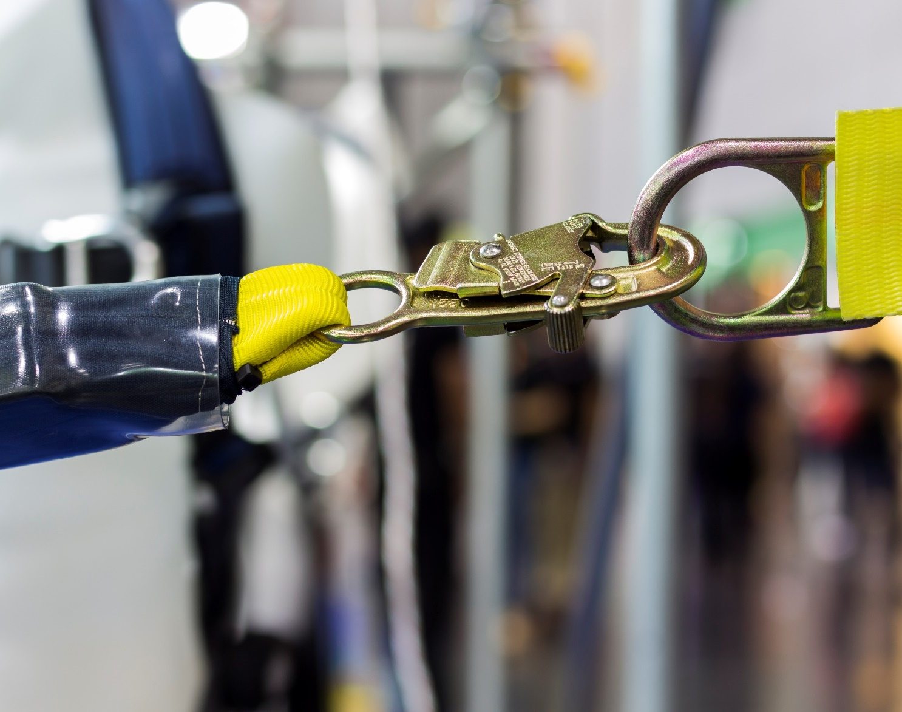
Step 4
Select the appropriate type of fall protection system
Choosing Fall Protection (Roofing) Video

Slide 28

Fall Protection Options Videos
Overview of Options
Prevent
ABC’s of Fall Protection
Control
Warn

Slide 29
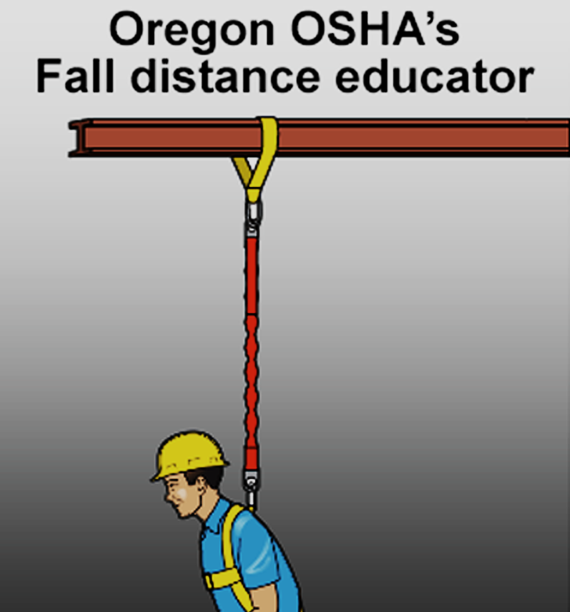
Calculating Fall Distance
Free Fall – the act of falling before a personal fall arrest system begins to apply force to arrest the fall.
Total Fall Distance – the free fall distance plus any distance the person falls beyond that.
Fall Distance Educator
Calculating Fall Distance Video
Swing Fall (Roofing)

Slide 30
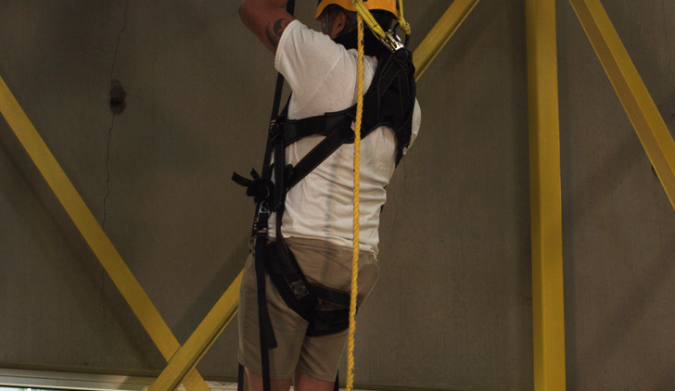
Step 5
Develop rescue/retrieval procedures
When using a personal fall arrest system, employers must provide for prompt rescue in case of a fall or assure that employees are able to rescue themselves.
Rescue Demonstrations Video
Rescue (Roofing) Video
Trauma Straps Video

Slide 31
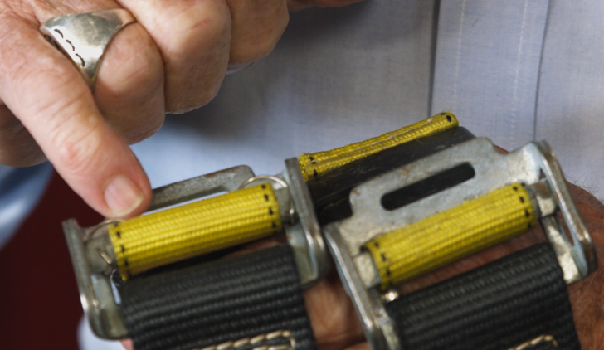
Step 6
Develop an equipment inspection, maintenance and storage program
Inspection/Maintenance (Fundamentals) Video
Inspection Example (Fundamentals) Video
Inspection Training Example (Roofing) Video

Slide 32
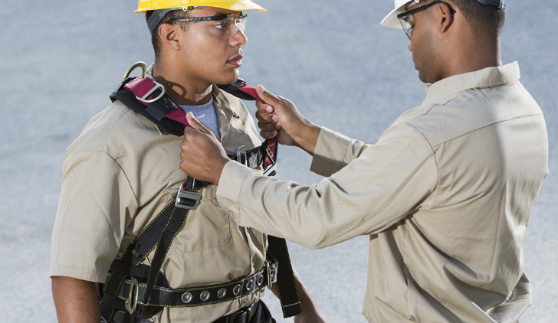
Step 7
Provide fall protection training

Slide 33
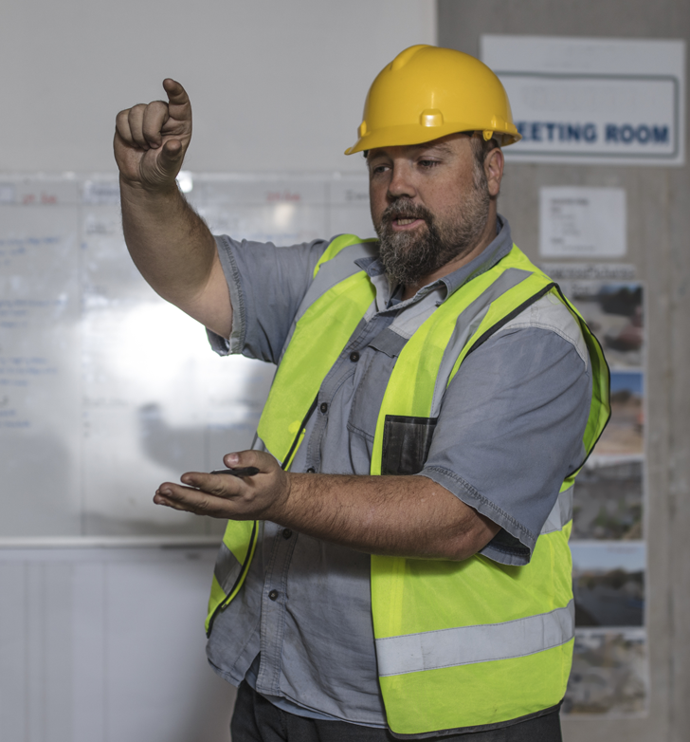
Fall Protection Training Videos
Purpose of Training
Training Topics
Train Your Team
Training for Roofers
Inspection Training Example (Roofing)

Slide 34
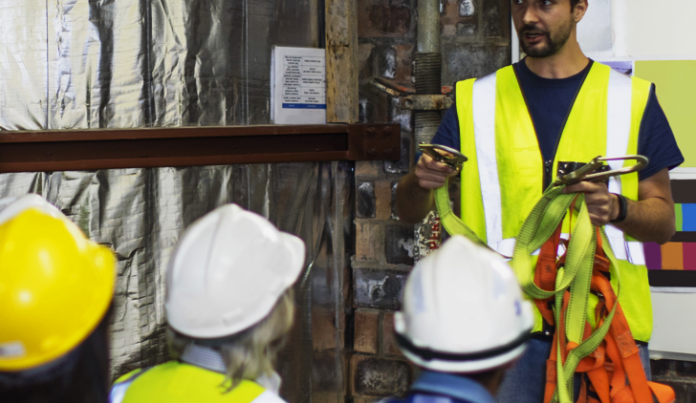
Provide training when:
Employees are assigned to work where fall hazards exist
Responsibilities change or new methods are used
There is a new fall hazard
The fall protection program is inadequate
Additional training is necessary
Employees have not acquired or retained adequate understanding

Slide 35
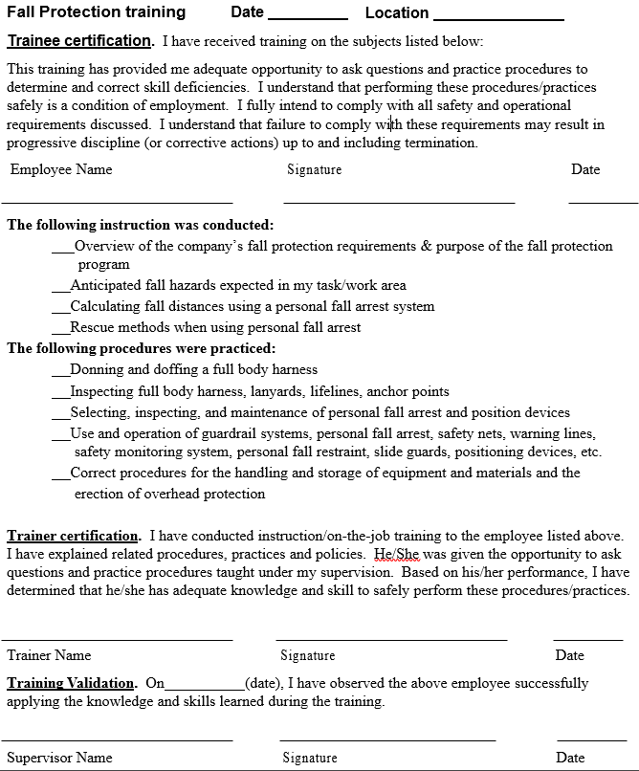
SAMPLE Training
Certification

Slide 36
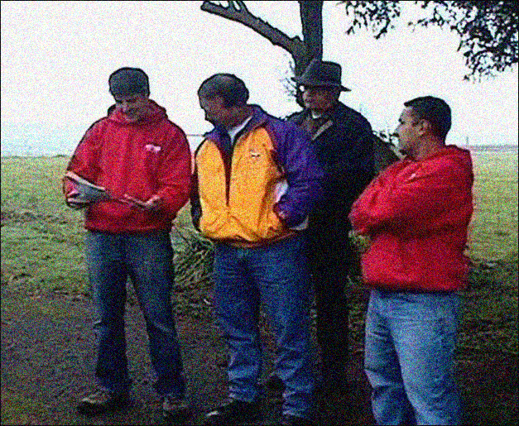
Step 8
Monitor the Fall Protection Program

Slide 37
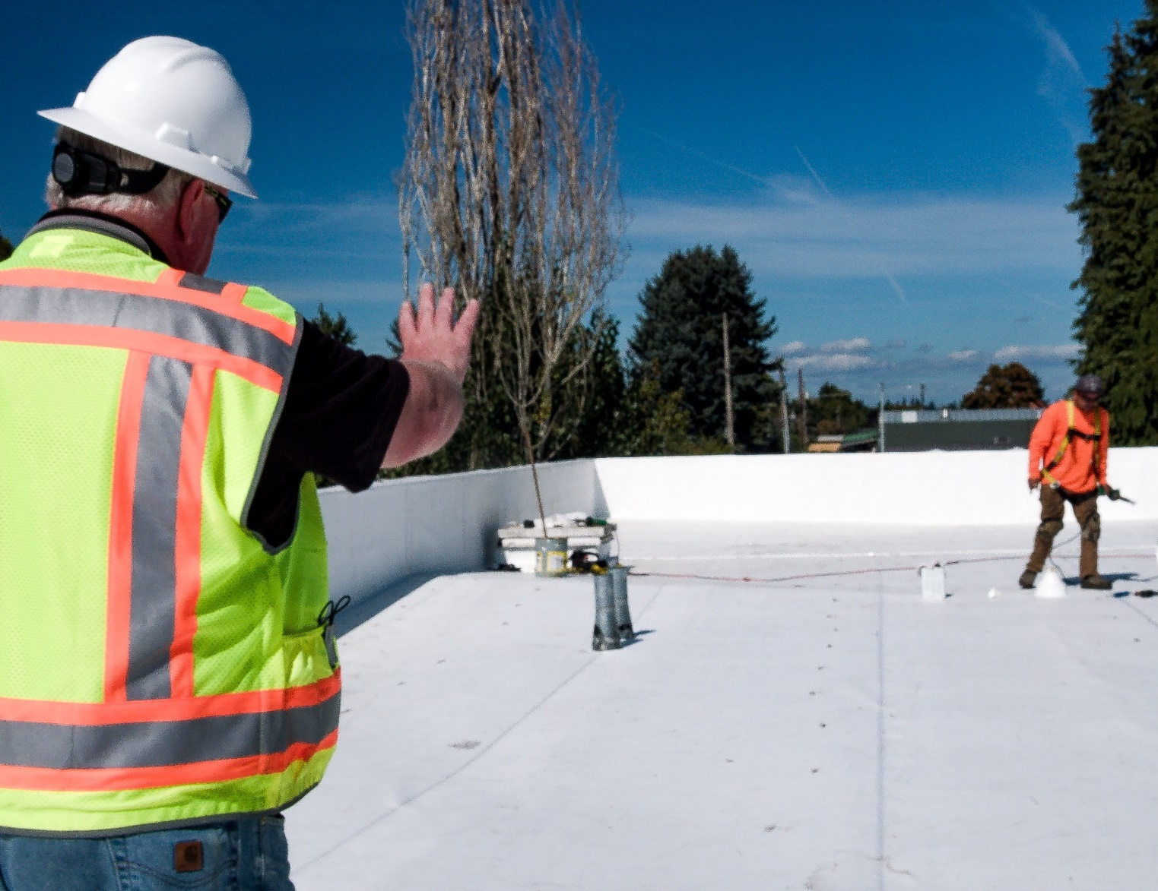
Step 4
Select the appropriate type of fall protection system
Safety Monitoring System
Warning Line System for Construction work
Designated area (general industry) low-slope roof

Slide 38
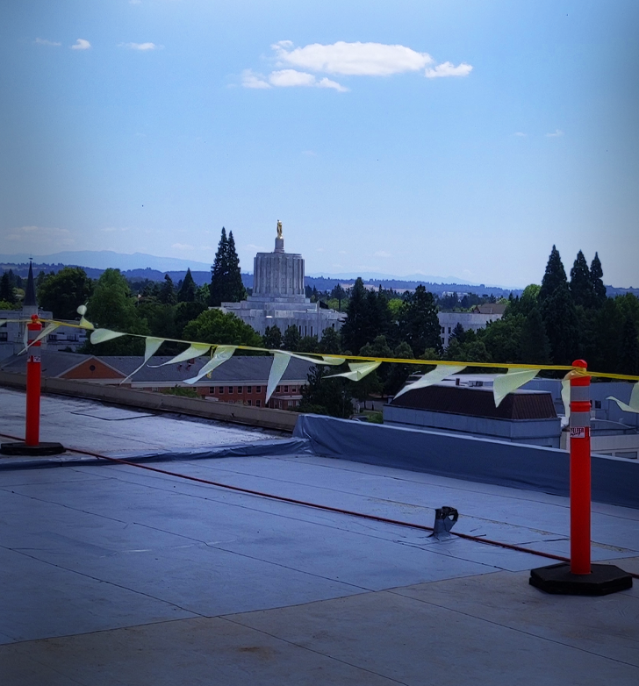
Safety Monitor & Warning lines videos
Warning Lines (Roofing)
Safety Monitor (Roofing)
Parapet

Slide 39
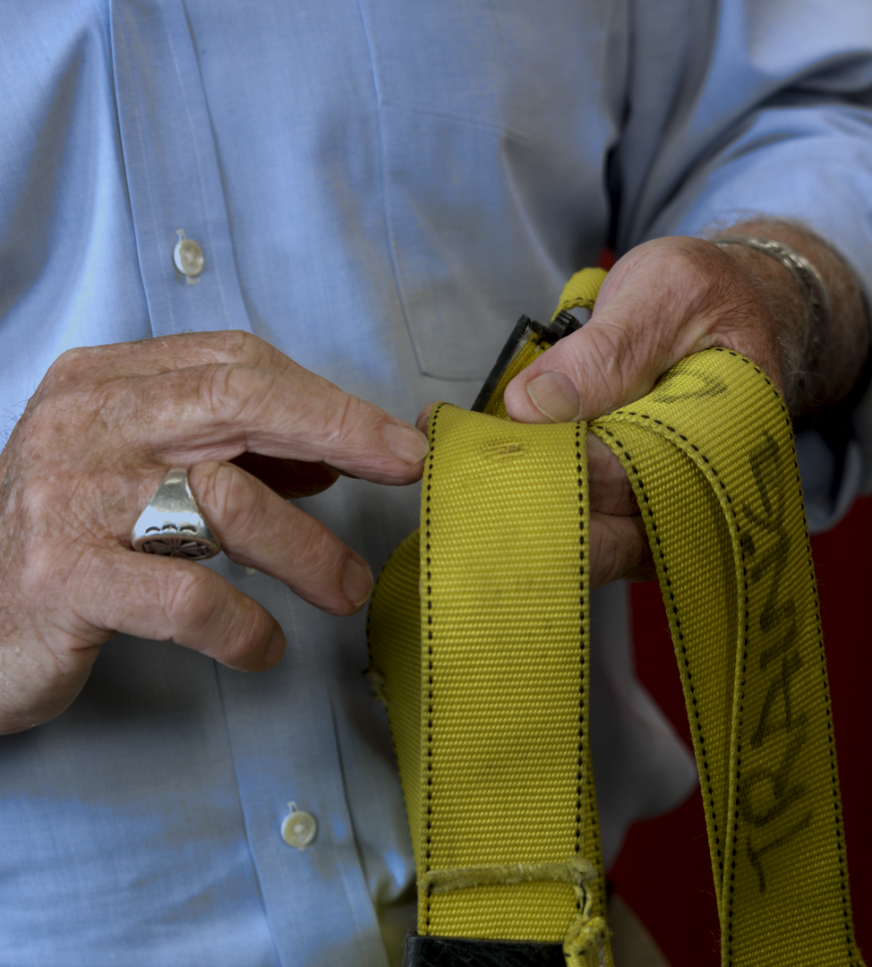
Fall Protection Equipment Inspection and Maintenance
Body Belt/Harness Inspection
Belts and rings
D-Rings
Attachment of buckles
Frayed, broken or contaminated strands
Tongue or billet
Tongue buckle
Friction buckle

Slide 40
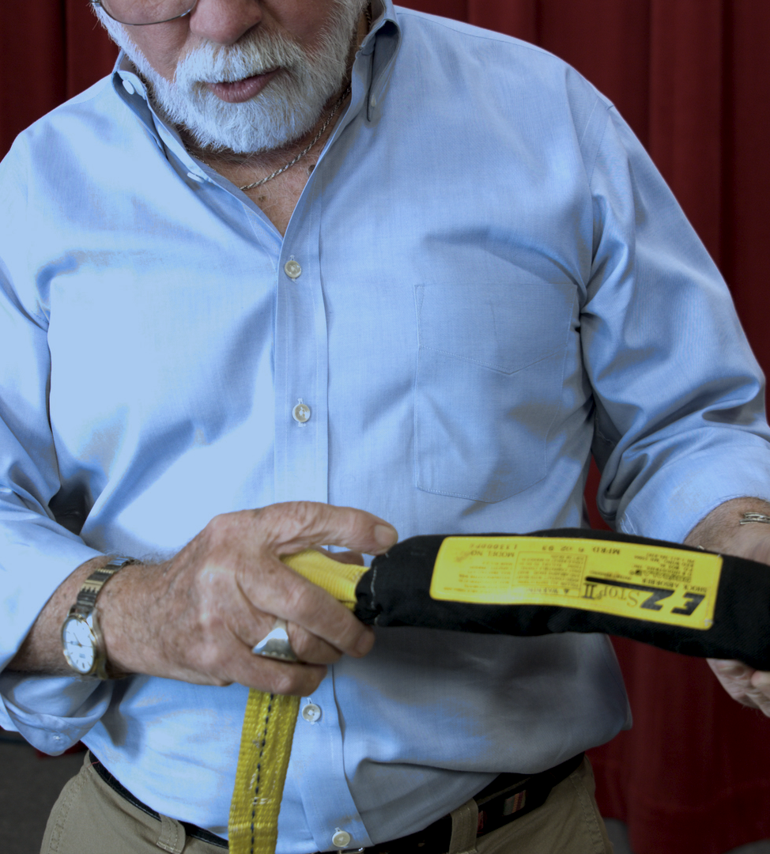
Fall Protection Equipment Inspection and Maintenance
Lanyard Inspection
Snaps
Thimbles
Web lanyard
Rope lanyard

Slide 41
Safety and Health Information Bulletin
Compatibility of Personal Fall Protection System Components
Suspension Trauma/Orthostatic Intolerance
  Trauma Straps Video

Slide 42

Preventing Slips & Trips
Flooring
Footwear
Other Preventative measures

Slide 43
Sources
http://www.hse.gov.uk/slips/index.htm (Health & Safety Executive)
http://www.cdc.gov/ (Centers for Disease Control and Prevention)
http://www.ccohs.ca/oshanswers/safety_haz/falls.html (Canadian Centre for Occupational Health & Safety)

Slide 44
Contact Us
Field Offices:
Portland 503-229-5910
Salem 503-378-3274
Eugene 541-686-7562
Medford 541-776-6030
Bend 541-388-6066
Pendleton 541-276-2353
Salem Central:
Toll Free number in English:
800-922-2689
Toll Free number in Spanish:
800-843-8086
Web site: www.osha.oregon.gov

Slide 45
Additional Educational Resources
Oregon OSHA’s YouTube Channel
Fall Protection A-Z Topic Index
PESO – English to Español

