Slide 1
Excavation Safety

Slide 2
Oregon OSHA Public Education Mission:
Consultative Services
Enforcement
Public Education and Conferences
Standards and Technical Resources
We provide knowledge and tools to advance self-sufficiency in workplace safety and health.

Slide 3
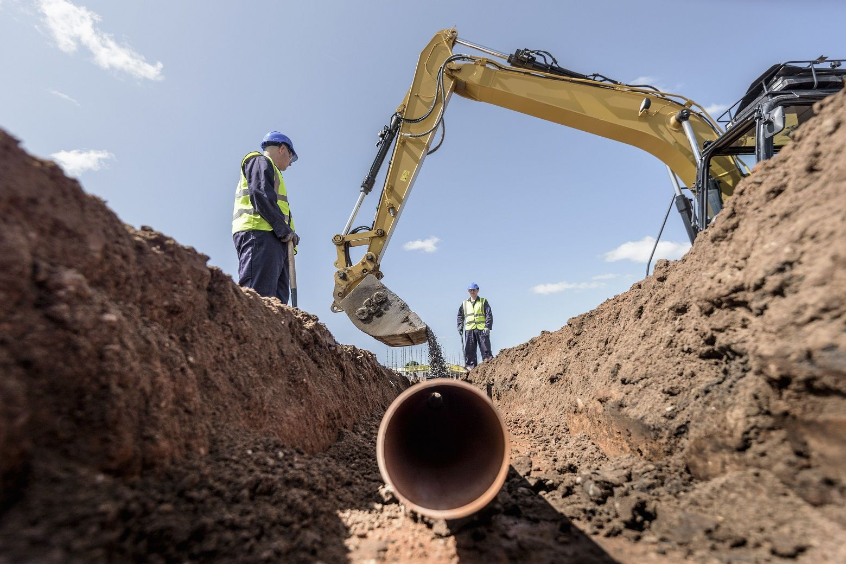
Contact us
Field Offices:
Portland 503-229-5910
Salem 503-378-3274
Eugene 541-686-7562
Medford 541-776-6030
Bend 541-388-6066
Pendleton 541-276-2353
Salem Central:
Toll Free English 800-922-2689
Toll Free Spanish 800-843-8086
Website: osha.oregon.gov

Slide 4
Example videos
Oregon OSHA - Cave In
Federal OSHA – 5 Things You Should Know to Stay Safe in a Trench
Federal OSHA – Excavations in Construction/Trenching
Federal OSHA – Excavations in Construction/Soil Classification
WorkPlace BC - YouTube Playlist
Marko Karr - Excavation & Trenching Safety

Slide 5
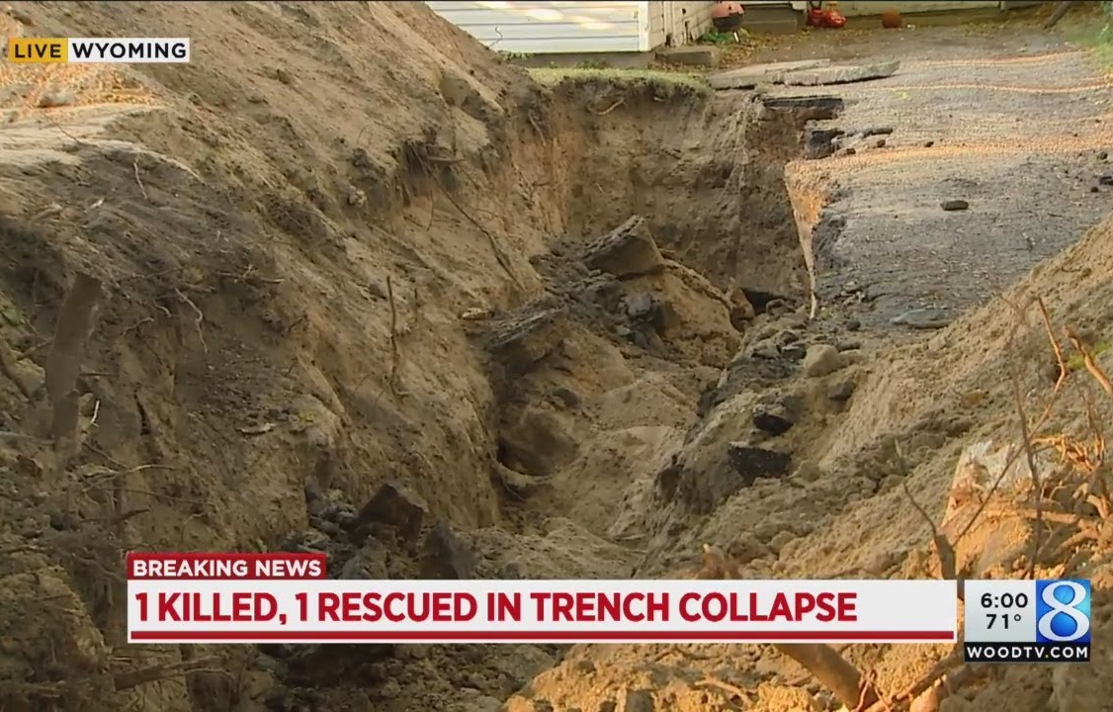
112%
The fatality rate for excavation work is 112% higher than the rate for general construction.

Slide 6
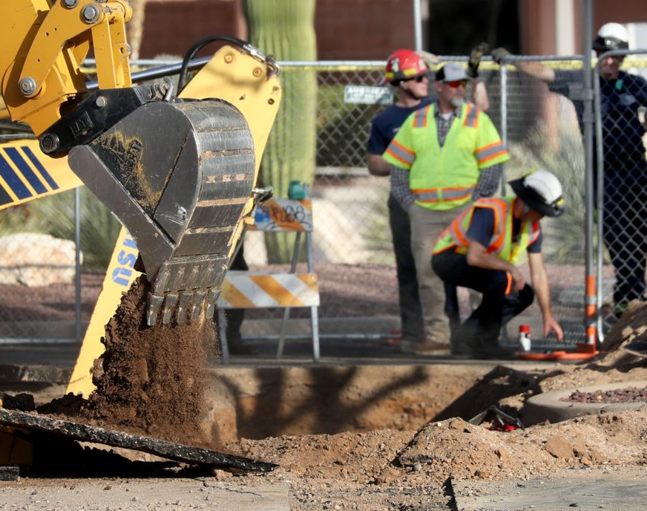
Annual averages
Cave-ins:
1,000 injuries/yr
140 permanent disability
54 deaths (76%)
Struck by excavator and components:
50 deaths

Slide 7
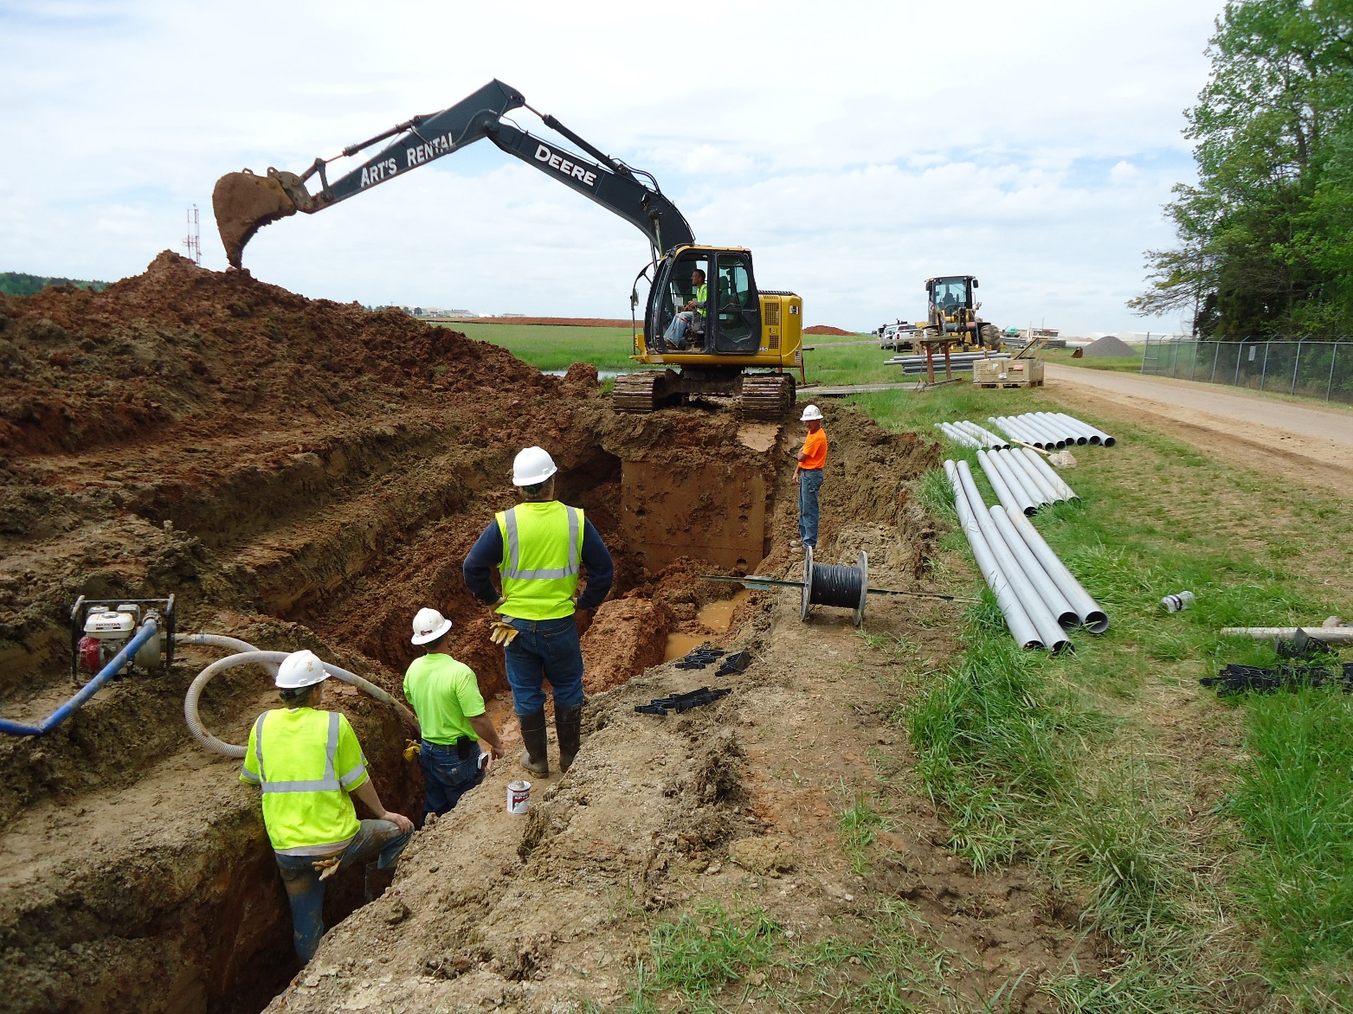
Objectives
Introduce you to OR-OSHA Div 3/Sub P Excavations
General requirements
Soil classification
Protective systems

Slide 8

Competent person
Capable of identifying hazards
Has authority to take corrective measures

Slide 9

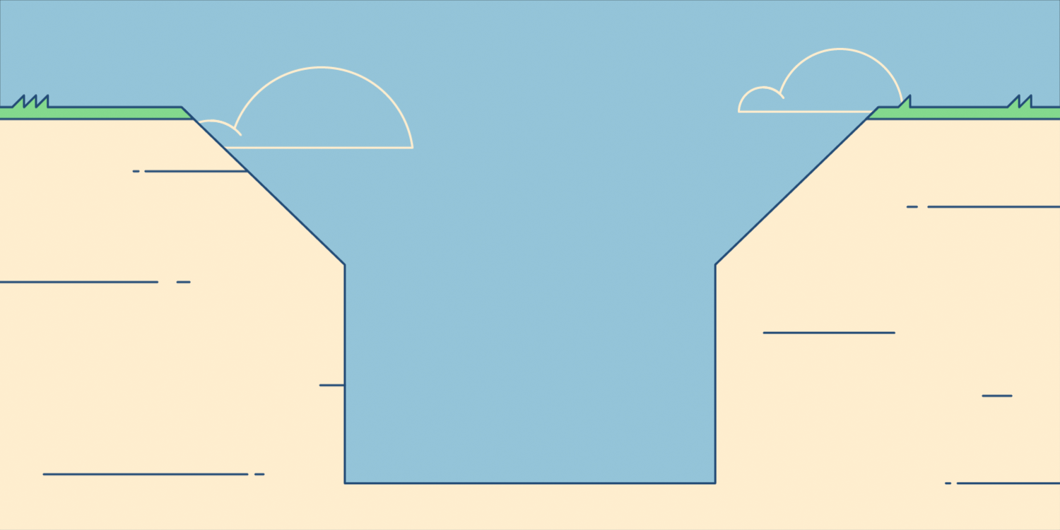
Protective system
Support systems
Sloping and benching
Shield systems

Slide 10
Trenching system videos
Trench Box – MGF
Trench Box – Vp Groundforce

Slide 11
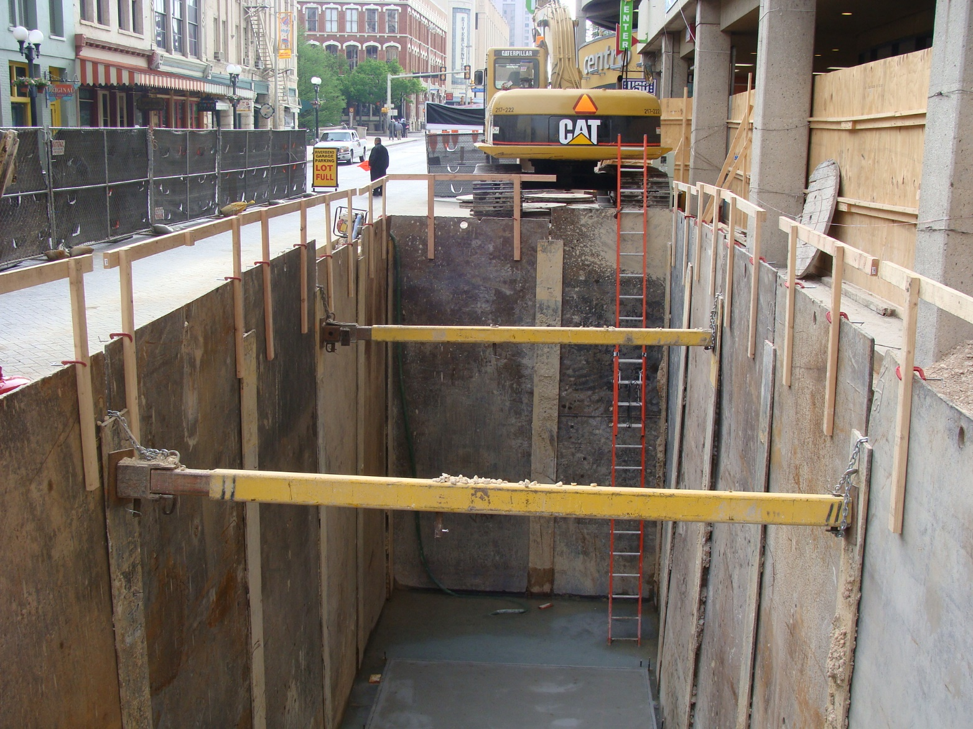
Support system
A structure that provides support to an:
Adjacent structure
Underground installation
Sides of an excavation
  Underpinning
  Bracing
  Shoring

Slide 12
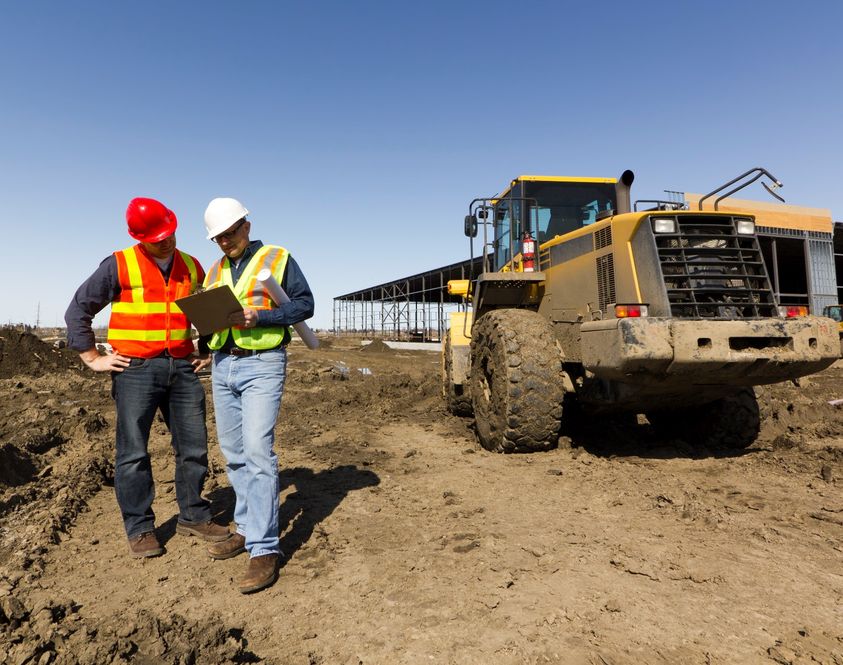
Tabulated data
Tables and charts approved by a registered professional engineer and used to design and construct a protective system

Slide 13
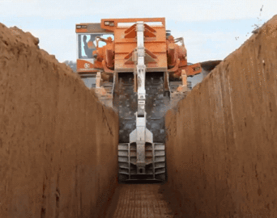
Trench
A narrow excavation
  In relation to it’s length
Depth is greater than the width
  width is not greater than 15 feet (measured at the bottom)

Slide 14

Preplanning against cave-ins
The most effective method to prevent cave-ins, or other serious mishaps, is to plan.

Slide 15

Preplanning questions
What types of soil will be found?
What are the soil moisture conditions?
Has the soil previously been disturbed?

Slide 16
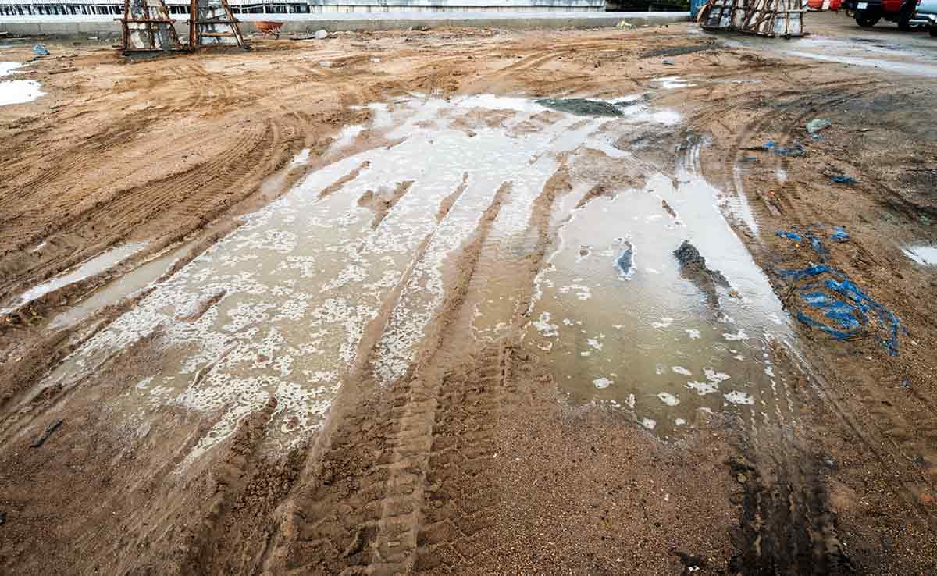
Preplanning questions
4. How large will the excavation be?
5. How long will the excavation be open?
6. What kinds of weather can we expect?

Slide 17
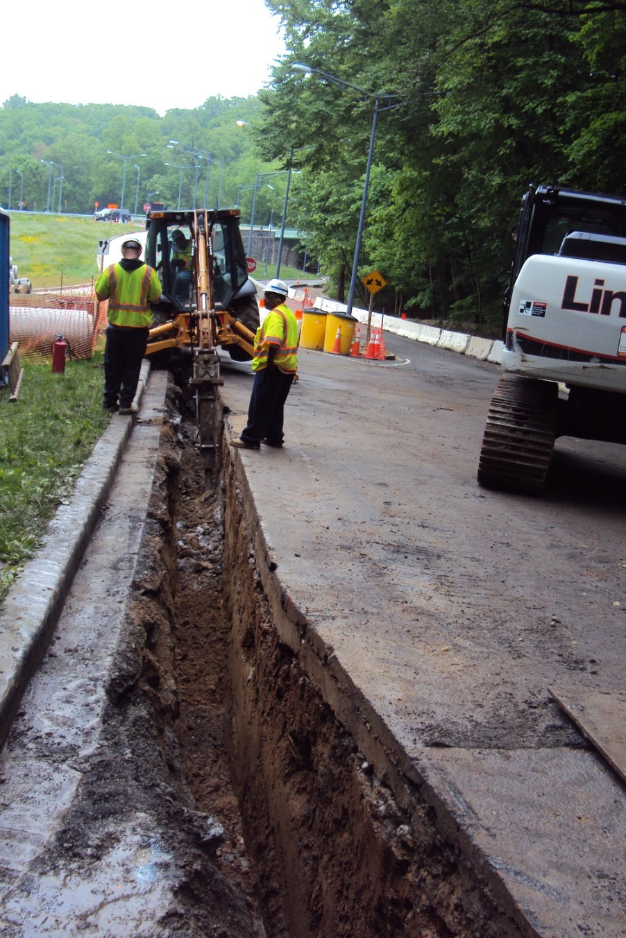
Preplanning questions
7. What equipment will be on the job?
8. Will the excavation be near structures?
9. Is traffic control needed?

Slide 18
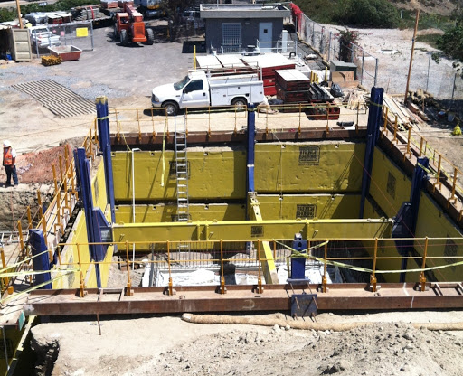
Preplanning questions
10. What sources of vibration are nearby?
11. Will water be a problem?
12. What kind of shoring?
- How much? –
13. Underground Utilities?

Slide 19
Utility notification center
Determine the estimated locations
Contact the utility or owner
Proceed cautiously
Support, protect, or safely remove the installation in open excavations

Slide 20
Utility notification center
Oregon Utility Notification Center
www.callbeforeyoudig.org
(503) 246-6699 PDX
(800) 332-2344

Slide 21
RED Electric power lines, cables or conduits, and lighting cables.
YELLOW Gas, oil, steam, petroleum or other hazardous liquid or gaseous materials.
ORANGE Communications, cable TV, alarm or signal lines, cables, or conduits.
BLUE Water, irrigation, and slurry lines.
GREEN Sewers, storm sewer facilities, or other drain lines.
WHITE Proposed excavation.
PINK Temporary survey markings.
PURPLE Reclaimed water, irrigation and slurry lines.

Slide 22
Surface encumbrances
Remove or support all surface encumbrances which can create a hazard.
What are surface encumbrances?

Slide 23
Surface encumbrance?

Slide 24
Access and egress
(1) Structural ramps must be designed by a Competent Person.
(2) A safe means of entering and leaving excavations must be provided for workers.

Slide 25
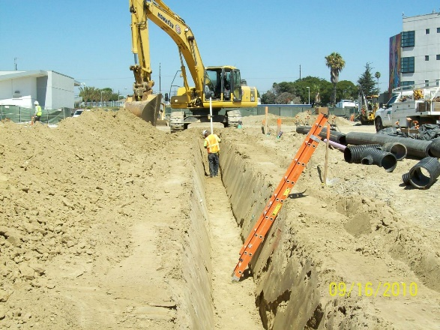
Access and egress
(2) A stairway, ladder, or ramp must be located in trenches which are at least 4 ft. deep and spaced so as to require no more than 25 ft. of lateral travel.

Slide 26
Nice!

Slide 27

Exposure to vehicular traffic
Employees exposed to vehicles must wear warning vests or other suitable garments marked with or made of reflectorized or high visibility material.

Slide 28
Exposure to falling loads
Employees are not allowed under loads handled by lifting or digging equipment.
Loose soil and rock
Equipment
Materials

Slide 29

Warning mobile equipment
When adjacent to an open excavation and the operator does not have clear view of the edge, a warning system must be installed.
Barricades
Hand signals
Earth berm

Slide 30

Hazardous atmospheres
Atmospheric testing is required when the following exist or could reasonably be expected to exist:
Oxygen deficiency (<19.5%)
Flammable substance
Toxic substance

Slide 31
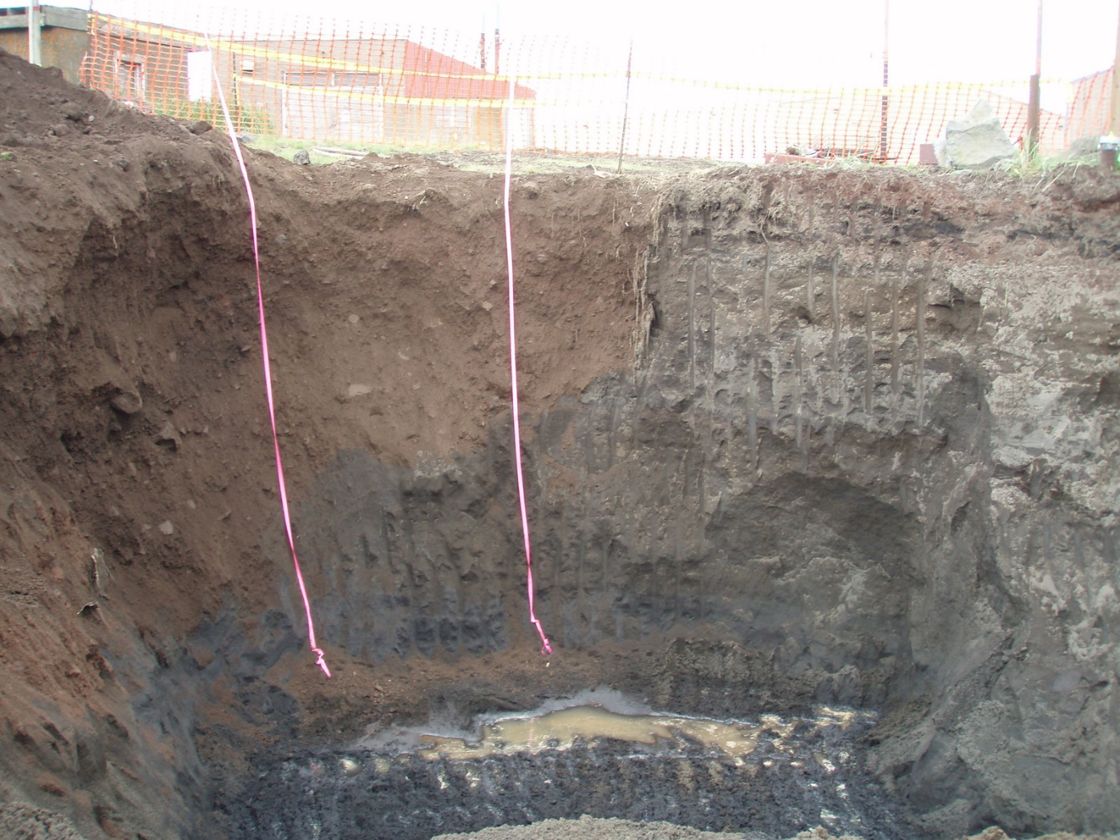
Where could some of these hazardous atmospheres exist?
Petroleum Contaminated
excavating around a landfill
excavating in contaminated soil
working around utilities
  (gas, sewer, purged lines?)
toxins nearby (CO, CO2)

Slide 32

Oxygen deficiency
Oxygen deficiency happens when oxygen is displaced by some other gas or vapor:
Settling CO from vehicles
CO produced by gas-powered equipment in a trench
Gases/vapors from nearby landfills, storage tanks, etc.

Slide 33
Oxygen deficiency
Testing must be conducted as often as necessary to ensure continuous safety.
Precautions may include ventilation or proper respiratory protection.

Slide 34
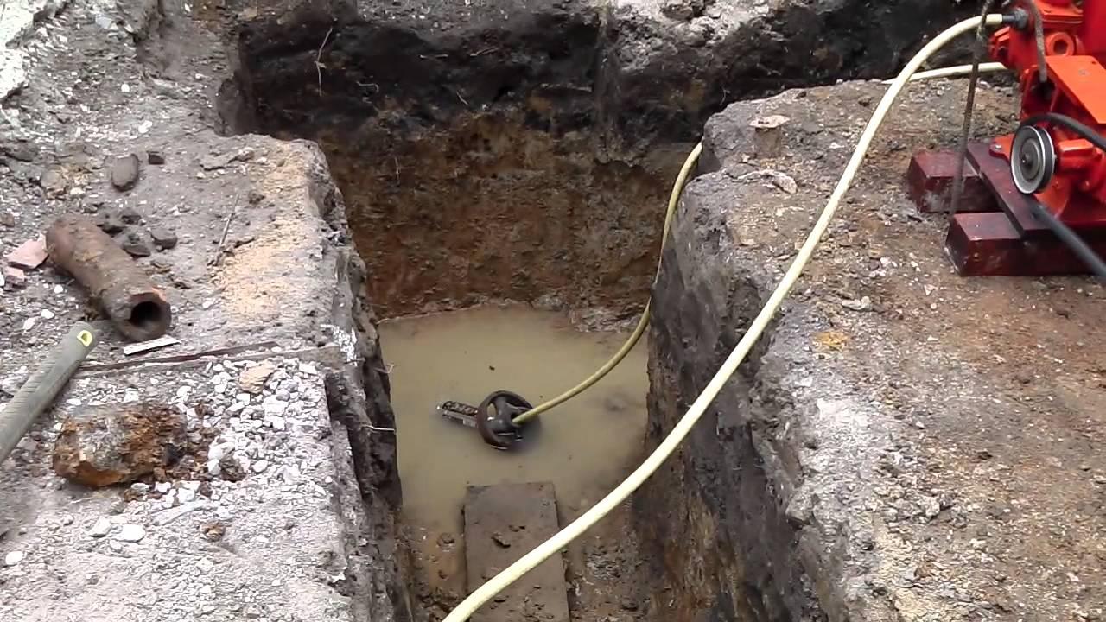
Water accumulation
The action of water against the sides of a trench can cause undermining and cave-ins.
If water removal equipment is used, the Competent Person must monitor its effectiveness.

Slide 35
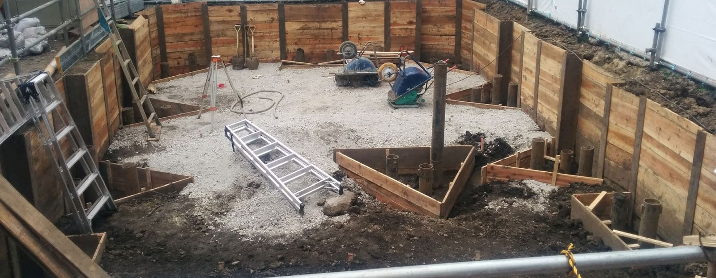
Adjacent structures
Support systems must be provided to ensure stability of adjacent buildings, walls, or other structures.
Shoring
Bracing
Underpinning

Slide 36
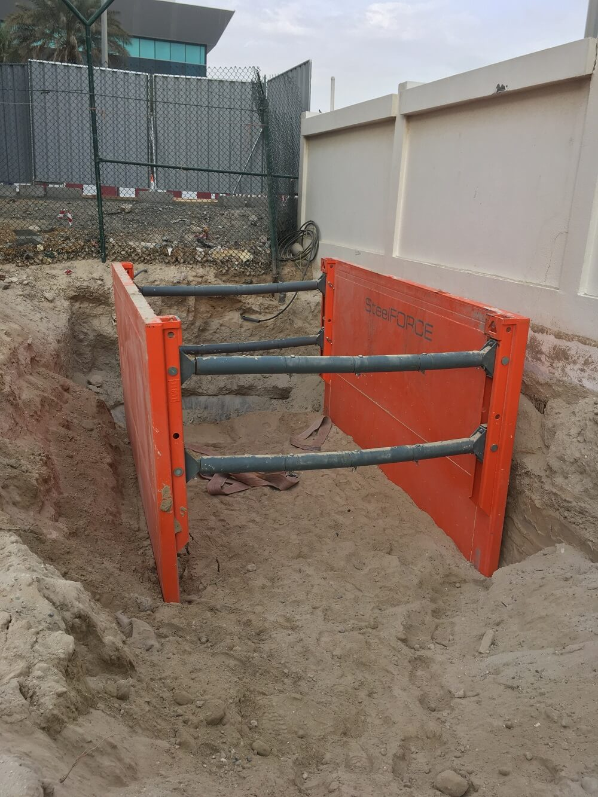
Adjacent structures
Excavating below the level of a base or footing (posing a hazard) is not permitted except when:
Excavating in stable rock
Support system provided
Registered Professional Engineer approves

Slide 37
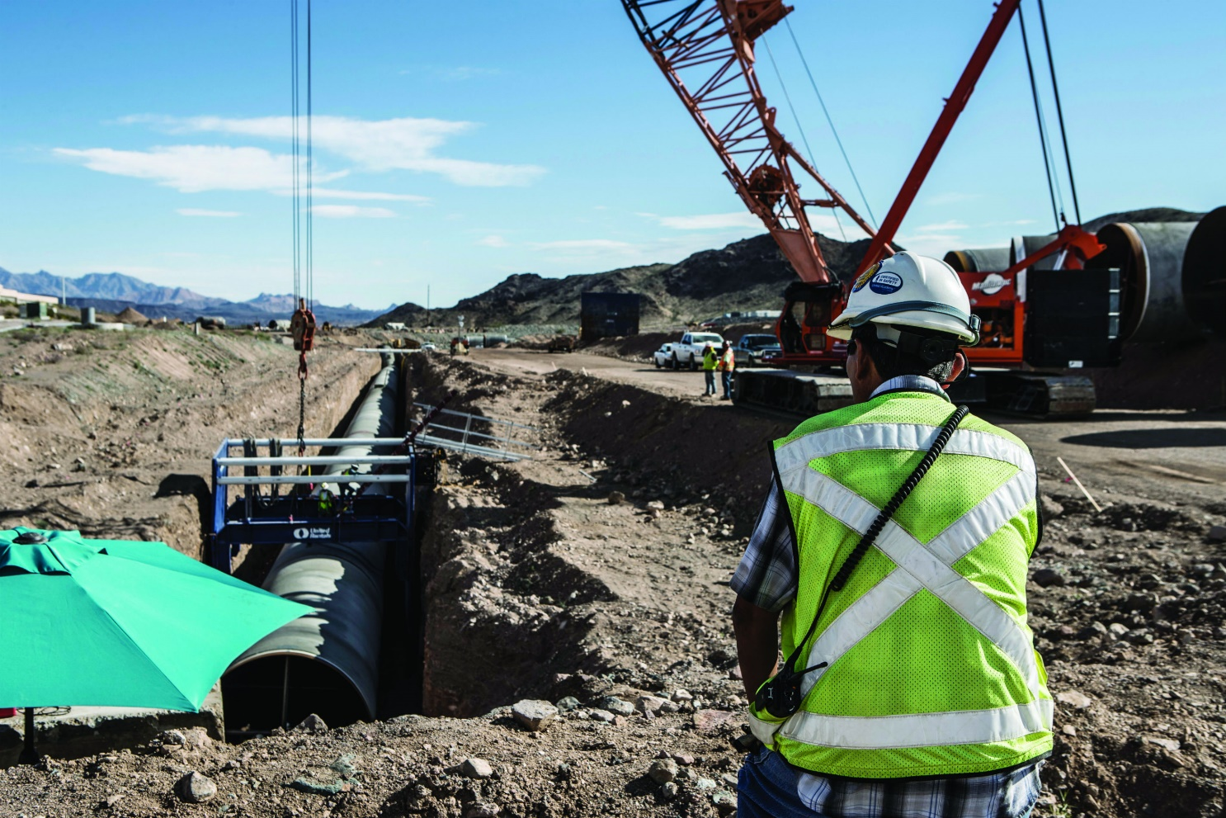
Daily inspections
A Competent Person must inspect excavations, adjacent areas, and protective systems daily:
Prior to the job
As needed
After any occurrence which would warrant an inspection

Slide 38
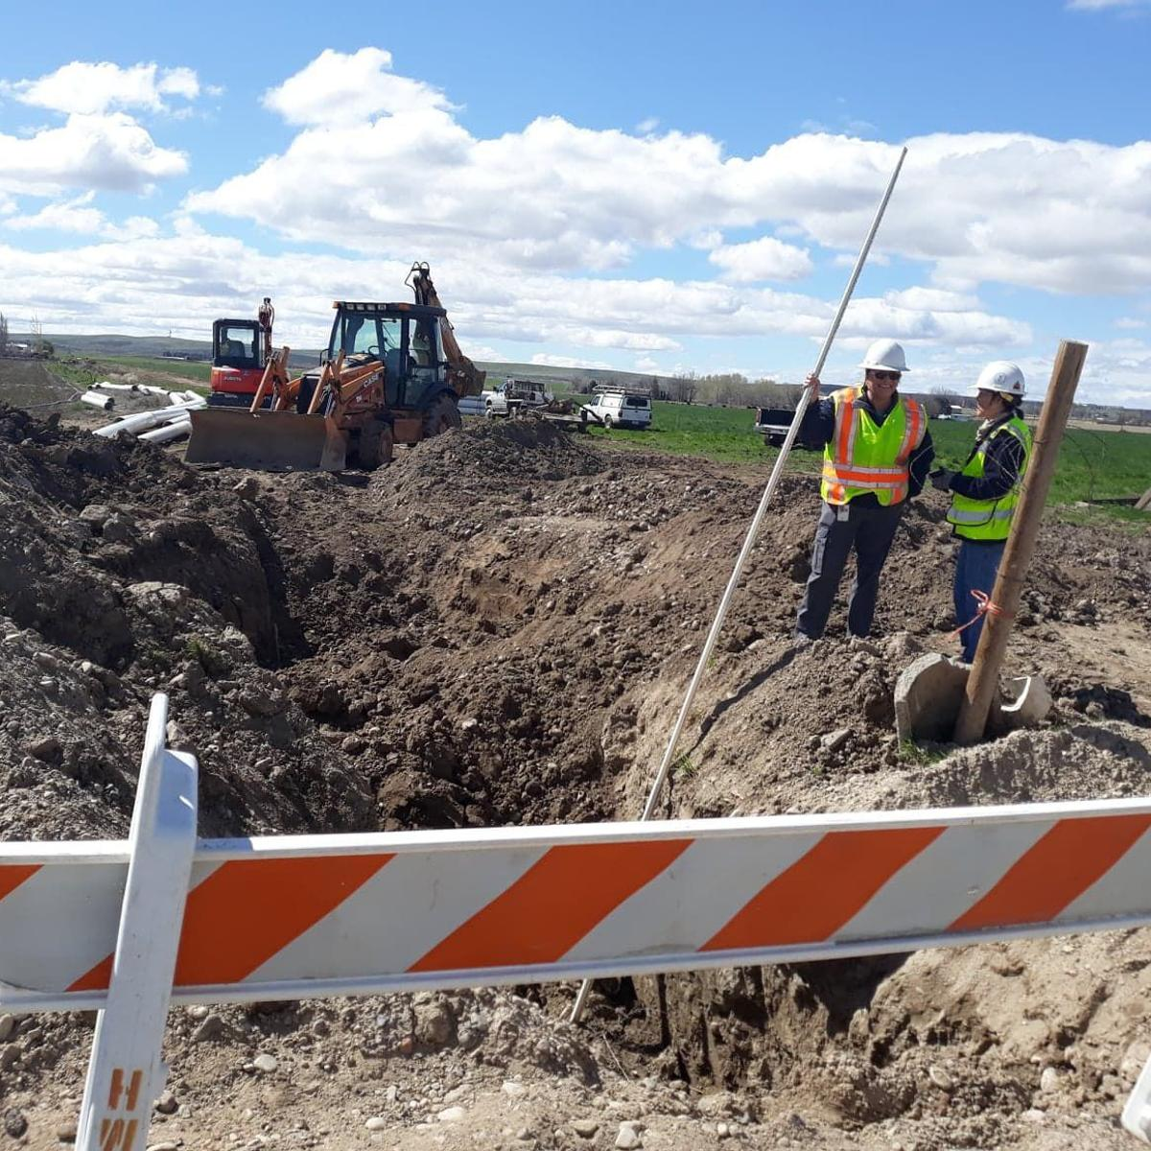
Look for evidence of:
Potential cave-in
Failure of protective systems
Hazardous atmospheres
Undermining
Water accumulation
Vibration
Utilities

Slide 39
Loose rock or soil protection
Protection must be provided when there is falling or rolling rock/soil from the excavation face:
Scale back
Keep all material and equipment back at least 2 feet from the edge

Slide 40
How close is the spoil pile here?

Slide 41
Fall protection
Walkways or bridges with guardrails must be provided where employees are permitted to cross over excavations.
All remote excavations must be barricaded, covered, or backfilled.

Slide 42
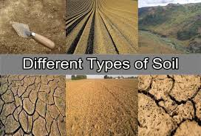
Soil classification system
Describes a method of classifying soil and rock deposits based on site and environmental conditions, and on the structure and composition of the earth deposits.
Appendix A in Oregon-OSHA Div 3/Sub P contains definitions, sets forth requirements, and describes acceptable visual and manual tests for classifying soils.

Slide 43
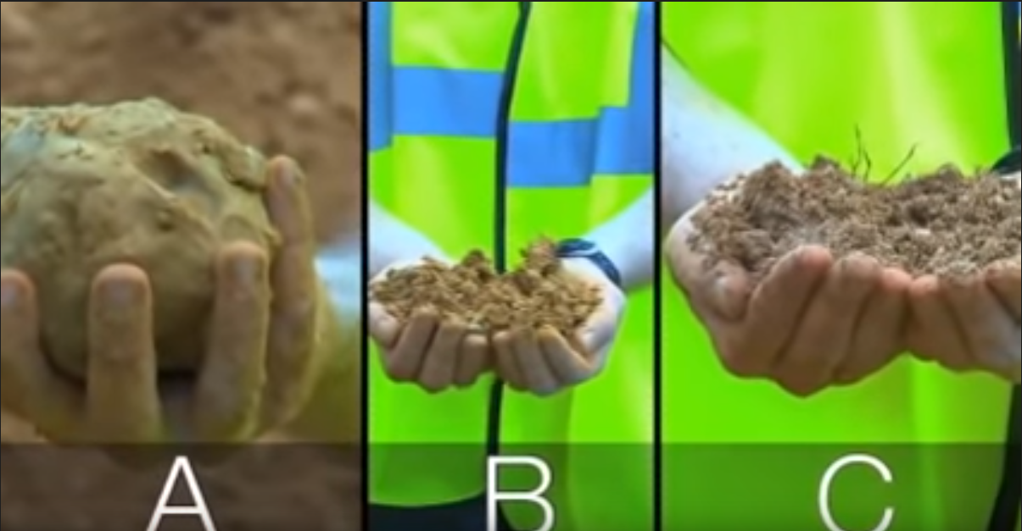
4 Soil classifications
Stable Rock
Type A
Type B
Type C
A
B
C

Slide 44
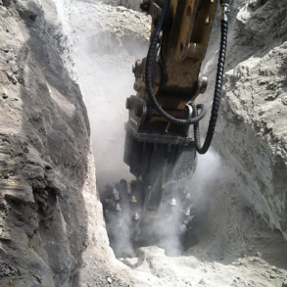
Stable rock
Natural solid mineral matter that can be excavated with vertical sides and remain intact while exposed.

Slide 45
Type A
Cohesive soils with an unconfined compressive strength of 1.5 tons per square foot (tsf) or greater.
Examples of cohesive soils are: clay, silty clay, sandy clay, clay loam, and, in some cases, silty clay loam and sandy clay loam.

Slide 46
Type B
Cohesive soil with an unconfined compressive strength greater than 0.5 tsf but less than 1.5 tsf.
Some examples are: granular cohesion less soils including angular gravel, silt, silt loam, sandy loam, and, in some cases, silty clay loam and sandy clay loam.

Slide 47
Type C
Cohesive soil with an unconfined compressive strength of 0.5 tsf or less.
Some examples include: gravel, sand, and loamy sand. Also included may be submerged soil or soil from which water is freely seeping, and submerged rock that is not stable.

Slide 48
What type of soil does this look like?

