Slide 1
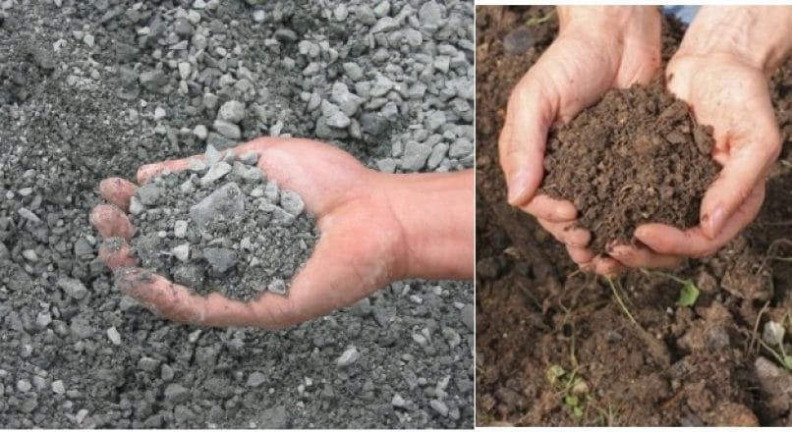
Visual tests
Observe soil in the sides of the excavation and as it is excavated.
Estimate the particle sizes:
Soil that is primarily composed of fine-grained material is cohesive material
Soil composed primarily of coarse-grained sand or gravel is granular material

Slide 2
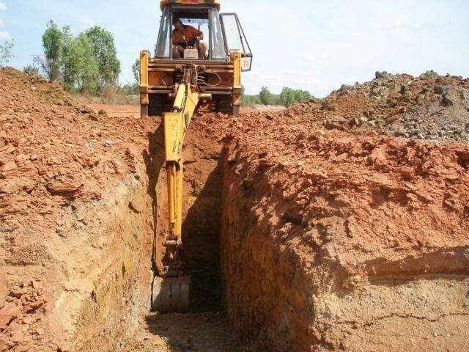
Visual tests
Observe soil as it is excavated.
Soil that remains in clumps when excavated is cohesive
Soil that breaks up easily and does not stay in clumps is granular

Slide 3
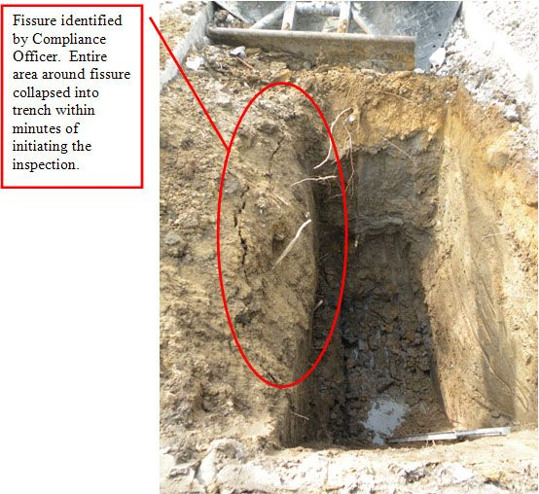
Visual tests
Observe the side of the opened excavation and the surface area adjacent to the excavation.
Crack-like openings such as tension cracks could indicate fissured material
If chunks of soil spill off a vertical side, the soil could be fissured

Slide 4
Visual tests
Observe the area adjacent to the excavation and the excavation itself for:
Evidence of existing utilities
Other underground installations
Other evidence of previously disturbed soil

Slide 5
Visual tests
Observe the opened side of the excavation to identify layered systems.
In a layered system, the system shall be classified in accordance with its weakest layer.
However, each layer may be classified individually where a more stable layer lies under a less stable layer.

Slide 6
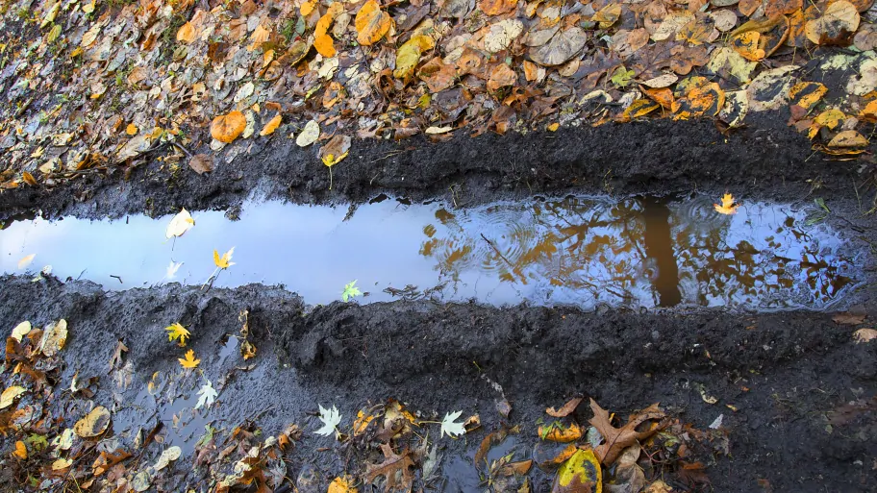
Visual tests
Observe the area adjacent to the excavation and the sides of the opened excavation for evidence of:
Surface water
Water seeping from the sides of the excavation
Location of the water table level

Slide 7
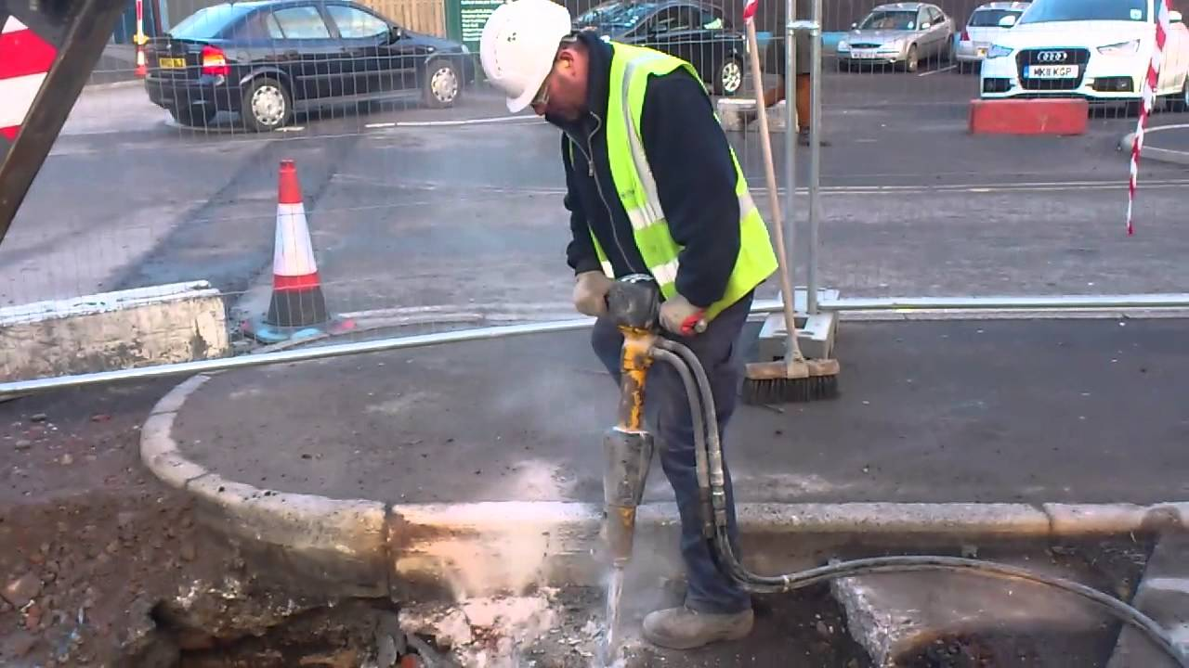
Visual tests
Observe the area adjacent to the excavation and the area within the excavation for sources of vibration that may affect the stability of the excavation face.

Slide 8
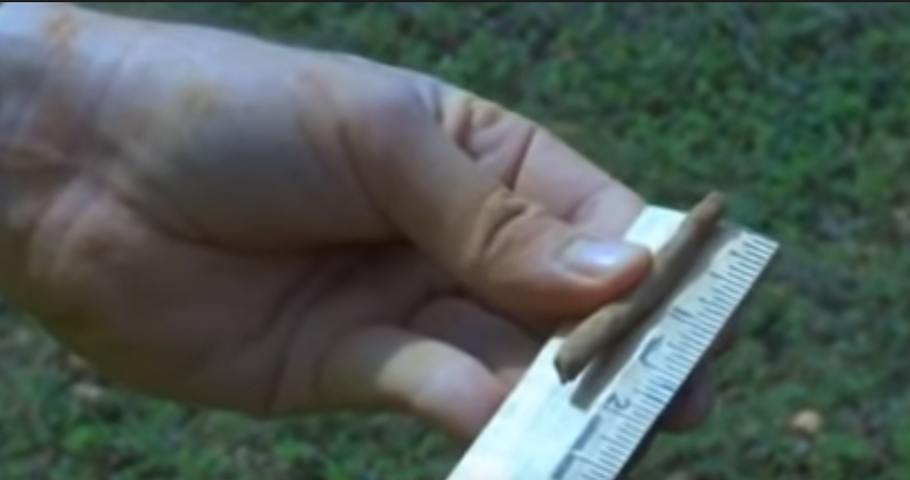
Manual tests
Plasticity
Mold a moist or wet sample of soil into a ball and attempt to roll it into threads as thin as 1/8 in.
in diameter.
Cohesive soil can be successfully rolled into threads without crumbling. If at least a two inch length of 1/8 in. thread can be held on one end without tearing, the soil is cohesive.

Slide 9
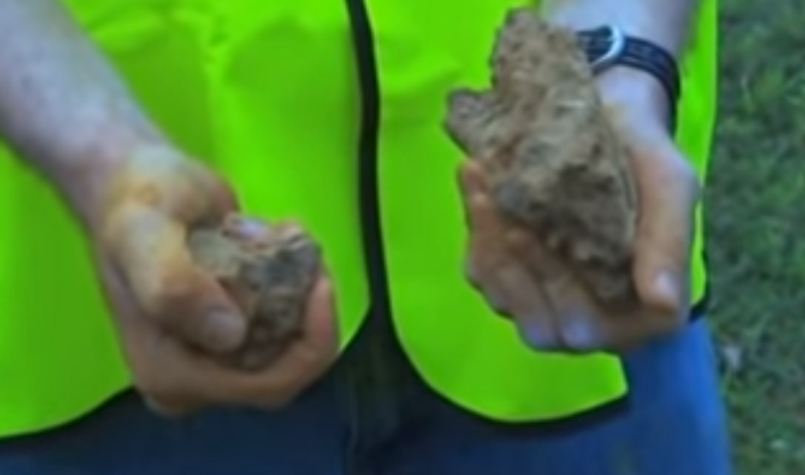
Manual tests
Dry strength
Dry fissured clay falls into clumps which break up into smaller clumps on its own or with some force.
Dry unfissured soil can be broken up into clumps which break into smaller clumps with great difficulty.
Dry granular soil crumbles on its own or with some force into fine individual grains.

Slide 10
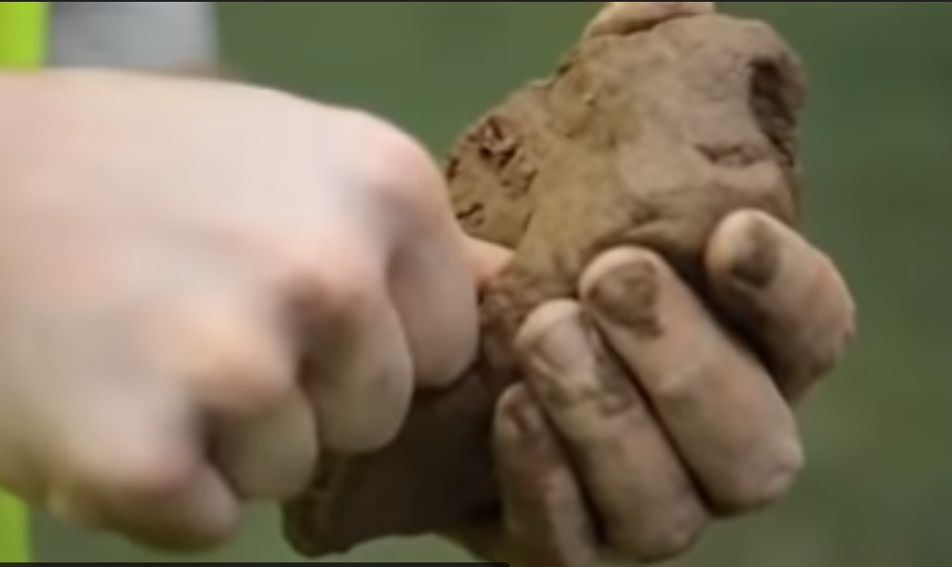
Manual tests
Thumb penetration
Conducted on an undisturbed soil clump immediately after excavating:
Type A soils can be penetrated by the thumb with difficulty
Type C soils can be easily penetrated several inches by the thumb and can be molded by light finger pressure

Slide 11
Manual tests
Strength test
Unconfined compressive strength of soils can be obtained by using a pocket penetrometer or a hand-operated shear vane.

Slide 12
Mechanics of a trench collapse
Cave-ins generally occur in stages.
If the first one doesn't get you, the second or third one will.
There are numerous reports of rescuers being caught in the second stage while attempting to extract a worker partially buried by the first stage of a cave-in.
When soil is removed from a trench, lateral pressures in the soil adjacent to the trench go unsupported.

Slide 13
Mechanics of a trench collapse
The soil in the trench walls bulge outward creating horizontal tension stress in the soil mass.
The ground adjacent to the trench settles an amount roughly equal to the lateral wall bulge.
This settling mass hangs on to adjacent soil, creating shear stresses in the soil further back from the trench opening.

Slide 14
Mechanics of a trench collapse
The soil mass adjacent to the trench, being elastic, will resist the lateral forces coming from the combined tension and shear to the point where the soil tensile strength is reached.

Slide 15
Stage 1
Vertical tension cracks form along the trench from about 1/3 to 2/3 of the trench depth back from its edge.
The cracks extend to about half the depth of the trench.

Slide 16
Stage 1
Once cracks develop, the weight of the soil mass is no longer carried by the soil back from the trench face.
A "floating" column of soil must then be supported entirely by the soil directly beneath it.

Slide 17
Stage 1
The lower part of the wall fails in shear under the increased weight of soil above.

Slide 18
Stage 2
Once the bottom of the trench wall falls into the excavation, the upper part of the wall is now hanging only by shear and tension stresses.
As this soil mass lets go, a second cave-in soon occurs.

Slide 19
Stage 3
There is little soil left to hold the "floating" soil column left after stage 2.
A third cave-in quickly follows.

Slide 20
Tension cracks
Usually form at a horizontal distance of .5 to .75 times the depth of the trench, measured from the top of the vertical face of the trench.

Slide 21
Sliding or sluffing
May occur as a result of tension cracks.

Slide 22
Toppling
Toppling occurs when the trench’s vertical face shears along the tension crack line and topples into the trench.

Slide 23
Subsidence & bulging
Surface subsidence and bulging in the vertical face is caused when the trench is unsupported, creating unbalanced stress. This will cause face failure and cave-in.

Slide 24
Bottom heaving or squeezing
Caused by the downward pressure created by the weight of adjoining soil. This pressure causes a bulge in the bottom of the cut.

Slide 25
Protective systems
Each employee in an excavation must be protected by a protective system except when:
excavation is made entirely in stable rock; or
excavations are less than 5 feet deep and a Competent Person determines that there is no indication of a potential cave-in.
four feet for WA folks!

Slide 26
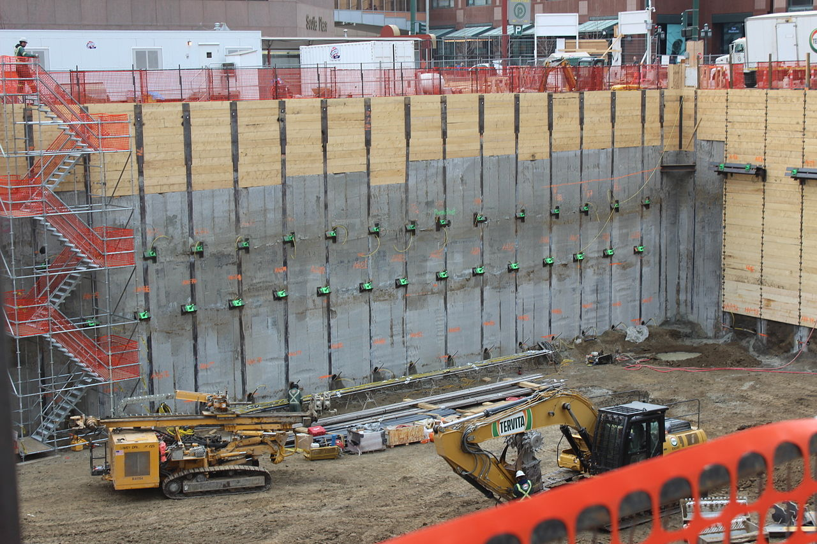
Protective systems for excavations over 20 feet deep must be designed by a
Registered Professional Engineer!

Slide 27
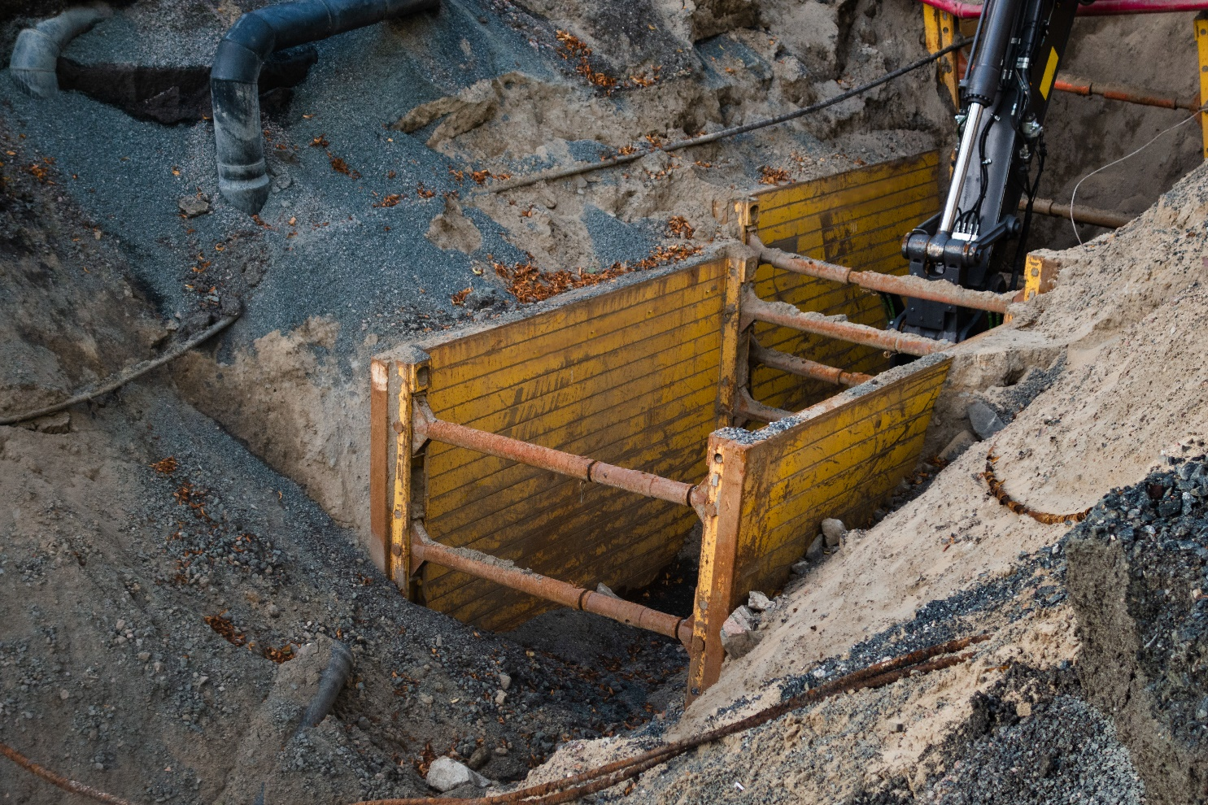
Selection of protective systems
Protective systems are divided into two categories:
Sloping and benching systems; and
Support systems, shield systems, and other protective systems.
The use of either of these categories of protective systems requires the choice of one of four design options.

Slide 28
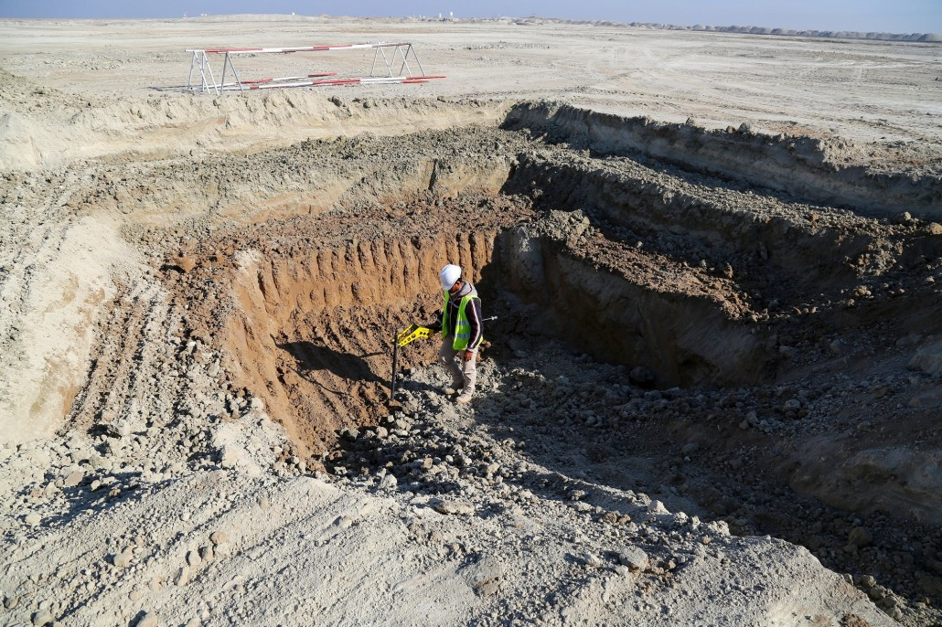
Sloping and benching options
Options include:
Slope no steeper than 11/2 : 1 (34°)
The use of Appendices A and B
Designs using other tabulated data
Design by a Registered Professional Engineer

Slide 29
Option 1

Slide 30
Option 2
Determination of Slopes and Configurations:
This option involves the use of Appendices A and B:
Appendix A is Soil Classification
Appendix B is Sloping & Benching

Slide 31
Option 2

Slide 32
Option 2

Slide 33

Option 3
Design sloping or benching systems by use of tabulated data, such as tables and charts.
Tabulated data must be in written form.
At least one copy of this data must be kept at the jobsite during construction of the protective system.

Slide 34
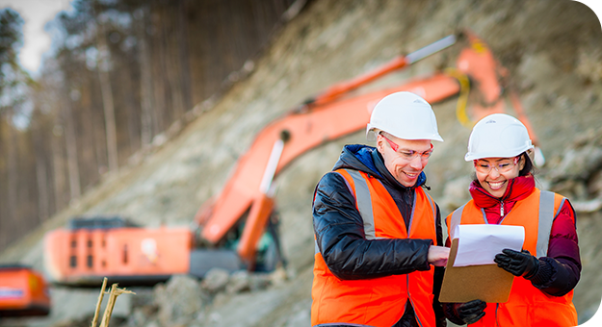
Option 4
Design sloping or benching systems by a Registered Professional Engineer.
Designs must be in written form.

Slide 35
Sloping disadvantages
For a 10 ft. deep cut, the extra right-of-way necessary to accommodate slope, spoil pile, material storage, and work access could be 40 ft or more on each side of the trench.

Slide 36
Sloping disadvantages
Cost factors a contractor should consider:
Cost of right-of-way
Excavated material
Extra backfill and compaction
Hauling of select fill
Schedule for extra excavation

Slide 37
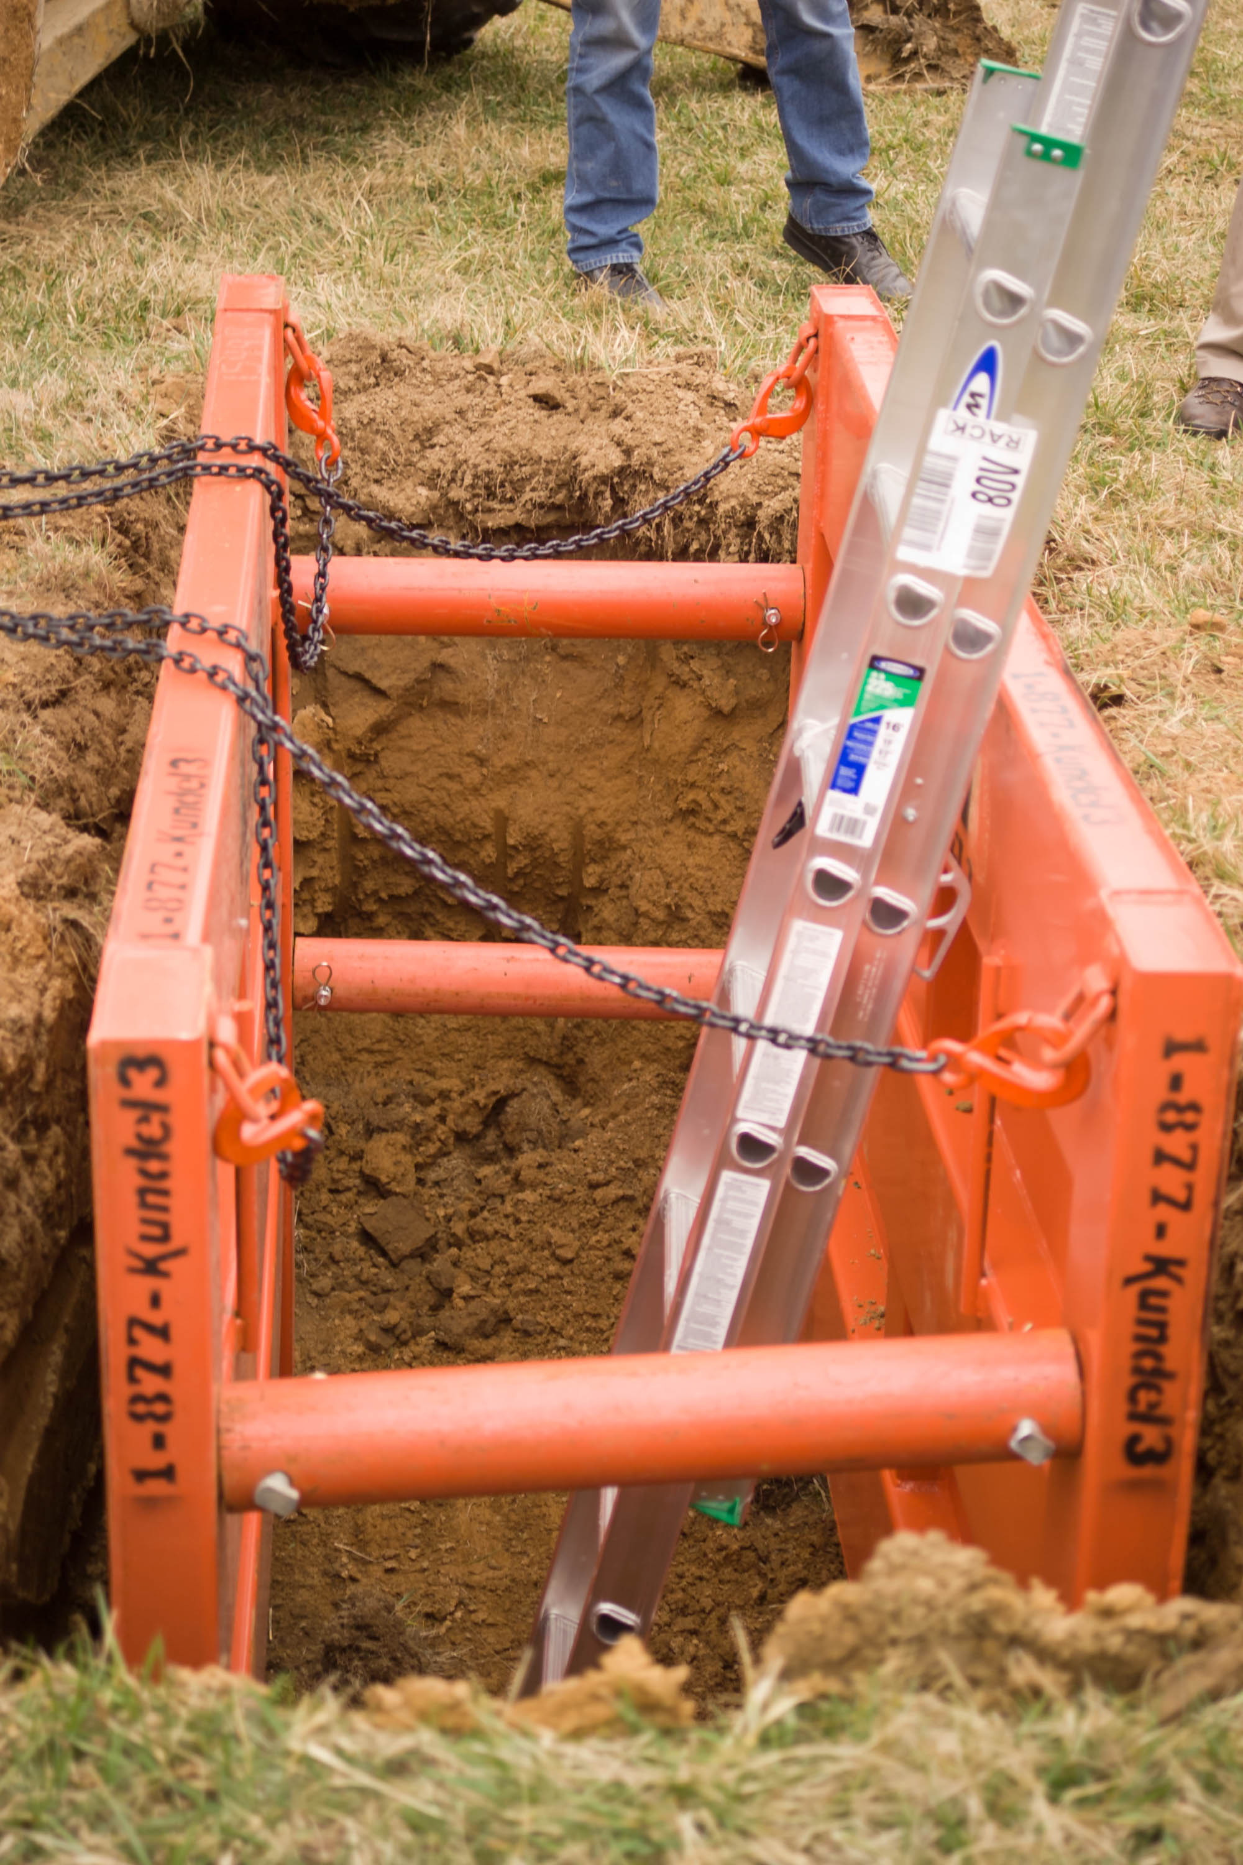
Supports, shields, and other protective systems
4 options include:
The use of Appendices A and C, or D
Designs using manufacturer’s tabulated data
Designs using other tabulated data
Design by a Registered Professional Engineer.

Slide 38
Option 1
Appendix A - Soil Classification
Appendix C - Timber Shoring Design
Appendix D - Aluminum Hydraulic Shoring

Slide 39
Option 1

Slide 40
Option 2
Designs using manufacturer’s tabulated data:
Follow manufacturer specifications to a T!
Deviations from design must be approved
Must be in writing and kept at the jobsite during construction of the protective system.

Slide 41
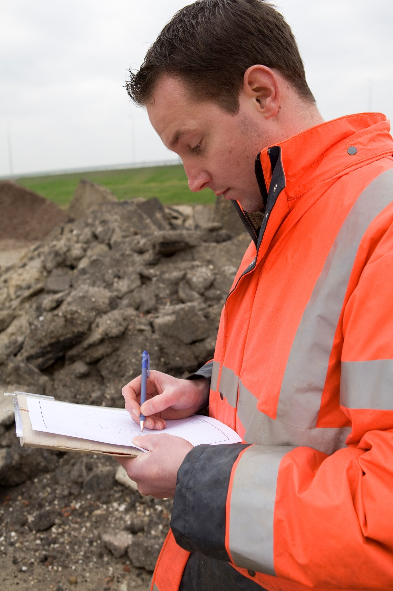
Option 3 & 4
Designs using other tabulated data
Must be kept at the jobsite during construction of the protective system.
Designs by a Registered Professional Engineer
These also must be kept at the construction of the system.

Slide 42
Materials & equipment
Materials and equipment used for protective systems must be free from damage or defects that might impair their proper function.

Slide 43
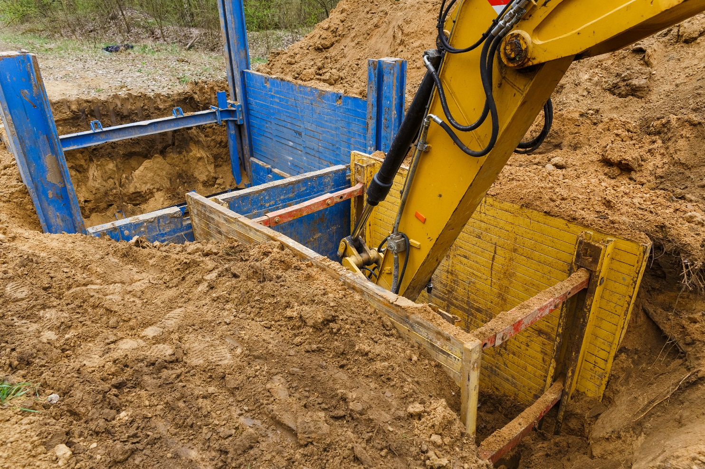
Materials & equipment
Manufactured systems must be used and maintained consistent with the manufacturer’s recommendations.
A Competent Person shall examine damaged material or equipment to evaluate its suitability for continued use.

Slide 44
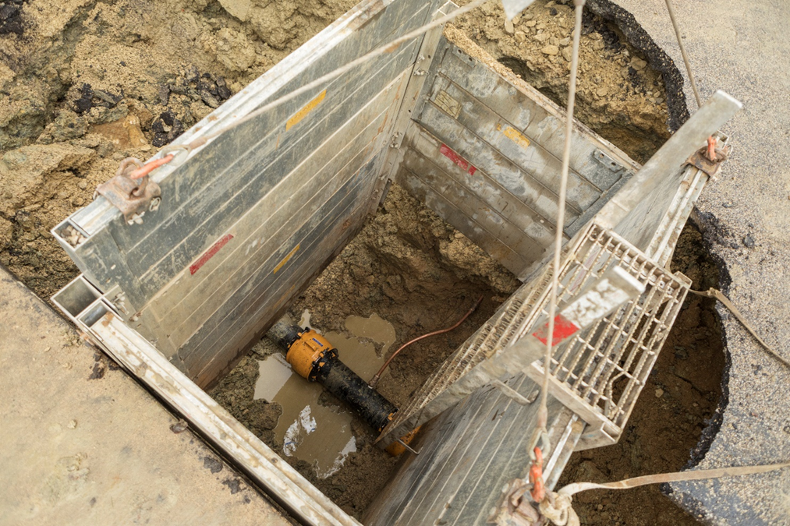
Installation & removal
Support system members are to be securely connected to prevent sliding, falling, kickouts, or other predictable failures.
Individual members of support systems must not be subjected to loads exceeding those which were designed to withstand.
Ensure additional protection before temporary removal of supports.

Slide 45
Installation & removal
Removal must begin and progress from the bottom.
Slowly release members to note potential collapse.

Slide 46
Installation & removal
Backfilling must progress together with the removal of support systems.
This can be your fall protection!

Slide 47
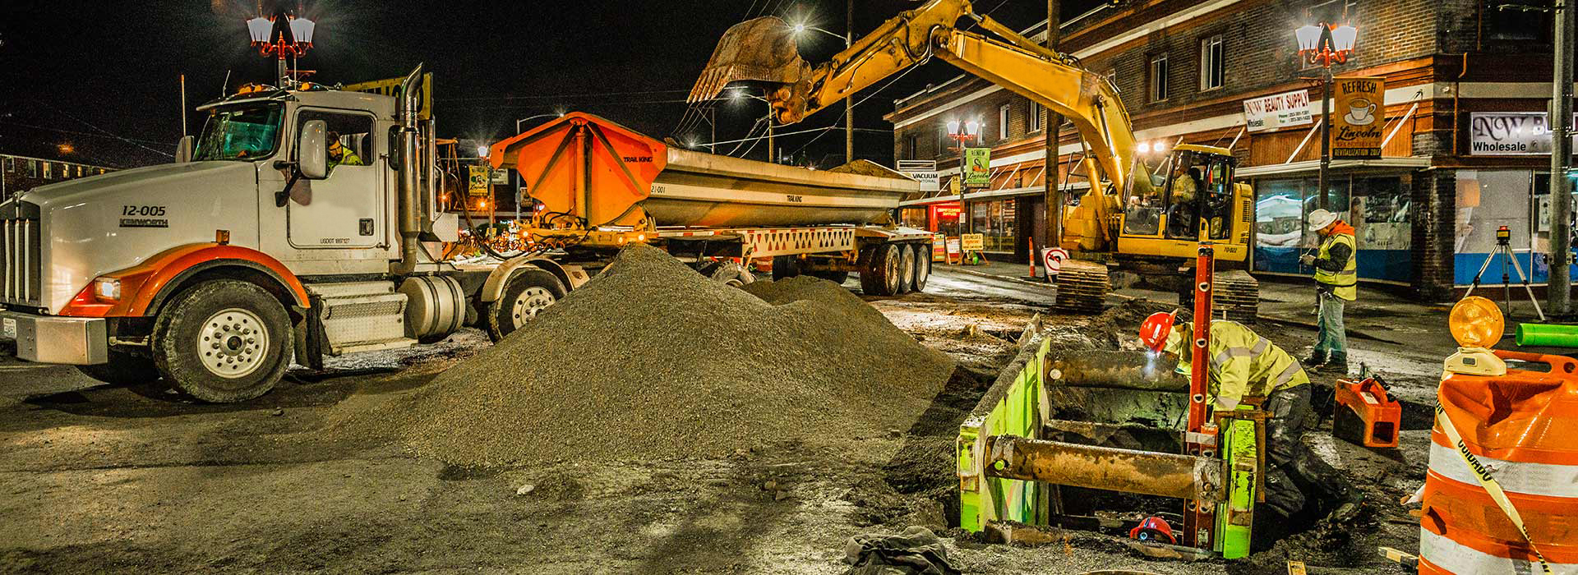
Support systems
Material may be dug to a level no more than 2 feet below the bottom members of the support system if the system is designed to resist the forces calculated to the full depth of the trench, and there is no indication of soil loss from behind or below the bottom of the support system.
Installation must be closely coordinated with the excavation.

Slide 48
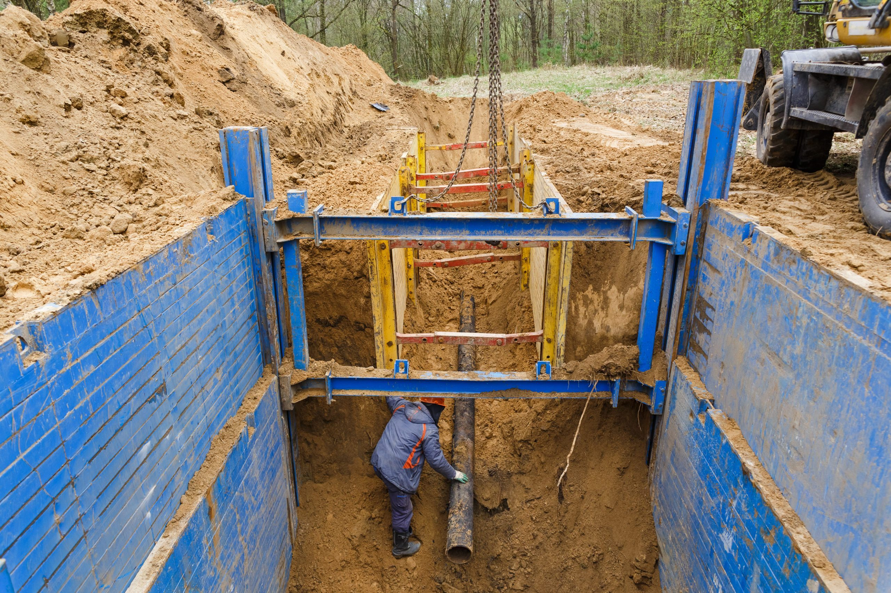
Sloping & benching systems
Employees may not work on the faces of slopes or benches above other workers unless the workers at the lower level are protected from the hazard of falling, rolling, or sliding material or equipment.

Slide 49
Trench shields
Never exceed loads which the system was designed.
Shields shall be installed in a way that will restrict lateral or other hazardous movement of the shield in the event of sudden lateral pressures.

Slide 50
Trench shields
Employees must be protected by the shield when accessing and egressing!

Slide 51
Trench shields
Employees must not be in shields when they are being installed, removed, or moved vertically.

Slide 52
Trench shields

Slide 53
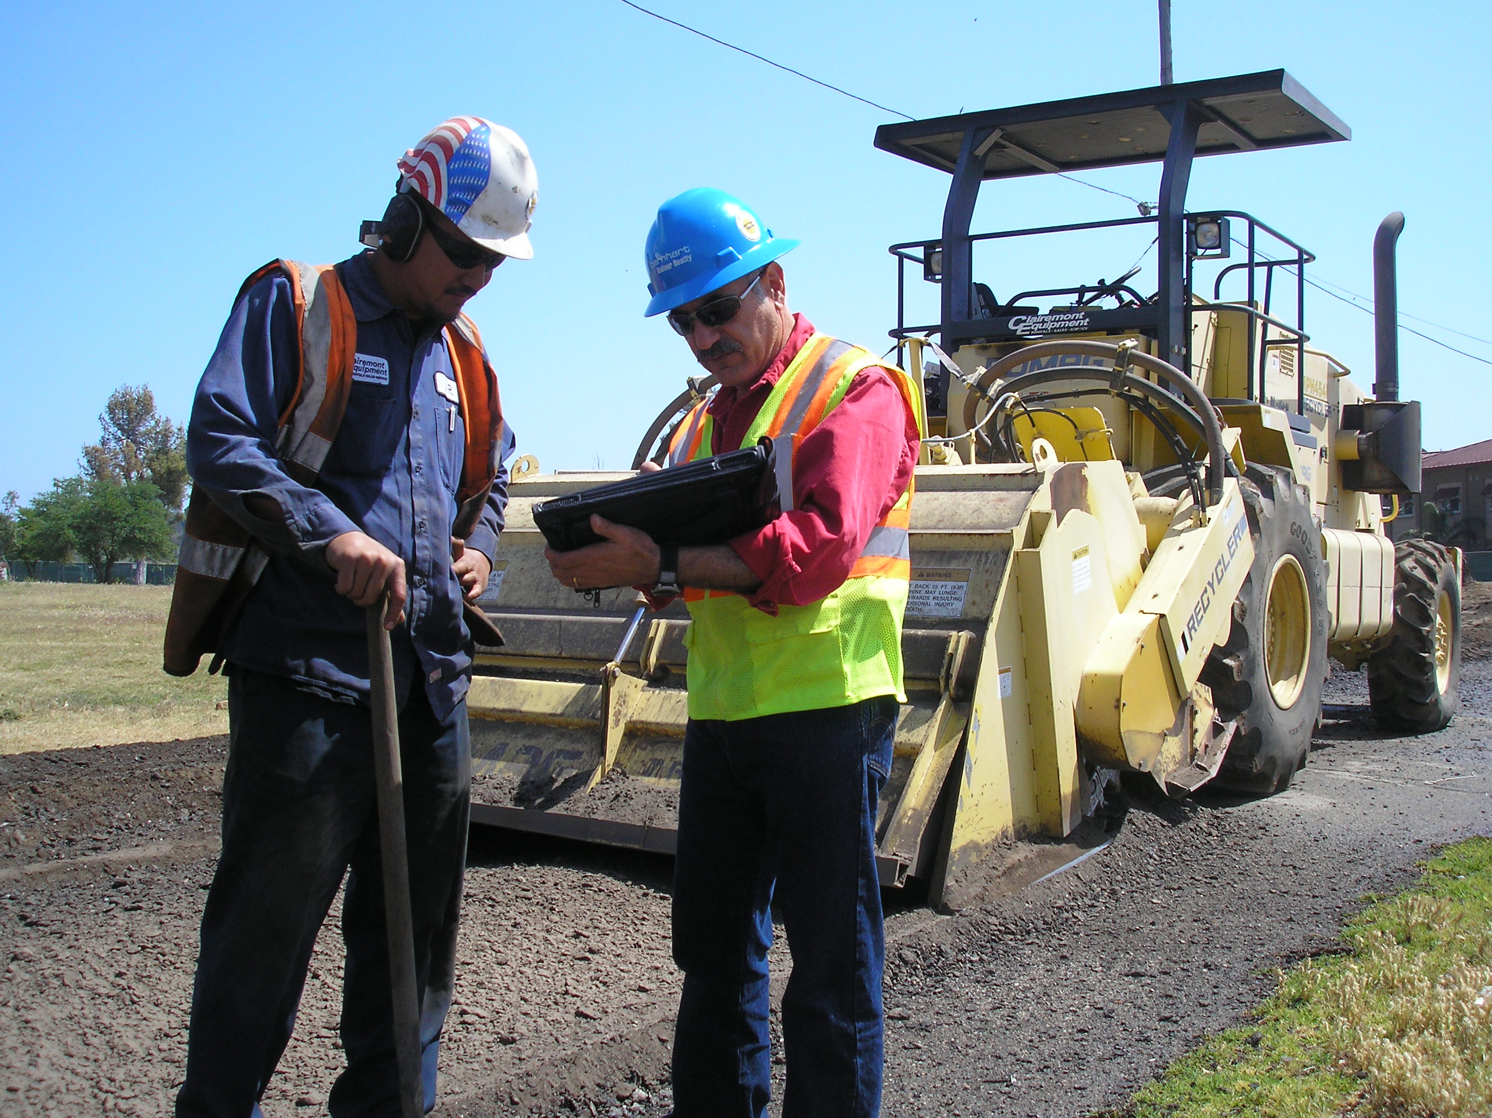
Summary of competent person duties
Design structural ramps
Monitor water removal
Inspect excavations, adjacent areas, and protective systems daily; prior to the start of work, as needed throughout the shift and after every hazard increasing occurrence (e.g. rainstorm)
Remove employees from hazard until hazard is eliminated

Slide 54
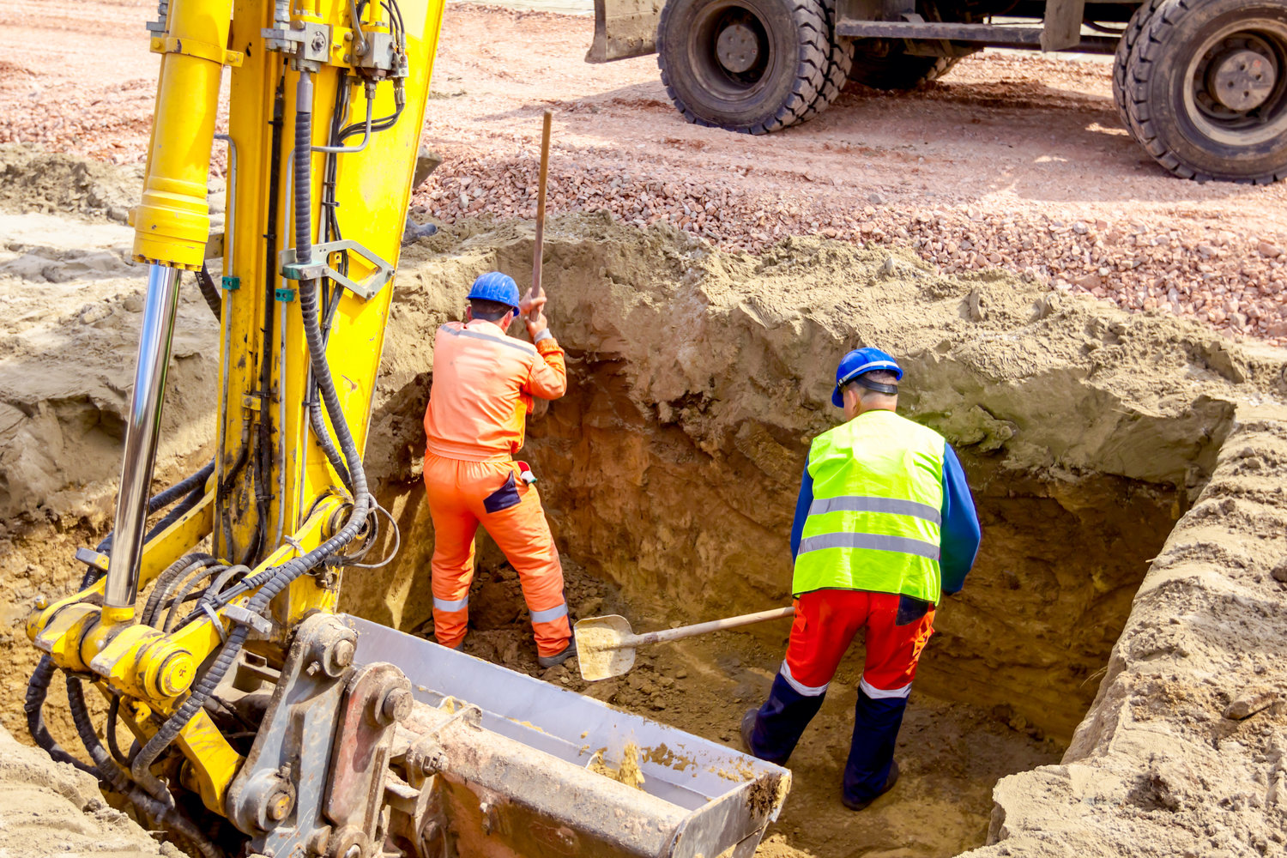
Summary of competent person duties
Examine materials and equipment for continued use, and remove from service if unusable
Classify the soil initially, and reclassify after changed conditions
Reduce soil slope below maximum allowable when surcharge loads are present

Slide 55
Let’s avoid this!

Slide 56
Additional Educational Resources
Oregon OSHA’s YouTube Channel
Oregon OSHA’s Online Courses
A-Z Topic Index – Excavation Safety
PESO – English to Español

Slide 57
Thank You!

