Slide 1


Worker Protection Standard
Pesticide Emphasis
Presented by Oregon OSHA Public Education

Slide 2


Oregon OSHA Public Education Mission:
Oregon OSHA Services
Consultation Services
Enforcement
Appeals
Public Education and Conferences
Standards and Technical Resources
We provide knowledge and tools to advance self-sufficiency
in workplace safety and health.

Slide 3
Contact us
Field Offices:
Portland 503-229-6193
Salem 503-373-7819
Eugene 541-686-7913
Medford 541-776-6016
Bend 541-388-6068
Pendleton 541-276-2353
Website: osha.oregon.gov
Salem Central
Toll Free English:
800-922-2689
Toll Free Spanish:
800-843-8086

Slide 4
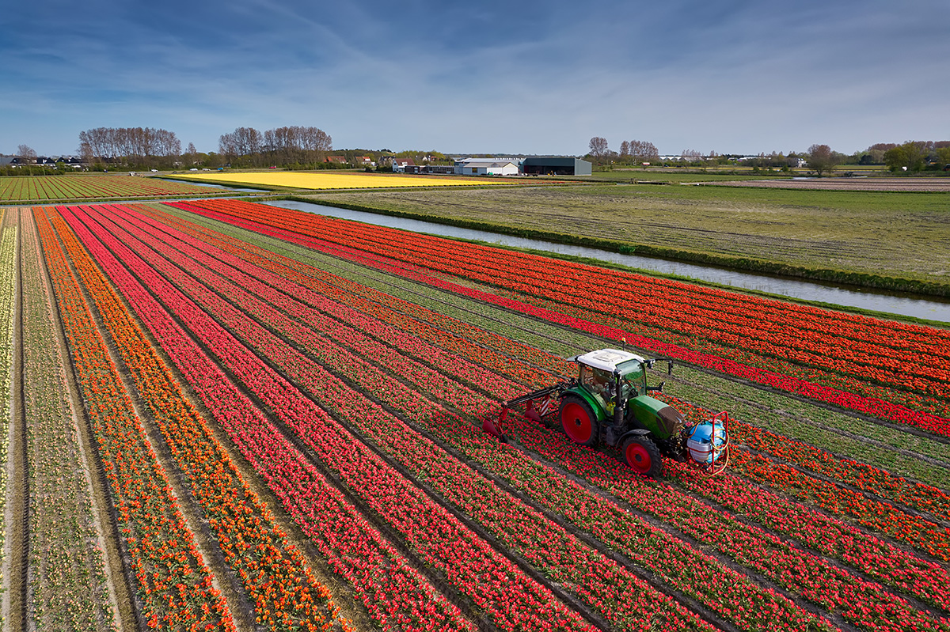
Goals
Identify the requirements of the WPS.
Differentiate between Oregon OSHA and WPS rules.
Identify the components of an effective WPS program.
Identify the eight label elements of the WPS.

Slide 5
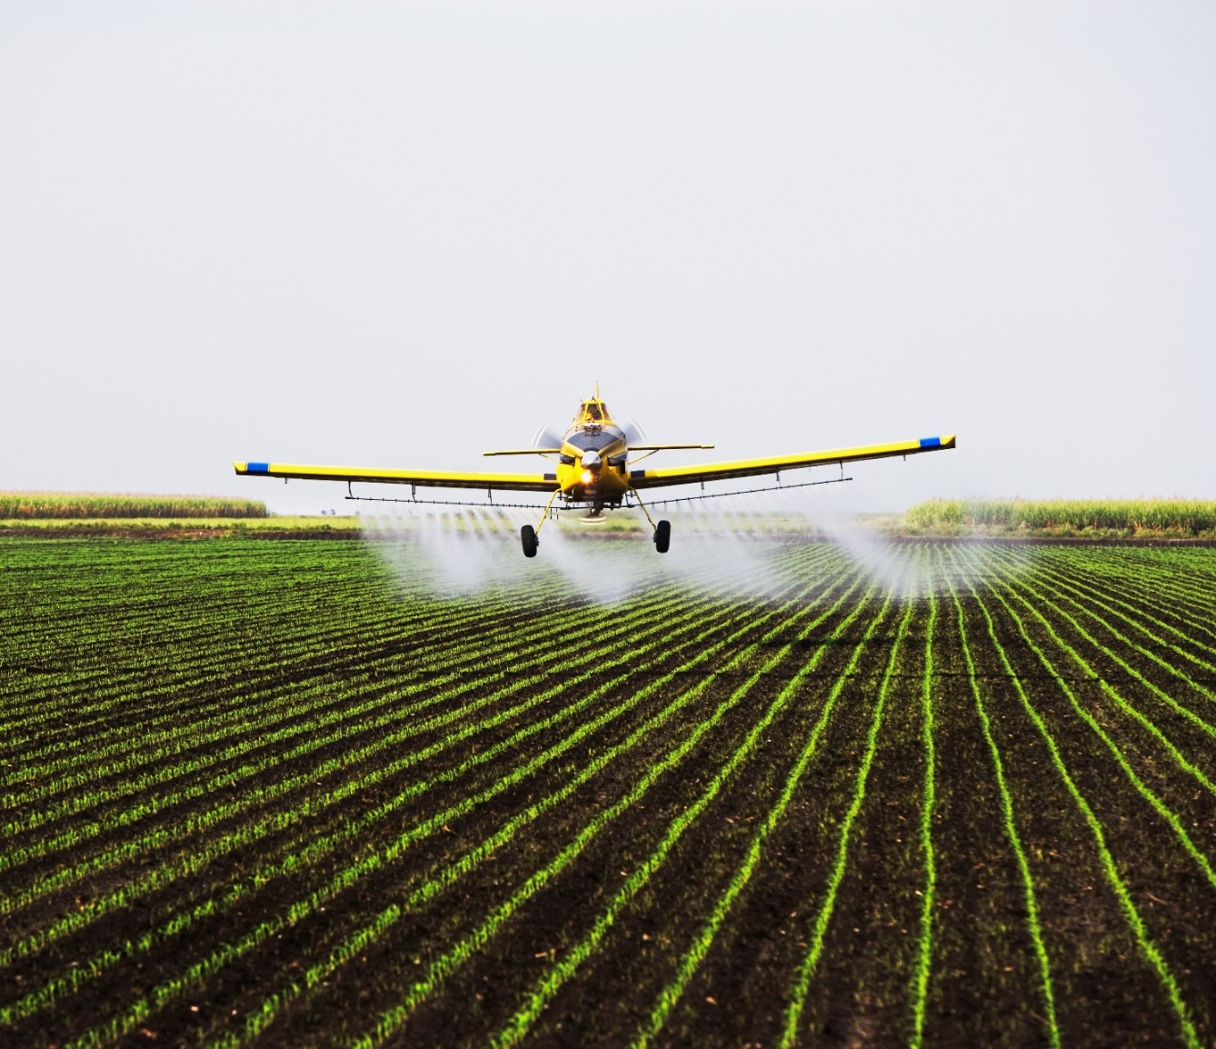
Introduction
Environmental Protection Agency (EPA)’s Pesticide Worker Protection Standard (WPS)
Oregon OSHA enforces…

Slide 6

Heat and wildfire smoke
Permanent rules effective in Oregon beginning in 2022
Heat
Heat Index
Shade
Water
Rest break
Acclimatization
Prevention plan
Wildfire Smoke
Exposure
AQI
Respirators
Exposure monitoring and training
Communication
Engineering and administrative controls

Slide 7
When Worker Protection applies to you
Pesticides have been applied or a restricted entry interval (REI) has been in effect within the last 30 days at your establishment.
The pesticide applied has an “Agriculture Use Requirements” Box on the label.
You employ pesticide handlers, and/or hand-labor workers on an agricultural, forest, or nursery operation. This includes outdoor and indoor spaces.

Slide 8

When Worker Protection does NOT apply to you
Pest control
Livestock
Non-commercial/Research
Gardens, parks, golf courses
Direct injection
Non-crop areas
Attractants/Repellents
Harvested portions

Slide 9
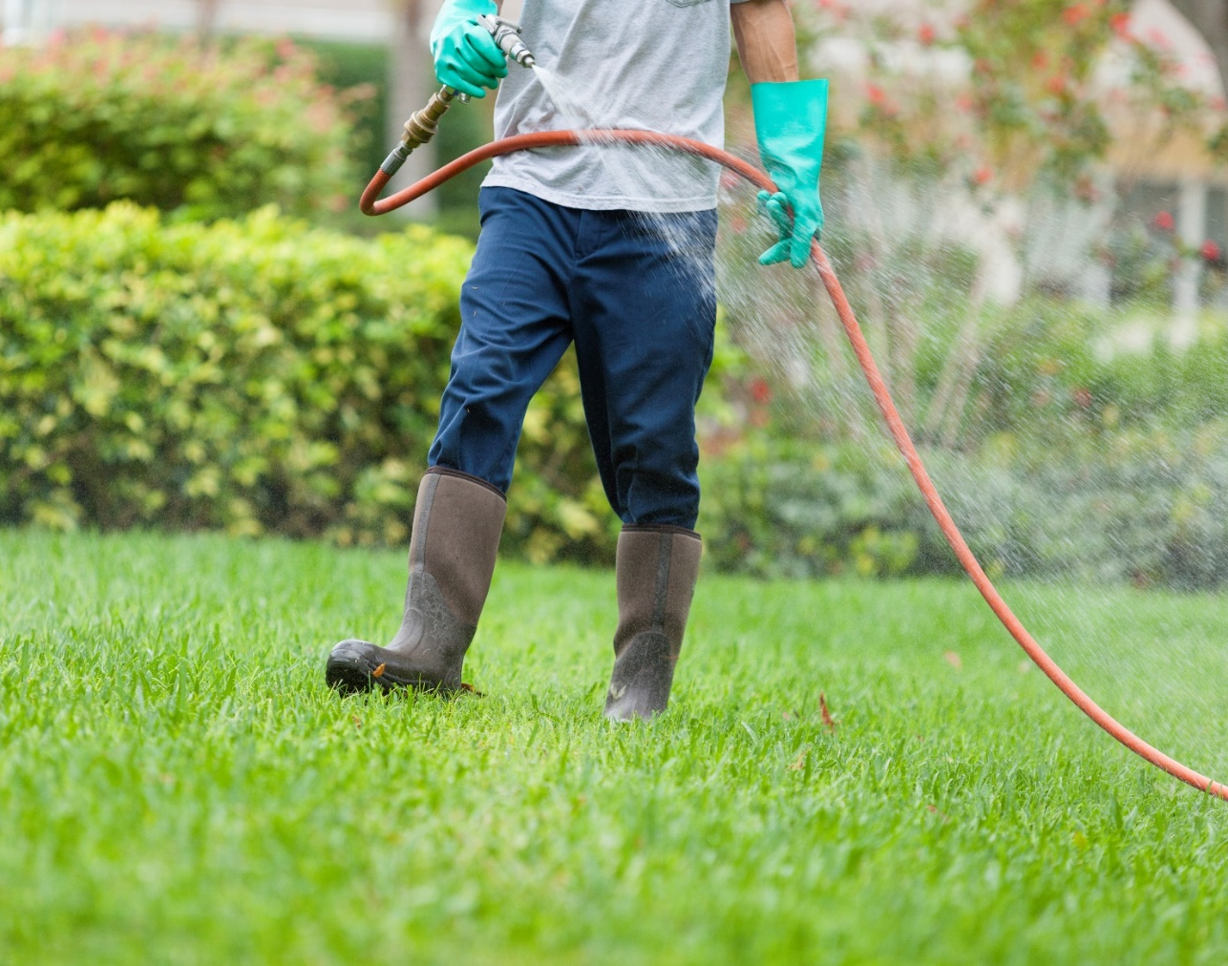
Definitions
Workers
Handlers

Slide 10
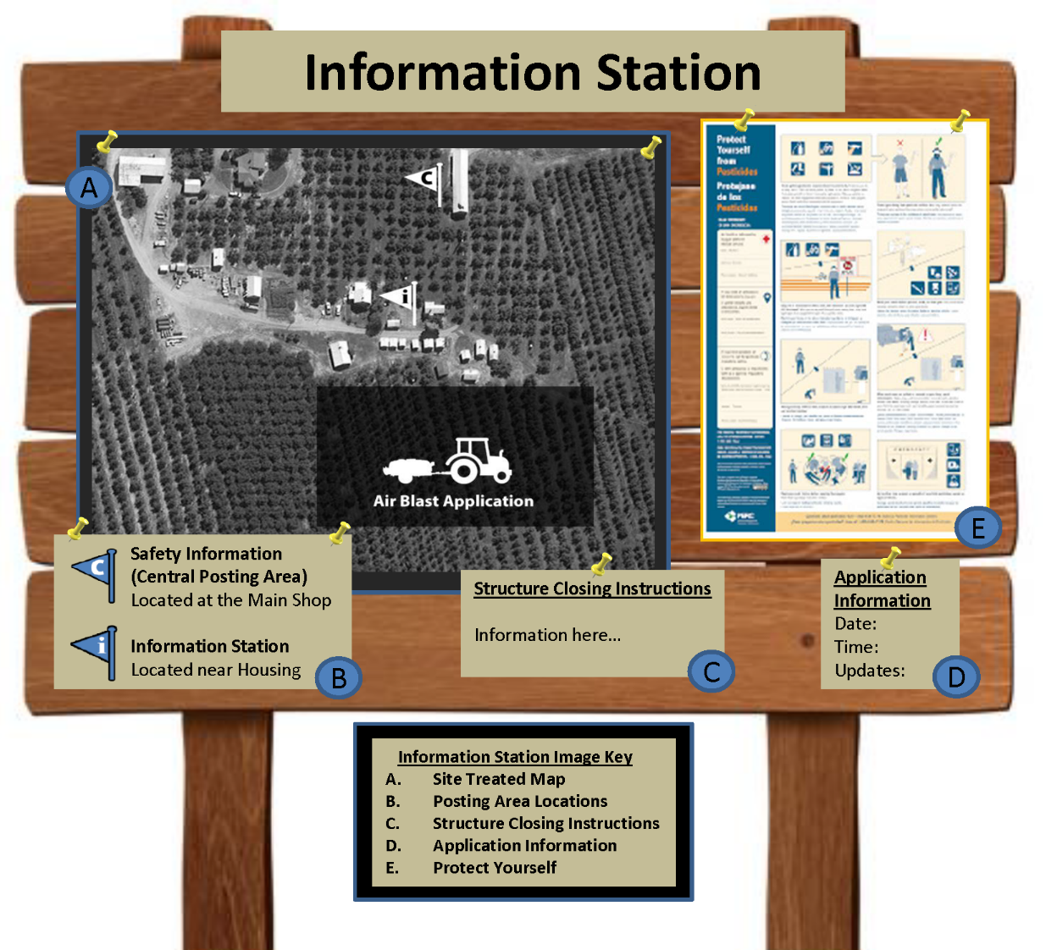
Required postings and record retention
Display or make available all information in an easily accessible (central) location on the agricultural establishment.

Slide 11
Protection for both workers and handlers
Pesticide Safety Training Q&A
When must workers and handlers be trained?
How often must workers and handlers be trained?
How do I train my workers and handlers?
Who can provide the training?
What about employees who speak a different language?
How long do I need to keep the training documentation?
Where should I train my employees?

Slide 12

Training records
Worker’s or handler’s printed name and signature
Date of training
Trainer’s name
Trainer’s qualifications
Employer’s name
Identification of EPA approved training materials

Slide 13

Sources
Environmental Protection Agency (EPA):
  Phone: 1-888-663-2155
  Website: www.epa.gov
Pesticide Educational Resources Collaborative:
  Website: www.pesticideresources.org

Slide 14
Training Exercise (page 16)
For English language learners in the group
Language Leader:
Bilingual person with good speaking skills.
Social Leader:
A person who is viewed as a leader by the group.
Technical Leader:
The person with the best job and safety-related knowledge (usually the most experienced).

Slide 15


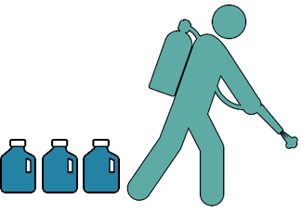
Decontamination supplies
Eye Wash : “Danger” or
“Danger Poison” Label
1 Gallon of Water : Person
3 Gallons of Water : Handler

Slide 16
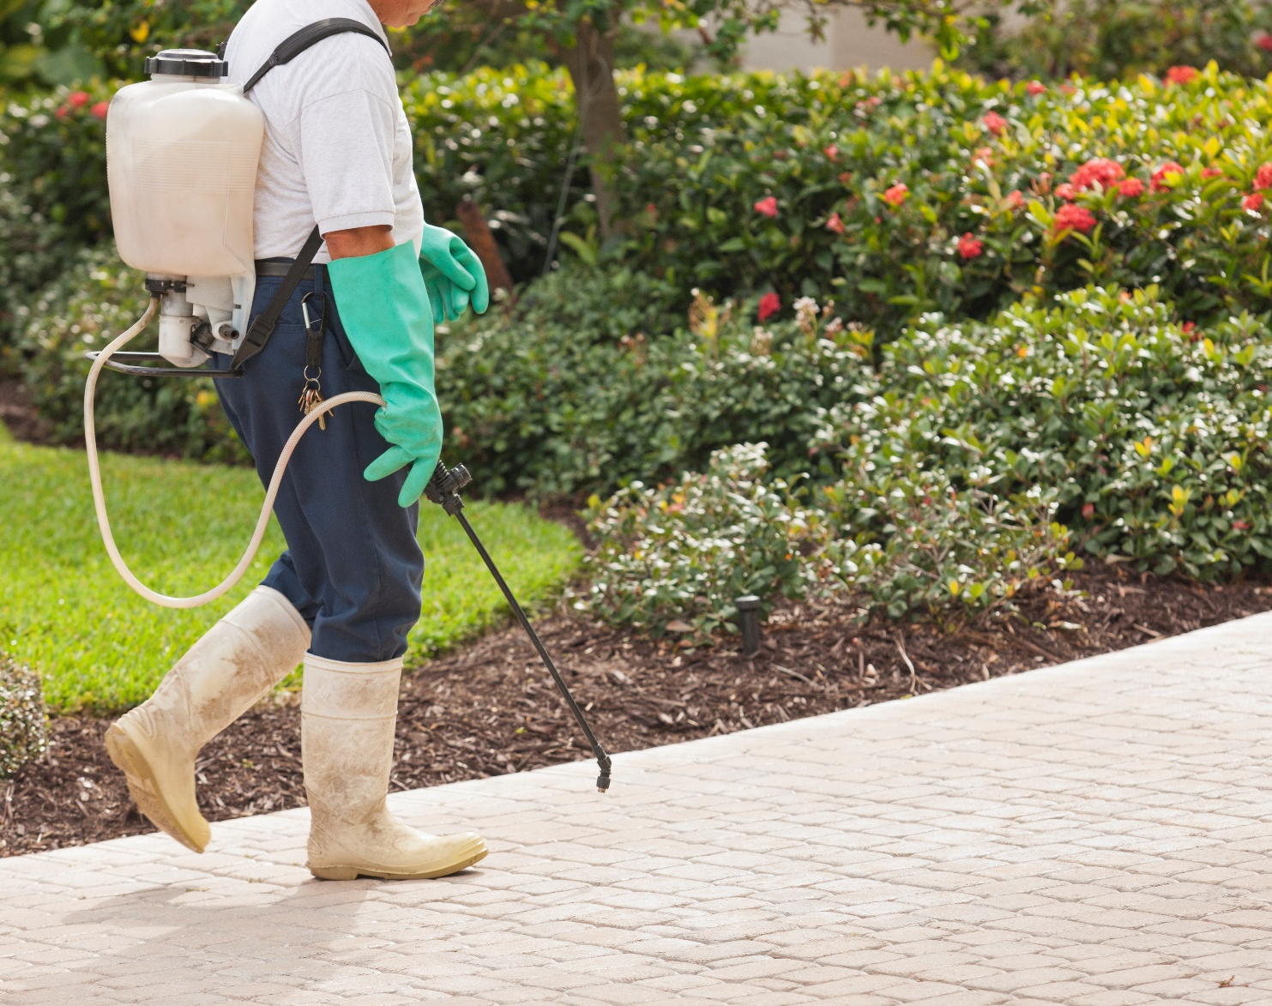
Handler
Location and description
Date, start, and end time
Product name, EPA registration (#), active ingredients, REI
Oral warnings, and treated area posting
Other safety requirements

Slide 17
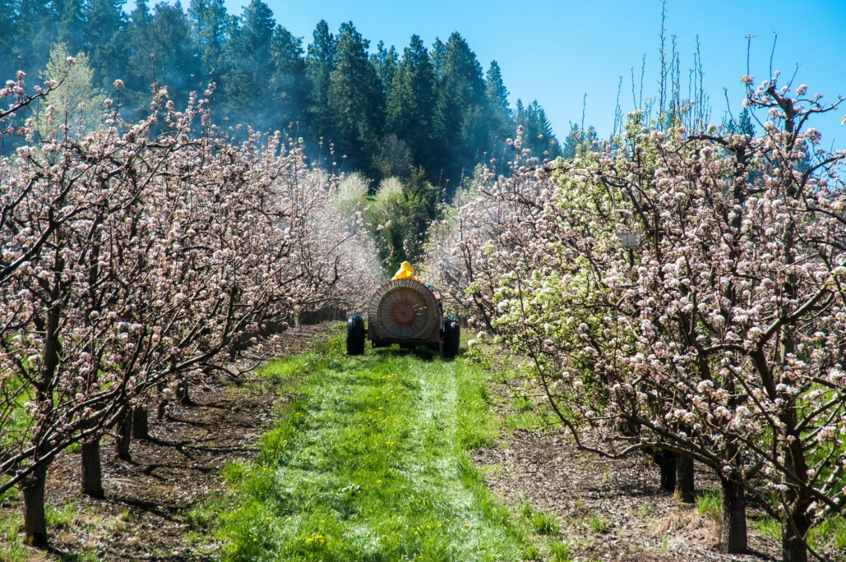
Employer
Specific location and description of any treated areas at their workplace where an REI is in effect that the commercial handler may be in or walk within 1/4 mile
Restrictions on entering those areas

Slide 18
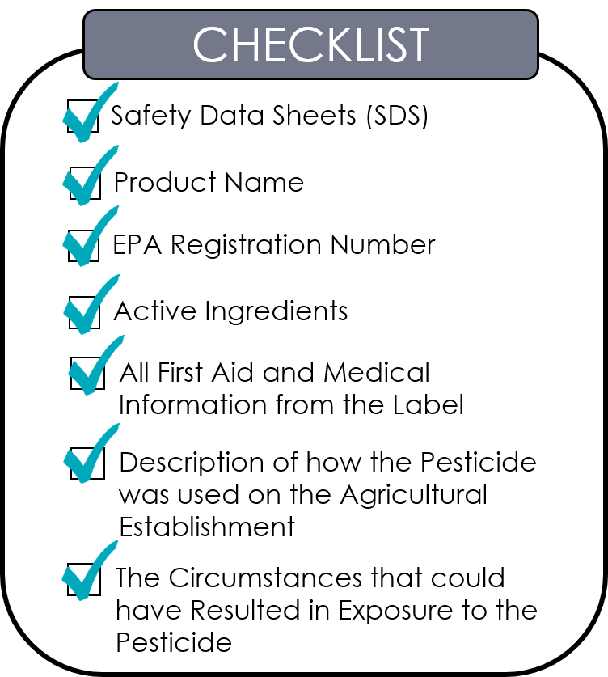
Exposed to pesticides
Transportation to emergency treatment
Provide information related to the pesticide to emergency personnel

Slide 19
Reporting requirements for ALL employers
Within 8 hours:
All work-related fatalities and catastrophes
Within 24 hours:
Any work-related:
Inpatient hospitalization
Amputation or avulsion
Loss of an eye
To report an incident, call Oregon OSHA’s toll-free line 24 hours a day, 7 days a week at 1-800-922-2689, or call your nearest Oregon OSHA field office. If a workplace death occurs on a holiday, or during the weekend, do not wait until regular business hours to report the workplace death.

Slide 20
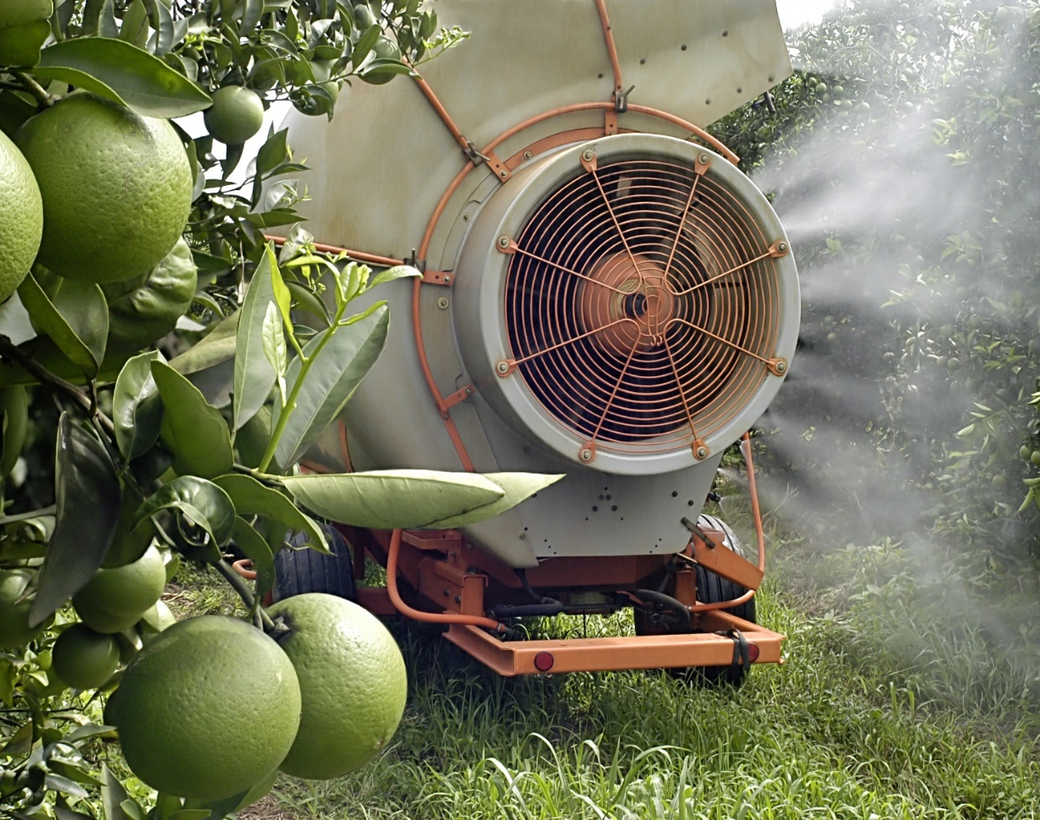
Agricultural employers: Restrictions during application
The application exclusion zone (AEZ) for outdoor production.
A specific area that varies by the type of application until the ventilation criteria are met for enclosed space production.

Slide 21
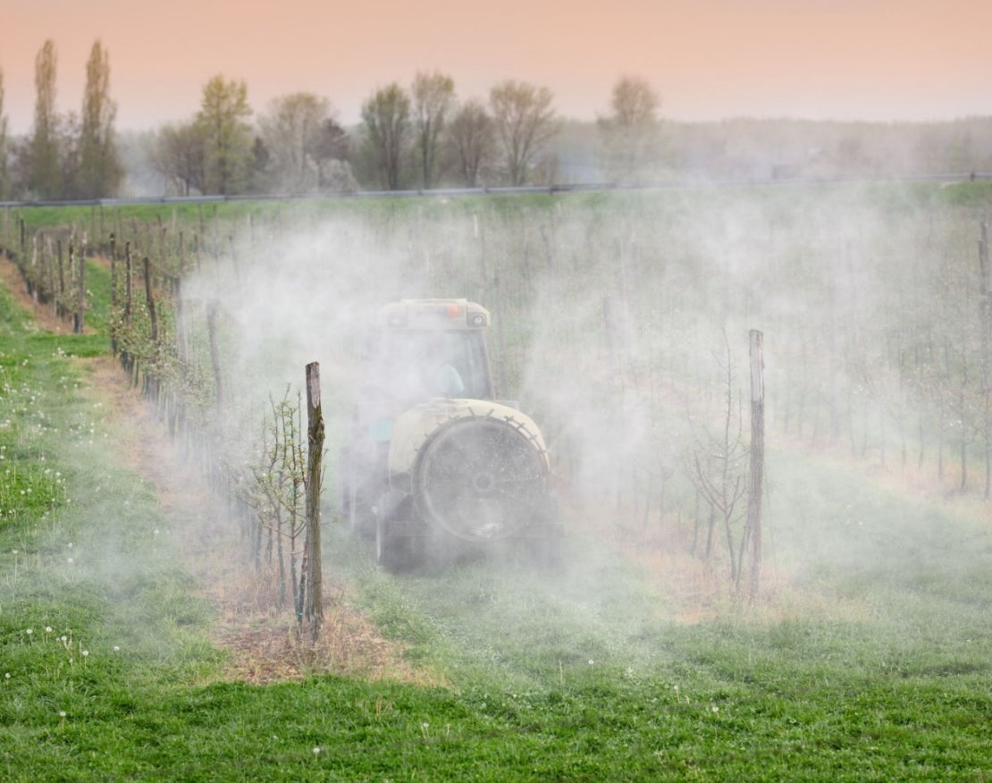
Restricted Entry Intervals (REIs)
If the pesticide label has notification directions, you must follow them.
If there are no notification directions on the label, you must either verbally warn or post signs.
If the REI is greater than 48 hours for an outdoor application, you must post signs.
If the REI is greater than 4 hours for an enclosed space (greenhouse) application, you must post signs.
Tell workers which method is in effect.

Slide 22
Levels of respiratory protection
Review the chart on workbook page 23. It lists images and descriptions of the most protective to least protective NIOSH respirators.

Slide 23
What is the Application Exclusion Zone (AEZ)?
AEZ YouTube Videos
English
Spanish

Slide 24
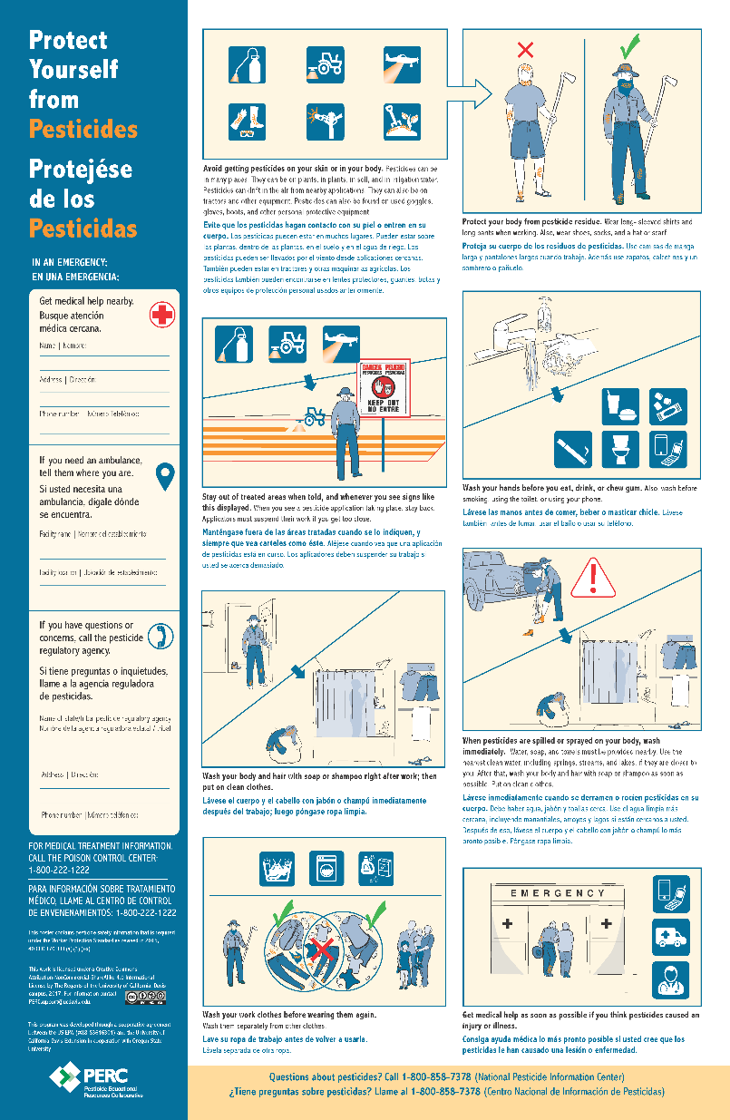

Posting information
Agricultural employer requirements:
ALH only
Information station
How to prevent or reduce pesticide exposure
Location of pesticide safety information
pesticideresources.org/wps/cp.html

Slide 25
Exercise (page 28)
What are the AEZ Requirements?
Review the decision matrix on page 27 for the Worker Protection Standard, Application Exclusion Zone.
Complete the scenarios on page 28.

Slide 26
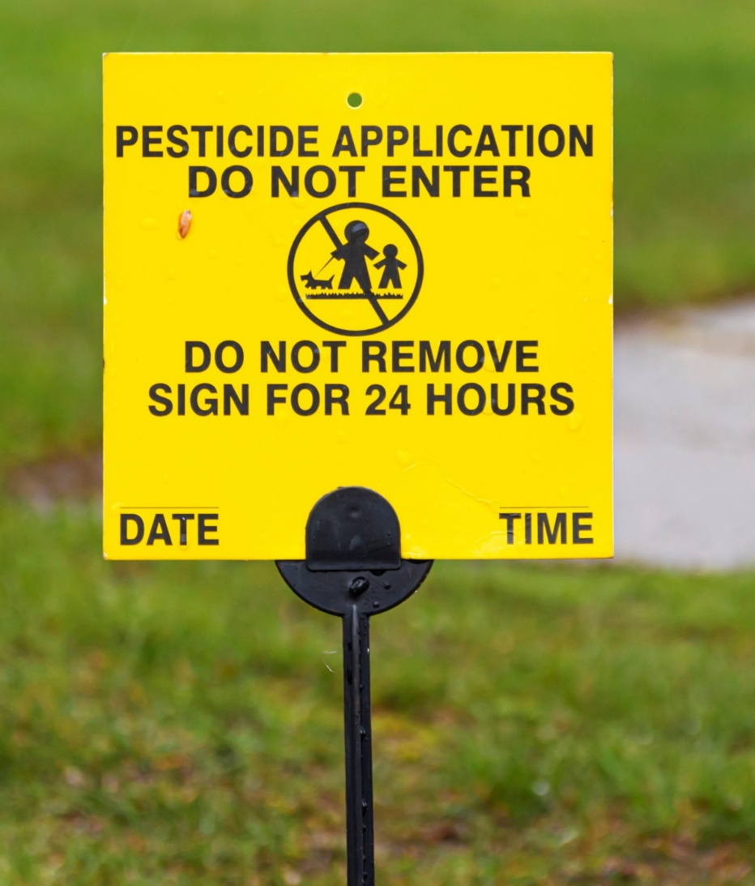
Application notification
Additional protection for workers
What do I need to do to notify my workers about a pesticide application?
What does a verbal warning mean?
What about warning the public about restricted entry?

Slide 27
Application notification (Continued)
Additional protection for handlers
Application restrictions and monitoring
  Specific instructions for handlers
Equipment
  Equipment safety for handlers
  Personal protective equipment
Remember to take steps to avoid heat-related illness when labeling requires the use of PPE for a handler activity.

Slide 28

WPS glove requirements
Pilots
Handlers and early entry workers
Glove liners
Hot or cold periods

Slide 29
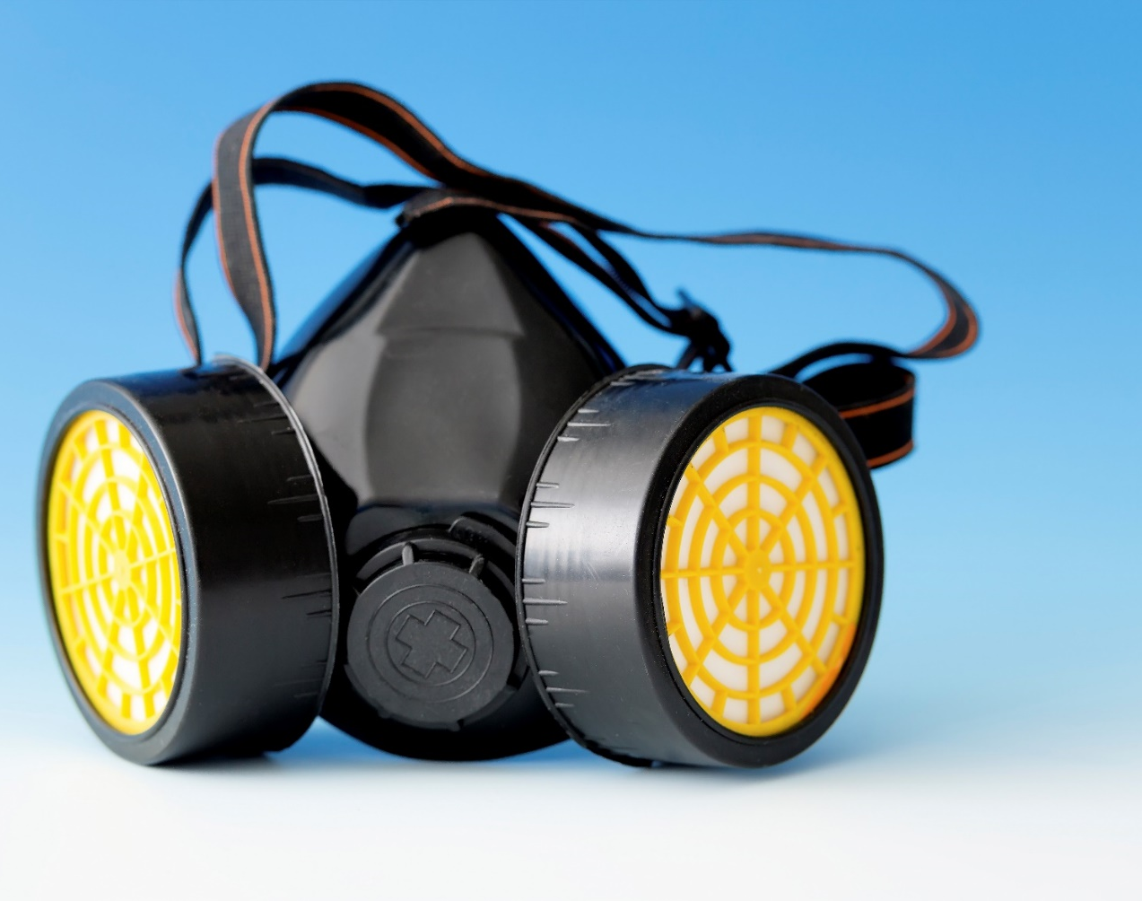
Care of PPE
Store
Wash
Respirators
Disposal
Instructions for people who clean PPE

Slide 30

Not directly employed by the establishment
Provide the following information:
The equipment may be contaminated with pesticides.
The potentially harmful effects of pesticide exposure.
How to handle equipment to limit exposure to pesticides.
How to wash themselves and/or their clothes to remove and prevent exposure to pesticide residues. Reference ORS 170.309 and 170.313(1).

Slide 31
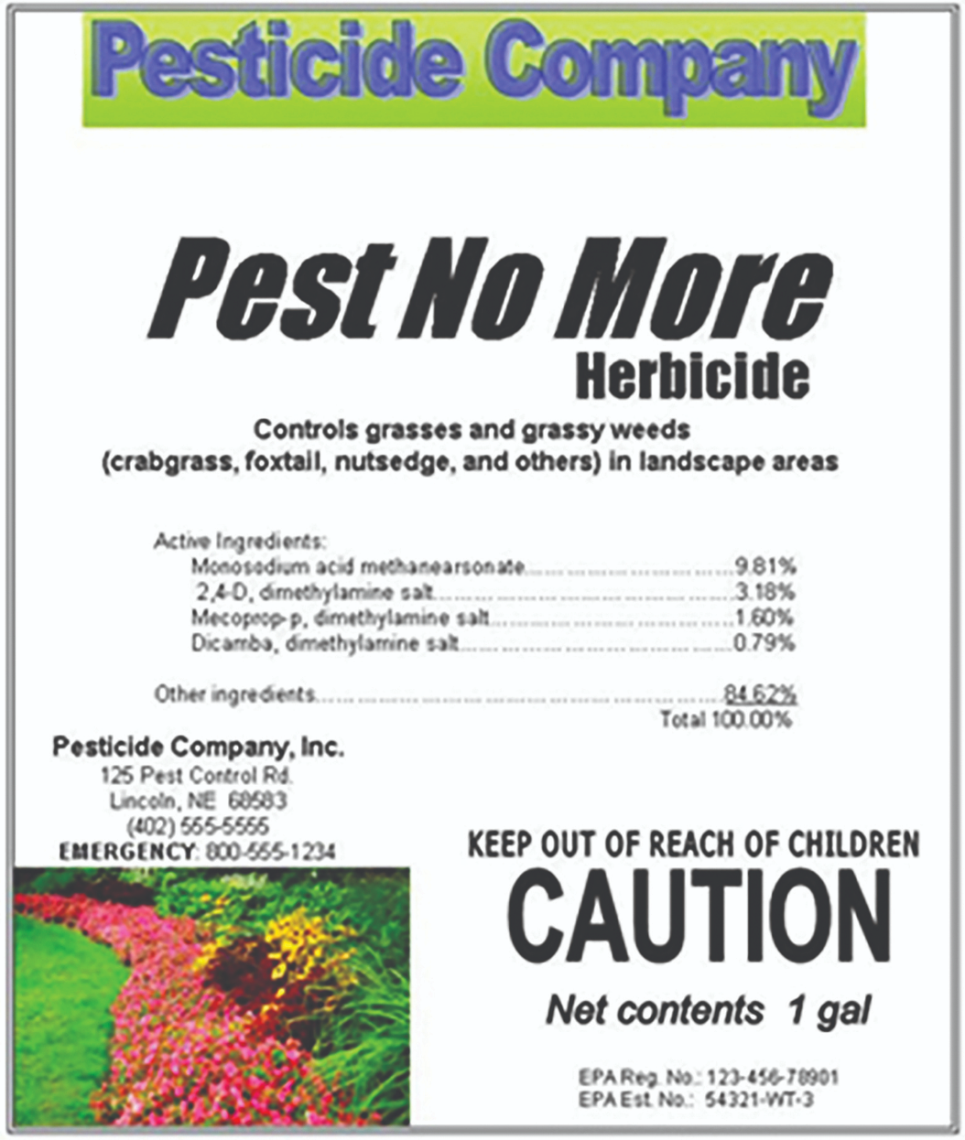
Eight items to notice on labels
Application restriction statement
40 CFR part 170 reference statement
Product-type identification statement
State restrictions
Spanish warning statement
Restricted entry statement
Notification-to-workers statement
Personal protective equipment statement

Slide 32
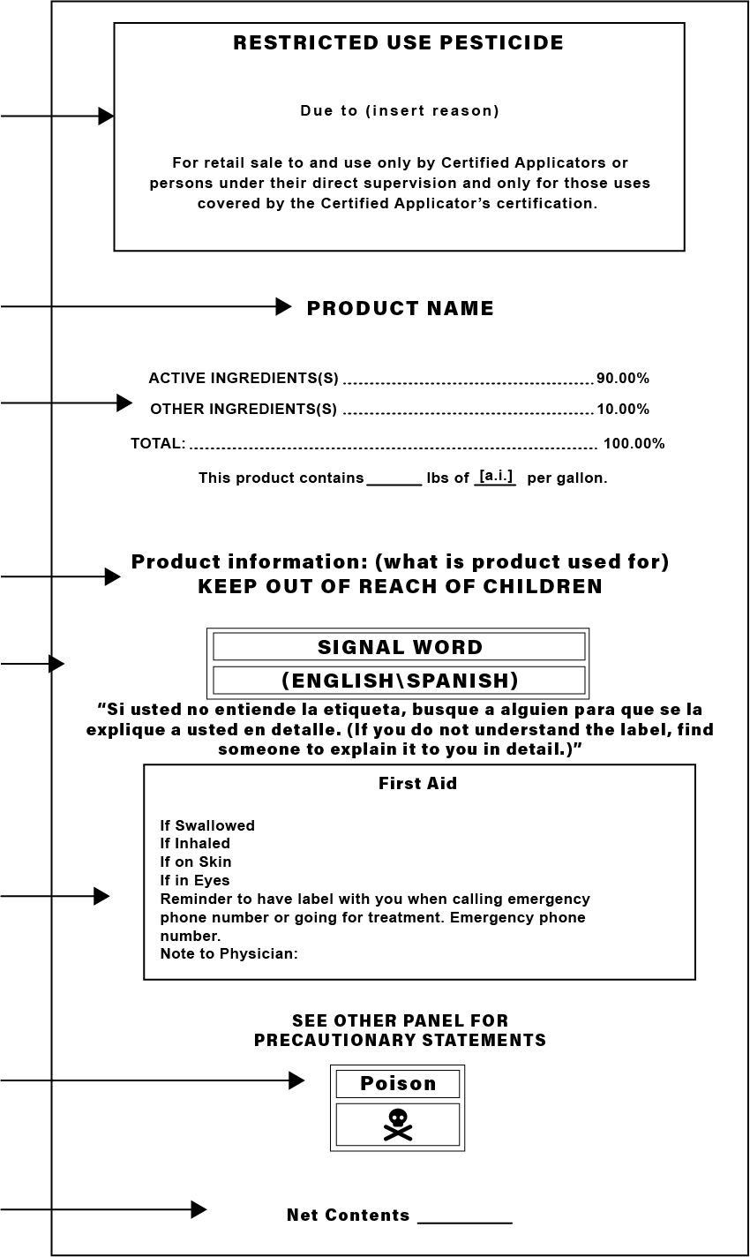
Review (page 36)
Parts of the label

Slide 33
Review - which rule applies
Have pesticides been applied, or has a restricted-entry interval been in effect within the last 30 days?

Slide 34
Last 30 days
Location of application
Product name
EPA registration (#)
Active ingredients
Time and date of the application
Restricted entry interval
Area treated | Product name | EPA Reg. number | Common name Active ingredient | Application Month/Day/ Time | Restricted entry interval | Do not enter until: Month/Day/Time
Example pesticide application record on next slide.

Slide 35
Example pesticide application record
Area treated | Product name | EPA Reg. number | Common name Active ingredient | Application Month/Day/ Time | Restricted entry interval | Do not enter until: Month/Day/Time
Pears Home Place | Dimethoate 2.67EC | 34704-489 | Dimethoate | May 5th - 11 a.m. | 10 days | May 15th - 11 a.m.
Blueberries Abilene Block | Captan 4L | 19713-644 | Captan | April 11th - 10:30 a.m. | 48 hours | April 13th- 10:30 a.m.
Grass Seed Field/Howell Prairie | Roundup Ultra | 524-475 | Glyphosate | March 25th - 2 p.m. | 4 hours | March 25th - 6 p.m.

Slide 36
Additional Educational Resources
Oregon OSHA
YouTube Channel
Website A-Z Topic Index
Online Training Courses
PESO – English to Español
Other Safety and Health Training Resources

Slide 37
Need more information? Call your nearest Oregon OSHA Office
Salem Central Office
350 Winter St. NE
Salem, OR 97301-3882
Phone: 503-378-3272
Toll-Free: 800-922-2689
Fax: 503-947-7461
en Español: 800-843-8086
Website: osha.oregon.gov
Eugene
1500 Valley River Drive, Suite 150
Eugene, OR 97401-4643
541-686-7562
Consultation: 541-686-7913
Medford
1840 Barnett Road, Suite D
Medford, OR 97504-8293
541-776-6030
Consultation: 541-776-6016
Pendleton
750 SE Emigrant Ave., Ste. 131
Pendleton, OR 97801
541-276-9175
Consultation: 541-276-2353
Portland
Durham Plaza
16760 SW Upper Boones
Ferry Road, Suite 200
Tigard, OR 97224-7696
503-229-5910
Consultation: 503-229-6193
Salem
1340 Tandem Ave. NE, Suite 160
Salem, OR 97301-8080
503-378-3274
Consultation: 503-373-7819
Bend
Red Oaks Square
1230 NE Third St., Suite A-115
Bend, OR 97701-4374
541-388-6066
Consultation: 541-388-6068

Slide 38
Thank you!

