Slide 1


Accident investigation
Presented by Oregon OSHA Public Education

Slide 2


Oregon OSHA Public Education Mission:
Oregon OSHA Services
Consultation Services
Enforcement
Appeals
Public Education and Conferences
Standards and Technical Resources
We provide knowledge and tools to advance self-sufficiency
in workplace safety and health.

Slide 3
Contact us
Field Offices:
Portland 503-229-6193
Salem 503-373-7819
Eugene 541-686-7913
Medford 541-776-6016
Bend 541-388-6068
Pendleton 541-276-2353
Salem Central
Toll Free English:
800-922-2689
Toll Free Spanish:
800-843-8086
Website: osha.oregon.gov

Slide 4

Goals
Complete the three primary tasks of an accident investigator:
Gather useful information
Analyze the facts surrounding the accident
Write the accident report

Slide 5
Accident investigation definitions
Accident
Incident
Lost-time injury
Hazard
Physical exposure
Environmental exposure
Direct cause
Surface cause
Root cause
Personal protective equipment (PPE)
Unsafe conditions
System weaknesses

Slide 6

Identify the proper steps for conducting an accident investigation:
Direct cause
Surface causes
Root causes

Slide 7

The purpose of investigating accidents
Determine the cause of the accident.
Determine what changes need to be implemented.
Determine if this affects other work areas and locations.
Determine what policies and procedures may need to be changed.

Slide 8

Where do workplace injuries come from?
Unpreventable acts account for 2 percent of all workplace accidents.
Hazardous conditions account for 10 percent of all workplace accidents.
Hazardous practices account for 88 percent of workplace accidents.

Slide 9
Activity (page 8)
Create groups, assign a team leader, and answer the following questions:
What’s the difference between an accident and an incident?
The two key conditions that must exist before an accident occurs are:

Slide 10
Laying the foundation
Have a written Analysis plan
  Who should be notified
  Who is authorized to notify outside agencies (police, fire, etc.)
  Who is assigned to conduct investigations
  Who receives and acts on investigation reports
  Expectation of time frames
    For conducting the investigation
    For follow-up actions (correction of causes)
Secure the Scene
  As soon as it is safe to do so
  Act quickly to record or document the scene (you may work around emergency responders)
  Determine witnesses

Slide 11
Reporting to Oregon OSHA
All employers are required to report:
Telephone numbers to call:
Within 8 hours:
All work-related fatalities and catastrophes
Within 24 hours:
Inpatient hospitalization
Amputation or avulsion
Loss of an eye
Bend | Pendleton
541-388-6066 | 541-276-9175
Eugene | Portland
541-686-7562 | 503-229-5910
Medford | Salem
541-776-6030 | 503-378-3274
Or call 800-922-2689 (toll-free)
The clock starts as soon as the employer knows one or more of the above conditions have occurred.

Slide 12

The six-step process
Secure the Scene
Collect the Facts
Develop the Sequence of Events
Determine the Cause
Recommend Improvements
Write the Report

Slide 13
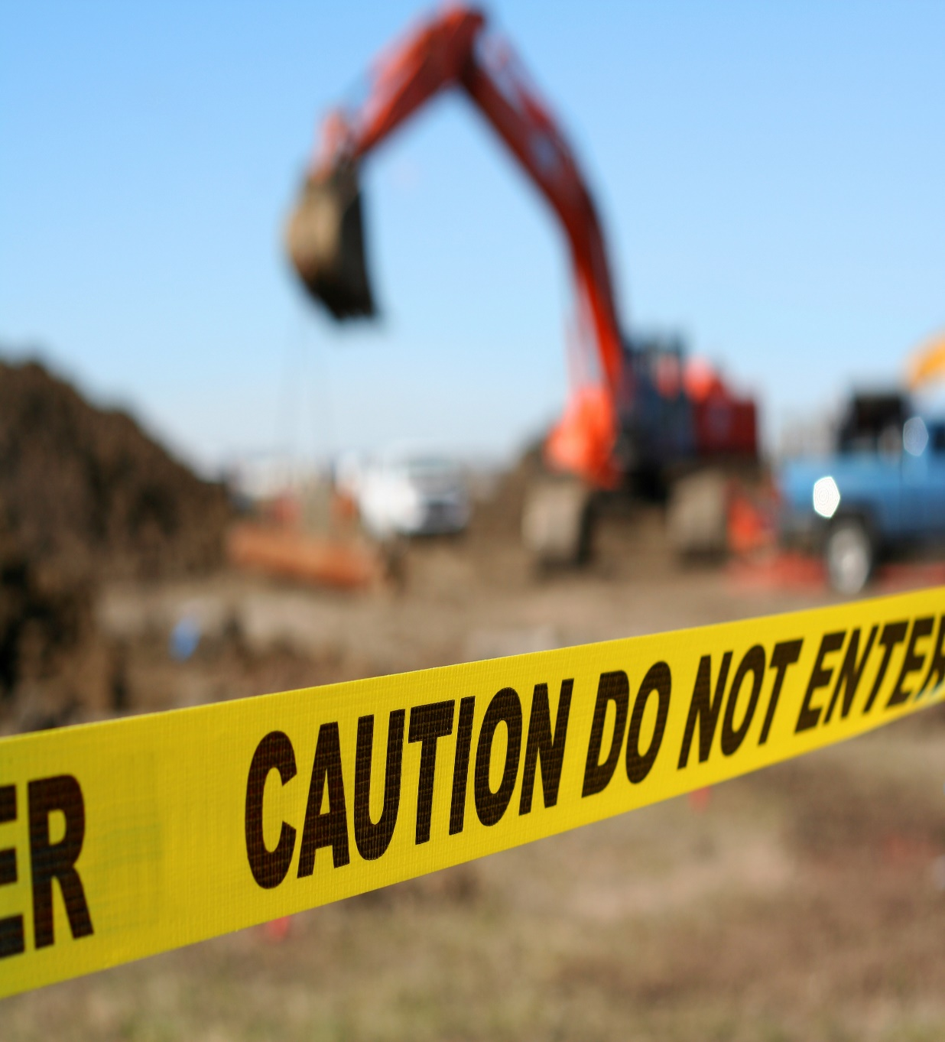
Step 1 - Secure the scene
Cordon off the area
Turn off or block equipment
Notify affected people
Survey the scene
Take note of anything to collect and submit for sampling
The primary goal in this step is to secure the accident scene to prevent further harm, then secondarily, to safeguard the evidence.

Slide 14
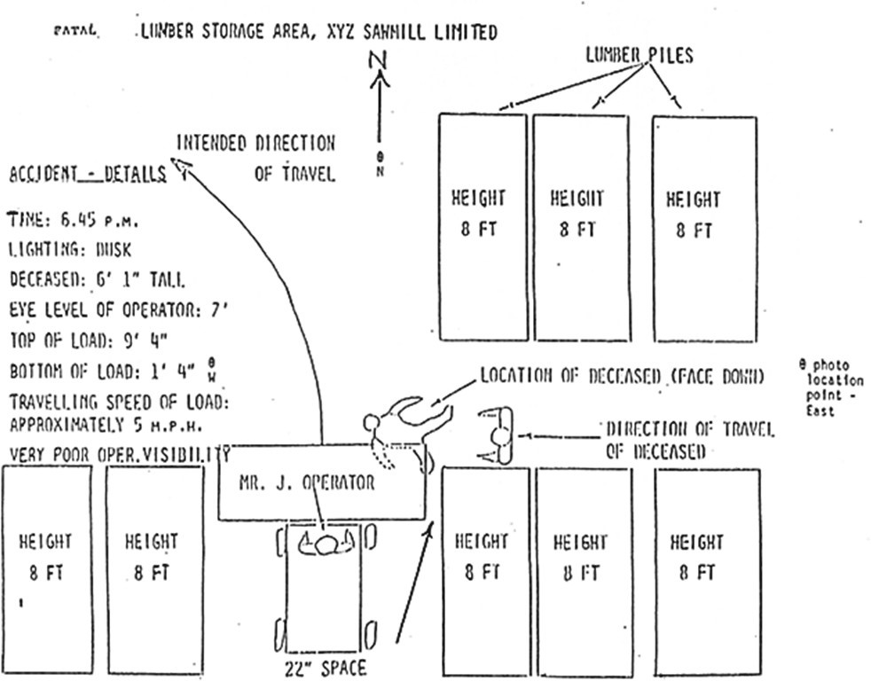
Step 2 - Collect the facts
Have an investigator’s kit available
Document and gather information
Photograph/sketch the scene
Take video at the scene
Review documents
Conduct interviews
The primary goal in this step is to secure the accident scene to prevent further harm, then secondarily, to safeguard the evidence.

Slide 15
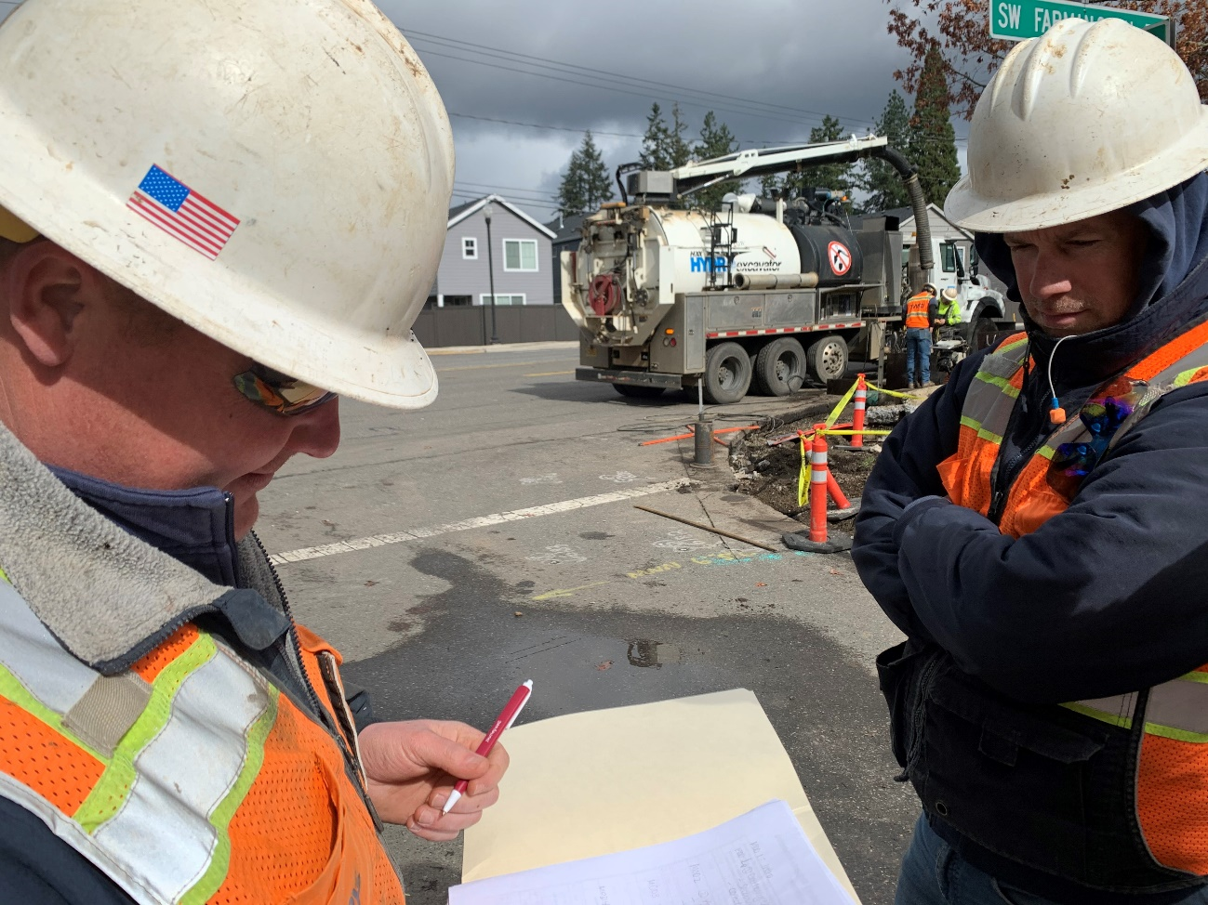
Exercise:
Get the facts (page 20)
Purpose: Gain as much information as possible about an accident through interviewing witnesses.
Instructions: Your instructor will describe an accident. Your team and the instructor are located at the scene of the accident and your job now is to ask follow-up questions to gather information about the accident. Make a list of your questions or notes.

Slide 16

Step 3 - Develop the sequence of events
Use the information gathered in Step 2 to determine the events prior to, during, and after an accident.
Next, study each factor/action to determine unsafe conditions (things or circumstances that directly caused the accident) and unsafe actions.

Slide 17
Actor / Action
Each event in the unplanned accident process identifies:
Actor – An individual or object that directly influenced the flow of the sequence of events:
  An actor initiates a change by performing or failing to perform an action.
  An actor may participate in the process or merely observe the process.
Action – Something that is done by an actor. Failure to act should be thought of as an act in itself.
  Actions may or may not be observable.
  An action may describe something that is done or not done.

Slide 18
Exercise:
What happened next? (page 22)
Use the information gathered about the accident your instructor described in the interview exercise to construct a sequence of events.
Instructions: Identify the events leading up to and including the injury event. Be sure you include only one actor and one action in each event. Decide where you want to start the sequence, then ask, “What happened next?”

Slide 19
Step 4 – Determine the cause
Once the sequence of events are developed, you can then study each factor/action to determine what contributed to or caused the accident:
Unsafe conditions: things and situations that directly caused the accident
Unsafe actions: actions taken or not taken that contributed to the accident
System weaknesses: underlying inadequate or missing programs, plans, policies, processes, and procedures that contributed to the accident.

Slide 20
Exercise:
Determine the cause (page 24)
Multiple Cause Theory
(Dan Petersen, “Safety Management: A Human Approach,” ASSE, Pages 10-11)
Behind every accident there are many contributing factors, causes, and sub-causes. These factors combine in a random fashion, causing accidents. We must find the fundamental root causes and remove them to prevent a recurrence.
What may be the causes(s) of the accident, according to the multiple causation theory?
What might be the solution to prevent the accident from recurring?
What are the strengths and weaknesses of this approach?

Slide 21
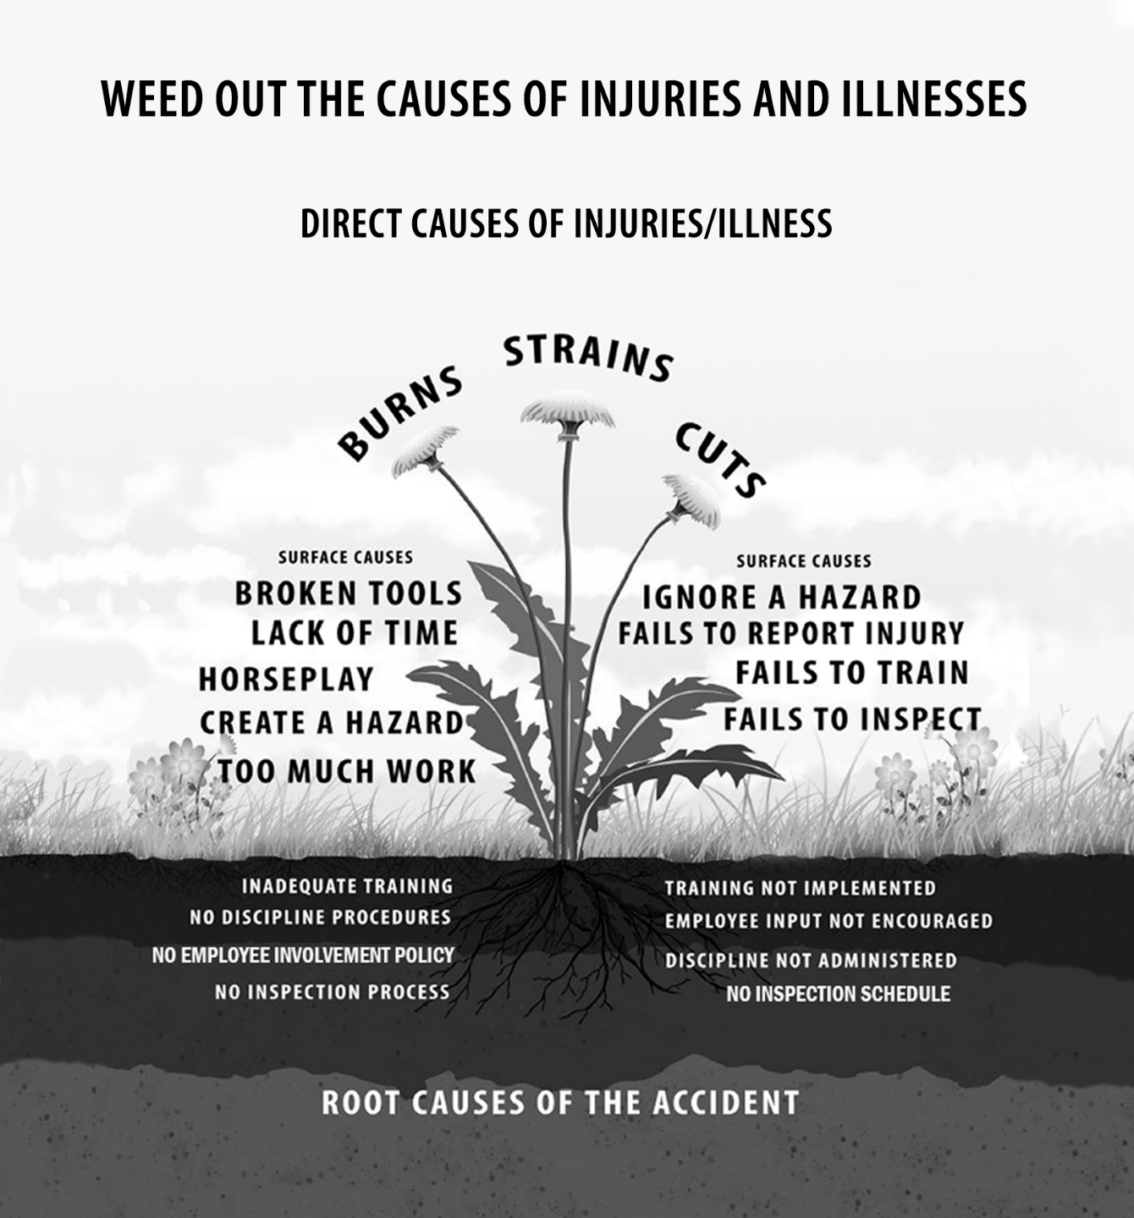
Weed out the causes of injuries and illnesses
Direct causes
Surfaces causes
Root causes

Slide 22

Steps in cause analysis
Analyze the injury event to identify and describe the direct cause of injury.
Analyze events occurring just before the injury event to identify those conditions and behaviors that caused the injury (primary surface causes) for the accident.
Analyze conditions and behaviors to determine other specific conditions and behaviors (contributing surface causes) that contributed to the accident.
Analyze each contributing condition and behavior to determine if weaknesses exist in carrying out safety policies, programs, plan, processes, procedures and practices (inadequate implementation).

Slide 23

Exercise:
Digging up the roots (page 27)
Enter the direct cause of injury in the top field from the previous exercise.
List one hazardous condition and one unsafe behavior from the sequence of events your group developed.
Determine contributing surface causes for the hazardous condition and unsafe behavior.
Determine implementation and design root causes for contributing surface causes.

Slide 24
Step 5 – Recommend improvements
Accident causes are addressed by recommending controls and safety system
improvements. Controls eliminate or reduce the direct and surface cause(s) of an accident. Safety system improvements address the root cause, specifically, missing or inadequate safety system policies and procedures that contributed to the accident.
Types of controls
Engineering controls
Management / administrative controls
Personal Protective Equipment (PPE)

Slide 25

Engineering controls
Physical fixes that eliminate the unsafe condition by isolating the worker from the hazard.
Design or redesign the facility, equipment, or process to eliminate the hazard or make it less hazardous.
Remove or enclose the hazard to prevent exposure in normal operations.
Substitute with a different item.
Replace the item with a safer version.

Slide 26

Management / administrative controls
Procedure that significantly limits daily exposure by control or manipulation of the work schedule or manner in which work
is performed by addressing workers’ actions.
Methods to eliminate or reduce the frequency and duration of exposure to unsafe conditions:
Change work habits
Improve sanitation and hygiene practices
Change the way an employee performs the job
Develop and implement a job hazard analysis (JHA)
Change work schedule

Slide 27

Personal protective equipment (PPE) controls
The use of PPE is not considered a management control and should be used in conjunction with the other controls; not on its own. When exposure to hazards cannot be engineered completely out of normal operations or maintenance work, and when safe work practices and administrative controls cannot provide sufficient additional protection from exposure, PPE is a control. Many tasks require the use of PPE in accordance with Safety Data Sheets (SDS) and Oregon OSHA requirements.
PPE includes:
Face shields
Steel-toed shoes
Safety glasses
Hard hats
Knee Guards
Leather aprons
Respirators
Hearing protection
Safety goggles
Harness
Gloves
Welding Shields
Visibility vest
Heat protection

Slide 28

Exercise:
Types of controls (page 29)
Why are engineering controls considered superior to management controls?

Slide 29
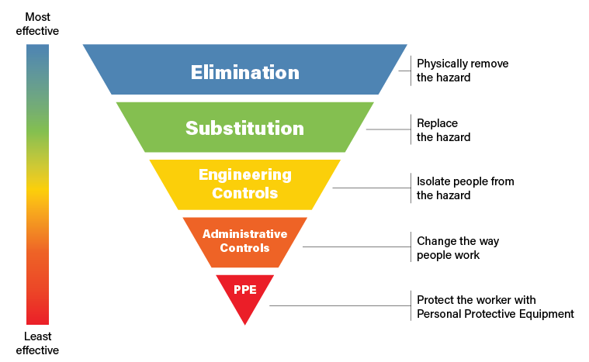
Exercise:
Recommending corrective action (page 30)
Discuss the interim measures on page 30 and use the hierarchy of control strategies as a guide to determine corrective actions that will eliminate or reduce one of the hazardous conditions or unsafe behaviors identified on page 27.
The Hierarchy of Controls

Slide 30

Improvement strategies to fix the system
Make improvements to policies, programs, plans, processes, and procedures in one or more of the following elements of the safety and health management system:
Management commitment
Accountability
Employee involvement
Hazard identification/control
Incident/accident analysis
Training
Evaluation

Slide 31
Exercise:
Fix the system….not the blame (page 31)
Develop and write a recommendation to improve one or more policies, plans, programs, processes, procedures, and practices identified as design weaknesses. This is to make sure the case study accident doesn’t reoccur.

Slide 32
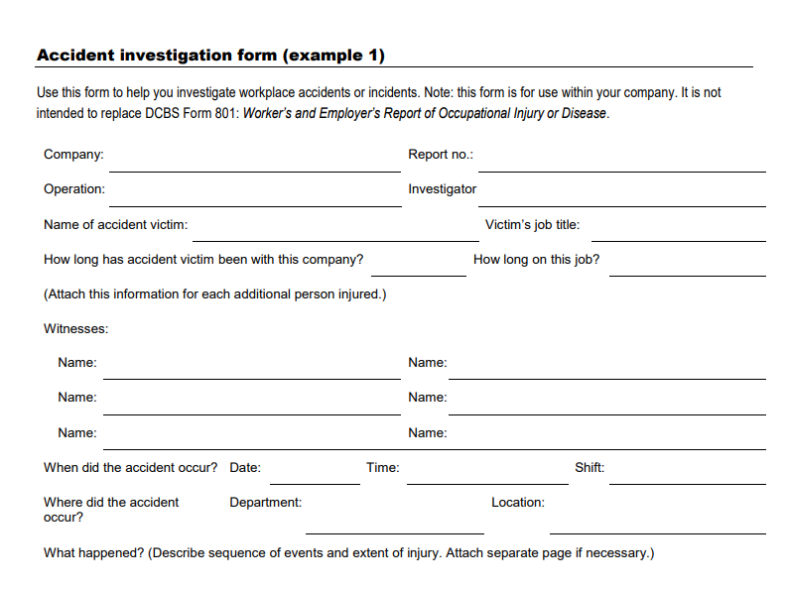
Step 6 – Writing the report
Seven points:
Background
Description of the accident
Findings
Recommendations
Summary / Conclusion
Review and follow-up actions
Attachments

Slide 33

Effective accident investigations
The report is an open document until all actions are complete.
For an accident investigation to be effective, management must:
Consider the findings
Develop a plan for corrective action and system improvements
Evaluate the plan periodically to maintain an effective program

Slide 34
Additional Educational Resources
Oregon OSHA’s YouTube Channel
A-Z Topic Index
Oregon OSHA Online Training Courses
PESO – English to Español
Other Safety and Health Training Resources

Slide 35
Need more information? Call your nearest Oregon OSHA Office
Salem Central Office
350 Winter St. NE
Salem, OR 97301-3882
Phone: 503-378-3272
Toll-Free: 800-922-2689
Fax: 503-947-7461
en Español: 800-843-8086
Website: osha.oregon.gov
Eugene
1500 Valley River Drive, Suite 150
Eugene, OR 97401-4643
541-686-7562
Consultation: 541-686-7913
Medford
1840 Barnett Road, Suite D
Medford, OR 97504-8293
541-776-6030
Consultation: 541-776-6016
Pendleton
750 SE Emigrant Ave., Suite 131
Pendleton, OR 97801
541-276-9175
Consultation: 541-276-2353
Portland
Durham Plaza
16760 SW Upper Boones
Ferry Road, Suite 200
Tigard, OR 97224-7696
503-229-5910
Consultation: 503-229-6193
Salem
1340 Tandem Ave. NE, Suite 160
Salem, OR 97301-8080
503-378-3274
Consultation: 503-373-7819
Bend
Red Oaks Square
1230 NE Third St., Suite A-115
Bend, OR 97701-4374
541-388-6066
Consultation: 541-388-6068

Slide 36
Thank you!

