Slide 1
Confined Space

Slide 2
Oregon OSHA Public Education Mission:
Consultation Services
Enforcement
Public Education and Conferences
Standards and Technical Resources
We provide knowledge and tools to advance self-sufficiency in workplace safety and health.

Slide 3
Contact us
Field Offices:
Portland 503-229-5910
Salem 503-378-3274
Eugene 541-686-7562
Medford 541-776-6030
Bend 541-388-6066
Pendleton 541-276-2353
Salem Central:
Toll Free English: 800-922-2689
Toll Free Spanish: 800-843-8086
Website: osha.oregon.gov

Slide 4
Videos
Oregon OSHA - Trench Cave in
Safety Animation – Confined Space Hazards
WorkSafeBC – Confined Spaces: Deadly Spaces

Slide 5
Who does the rule apply to?
Oregon employers covered by:
General industry (Division 2)
Construction (Division 3)

Slide 6
What doesn’t the rule apply to?
Employers covered by Federal OSHA
Work covered by another rule

Slide 7
Are there words in the rule with specific definitions?
Yes! They can be found in Section 3 of the rule, which is located in Appendix A of this workbook.

Slide 8
What is a confined space?
It is a space that meets all of the following requirements:
Large enough and shaped so someone can fully enter and do work
AND
Entry and/or exit is limited or restricted
AND
Is not designed for continuous human occupancy.

Slide 9
Activity
Identify the confined spaces in the following photos.

Slide 10
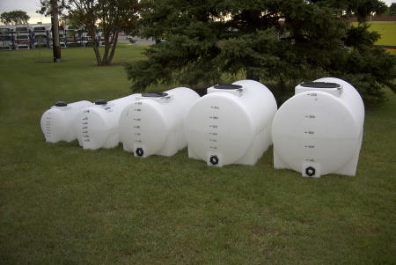
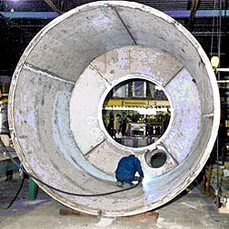
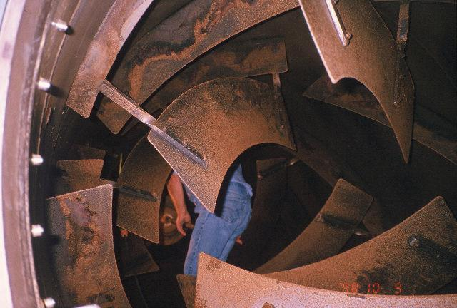
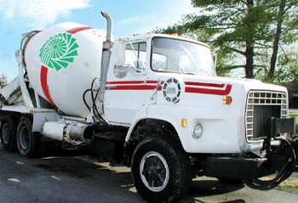
What is a confined space?
Welding During
Tank Construction
Plastic Tanks
Cement Mixer
Cement Mixer Drum

Slide 11
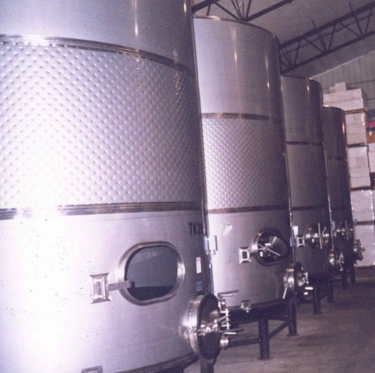
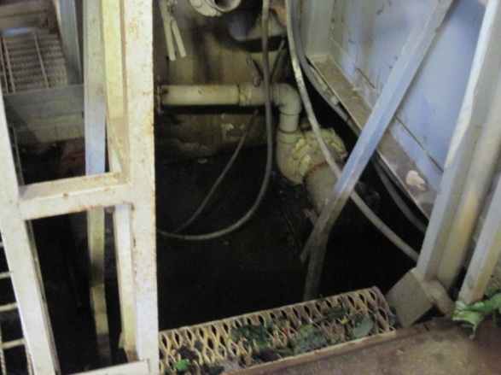
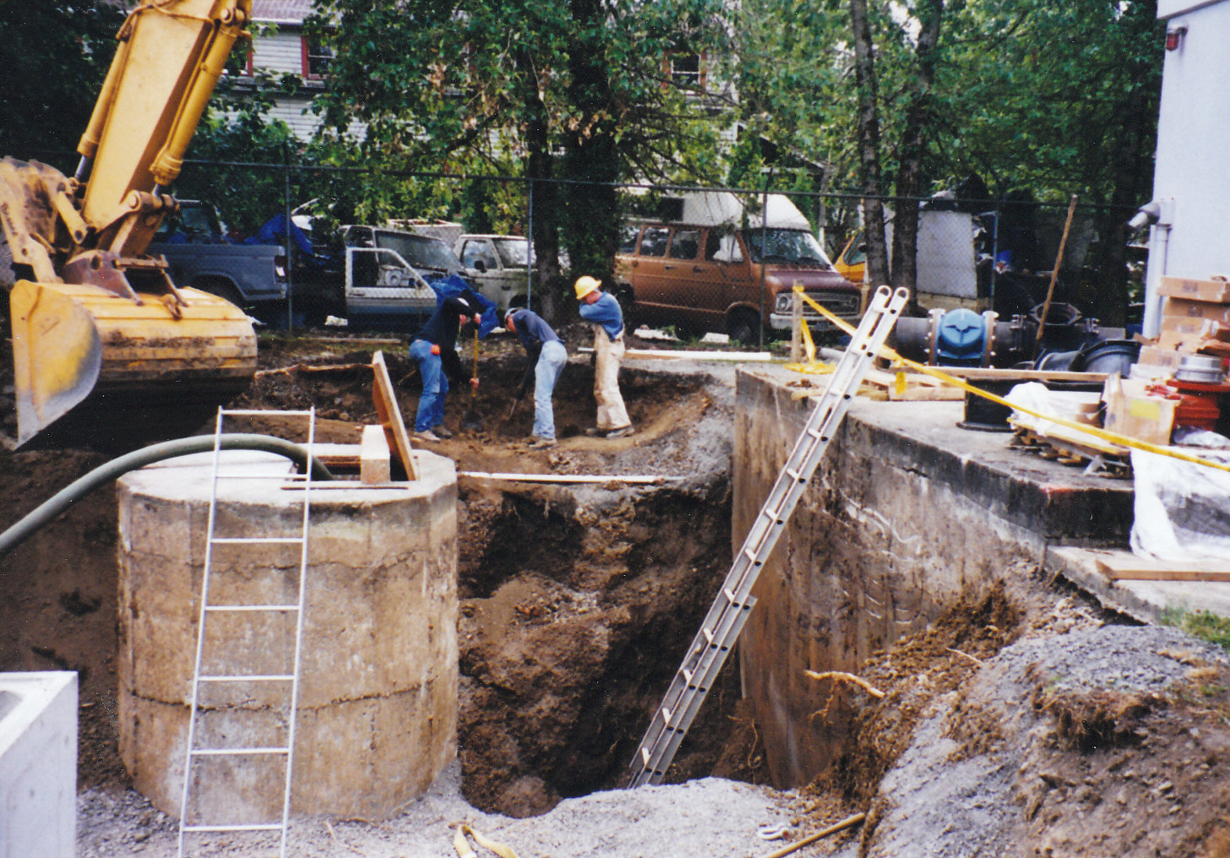
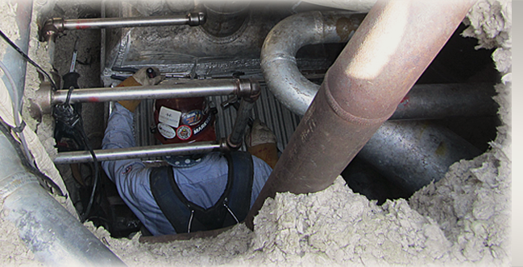
What is a confined space?
Fermentation
Tank
Produce
Washer
Underground
Utility Tunnel
Manhole in Excavation

Slide 12
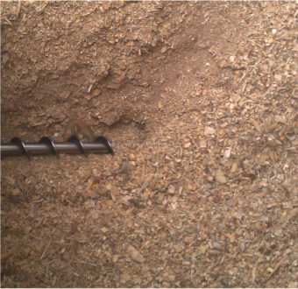
What is a permit required confined space?
It is a confined space with a hazard:
Have or could have a hazardous atmosphere
Contains a material that could trap or bury
Is shaped so a person could be trapped or asphyxiated
Has any other recognized serious safety or health hazard

Slide 13
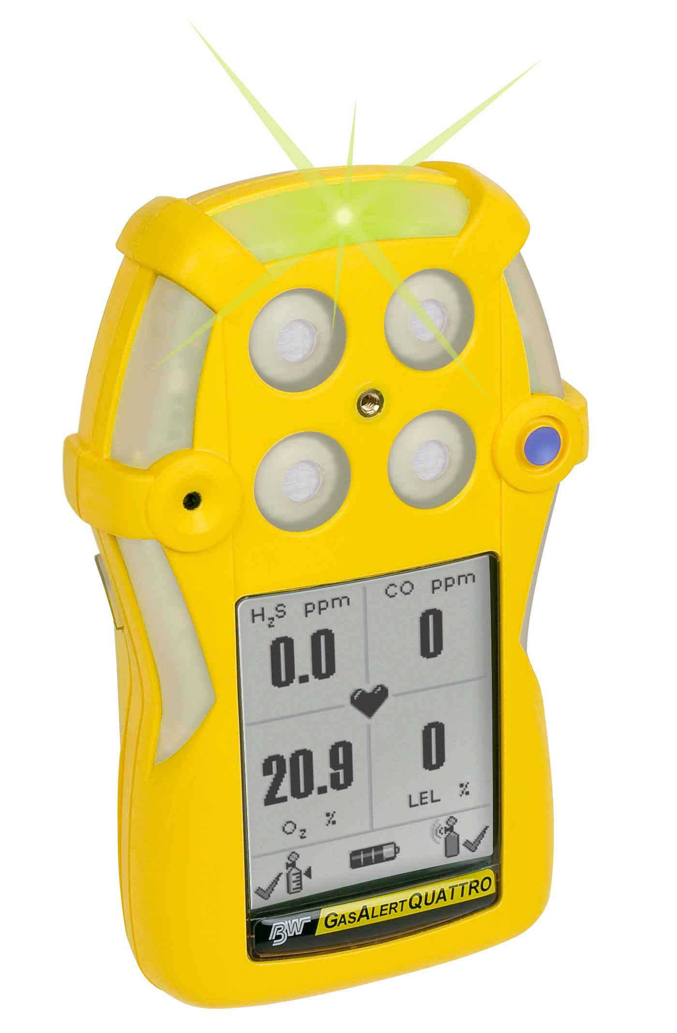
Hazard evaluation
Types:
Physical hazards
Atmospheric hazards

Slide 14
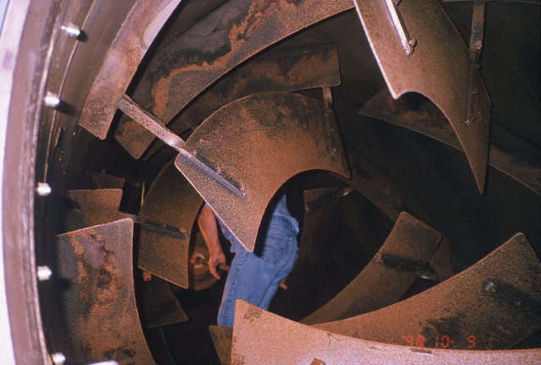
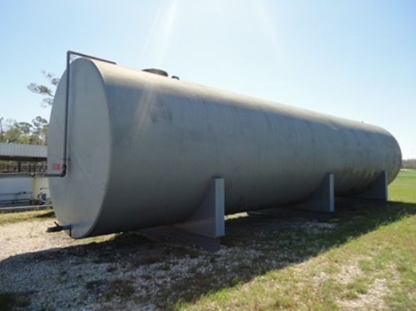
Identify the permit-required confined spaces

Slide 15
Signs

Slide 16
Options for entering a permit – required confined space
Permit-Required Confined Space
Employees do not enter
Permit Entry
Alternate Entry when allowed

Slide 17
Employees do not enter

Slide 18
Entry with a permit

Slide 19
Alternate entry

Slide 20
Multi-employer worksites
Your employees do not enter, but someone else’s do.
or
Your employees enter someone else’s space.

Slide 21
Records

Slide 22
Additional Educational Resources
Oregon OSHA’s YouTube Channel
A-Z Topic Index
PESO – English to Español
Online Training Courses
Federal OSHA Confined Spaces Advisor

Slide 23
Thank You!

