Slide 1
Hazard Identification

Slide 2
Oregon OSHA Public Education Mission:
Consultative Services
Enforcement
Public Education and Conferences
Standards and Technical Resources
We provide knowledge and tools to advance self-sufficiency in workplace safety and health.

Slide 3
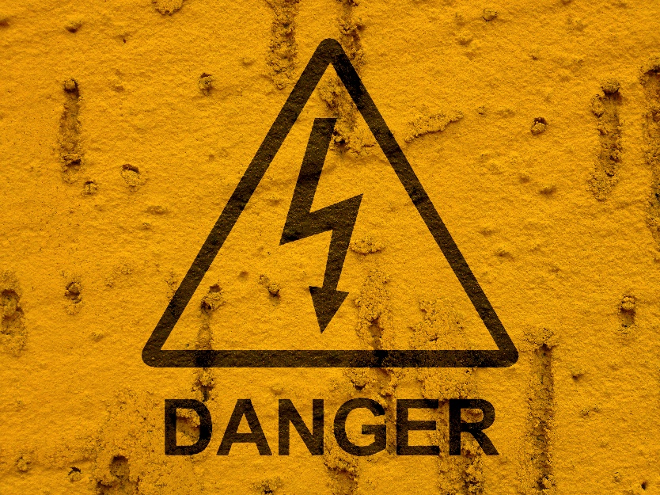
Contact us
Field Offices:
Portland 503-229-5910
Salem 503-378-3274
Eugene 541-686-7562
Medford 541-776-6030
Bend 541-388-6066
Pendleton 541-276-2353
Salem Central:
Toll Free English: 800-922-2689
Toll Free Spanish: 800-843-8086
Website: osha.oregon.gov

Slide 4
Top 10 Most Dangerous Industries in America (2018) Bureau of Labor Statistics
# | Occupation | Fatalities | Fatal work injury rate (per 100,000 workers)
1 | Construction | 971 | 9.5
2 | Transportation and warehousing | 882 | 15.1
3 | Agriculture, forestry, fishing, and hunting | 581 | 23
4 | Professional and business services | 532 | 3
5 | Government | 473 | 2
6 | Manufacturing | 303 | 1.9
7 | Retail trade | 287 | 2
8 | Leisure and hospitality | 262 | 2.2
9 | Educational and health services | 189 | .08
10 | Mining, quarrying, and oil and gas extraction | 112 | 12.9

Slide 5
Purpose
Provide you the basic knowledge and skills to identify, analyze, and apply control strategies to eliminate or reduce hazardous conditions and unsafe practices in the workplace.

Slide 6
What to expect
Identifying hazards
Why, rules, definitions
Types
Causes
Tools
Controlling hazards
Hierarchy of controls
Maintenance
Tracking
Group exercises

Slide 7
Injuries and illnesses every year
6,000 die from injuries
50,000 die from chemical exposures
6,000,000 suffer nonfatal injuries
Injuries cost $110,000,000

Slide 8
What is exposure?
How close are you to the danger zone?

Slide 9
Types of hazards
What is the final effect?

Slide 10
4 Strategies
Safety inspection
Observation
Job hazard analysis
Incident/accident investigation

Slide 11
Safety inspection
Who is involved?
Major weakness?
How can we overcome this weakness?
Safety Inspection - Video

Slide 12
Job hazard analysis (JHA)
Why is it important to involve the employees in the JHA process?
Introduction to the Job Hazard Analysis - Video

Slide 13
What’s the hazard?
What kind of accident might occur?

Slide 14
What’s the hazard?
What kind of accident might occur?

Slide 15
What’s the hazard?
What kind of accident might occur?

Slide 16
Hierarchy of controls
Engineering controls
Administrative controls
Personal protective equipment
Understanding Hazard Controls Example - Video

Slide 17
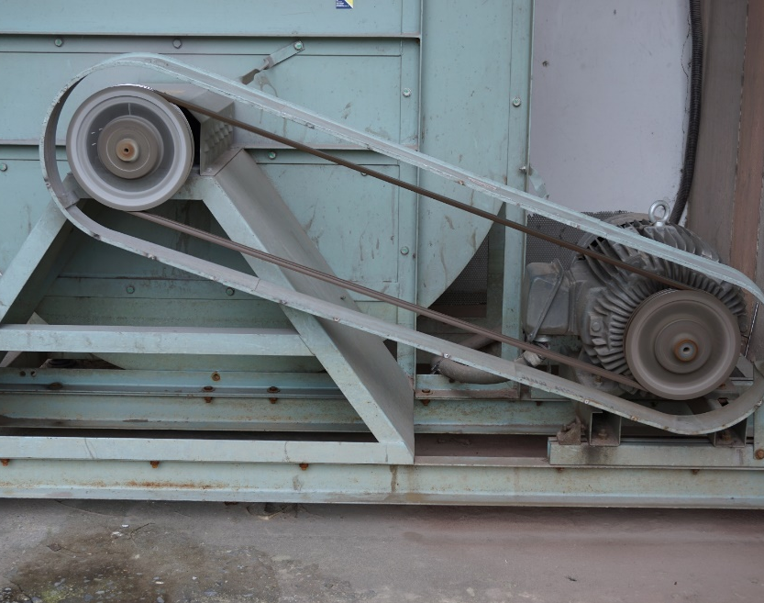
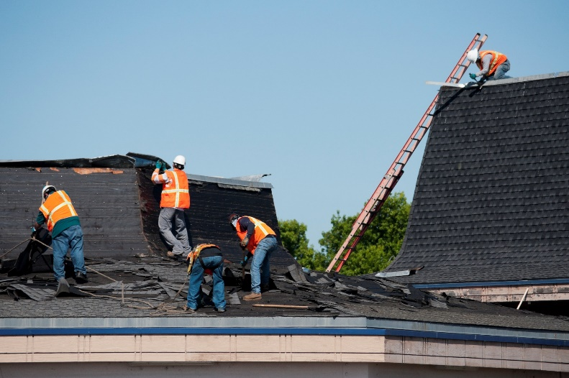
How do you control these hazards?

Slide 18
Additional Educational Resources
Oregon OSHA’s YouTube Channel
A-Z Topic Index – Hazard Identification
PESO – English to Español

Slide 19
Thank You!

