Slide 1


Heat Illness Prevention / Wildfire Smoke Hazards
Presented by Oregon OSHA Public Education

Slide 2


Oregon OSHA Public Education Mission:
Oregon OSHA Services
Consultation Services
Enforcement
Appeals
Public Education and Conferences
Standards and Technical Resources
We provide knowledge and tools to advance self-sufficiency
in workplace safety and health.

Slide 3
Contact us
Field Offices (Consultation):
Portland 503-229-6193
Salem 503-373-7819
Eugene 541-686-7913
Medford 541-776-6016
Bend 541-388-6068
Pendleton 541-276-2353
Salem Central
Toll Free English:
800-922-2689
Toll Free Spanish:
800-843-8086
Website: osha.oregon.gov

Slide 4
Heat Illness Prevention / Wildfire Smoke Hazards
This two-topic workshop reviews the training requirements found in Oregon OSHA's rules, rule exemptions, and industry best practices and advanced hazard analysis methods. You will also learn about employees’ rights. See below for additional class details.
Heat Illness Prevention (Topic 1)
You will learn about heat-related illnesses with their common signs, symptoms, recommended first aid responses, and risk factors. This class discusses control measures the rules require employers to provide at certain heat indices, such as access to shade and drinking water. You will learn how the heat index is measured and how to utilize NIOSH’s Heat Safety Tool app. This class walks you through how to develop and implement a written plan for acclimatization and create a heat illness prevention plan.
Wildfire Smoke Hazards (Topic 2)
You will learn about, air quality measurements, potential health effects and symptoms of wildfire smoke exposure, and proper usage of filtering facepiece respirators.
Notes:
Instructor, please expand on the purpose of this two-topic combination training and why it’s being presented this way.

Slide 5

Heat Illness Prevention (Topic 1)
We will cover the following:
Heat-related illnesses
Signs, symptoms, and first-aid responses
Heat index
Control measures
Acclimatization
Training requirements
Additional Oregon OSHA rules

Slide 6

Heat Illnesses and Prevention
Being prepared for the hot season requires the same planning as many other hazards covered by Oregon OSHA rules.

Slide 7

Local Emphasis Program
The heat illness prevention rule is an emphasis program, meaning that when the rule is in effect, enforcement officers will generally be looking at these requirements.

Slide 8
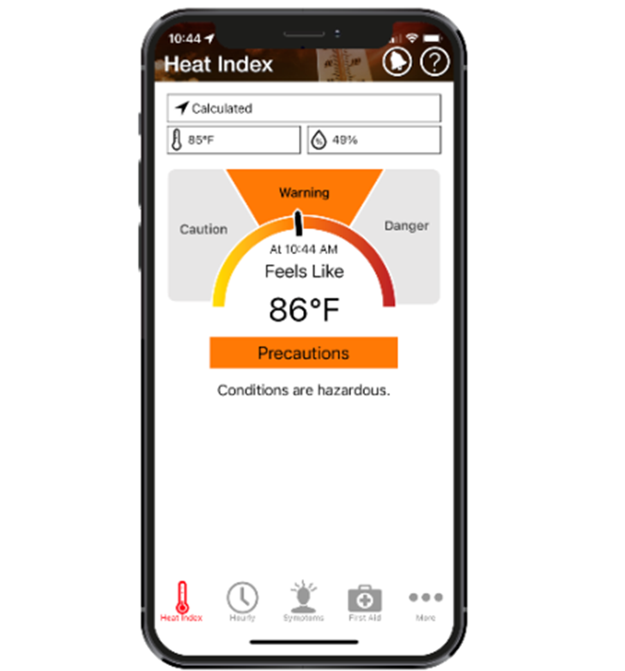
Terminology
Heat Illness – Multiple medical conditions can occur when the body cannot adequately cool itself through sweating, typically in response to high external temperatures.
Heat Index – The Heat Index is a measure of how hot it really feels when relative humidity is factored in with the actual air temperature.

Slide 9
Full Exemptions
Work activities involving incidental exposures to a heat index above 79 degrees Fahrenheit, but only when the employee is not exposed for more than 15 minutes in any sixty-minute period.
Harmful or hazardous temperature and humidity conditions created by a work process covered under OAR 437-002-0144(2), but only when the outdoor ambient temperature alone would not cause the workplace heat index to exceed 79 degrees Fahrenheit, regardless if the work process was creating any heat at the time of exposure.
Emergency operations, but only when directly involved in the protection of life or property, or the restoration of essential services.

Slide 10
Partial Exemptions
Employees performing either “rest” or “light” workloads when the heat index is less than 90°F.
Wildland firefighters and associated support activities are only exempt from the acclimatization requirements.
Employees who work from home are only subject to the training requirements.

Slide 11
Heat-Related Worker Deaths in the USA by Year
Class Questions:
What characteristics of Oregon may be associated with fewer heat-related-deaths than other states?
In contrast, what characteristics of Oregon might contribute to heat-related-illnesses and even deaths?

Slide 12
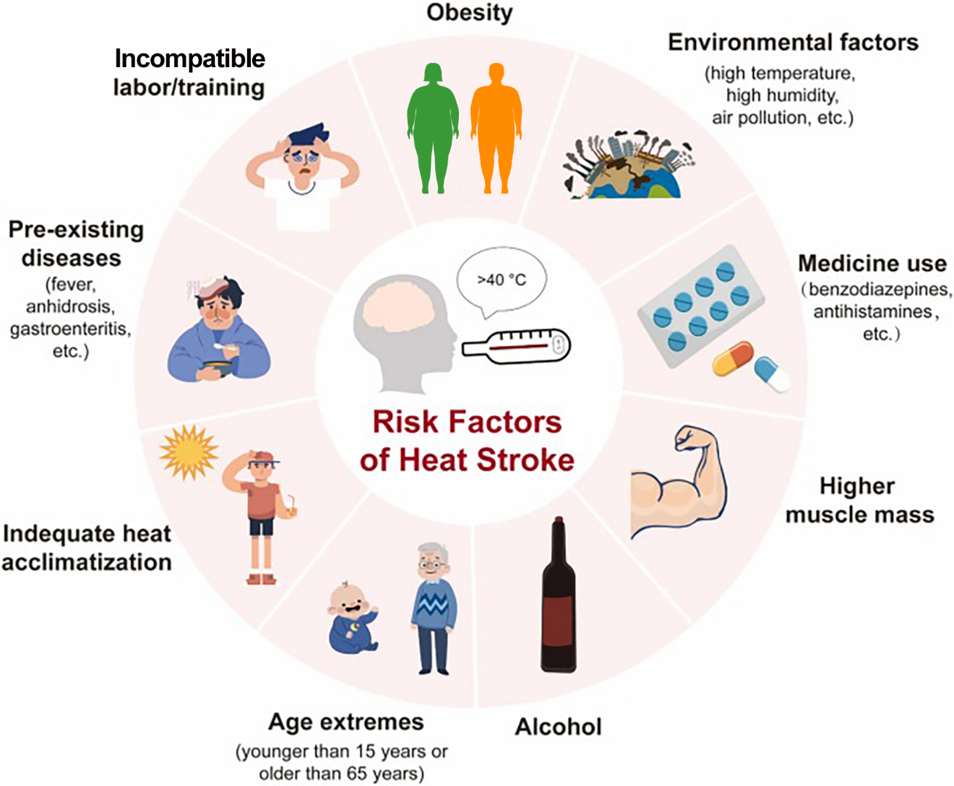
Factors of Heat on the Body
    Temperature is a significant factor, but one of many:
    Physiological
    Environmental
    Work Methods
    Acclimatization
    Additional Burden of Clothing and Equipment

Slide 13

Employee Factors
Some factors that may increase the risk of heat stress:
The effect of personal protective equipment (PPE) on the body’s ability to regulate heat;
The effect of the type of work clothing on the body’s ability to regulate heat;
Relative humidity, whether work activities are indoors or outdoors;
The intensity of the work being performed; and
Performing work in direct sunlight.
These considerations are REQUIRED
when choosing Work/Rest Option A

Slide 14
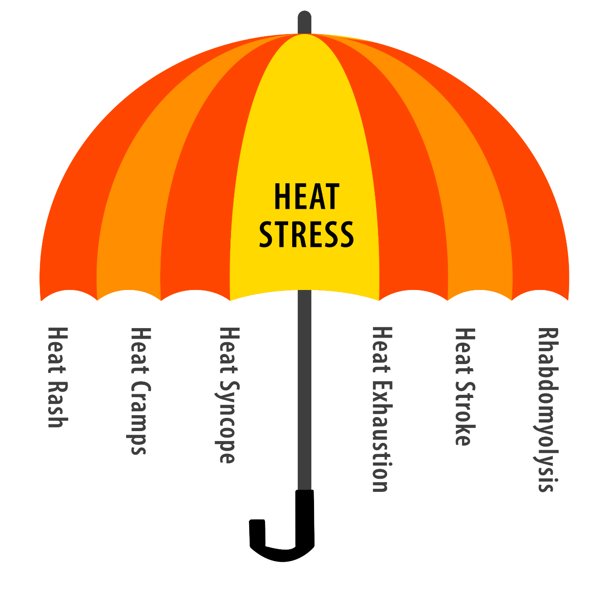
Common Forms of Heat-Related Illnesses
Heat stress is an umbrella term for a range of illnesses. Remember that heat stress is a MULTIVARIATE condition.
These are some of the related Illnesses…

Slide 15
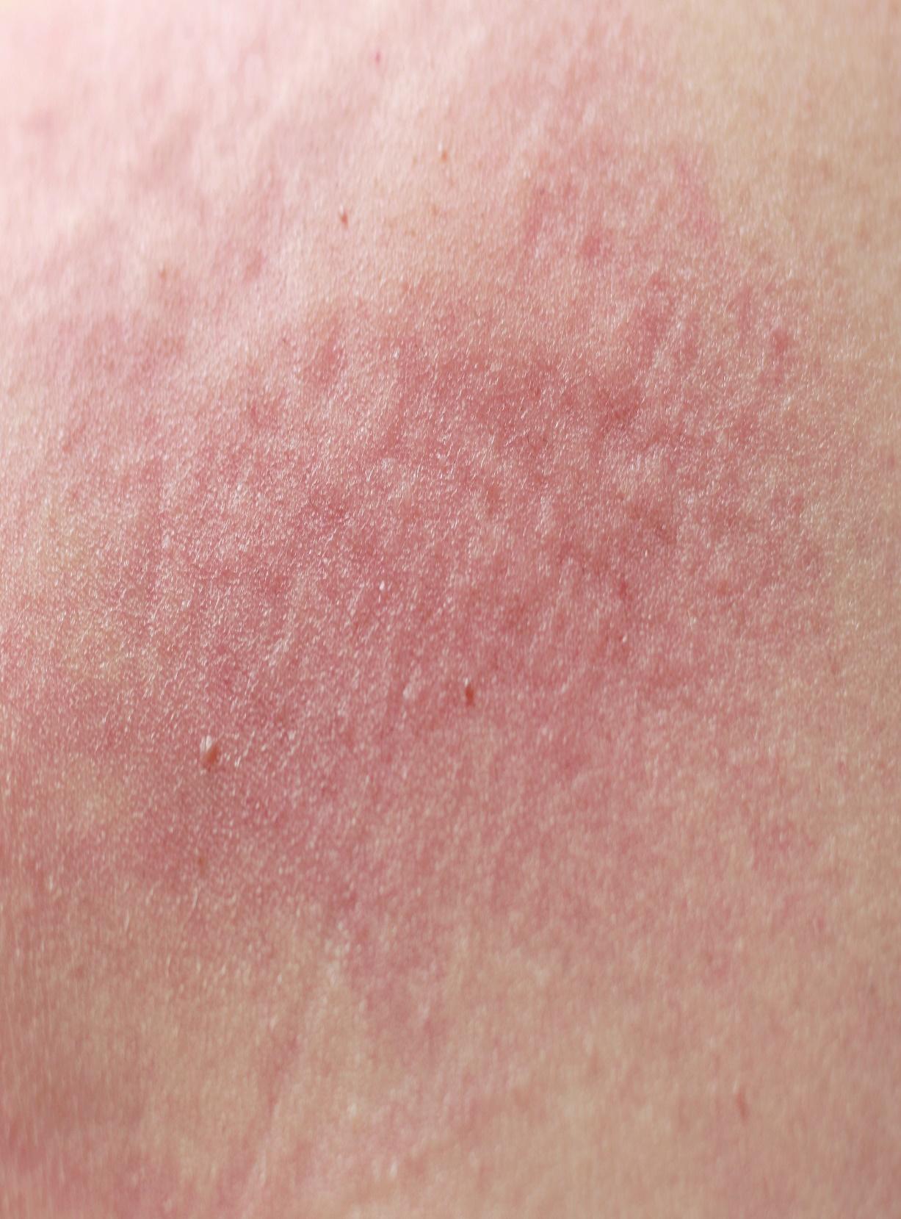
Heat Rash
Heat rash occurs when sweat ducts become blocked, trapping sweat under the skin.
-Rashes and itching
You may have heard of “prickly heat.”

Slide 16
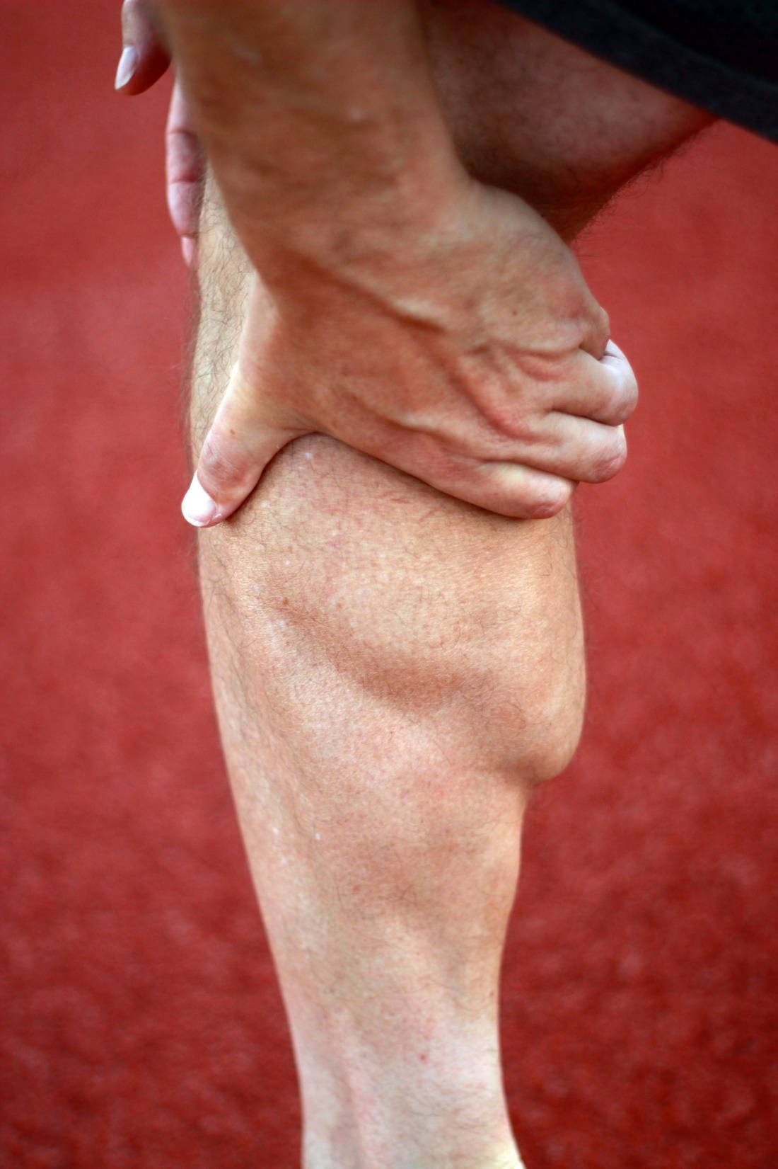
Heat Cramps
Heat cramps are muscle spasms that typically occur in the abdomen, arms, or legs, caused by the loss of fluids and electrolytes from heavy sweating. While painful, they are less severe than other forms of heat-related illness. However, heat cramps can lead to other forms of heat illnesses.

Slide 17

Heat Syncope
Heat Syncope is the level of heat illness in which fainting can occur. This is due to vasodilation (widening of blood vessels) and reduced blood flow to the brain when someone stands for an extended period in the heat or suddenly rises from a sitting or lying position, leading to fainting.
Watch for:
Fainting (short duration)
Light-headedness from standing from a sitting or lying position

Slide 18

Heat Exhaustion
Heat Exhaustion is a serious degree of heat illness that arises from the body overheating due to prolonged exposure to high temperatures combined with dehydration.
Symptoms: heavy sweating, weakness, cold, pale and clammy skin, dizziness, muscle cramps, and nausea. Quick treatment is crucial to prevent progression to heat stroke.
Watch for:
Weakness
Dizziness
Headache
Fatigue
Muscle cramps
Vomiting

Slide 19

Heat Stroke (Most Severe)
Heat Stroke occurs when the body's temperature regulation system fails, and body temperature rises to 104°F (40°C) or higher.

Slide 20
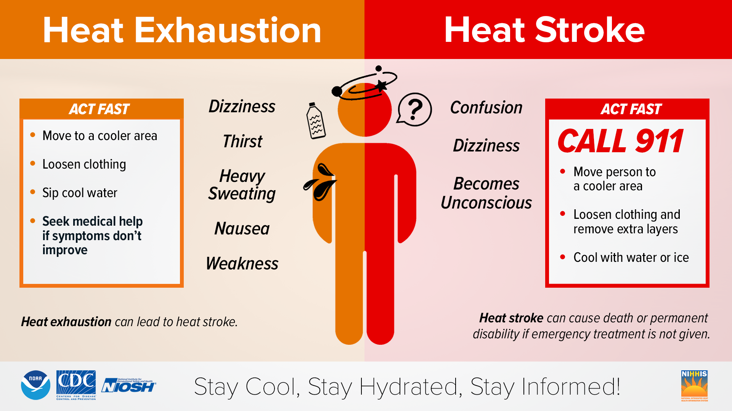
Heat Stroke Symptoms
Hot, dry skin or profuse sweating, hallucinations, chills, throbbing headache, confusion, dizziness, and slurred speech. Immediate medical attention is necessary to prevent serious complications or death.
What are some takeaways from this illustration?

Slide 21
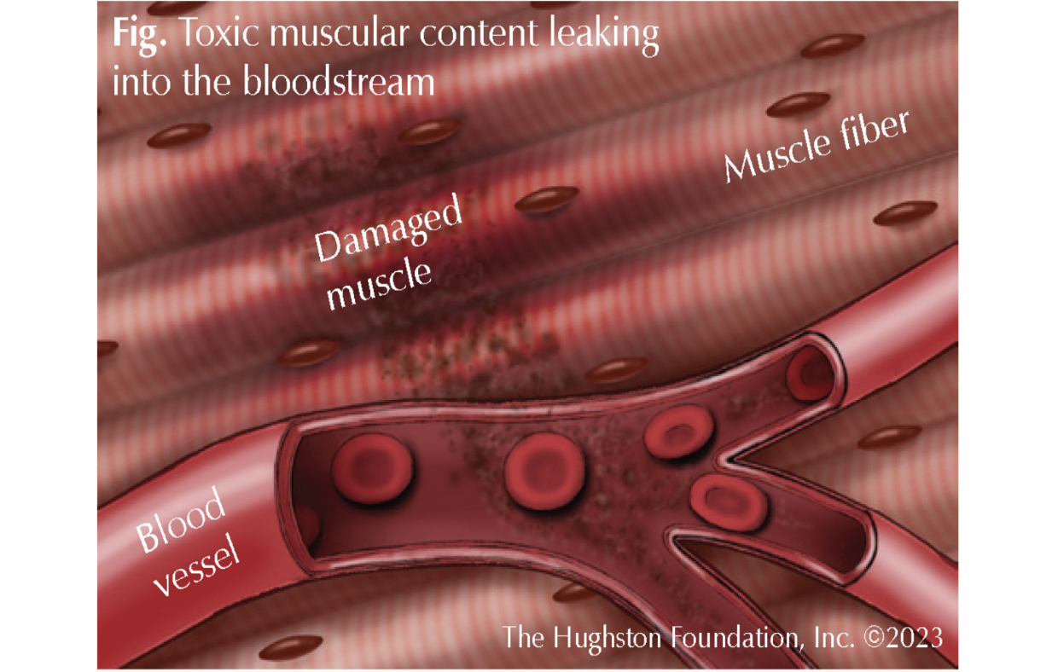
Rhabdomyolysis
Rhabdomyolysis is the rapid breakdown, rupture, and death of muscle associated with heat stress and prolonged physical exertion.
Symptoms include:
Muscle cramps and/or pain
Abnormally dark urine (tea or soda-colored)
Weakness
Exercise intolerance
Could be asymptomatic
OFTEN MISDIAGNOSED AND REQUIRES BLOOD TEST
First Aid
Stop activity and drink water.
Seek immediate medical attention and ask to be checked for rhabdomyolysis.
https://hughston.com/wellness/rhabdomyolysis-2/
https://www.cdc.gov/niosh/heat-stress/about/illnesses.html
Notes:
When the muscle tissue dies, electrolytes and large proteins are released into the bloodstream, which can cause irregular heart rhythms and seizures and damage the kidneys.
Repeated blood tests for the muscle protein creatine kinase (CK or creatine phosphokinase [CPK]) are the only accurate test for rhabdo.

Slide 22
Heat Illnesses and First Aid/Medical Treatment
Do not underestimate the urgency
of first aid and medical treatment for heat-related illnesses.
The basic logistics of first aid and emergency response:
  Assessing needs
  Developing a policy
  Access to emergency services
  Training of personnel on how to recognize symptoms and render first aid
  Physical resources required for first aid
  Plan, plan, and plan more… When that fails, learn from incidents and plan even more.

Slide 23
Heat Illnesses and First Aid/Medical Treatment
Heat Rash Keep affected skin cool and dry Use powders instead of balms or ointments (e.g., talc-free powders) | Heat Cramps Stop activity and rest in cool shady space Drink electrolyte Gently stretch and massage affected muscles Wait for at least a few hours before continuing work | Heat Syncope Have affected person lay down in cool shady environment Loosen tight clothing Cool person by fanning or cool wet cloths Rehydrate with water or electrolyte Seek medical help if not responsive to first aid
https://www.cdc.gov/niosh/heat-stress/about/illnesses.html

Slide 24
Heat Illnesses and First Aid/Medical Treatment
    Rhabdomyolysis
First Aid Recognize the symptoms Stop strenuous activity Hydrate SEEK MEDICAL CARE | Medical Care Requires blood testing Administer IV fluids Electrolyte monitoring Kidney function monitoring Pain management
    This condition REQUIRES testing for diagnosis.
    Studies show significant problems stemming from misdiagnosis or lack of diagnosis.
https://www.cdc.gov/niosh/heat-stress/about/illnesses.html

Slide 25
Heat Illnesses and First Aid/Medical Treatment
Heat Exhaustion
Take worker to a clinic or emergency room for medical evaluation and treatment.
Call 911 if medical care is unavailable.
Have someone stay with the worker until help arrives.
Remove the worker from the hot area and give liquids to drink.
Remove unnecessary clothing, including shoes and socks.
Cool the worker with cold compresses or have the worker wash their head, face, and neck with cold water.
Encourage frequent sips of cool water.
Heat Stroke
Call 911 for emergency medical care.
Stay with the worker until emergency medical services arrive.
Move the worker to a shaded, cool area and remove outer clothing.
Cool the worker quickly, using the following methods:
  With a cold water or ice bath, if possible
  Wet the skin
  Place cold wet cloths on the skin
  Soak clothing with cool water
Circulate the air around the worker to speed cooling.
Place cold wet cloths or ice on the head, neck, armpits, and groin; or soak the clothing with cool water.
https://www.weather.gov/safety/heat-illness
https://www.cdc.gov/niosh/heat-stress/about/illnesses.html

Slide 26

Emergency Medical Plan
Must have a plan in place to respond to emergencies in accordance with OAR 437-002-0161(4) or OAR 437-004-1305(4) for agriculture employers.

Slide 27
Heat Illness Prevention Plan
  Develop a Written Policy
  Methods of compliance
    Thresholds (Heat Index)
    Engineering Controls
    Training
    Communication Methods
    Medical and First Aid
    Record Keeping (Minimum 1 year retention for training records)
  Emergency action/response
Provides a framework for consistency in performance.
No downsides other than the requirement for managerial resources and deliberation.
  Resource: Oregon OSHA

Slide 28
Heat Illness Prevention Plan
  What the key points look like:
Employee Training on Heat Hazards:
  Train on the hazards of heat exposure and preventive steps for heat-related illnesses.
Identification and Response to Dehydration:
  Teach how to recognize dehydration symptoms and respond to heat-related illnesses in others.
Water Provision:
  Ensure sufficient amounts (32 oz per person per hour) of cool or cold potable water is available in work areas.
Hydration Opportunities:
  Provide frequent opportunities and encouragement for employees to drink water.
continued on next slide
28

Slide 29
Heat Illness Prevention Plan
Rest and Recovery Areas:
  Provide sufficient space for resting in shaded or climate-controlled areas.
  Designate areas for cooling off and recovery upon recognizing heat illness symptoms.
Heat Illness Prevention Breaks:
  Implement rest break schedules to maintain employee safety in high-heat conditions.
Heat Acclimatization Procedures:
  Enact acclimatization measures for new or returning employees after an absence of seven days or more.
29

Slide 30
Drinking Water
  Required when the heat index is at 80°F or higher
  Hydration and electrolyte replenishment is crucial for workers in high heat environments
  Employers must be able to provide each employee up to 32 oz of cold or cool drinking water every hour
  Employees must be given ample opportunity to drink water
  Employers do not have to store the entire quantity of drinking water but must be able to replenish their supply
  Cool to cold water temperature = 35 - 77°F
30

Slide 31

Methods of Compliance
Avoid working in the hotter parts of the day.
  Shift Variation.
  Deciding when it is just too hot to do specific work tasks.
Removes the hazardous condition.
Sets a positive example of organizational culture.
Sometimes requires much earlier or later work times.
  This may cause human factor concerns.
Other local authorities may disallow for very early or late work.

Slide 32


Methods of Compliance
  Replace the methodology with a more efficient method.
  Technology and mechanical advantage.
Reduces the hazardous condition.
May reduce turnover.
Costly?
  Requires economic feasibility.
  Costs likely transfer to the customer.
  May require higher skilled labor.
  Break-even analysis may be helpful.
  The right tool for the job goes a long way.

Slide 33
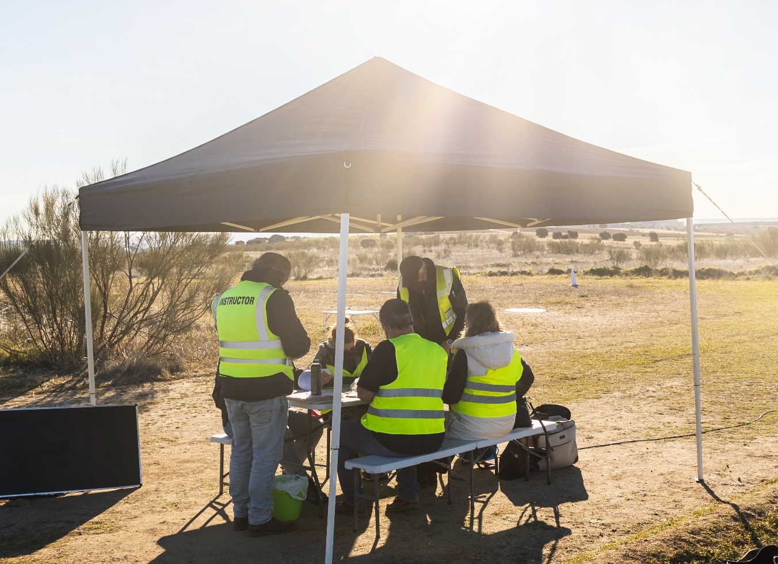
Methods of Compliance
Implement designed methods of reducing the hazard.
  Portable shade systems.
  Mechanical ventilation.
Reduces hazard severity.
Allows for work in high heat conditions.
Dependent on work/rest control.
Requires space.
Labor costs during break periods.

Slide 34
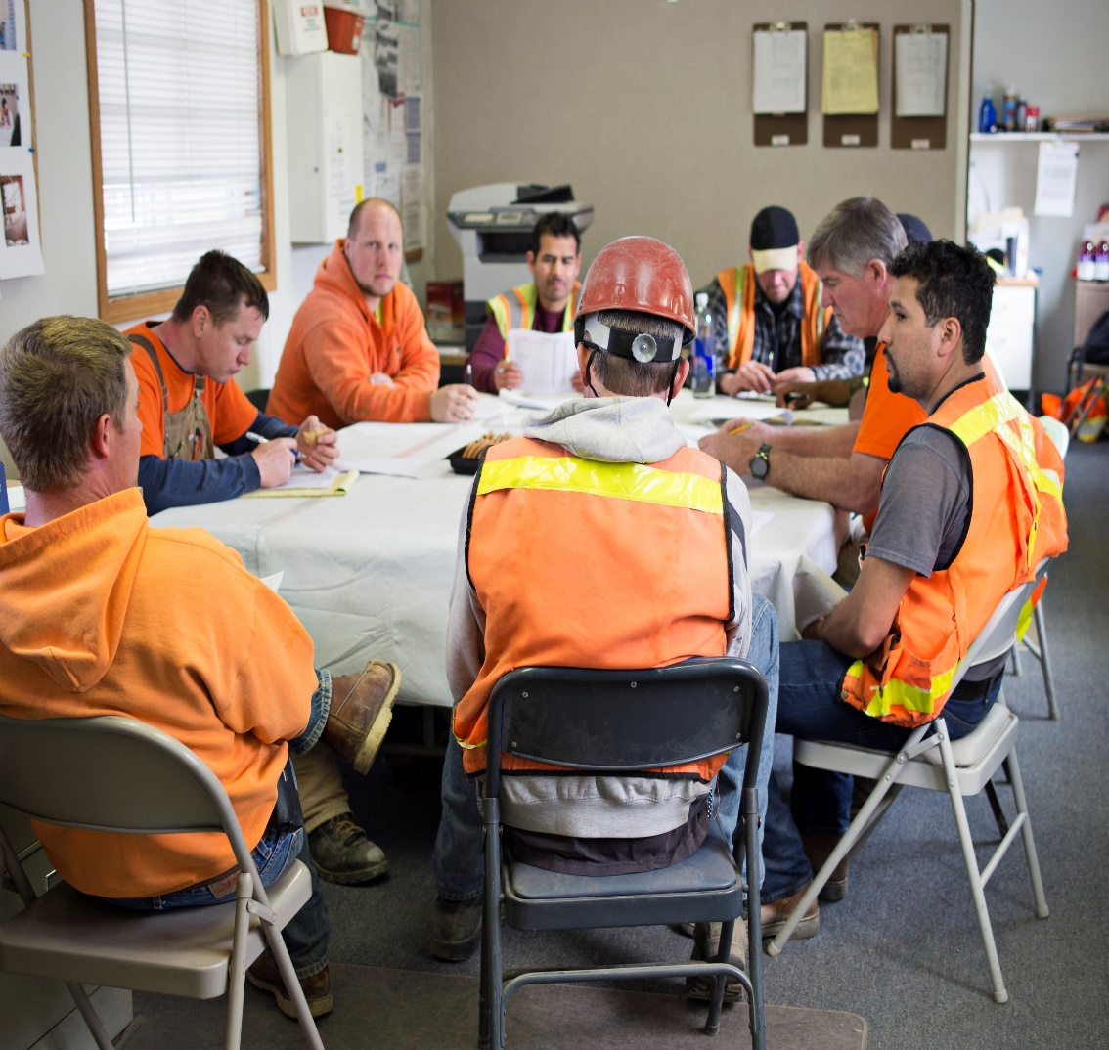
Methods of Compliance
    Training (REQUIRED)
Allows for consistent work practices per policies.
Offers advancement and growth in careers.
Directly linked to reductions in workplace incidents.
Requires time and resources.
May be stagnant unless effort and tracking are in place.
Many OSHA violations reference missing or inadequate training.
Class Question:
Do you think that watching a video on machine guarding is enough training for a hydraulic press operator?

Slide 35
Methods of Compliance
    Required Training Elements
Risk factors: personal (e.g., COPD, asthma, kidney disease, obesity) and environmental; added heat from exertion, clothing, and PPE.
Employer duties: provide water, heat index info/risks, shade, preventative rest breaks, first aid access, and protect employees’ rights from retaliation.
Hydration: drink small amounts frequently, up to 32 oz per hour when hot and sweating.
Acclimatization: understand purpose and methods per the employer’s plan.
Heat illness: know types, common signs/symptoms, and appropriate first aid/emergency response; can rapidly become life-threatening.
Reporting: immediately report signs/symptoms in yourself or others.
Nonoccupational factors: drugs, alcohol, obesity, etc., reduce heat tolerance.

Slide 36

Methods of Compliance
    Communication (High Heat Practices)
    Employers must maintain communication with employees by voice, electronic, or equally effective means, so that employees at the worksite can contact a supervisor anytime when necessary.
This administrative method allows for more rapid identification of signs and symptoms.
May also be associated with identifying other safety and health concerns.
May seem like a nuisance to employees at the lower threshold levels or in certain job roles.
  Can affect behavior (+/-)

Slide 37
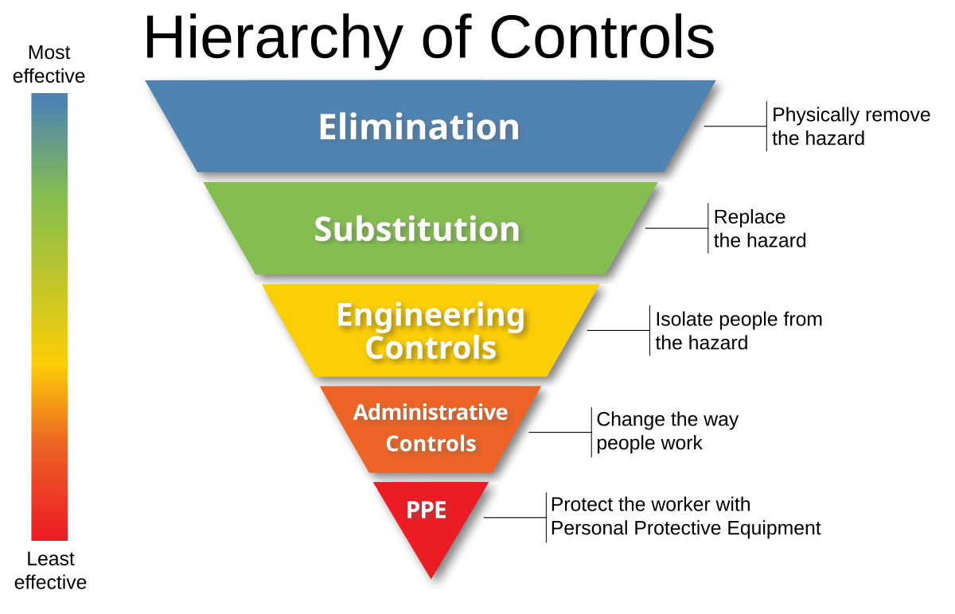
Activity
What types of controls could we use to control the heat stress of outdoor workers?

Slide 38
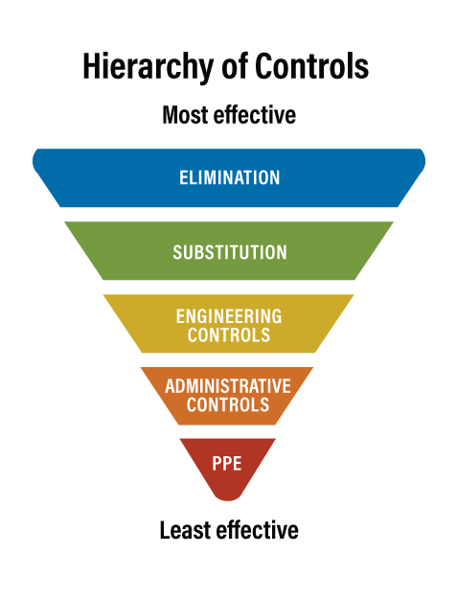
    Common Control Examples
    Reschedule work to occur during cooler times of day to ELIMINATE the hazard.
    Replace physically demanding tasks with mechanical and efficient SUBSTITUTIONS.
    Provide shade systems and mechanical ventilation to ENGINEER hazard reduction.
    Implement ADMINISTRATIVE work shift changes, rest cycles, train workers on heat stress topics and policies, and develop a hydration policy/schedule.
    Utilize cooling PPE equipment (e.g., cooling vests, hats, and moisture-wicking UV-protectant clothing). Sunscreen and sunglasses also fall under this category.

Slide 39

Heat Illness Prevention Rule Summary
80 Heat Index: Threshold for rule applicability
Develop a (written) Heat Illness Prevention Plan.
Access to Shade:
  Establish shade areas; may be natural or artificial.
  Shade must be ventilated, close to work areas, and accommodate resting employees.
Drinking Water:
  Provide enough cool or cold drinking water for each employee to consume 32 ounces per hour.
Supervisor and Employee Training:
  Annual training on heat illness risks, symptoms, first aid, and preventive practices. Training documentation is required.
Emergency Medical Plan:
  Implement plans for responding to heat illness signs, contacting emergency services, and providing first aid.
Acclimatization Plans:
  Develop practices for employees to adapt to heat, following guidelines or creating their own plan.

Slide 40
Heat Illness Prevention Rule Summary
90 Heat Index: High Heat ADDITIONAL Practices
Communication:
  Maintain voice, observation, or electronic communication for employee-supervisor contact.
  Use cell phones or texts only with reliable reception.
Monitoring for Heat Illness:
  Regular checks on solo workers via radio, cell phone, or other methods.
  Implement a mandatory buddy system.
  Use other effective observation/communication methods as needed.
  Monitor indoor temperatures when no mechanical ventilation is available.
Emergency Response Designation:
  Assign specific employees to call for emergency medical services.
  Permit other employees to call for emergency services if designated staff are unavailable.
Rest Breaks for Heat Illness Prevention:
  Provide rest breaks aligned with policy or law requirements.
  Treat preventive cool-down breaks as part of work duties.

Slide 41
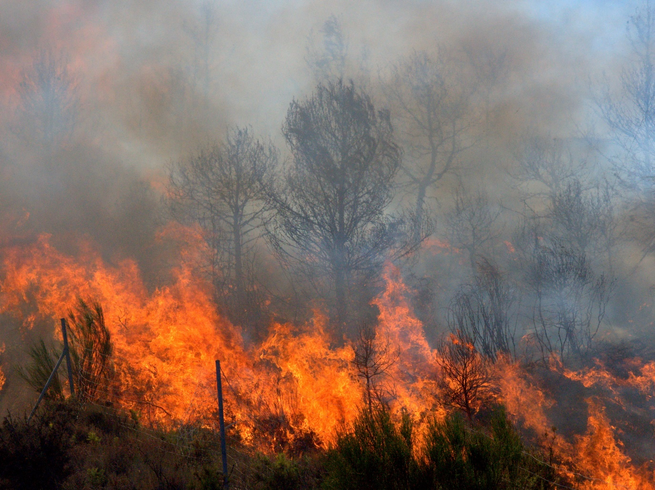
Wildfire Smoke (Topic 2)
We will cover the following:
Definitions
Scope and Exemptions
Characteristics of Smoke and Exposure
Information and Training
Exposure Controls
Usage of filtering facepiece respirators
Rule Wrap-up and Summary

Slide 42
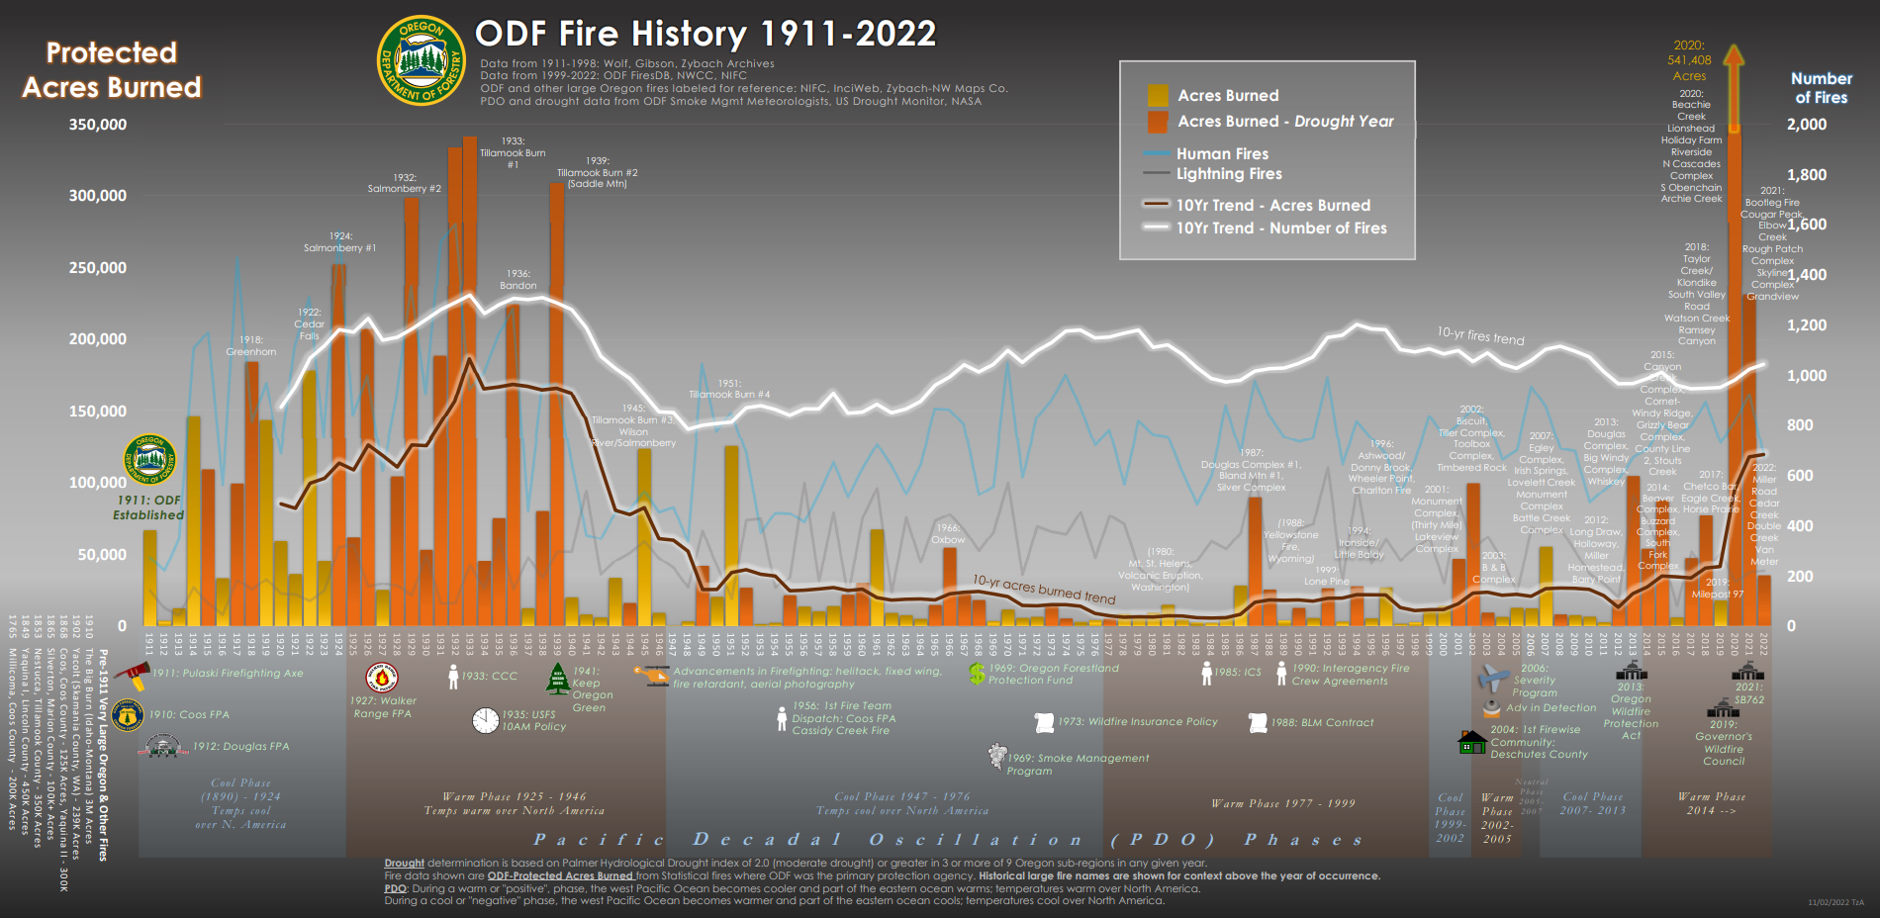
Timeline and Severity from Oregon Department of Forestry
To view a larger image, visit: https://www.oregon.gov/odf/fire/documents/odf-century-fire-history-chart.pdf

Slide 43



Definitions
Air Quality Index (AQI):
  Developed by the U.S. EPA
  Indicates overall air quality
  Based on pollutants: ground-level ozone, particulate matter, carbon monoxide, sulfur dioxide, nitrogen dioxide
NIOSH:
  National Institute for Occupational Safety and Health
  Part of the U.S. CDC
  Tests and approves respirators for workplace use
PM2.5 (U.S. EPA):
  Fine particulate matter with a diameter of 2.5 micrometers or smaller
  Solid particles & liquid droplets in air
  Measured in micrograms per cubic meter (µg/m3)

Slide 44
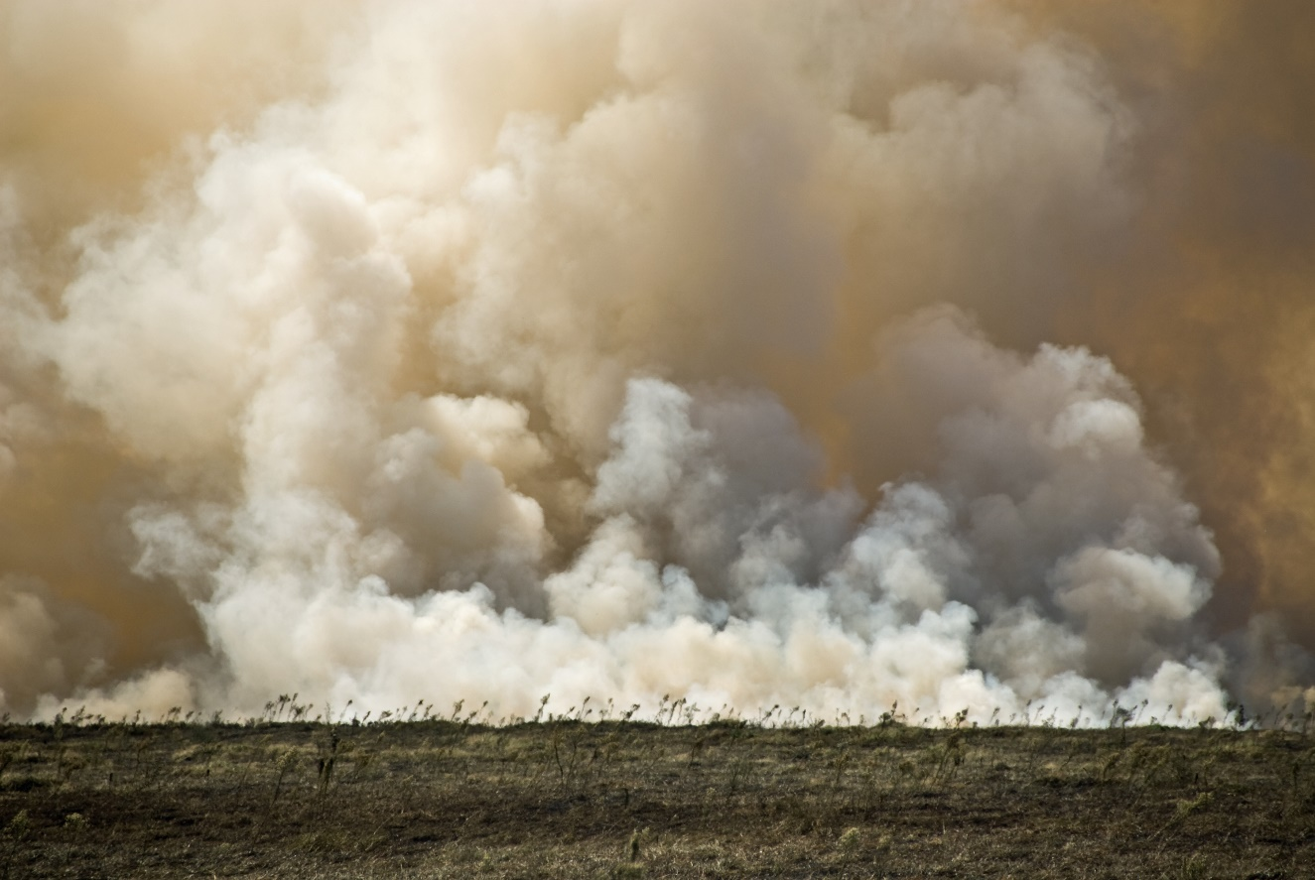
Definitions
Sensitive Groups:
  Individuals likely to be more affected by air pollution.
  Includes people with respiratory or heart conditions, children, elderly, pregnant women, people with diabetes.
Wildfire Smoke:
  Emissions from unplanned fires in wildlands.
  Can negatively impact air quality for adjacent and distant populated areas.
Wildlands:
  Uncultivated, sparsely populated areas.
  Mostly covered by grass, brush, trees, or a combination.

Slide 45
Scope / Exemptions
Scope and Application
  Applies To: Employers in public and private sectors where employees may be exposed to wildfire smoke.
  Specific Conditions: Ambient air concentration of PM2.5 at or above 35.5 µg/m³ (AQI 101).
Exemptions
  Enclosed Buildings/Structures: With filtered mechanical ventilation; requires keeping windows and other openings closed.
  Enclosed Vehicles: With properly maintained cabin air filters; windows and other openings must remain closed.
  Operations Suspension: Employer may suspend operations to avoid exposure to PM2.5 concentrations at or above AQI 101.
  Home-Based Employees: Those working from home are exempt.
Notes:
Picture generated in AI by Microsoft. Good point of discussion.

Slide 46
Scope / Exemptions
Partial Exemptions:
  Specific Cases Only Requiring Training and Respirator Use:
    Wildland Firefighting: Including fire camp services and fire management.
    Emergency Operations: Covering protection of life or property, public safety power shutoffs, and essential service restoration.
    Intermittent Exposure: Work involving exposure to PM 2.5 at or above 35.5 µg/m³ for less than 15 minutes per hour, totaling less than one hour in 24 hours.
Rules Associated:
  Oregon Administrative Rules Oregon Occupational Safety and Health Division 437-002-1081 and 437-004-9791 for agriculture employers.

Slide 47
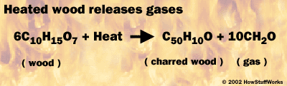
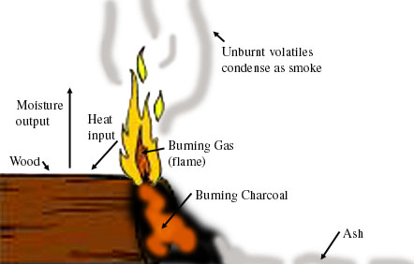
Smoke—What is it?
According to the US Department of Forestry…
Contents of Wildfire Smoke:
  Tiny particles, gases, and water vapor.
  The majority is water vapor; the remainder includes carbon monoxide, carbon dioxide, nitrogen oxide, volatile organic compounds, air toxins, and fine particles.
Health Risks of Smoke:
  Smoke inhalation is found to be harmful.
  Higher risk groups include those with heart/lung diseases, children, and the elderly.
  Symptoms may include scratchy throat, cough, irritated sinuses, headaches, and difficulty breathing.
  More on this soon…

Slide 48
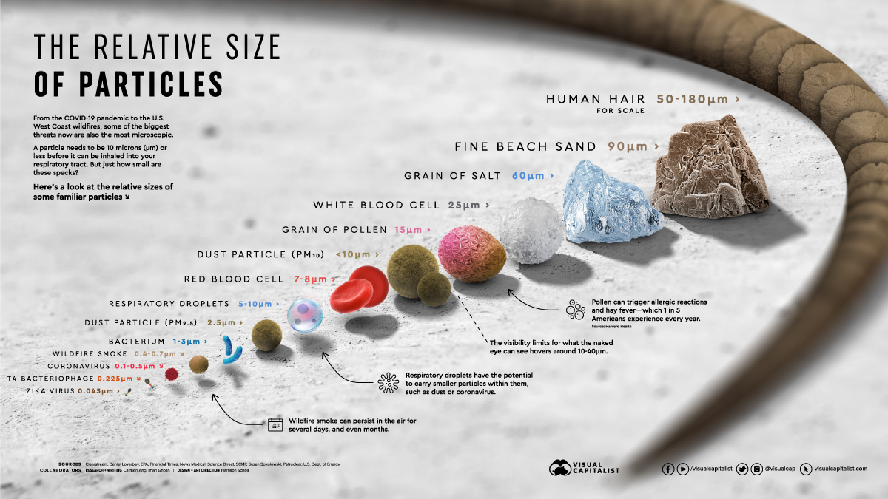
Smoke Physical Characteristics
    Smoke is ultrafine particulate (0.1-1 micron in diameter)
Notes:
Picture generated by US DOE

Slide 49
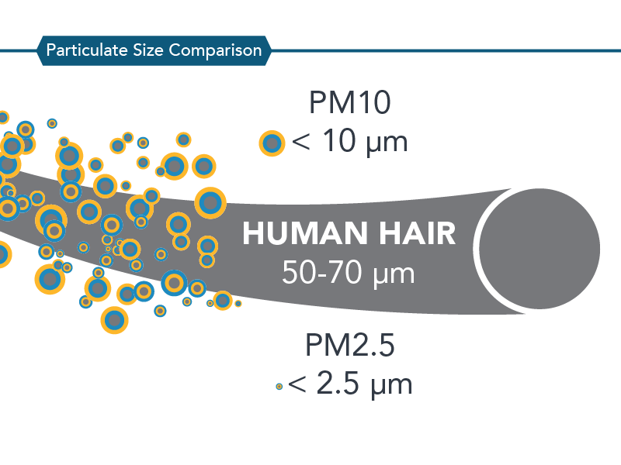
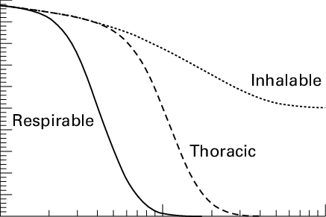
Smoke Physical Characteristics
What does PM 2.5 Mean?
Particulate matter that is 2.5 micrometers in diameter or smaller.
These tiny particles can penetrate deep into the respiratory system, potentially causing health problems.
What makes wildfire smoke unique in exposure profile compared to nuisance dusts?
Notes:
Source from CDC

Slide 50
Smoke Behavior
    Fate and Transport
Vertical Movement:
  Wildfire heat generates convective currents.
  Lifts smoke high into the atmosphere, up to the troposphere.
Atmospheric Transport:
  Prevailing winds at varying altitudes direct smoke's path and travel distance.
Plume Dispersion:
  Smoke plume disperses and mixes with air, reducing concentration as it travels.
Chemical Transformations:
  Smoke undergoes chemical reactions en route.
  Forms secondary pollutants like ozone and secondary organic aerosols.
Deposition:
  Smoke settles back to the ground via wet (rain/snow) or dry (gravity) deposition.
Notes:
Picture generated in AI by Microsoft.

Slide 51
Wildfire-Smoke Health Hazards
The Oregon Health Authority (OHA) identifies wildfire smoke as a hazard for specific groups:
If you have heart or lung disease, such as congestive heart failure, angina, COPD, emphysema or asthma, you are at higher risk of having health problems from smoke.
Older adults are more likely to be affected by smoke, possibly because they are more likely to have heart or lung diseases than younger people.
Children are more likely to be affected by health threats from smoke because their airways are still developing and because they breathe more air per pound of body weight than adults. Children also are more likely to be active outdoors.
People who are pregnant are at higher risk due to the changes to their bodies during pregnancy and the effects of smoke pollution on the fetus.
People who work or live outdoors and those with low incomes may be at higher risk of smoke exposure, even if they do not fall within any of the other at-risk groups.
Reid, C. E., Brauer, M., Johnston, F. H., Jerrett, M., Balmes, J. R., & Elliott, C. T. (2016). Critical review of health impacts of wildfire smoke exposure. Environmental health perspectives, 124(9), 1334-1343.

Slide 52
Additional Studies
Recent Studies
  Associations found between wildfire smoke and all-cause mortality. Further research needed to identify specific causes.
Detailed Findings
  1997 Southeast Asian Wildfire: Increased mortality in Malaysia linked to PM10 and reduced visibility (Sastry 2002).
  2010 Moscow Heat Wave & Wildfires: Smoke contributed to approximately 29% of excess deaths during the event (Shaposhnikov et al. 2014).
  Sydney Studies: Both short (8 years, Morgan et al. 2010) and long-term studies (13.5 years, Johnston et al. 2011) indicate a rise in mortality on smoke-affected days.
  Southern Europe Meta-Analysis: Cardiovascular deaths increased on smoke-affected days compared to normal days (Faustini et al. 2015).
  This research field has many gaps, as most research areas do.
Notes:
Reid, C. E., Brauer, M., Johnston, F. H., Jerrett, M., Balmes, J. R., & Elliott, C. T. (2016). Critical review of health impacts of wildfire smoke exposure. Environmental health perspectives, 124(9), 1334-1343.

Slide 53
Link to Emergency Room Visits
Respiratory Impact
  Significant decline in lung function among non-asthmatic children (Jacobson et al. 2012, 2014).
  Increased respiratory illnesses, emergency visits, and hospitalizations linked to smoke exposure (various sources).
Cardiovascular Findings
Mixed results; some studies indicate an increase in cardiac arrests and myocardial infarctions associated with PM2.5 from wildfires (Dennekamp et al. 2015; Haikerwal et al. 2015).
Inconsistencies
While some research suggests links between wildfire smoke and respiratory infections, overall conclusions are varied and require further investigation.
This scoping review examined a significant amount of studies on wildfire smoke exposure. There are still many gaps in the field.
Notes:
Reid, C. E., Brauer, M., Johnston, F. H., Jerrett, M., Balmes, J. R., & Elliott, C. T. (2016). Critical review of health impacts of wildfire smoke exposure. Environmental health perspectives, 124(9), 1334-1343.

Slide 54
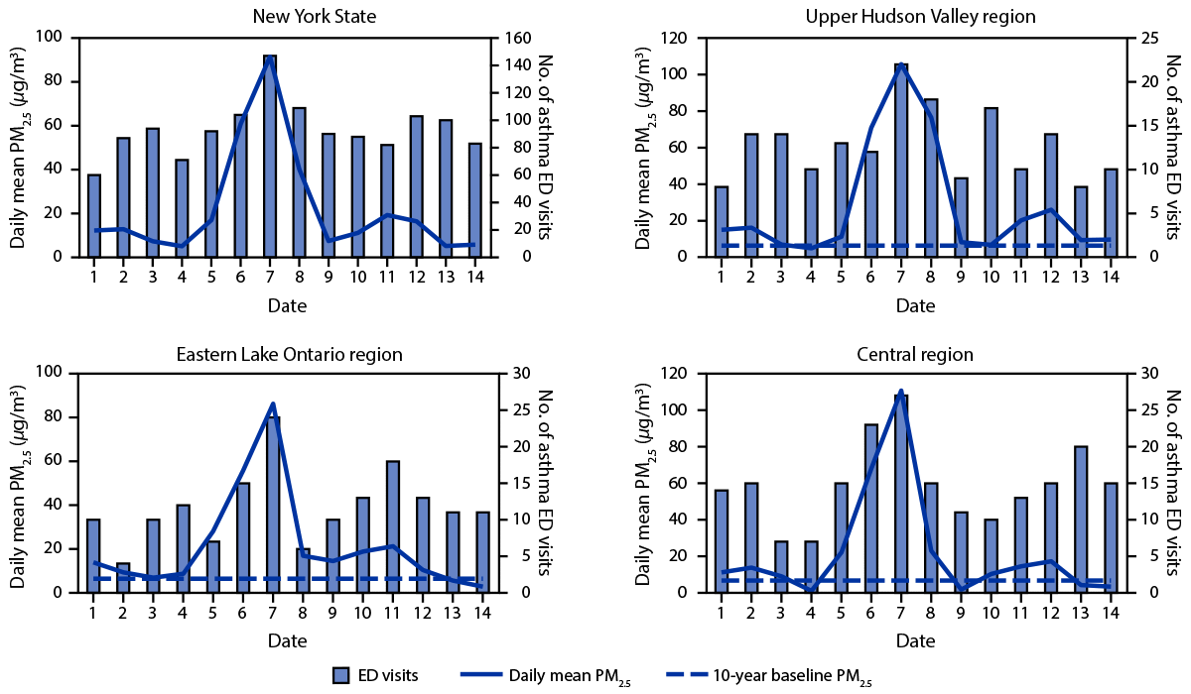
Wildfire-Smoke Health Hazards
Notes:
Source: CDC. Ask the class what their thoughts are. Compelling?

Slide 55
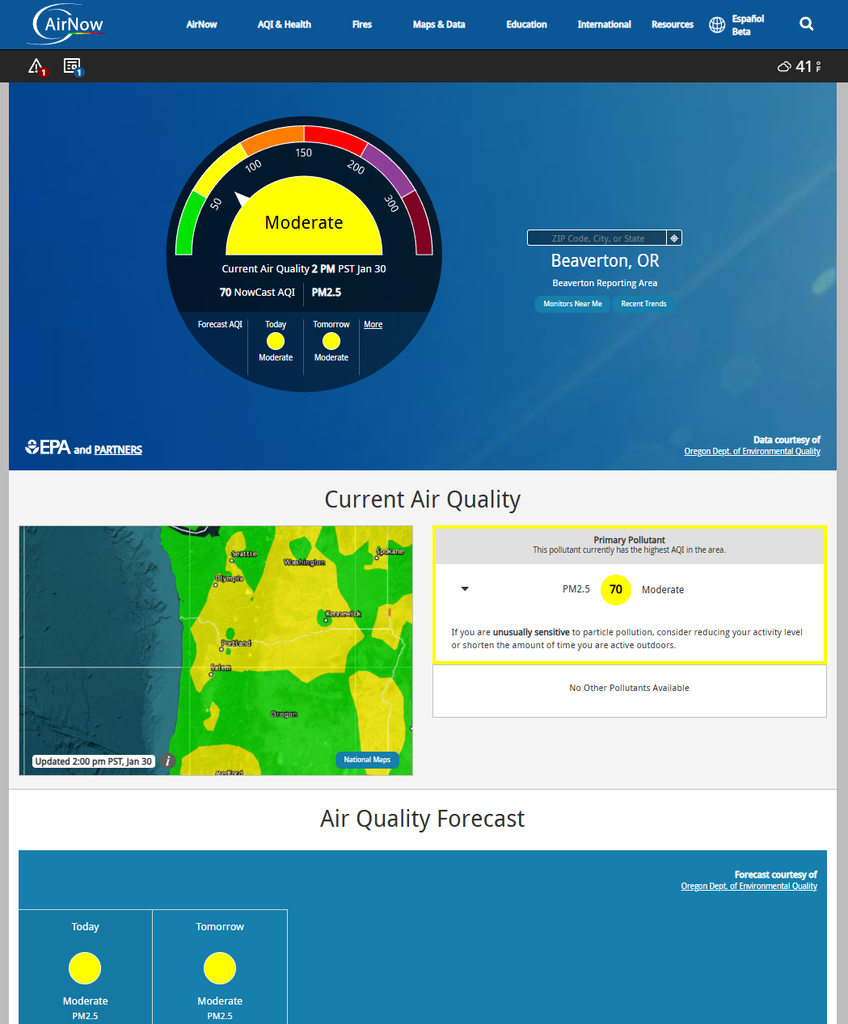
Exposure Assessment
Public Resources
  Check average & forecasted AQI for PM2.5 on Oregon Department of Environmental Quality, U.S. EPA AirNow, or Interagency Wildland Fire Air Quality Response Program websites.
  Download the AirNow app for free on the Apple App Store or the Google Play Store.
Local Notifications
  Stay informed through air quality advisories from the Oregon Department of Environmental Quality or local health agencies.
Notes:
Picture generated in Airnow.

Slide 56
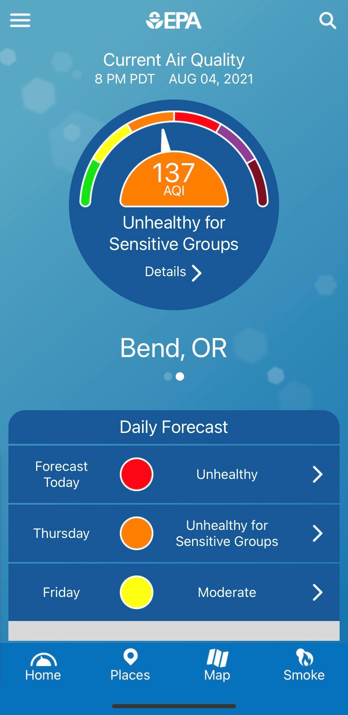

Exposure Assessment (Activity)
For those who are comfortable, please visit airnow.gov and check the condition of your location.
What is the current AQI?
Would the rule apply?

Slide 57
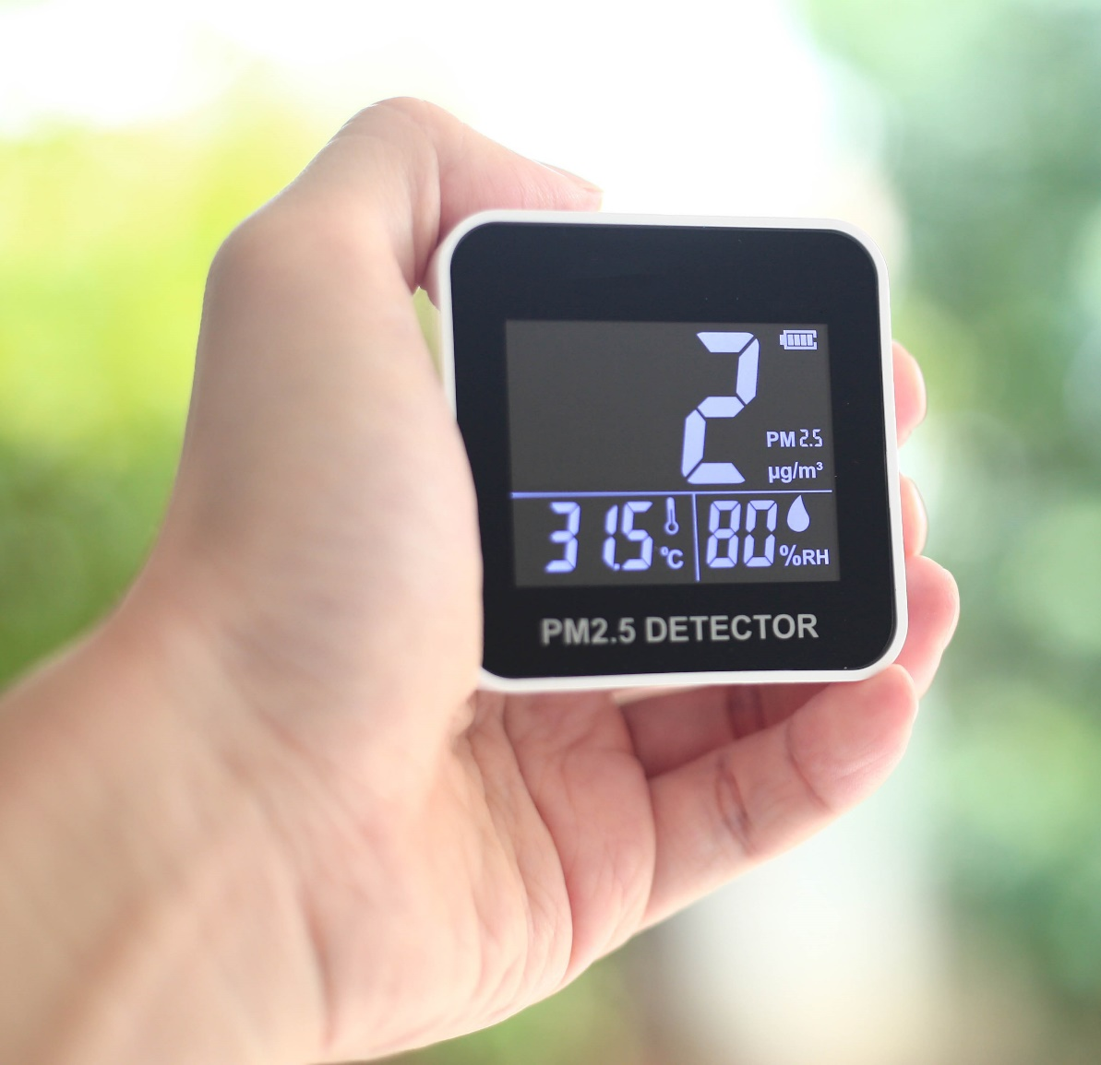
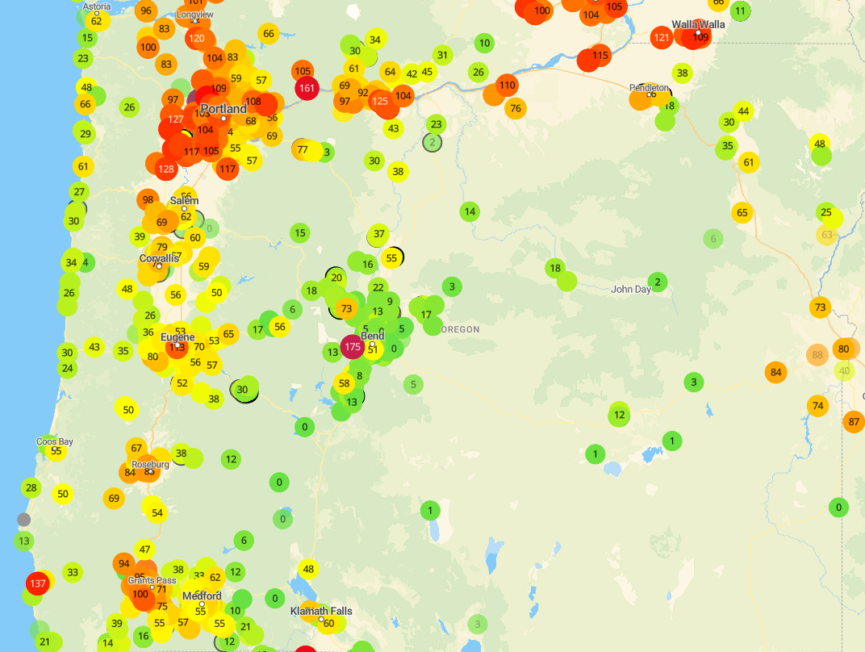
Exposure Assessment
Direct Measurement
  Use appropriate devices to measure PM2.5 directly at the workplace as per manufacturer’s instructions.

Slide 58
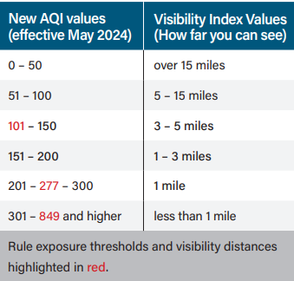
Exposure Assessment
Alternative Method
  If standard methods are unavailable, use the 5-3-1 Visibility Index (Appendix B, Table 1) to estimate PM2.5 levels during daylight. THIS IS THE UPDATED TABLE.

Slide 59
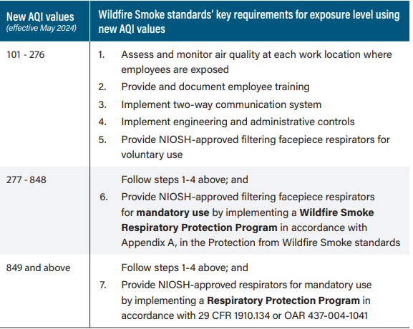
Updated AQI Values

Slide 60
Exposure Thresholds
PM2.5 ≥ 35.5 µg/m³ (AQI 101) but < 202.1 µg/m³ (AQI 277): Voluntary use of NIOSH-approved filtering facepiece respirators. Engineering and administrative controls to reduce PM2.5 exposure below 35.5 µg/m³. Two-way communication systems to report air quality changes and symptoms. | PM2.5 ≥ 202.1 µg/m³ (AQI 277) but < 500.6 µg/m³ (AQI 849): Required filter facepiece respirators under a Wildfire Smoke Respiratory Protection Program, which can be less stringent than standard respirator requirements (no medical evaluations or fit testing required). Employee training on proper respirator use and seal checks. | PM2.5 ≥ 500.6 µg/m³ (AQI 849): Required use of appropriate NIOSH-approved respirators. Complete implementation of a full Respiratory Protection Program including medical evaluations and fit testing in compliance with 29 CFR 1910.134 or OAR 437-004-1041 for agriculture employers.

Slide 61

Information and Training
Annual training for all employees potentially exposed to PM2.5 levels ≥ 35.5 µg/m³ (AQI 101).
Includes new hires, current employees, supervisory and non-supervisory personnel.
Training to be provided in understandable language and format that encourages feedback.

Slide 62
Information and Training
Symptoms of Exposure:
  Eyes: Burning, redness, tearing.
  Respiratory: Runny nose, sore throat, cough, sinus irritation, wheezing, difficulty breathing.
  General: Fatigue, headache, irregular heartbeat, chest pain.
Health Risks:
  Acute and chronic effects of smoke exposure.
  Increased risks to sensitive groups and potential impact on cardiovascular health and asthma.
  Remember, this is for the purpose of EMPLOYEES understanding the signs and symptoms for reporting purposes and HOW THEY REPORT symptoms.
Notes:
Picture generated in AI by Microsoft.

Slide 63
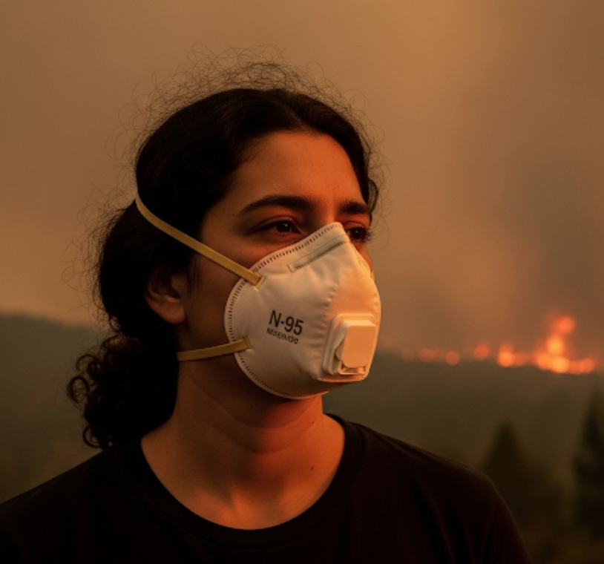
Information and Training
Rights and Safety:
  Right to report health issues and seek treatment without fear of retaliation.
  Access to current PM2.5 levels and AQI values.
Protective Measures:
  Use of filtering facepiece respirators.
  Employer's methods to reduce exposure, including availability and maintenance of respirators.
Emergency Procedures and Monitoring:
  Response to immediate health symptoms like asthma attacks.
  Operation of hazard controls and equipment (air monitoring if applicable).
  Understanding the employer's communication system for smoke exposure information.
Notes:
Picture generated in AI by Microsoft.

Slide 64

Information and Training
Training Records:
  Maintain records including employee names, training dates, and trainers for at least one year.
  Ensure documentation of both supervisor and employee training sessions.
  RECOMMENDATION:
  KEEP THOSE RECORDS INDEFINITELY
  Recommendation: Utilize a data management system to organize all safety and health training records.

Slide 65
    Some Comm
    If AQI hits a specific level, cease work until improvement. If possible, relocate work indoors. Eliminate.
    SUBSTITUTE for remote work, if possible.
    Utilize high filtration mechanical ventilation to ENGINEER a hazard reduction.
    Use scheduling to limit the amount of exposure through ADMINISTRATION.
    Supply employees with NIOSH-Approved respirators for voluntary or required use when PM2.5 concentration levels exceed AQI thresholds. THIS IS PPE.
Exposure Controls

Slide 66
Activity- Exempt or Not?
A group of landscape maintenance workers employed with a private-sector gardening company is scheduled to work outdoors during the wildfire season in Oregon. The area where they are assigned has recently experienced wildfires, leading to elevated levels of air pollution. Real-time air quality monitoring reports indicate that the ambient air concentration for PM2.5 is currently at 110 µg/m³, an Air Quality Index (AQI) value of 189 for PM2.5.
Answer on next slide.

Slide 67
Activity- Exempt or Not?
A group of landscape maintenance workers employed with a private-sector gardening company is scheduled to work outdoors during the wildfire season in Oregon. The area where they are assigned has recently experienced wildfires, leading to elevated levels of air pollution. Real-time air quality monitoring reports indicate that the ambient air concentration for PM2.5 is currently at 110 µg/m³, an Air Quality Index (AQI) value of 189 for PM2.5.
According to Oregon OSHA rule 437-002-1081 concerning Protection from Wildfire Smoke, this standard applies to all public and private sector employers whose employees might be exposed to air with a PM2.5 level at or above 35.5 µg/m³ (AQI 101). Since the AQI in the scenario is significantly above 101, the rule clearly applies.
The employer must take appropriate actions to protect the employees. This could include providing appropriate respirators, relocating work to less affected areas, or adjusting work schedules to minimize exposure. Additionally, they must provide training and information regarding the risks associated with wildfire smoke as stipulated in the rule.
Notes:
Instructor, please add an Agriculture employer example to discuss.

Slide 68
Activity- Exempt or Not?
An IT company in downtown Portland, Oregon, operates from a modern office building equipped with an advanced HVAC system that includes high-efficiency particulate air (HEPA) filters. A wildfire has started in a nearby region, reducing local air quality. Despite this, the air quality inside the building remains mostly unaffected due to the filtration system.
Answer on next slide.

Slide 69
Activity- Exempt or Not?
An IT company in downtown Portland, Oregon, operates from a modern office building equipped with an advanced HVAC system that includes high-efficiency particulate air (HEPA) filters. A wildfire has started in a nearby region, deteriorating local air quality. Despite this, the air quality inside the building remains unaffected due to the filtration system.
The mentioned rule exempts workplaces like enclosed buildings and structures where the air is filtered by a mechanical ventilation system, and the employer ensures that windows, doors, and other openings are kept closed, except for brief necessary openings. In this scenario, the IT company's office environment does not expose the employees to unfiltered outdoor air, and the conditions specified by the exemption are met.
Given the building’s mechanical air filtration system and controlled access to exterior openings, the employment setting in this scenario is exempt from this specific standard. However, the employer may still choose to monitor the situation and provide general health advice related to air quality as a best practice.

Slide 70
Wildfire Smoke Rule Review and Summary
Scope
  Applies when employees are exposed to PM2.5 levels ≥ 35.5 µg/m³ (AQI 101).
  Exemptions include enclosed buildings or vehicles with filtered air, suspended operations, and home-based work.
Exposure Levels and Requirements
  PM2.5 ≥ AQI 101 but ≤ AQI 276:
    Voluntary use of NIOSH-approved filtering facepiece respirators.
    Engineering and administrative controls to reduce PM2.5 exposure below 35.5 µg/m³.
    Two-way communication systems to report air quality changes and symptoms.
  PM2.5 ≥ AQI 277 but ≤ AQI 848:
    Required filter facepiece respirators under a Wildfire Smoke Respiratory Protection Program, which can be less stringent than standard respirator requirements (no medical evaluations or fit testing required).
    Employee training on proper respirator use and seal checks.
  PM2.5 ≥ 849 AQI:
    Required use of appropriate NIOSH-approved respirators.
    Complete implementation of a full Respiratory Protection Program, including medical evaluations and fit testing in compliance with 29 CFR 1910.134 or OAR 437-004-1041 for agriculture employers.

Slide 71
Wildfire Smoke Rule Review and Summary
Training and Information
  Annual training on wildfire smoke hazards, symptoms of exposure, respirator usage, and rights related to workplace health.
  Training documentation to be maintained with records of conducted training.
Exceptions
Certain emergency and public safety operations are subject to modified provisions focusing mainly on exposure notifications and worker training.

Slide 72
Additional Educational Resources
Oregon OSHA’s YouTube Channel
A-Z Topic Index - Heat Illness Prevention
A-Z Topic Index – Wildfire Smoke
Oregon OSHA Online Training Courses
PESO – English to Español
Other Safety and Health Training Resources

Slide 73
Need more information? Call your nearest Oregon OSHA Office
Salem Central Office
350 Winter St. NE
Salem, OR 97301-3882
Phone: 503-378-3272
Toll-Free: 800-922-2689
Fax: 503-947-7461
en Español: 800-843-8086
Website: osha.oregon.gov
Eugene
1500 Valley River Drive, Suite 150
Eugene, OR 97401-4643
541-686-7562
Consultation: 541-686-7913
Medford
1840 Barnett Road, Suite D
Medford, OR 97504-8293
541-776-6030
Consultation: 541-776-6016
Pendleton
750 SE Emigrant Ave., Suite 131
Pendleton, OR 97801
541-276-9175
Consultation: 541-276-2353
Portland
Durham Plaza
16760 SW Upper Boones
Ferry Road, Suite 200
Tigard, OR 97224-7696
503-229-5910
Consultation: 503-229-6193
Salem
1340 Tandem Ave. NE, Suite 160
Salem, OR 97301-8080
503-378-3274
Consultation: 503-373-7819
Bend
Red Oaks Square
1230 NE Third St., Suite A-115
Bend, OR 97701-4374
541-388-6066
Consultation: 541-388-6068

Slide 74
Thank you!

