Slide 1
Job Hazard Analysis
(JHA)
Oregon OSHA
Tools and Techniques for
Job Hazard Analysis (JHA)

Slide 2
Oregon OSHA Public Education Mission:
Consultation Services
Enforcement
Public Education and Conferences
Standards and Technical Resources
We provide knowledge and tools to advance self-sufficiency in workplace safety and health.

Slide 3

Contact us
Field Offices:
Portland 503-229-6193
Salem 503-373-7819
Eugene 541-686-7913
Medford 541-776-6016
Bend 541-388-6068
Pendleton 541-276-2353
Salem Central:
Toll Free English: 800-922-2689
Toll Free Spanish: 800-843-8086
Website: osha.oregon.gov

Slide 4
Videos
Oregon OSHA - Overview of JHA
Oregon OSHA – Writing a Job Procedure
Oregon OSHA - Job Steps and Tasks
Oregon OSHA - Identifying Hazards
Oregon OSHA – Hierarchy of Controls
Oregon OSHA – Planning a Safety Inspection
Oregon OSHA – Safety Inspection

Slide 5
Goals
Explain why JHAs are important
Describe the five-step JHA procedure
Conduct a JHA for a hazardous task

Slide 6
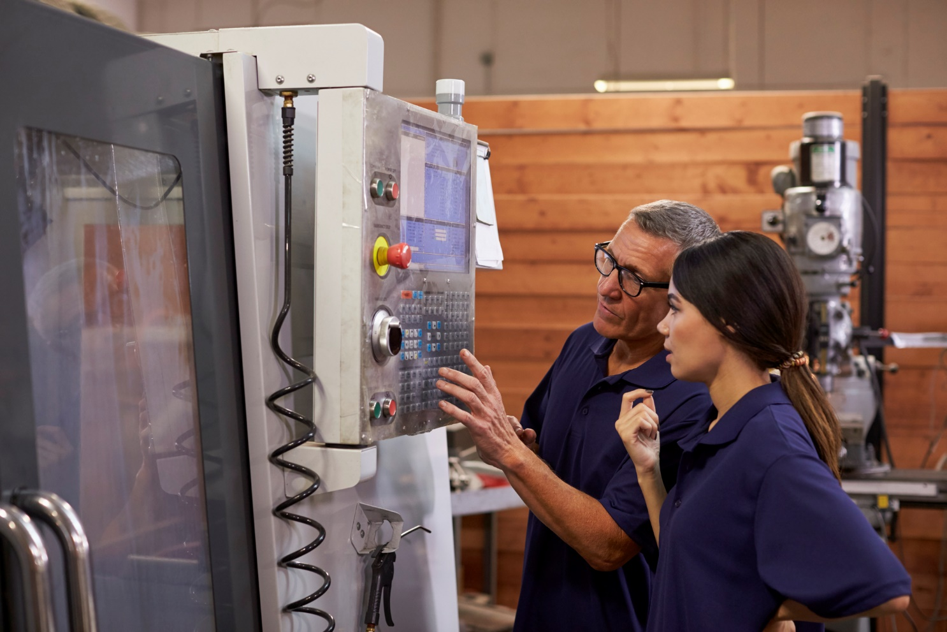
What is a job hazard analysis (JHA)?
The JHA is an analysis and improvement process that can literally transform workplace safety.
The JHA is a structured process that can discover the causes for the vast majority of workplace injuries and illnesses.

Slide 7
Is the employer required to conduct a job hazard analysis?
Most Oregon OSHA standards do not specifically require the employer to conduct a JHA.
Employer is required to take the necessary steps to furnish employment (jobs, tasks, procedures) that is safe and healthful.
The JHA helps fulfill this requirement.

Slide 8

Why is a job hazard analysis important?
Workers are injured and killed at the workplace every day in the United States.
Safety and health can add value to your business, your job, and your life.
One of the best ways to ensure safe work procedures is to conduct a JHA.

Slide 9

What is a “job”?
It's important to understand that a “job” in this procedure does not refer to the employee's job title or occupation such as forklift operator or roofer.
Actually, we’re analyzing a "task" that is composed of a series of steps.

Slide 10

Conducting the JHA
Step 1 - Prepare to conduct the JHA
Conduct an initial job review.
Review your accident history.
What records and reports will you review?
Involve your employees.
What are some reasons to involve employees in the JHA?

Slide 11
List hazardous jobs
Ask each supervisor and employee to identify the various jobs that will require an evaluation in each department.
Discuss the various jobs where you work.

Slide 12

Conduct a risk analysis
Factors that increase risk include:
Number of employees exposed
Frequency of each exposure
Duration of each exposure
Proximity of employees to the point of danger
Unreasonable workload
Working under stress (hurry, fatigue, illness, personal problems)
Environment (noise, light, wind, rain)

Slide 13
Prioritize hazardous jobs
Analyze the “worst first"
Another way to prioritize jobs
Use the risk matrix

Slide 14

Conducting the JHA
Step 2 – Observe the job and list the steps
What are some ways to observe and record job steps?
What is a "step"?

Slide 15
Tips on conducting the JHA
Be sure to record enough information to describe each job action without getting overly detailed.
Avoid long, overly detailed breakdown of steps.
Do not combine steps (look for "and" in the step).
Get input from other workers who have performed the same job.

Slide 16
Tips on conducting the JHA
Review the steps with workers to make sure you have not omitted something.
Point out that you are evaluating the task, not the worker’s job performance.
Include the employee in all phases of the analysis, from reviewing the job steps and procedures to discussing uncontrolled hazards and recommended solutions.
It may be helpful to photograph or videotape the worker performing the job.

Slide 17
Using the worksheet, discuss and write a brief description of each step for any of the following common jobs:
Filling a lawn mower with gasoline
Changing a ceiling light bulb
Cleaning out a rain gutter
Cutting a piece of wood with a handsaw
Mixing a pesticide/herbicide in a portable sprayer
Moving a box
Choose another common task at work or home

Slide 18
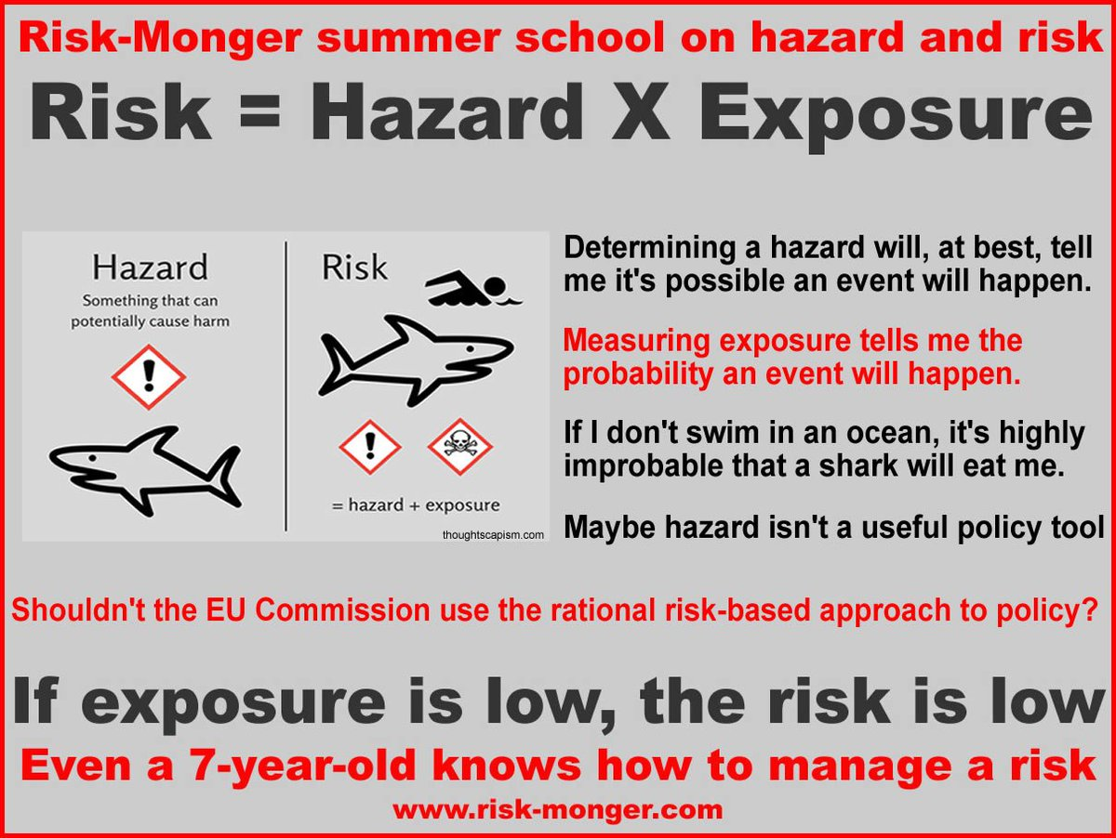
Conducting the JHA
Step 3 - Describe the hazards in each step
Hazards and Exposure
A hazard is an unsafe _______ that could cause injury or illness to an employee.
Exposure usually refers to an employee's placement relative to the hazard’s ________ ________ .

Slide 19

Don't forget to look for potential hazards
To ensure that all hazards associated with a step are identified, analyze each step to identify potential as well as actual hazards produced by both work environment and the activity being performed.
Notes:
Be sure to consider the following:
Is there danger of striking against, being struck by, or otherwise making harmful contact with an object?
Can the worker be caught in, by, or between objects?
Is there potential for a slip or trip?
Can the employee fall from one level to another or even on the same level?
Can pushing, pulling, lifting, lowering, bending, or twisting cause strain?
Is the work environment hazardous to safety or health?
Are there concentrations of toxic gas, vapor, fumes, or dust?
Are there potential exposures to heat, cold, noise, or ionizing radiation?
Are there flammable, explosive, or electrical hazards?

Slide 20
Types of hazards in the workplace
Falls
Impact
Mechanical
Vibration and noise
Toxics
Health and temperature
Flammability/fire
Explosives
Pressure hazards
Electrical contact
Ergonomics
Biohazards

Slide 21
Activity
Use the worksheet to list the steps that have hazards. Describe the hazards and the type of injury/accident that could result.
Note: Not all steps will have hazards.

Slide 22

Conducting the JHA
Step 4 - Develop preventive measures
How do I correct or prevent hazards?

Slide 23
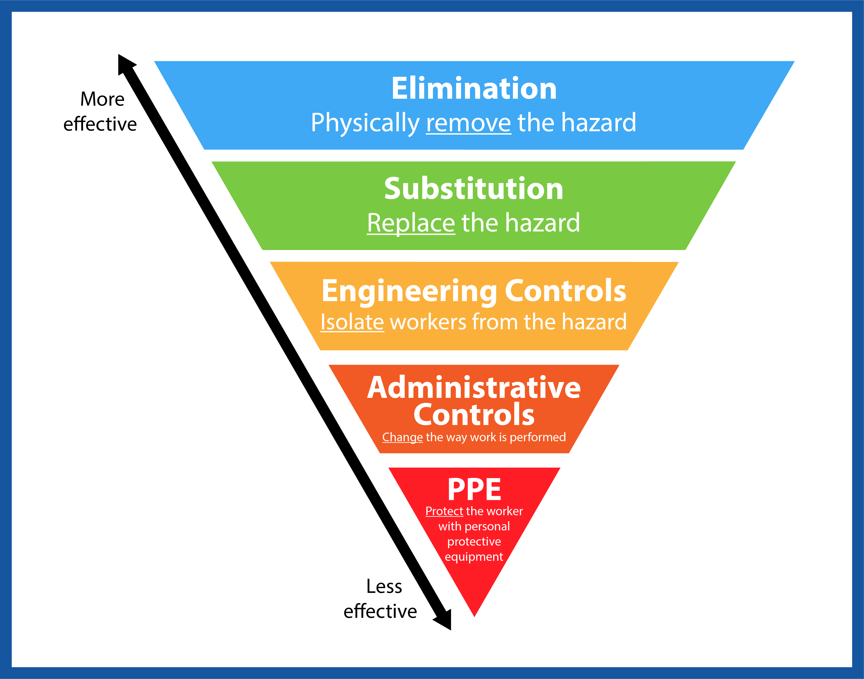
Hazard control strategies
Elimination
Substitution
Engineering controls
Administrative controls
PPE

Slide 24
Activity
Use the worksheet to identify and list preventive measures in each step of the task your team has developed.

Slide 25
Conducting the JHA
Step 5 - Write the safe job procedure (SJP)
Criteria for an effective safe job procedure.
Write in a step-by-step format. Usually this means writing a number of paragraphs.
If no hazard or possible unsafe behavior exists in a step, just state the action.
If a hazard does exist in a step, state the action and identify:
  1) the hazard
  2) the possible injury it could cause, and
  3) safety measures to prevent the injury.

Slide 26
Conducting the JHA
Step 5 - Write the safe job procedure (SJP) continued…
Try to paint a word picture - concrete vs. abstract.
Write in the active voice – “take,” not “should be taken.”
Write as clearly as possible using simple words – “use,” not “utilize.”
Keep sentences short. Use no more than 7-15 words.
Try to write in a less technical, more conversational style.

Slide 27
Activity
Using the worksheet, write a safe job procedure for your team’s job.
Evaluate the SJP using the criteria discussed on the previous page.
Be prepared to analyze and evaluate SJPs developed by other groups.
Team leader: Assign different members of the team to make sure hazards, injuries, and safety measures are included in each step.

Slide 28

Reviewing the JHA
It is particularly important to review your job hazard analysis if an illness or injury occurs on a specific job. Based on the circumstances, you may determine that you need to change the job procedure to prevent similar incidents in the future.
Any time you revise a job hazard analysis, it is important to train all employees affected by the changes in the new job methods, procedures, or protective measures adopted.

Slide 29
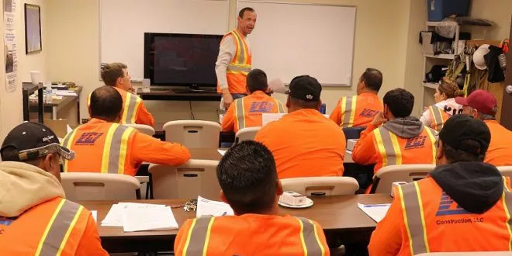
Use the JHA as a lesson plan
To get more value out of the JHA program, consider using the completed JHA as a lesson plan when training new employees.
Incorporate the SJP into the organization's safety training plan. Doing so helps guarantee safe job procedures are taught from the start.

Slide 30
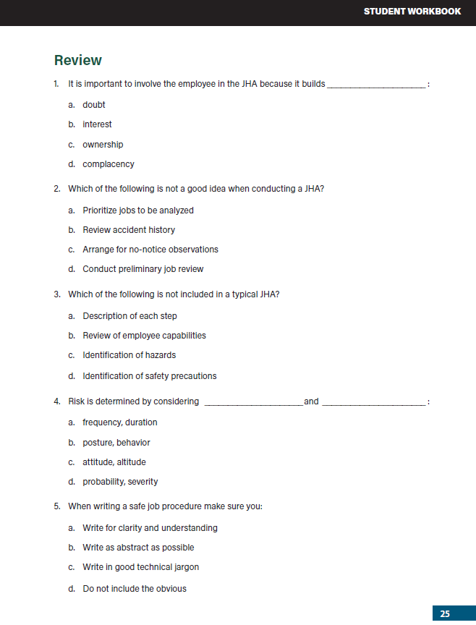
Knowledge Check

Slide 31
Additional Educational Resources
Oregon OSHA’s YouTube Channel
A-Z Topic Index
PESO – English to Español
Online Training Courses

Slide 32
Thank You!

