Slide 1
Worker Protection Standard
Pesticide Emphasis

Slide 2
Oregon OSHA Public Education Mission:
Consultative Services
Enforcement
Public Education and Conferences
Standards and Technical Resources
We provide knowledge and tools to advance self-sufficiency in workplace safety and health.

Slide 3
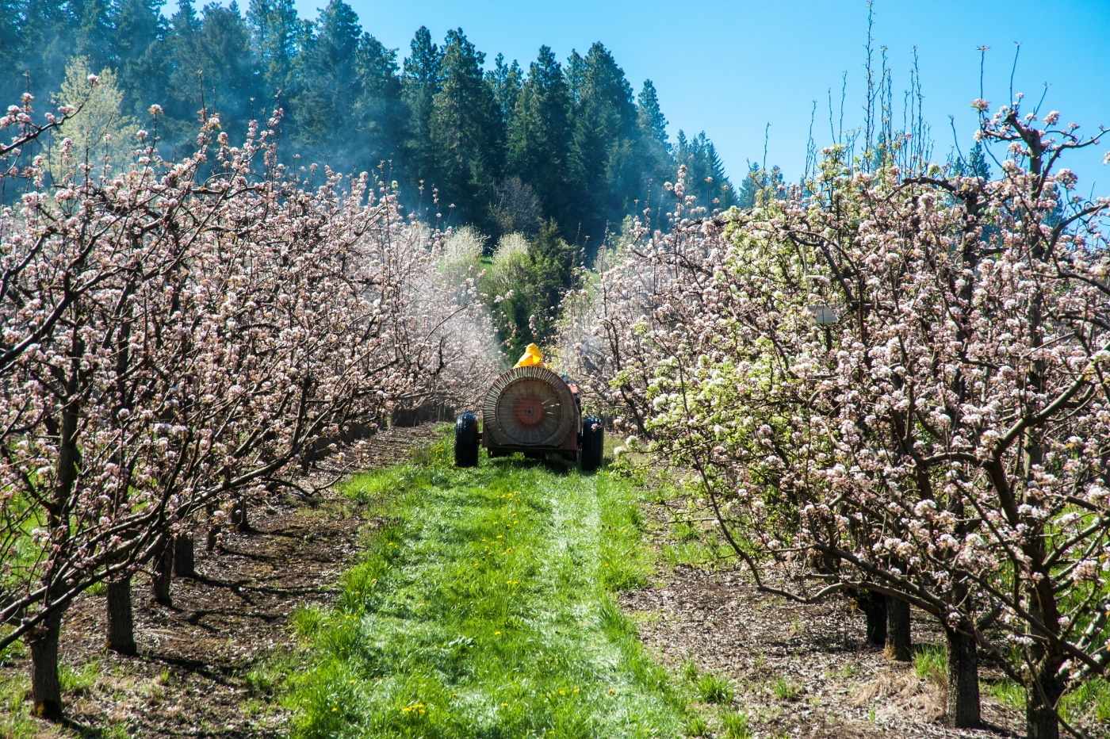
Contact us
Field Offices:
Portland 503-229-5910
Salem 503-378-3274
Eugene 541-686-7562
Medford 541-776-6030
Bend 541-388-6066
Pendleton 541-276-2353
Salem Central:
Toll Free English: 800-922-2689
Toll Free Spanish: 800-843-8086
Website: osha.oregon.gov

Slide 4
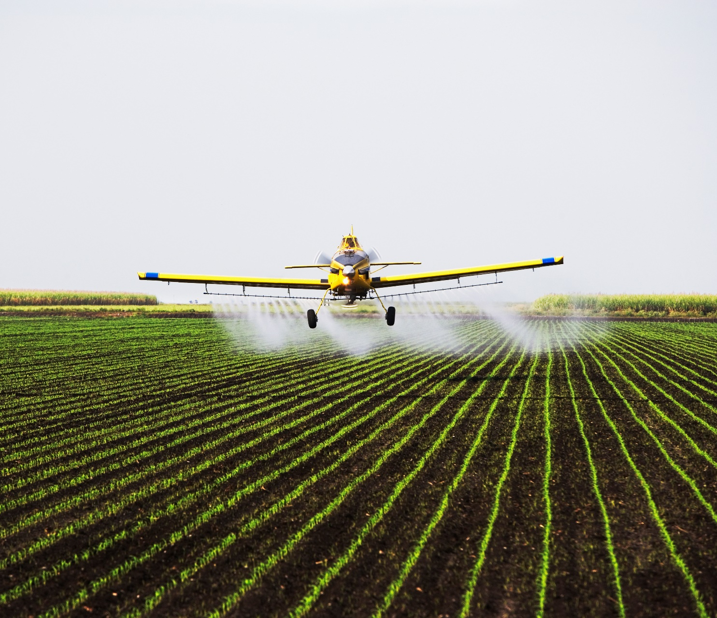
Introduction
Environmental Protection Agency (ESP)’s Pesticide Worker Protection Standard (WPS)
Oregon OSHA enforces…

Slide 5
When Worker Protection applies to you
Pesticides have been applied or a restricted entry interval (REI) has been in effect within the last 30 days at your establishment.
The pesticide applied has an “Agriculture Use Requirements” Box on the label.
You employ pesticide handlers, and/or hand-labor workers on an agricultural, forest, or nursery operation. This includes outdoor and indoor spaces.

Slide 6

When Worker Protection does NOT apply to you
Pest control
Livestock
Non-commercial/Research
Gardens, parks, golf courses
Direct injection
Non-crop areas
Attractants/Repellents
Harvested portions

Slide 7
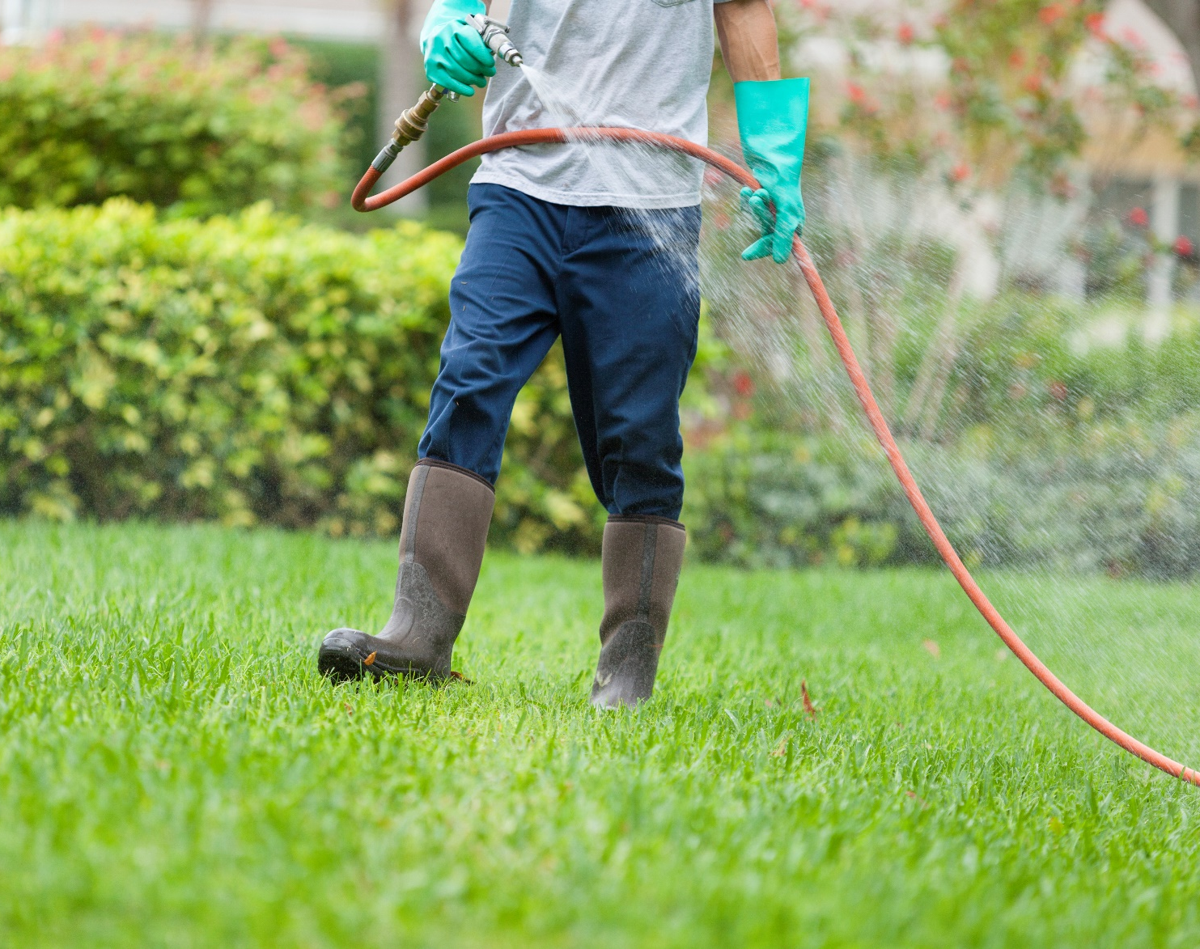
Definitions
Workers
Handlers

Slide 8
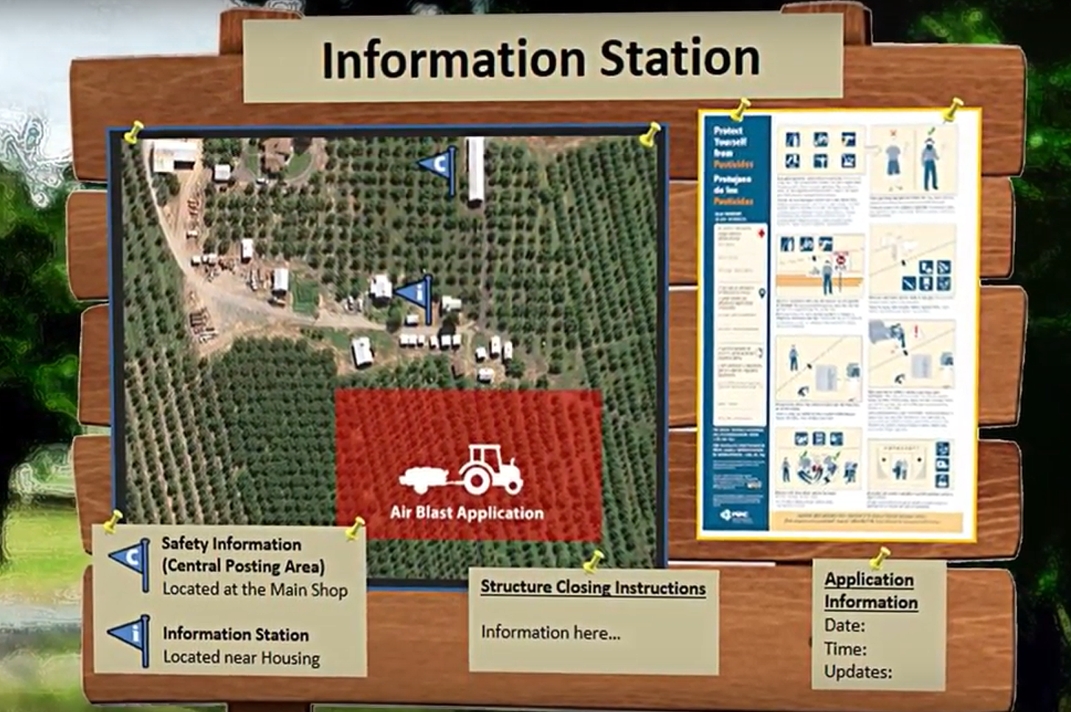
Required postings and record retention
Display or make available all of the information in an easily accessible (central) location on the agricultural establishment.

Slide 9

Q&A
When must workers and handlers be trained?
How often must workers and handlers be trained?
How do I train my workers and handlers?
Who can provide the training?
What about employees who speak a different language?
How long do I need to keep the training documentation?
Where should I train my employees?

Slide 10

Training records
Worker or Handler’s printed name and signature
Date of training
Trainers name
Trainers qualifications
Employer name
Identification of EPA approved training materials

Slide 11

Sources
Environmental Protection Agency (EPA):
  Phone: 1-888-663-2155
  Website: www.epa.gov
Pesticide Educational Resources Collaborative:
  Website: www.pesticideresources.org

Slide 12
Workers
Social Leader:
The person the group sees as their leader; the person they trust the most.
Language Leader:
The Spanish – or other non-English speaking person with the best English communication skills.
Technical Leader:
The person with the best job and safety related knowledge and skills.

Slide 13



Decontamination supplies
1 Gallon of Water : Person
3 Gallons of Water : Handler
Eye Wash : “Danger” or
“Danger Poison” Label

Slide 14
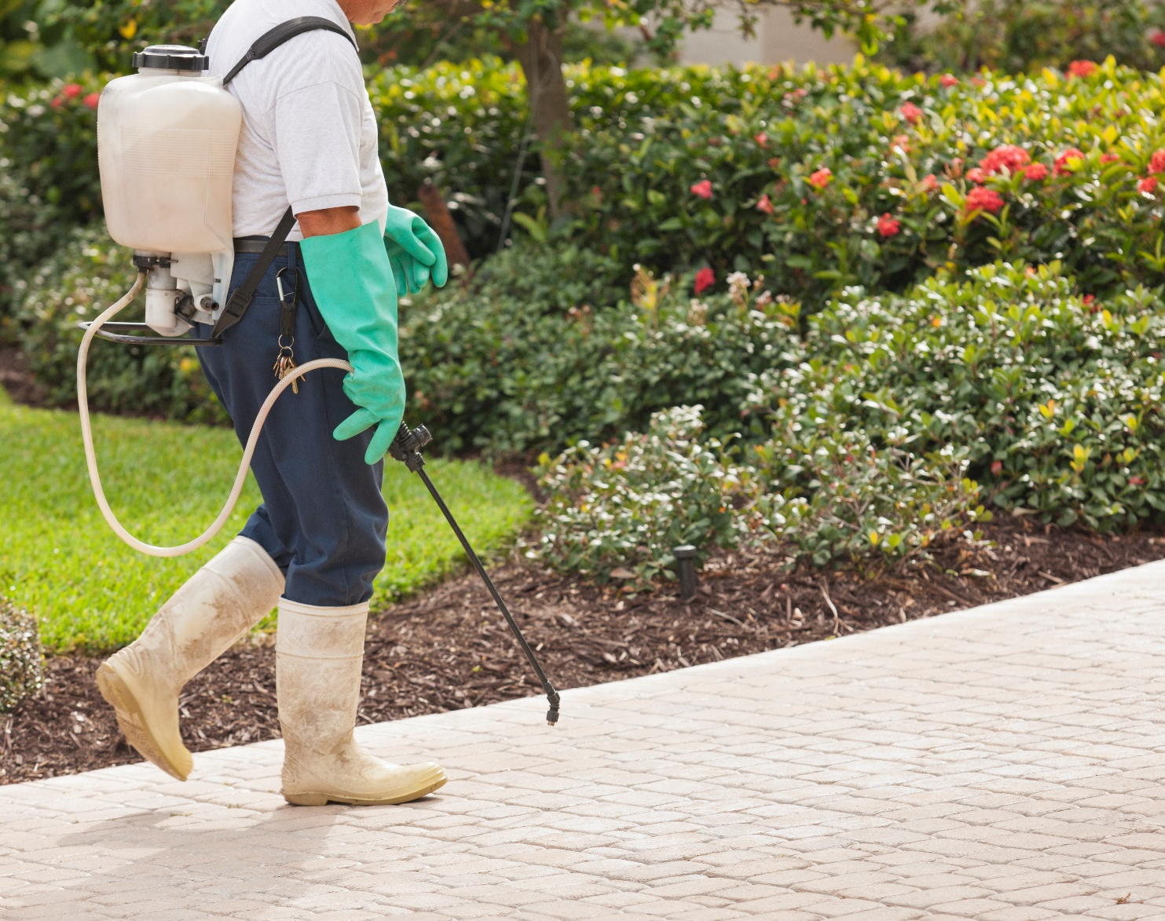
Handler
Location and description
Date, start, and end time
Product name, EPA registration (#), active ingredients, REI
Oral warnings, and treated area posting
Other safety requirements

Slide 15
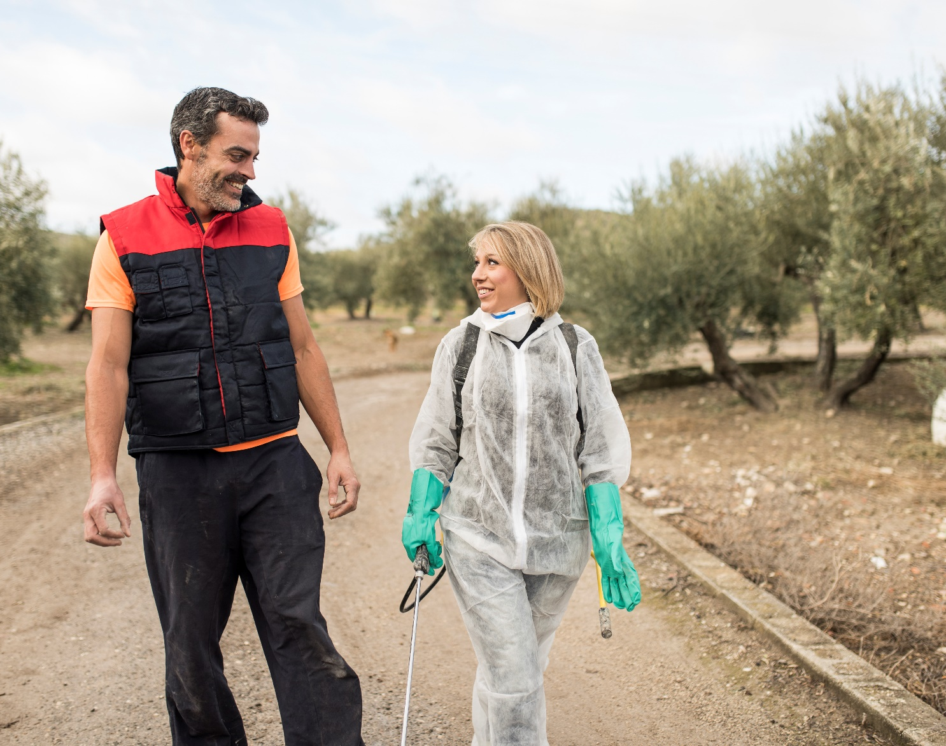
Employer
Specific location and description of any treated areas at their workplace where an REI is in effect that the commercial handler may be in or walk within 1/4 mile
Restrictions on entering those areas

Slide 16
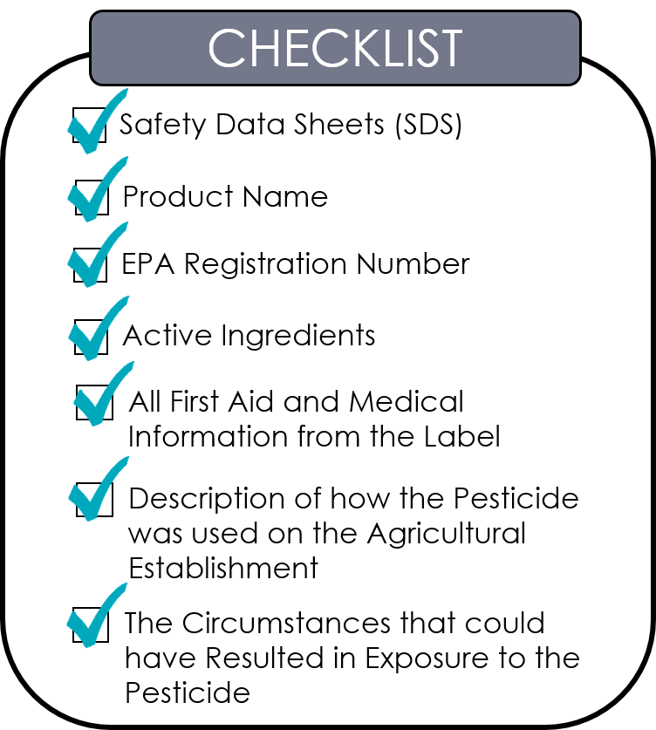
Exposed to pesticides
Transportation to emergency treatment
Provide information related to the pesticide to emergency personal

Slide 17







Reporting timelines
Fatality : 8 hours
In-Patient Hospitalizations : 24 hours
Catastrophe : 8 hours
Amputations & Avulsions : 24 hours
Or

Slide 18

Restrictions during applications
The application exclusion zone (AEZ) for outdoor production.
A specific area that varies by the type of application until the ventilation criteria are met for enclosed space production.

Slide 19
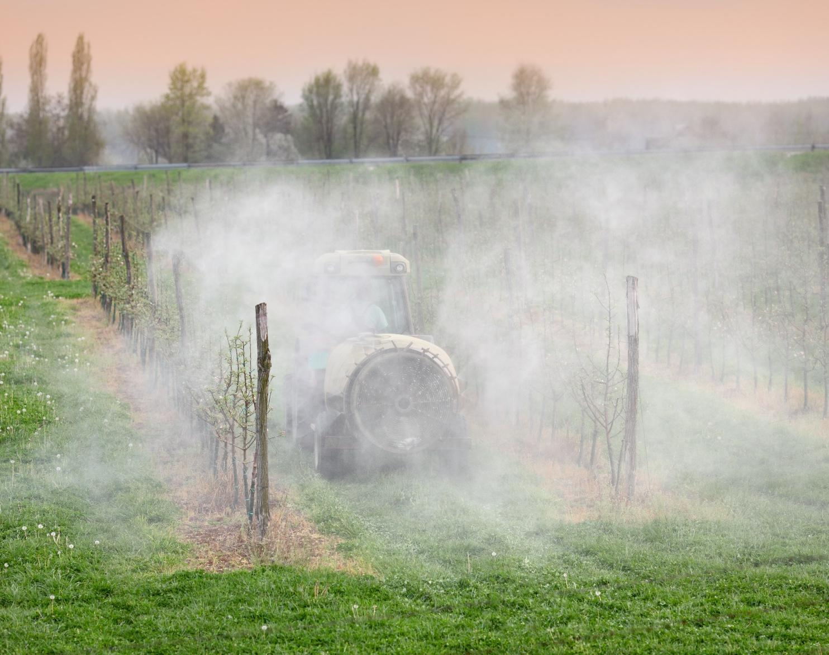
Restricted Entry Intervals (REIs)
Orally warn workers and post treated areas if the pesticide label requires it.
If the label is silent on notification, either orally warn workers, or post entrances to treated areas.
Post all enclosed space applications on the entrance of the space if the REI is great than 4 hours.
Tell workers which method is in effect.

Slide 20
Application Exclusion Zone (AEZ) - video
English
Spanish

Slide 21

WPS glove requirements
Pilots
Handlers and early entry workers
Glove liners
Hot or cold periods

Slide 22
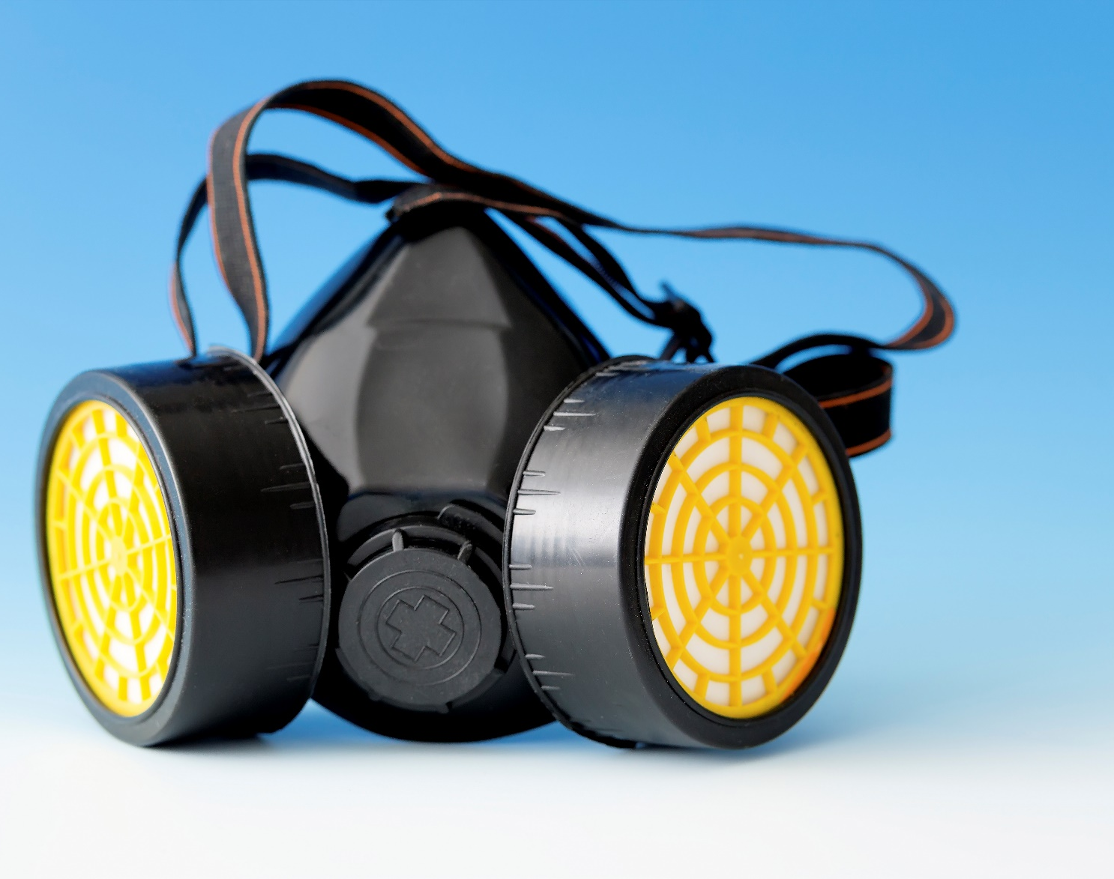
Care of PPE
Store
Wash
Respirators
Disposal

Slide 23

Not directly employed by the establishment
The equipment may be contaminated with pesticides.
The potentially harmful effects of pesticide exposure.
How to handle equipment to limit exposure to pesticides.
How to wash themselves and/or their clothes to remove and prevent exposure to pesticide residues. Reference ORS 170.309 and 170.313(1).

Slide 24
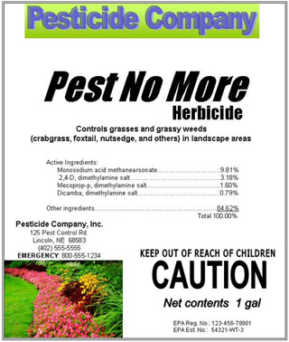
8 items to notice on labels
Application restriction statement
40 CFR part 170 reference statement
Product-type identification statement
State restrictions
Spanish warning statement
Restricted entry statement
Notification-to-workers statement
Personal protective equipment statement

Slide 25
Have pesticides been applied, or has a restricted-entry interval been in effect within the last 30 days?

Slide 26
Posting information
Central location
WPS poster and emergency information

Slide 27
Last 30 days
Location of application
Product name
EPA registration (#)
Active ingredients
Time and date of the application
Restricted entry interval

Slide 28
Example

Slide 29
Additional educational resources
Oregon OSHA’s YouTube Channel
A-Z Topic Index – Worker Protection Standard
PESO – English to Español

Slide 30
Thank you!

